Slide 1
#HeyBlue
Sub heading

Slide 2
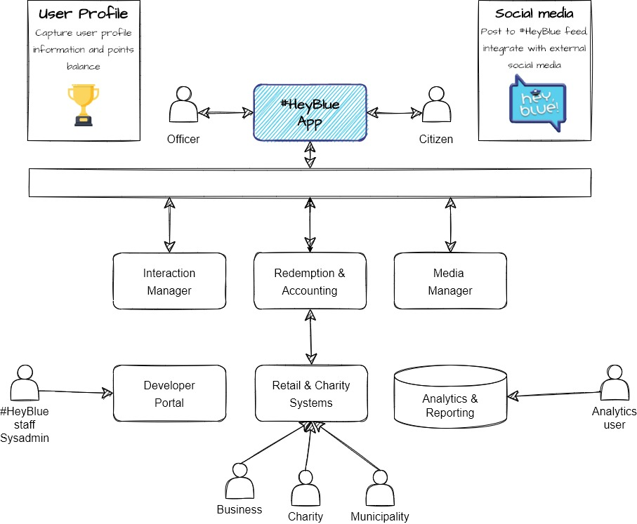

Slide 3
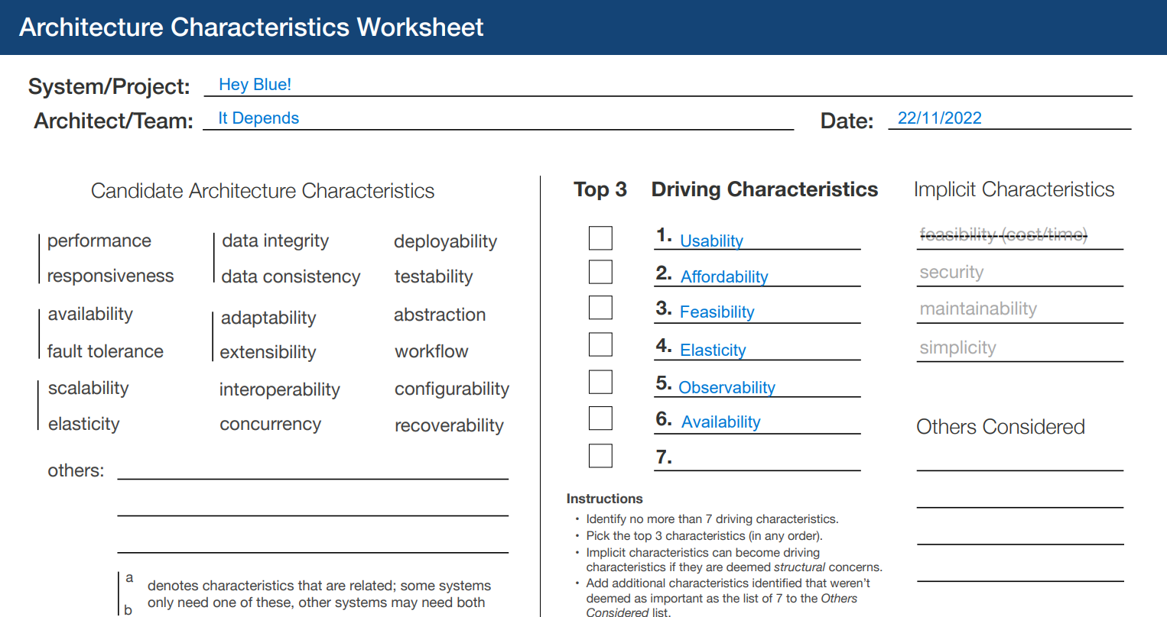
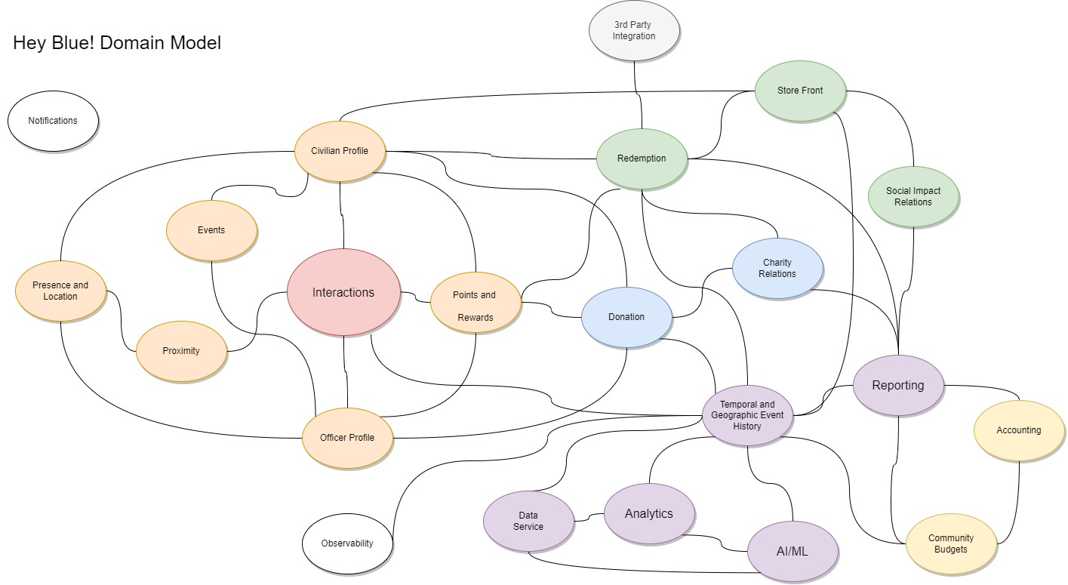
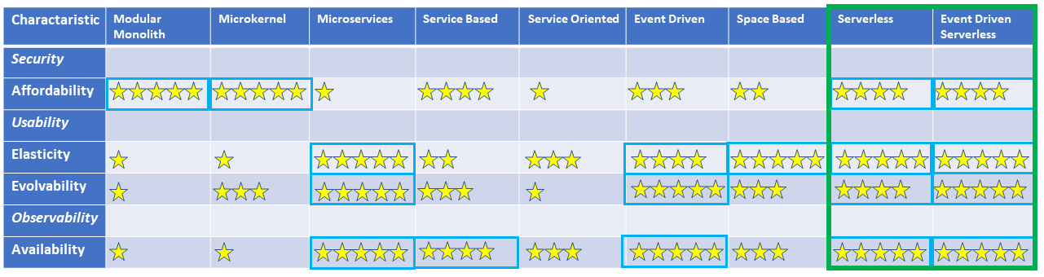

Slide 4
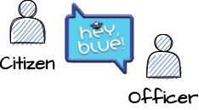

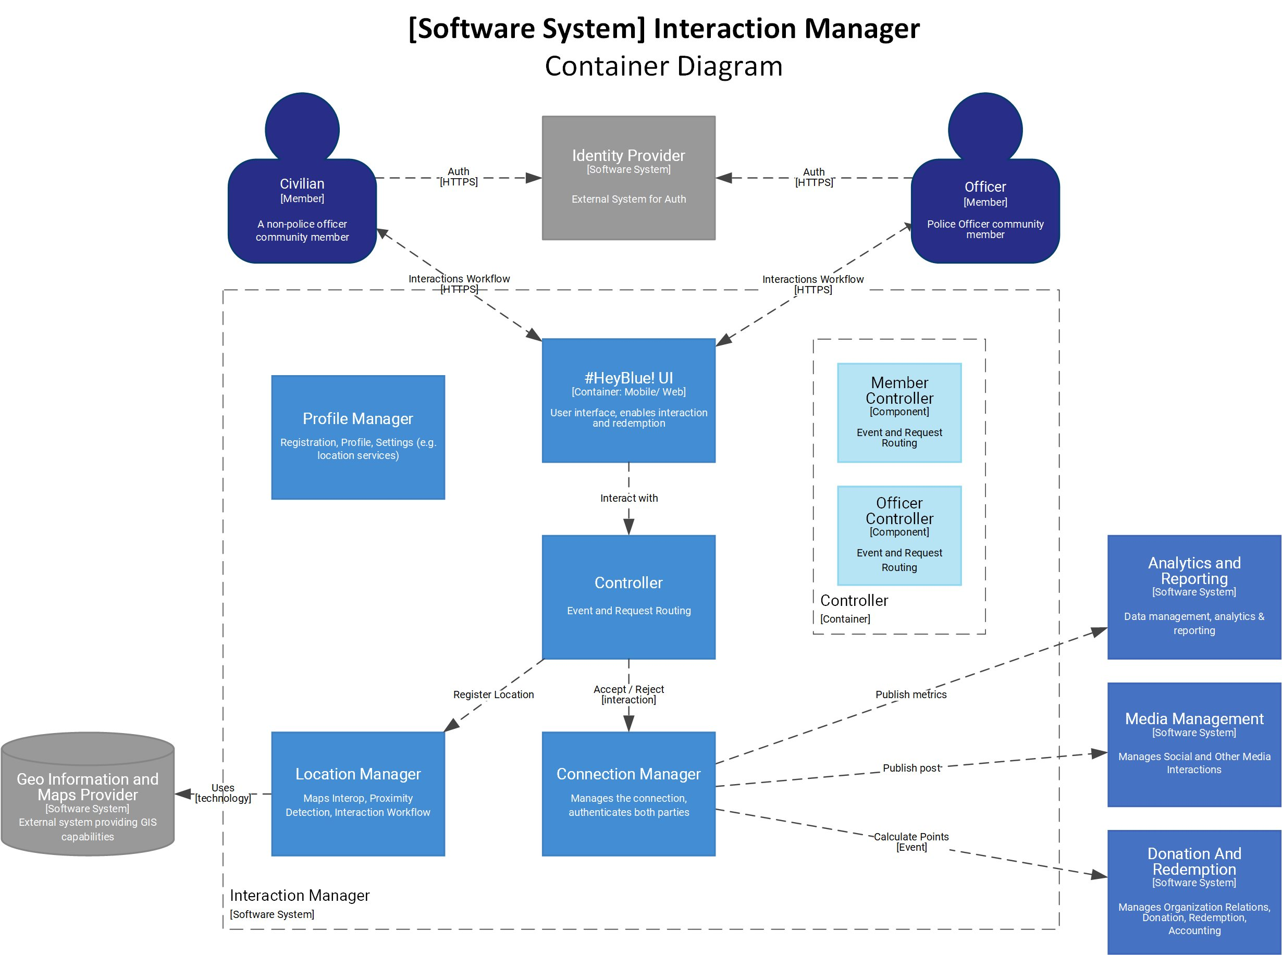

Connect the dots
ADRs
char
ADRs
Software System spcc
Straight through architecture

Slide 5
Story Map
Create an Interaction
Register
Notify
Proximity
Interact
Share
Earn Points
Create profile for Citizen
Location Tracking
Proximity Alert
Share to #HeyBlue feed
Calculate Rewards
Create profile for Officer
Option to connect
Share to Social Media
Add rewards to profile
Update profile
Get Map
Non Functionals
Data Protection
Must have

Slide 6
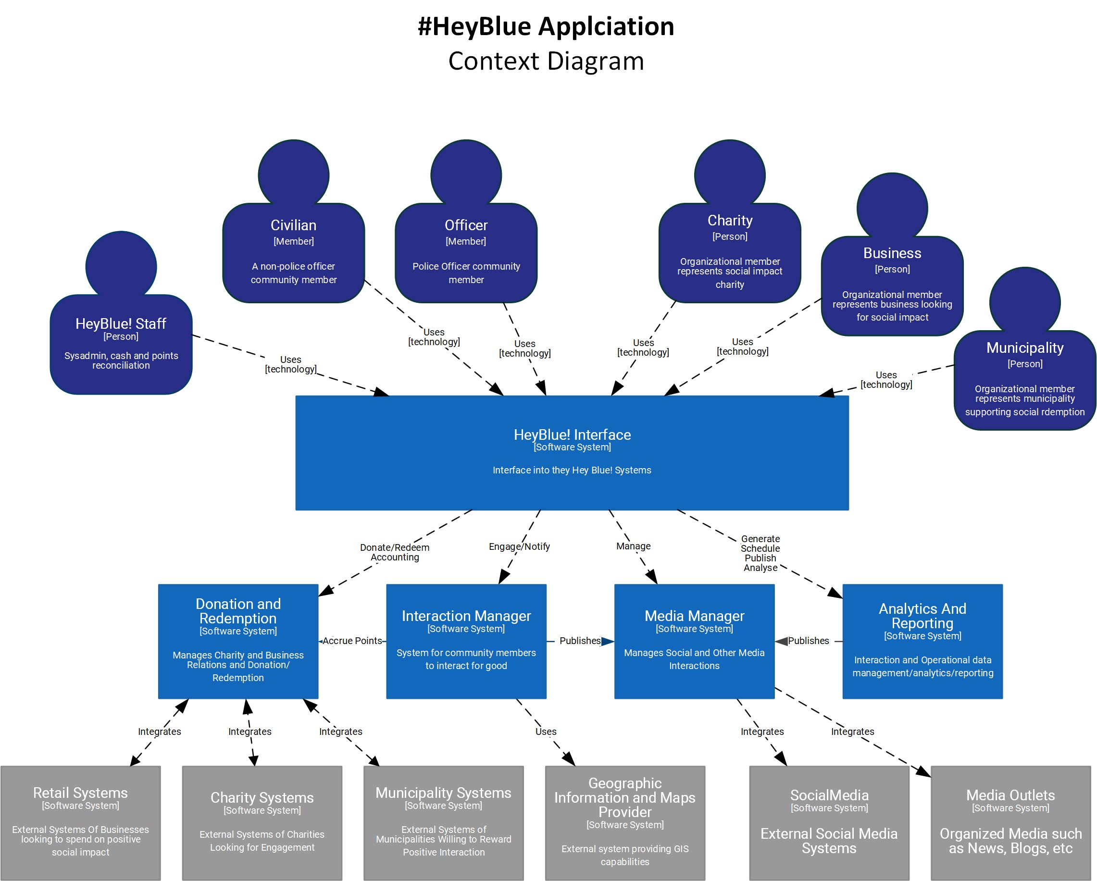

Slide 7
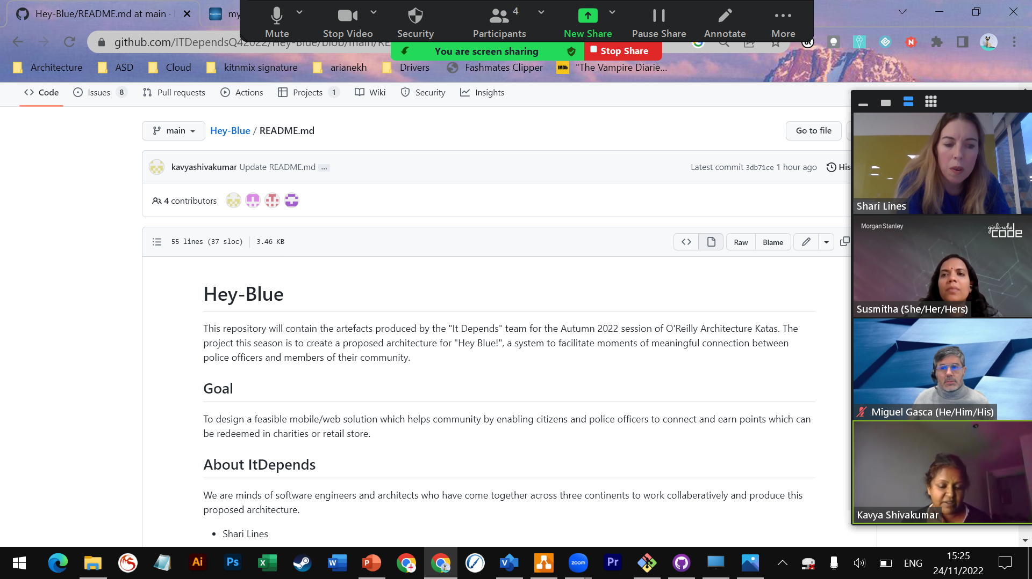
https://github.com/ITDependsQ42022/Hey-Blue/blob/main/README.md

Slide 8
Notes
Don’t force everything into a story
Client facing requirements can use story structure
 As a user I need to check my points balance so that I can redeem rewards
Non functional requirements may just be requirements!
 As a customer I need a performant system so as not to get really frustrated
 The system shall respond within 5ms
Use the right diagram for the right job
 C4 is good at the system level
 UML, SysML, BPMN is good for details

