Slide 1
#HeyBlue
Sub heading

Slide 2
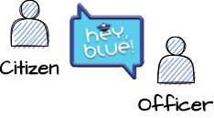
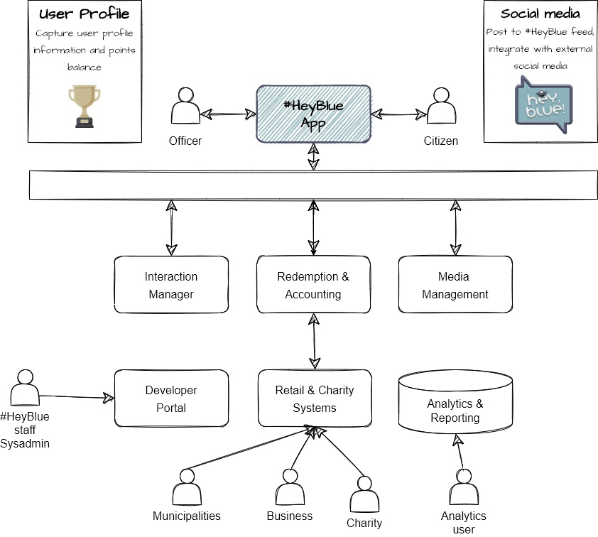

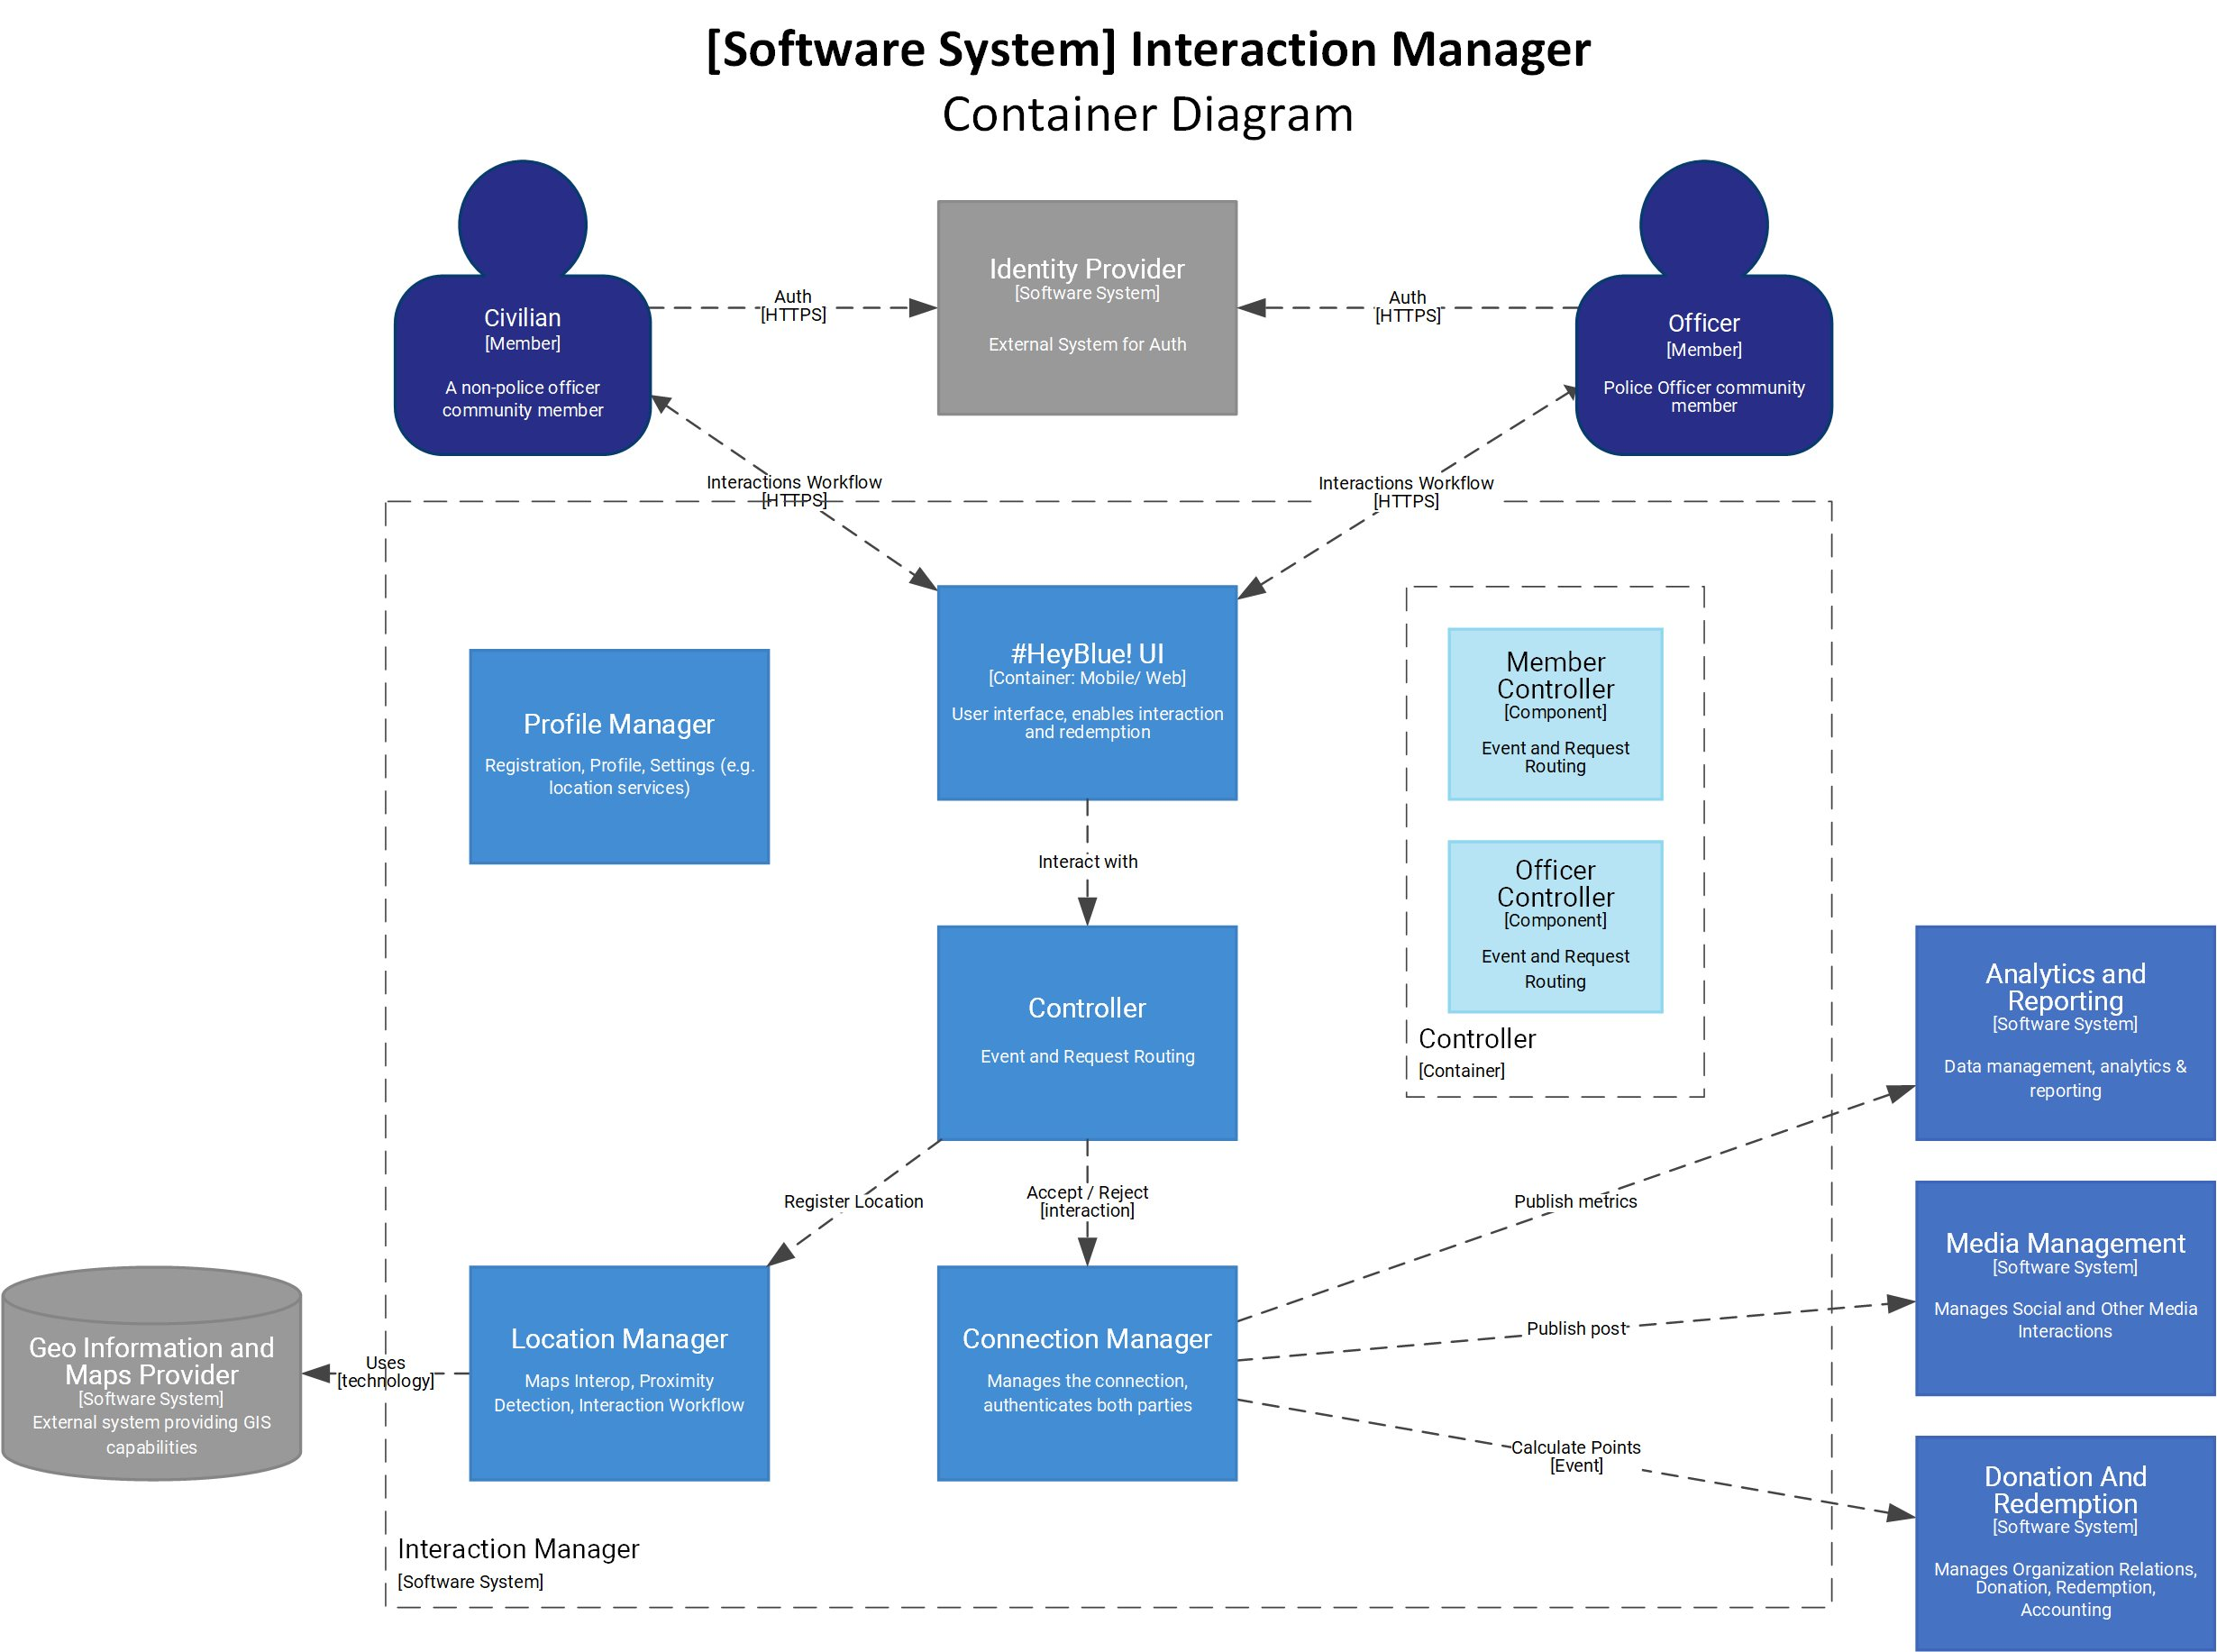

Connect the dots
Straight through architecture

Slide 3
Story Map
Create an Interaction
Citizen Redeems Points
Officer Redeems Points
Redeem Points
Capture Analytics
Register
Notify
Proximity
Interact
Share
Earn Points
Browse
Redeem
Capture
Create profile for Citizen
Location Tracking
Proximity Alert
Share to #HeyBlue feed
Calculate Rewards
Charities Connect
Find retailers
API to analytics
Create profile for Officer
Option to connect
Share to Social Media
Add rewards to profile
Browse Charities
Find Charities
Track engagement
Update profile
Get Map
Businesses Connect
Browse Businesses
Security
Affordability
Usability
Elasticity
Evolvability
Observability
Availability
Must Have…
Activity
Non Functionals
Data Protection
Define transient data
User Story
Task

Slide 4
Notes
Don’t force everything into a story
Client facing requirements can use story structure
 As a user I need to check my points balance so that I can redeem rewards
Non functional requirements may just be requirements!
 As a customer I need a performant system so as not to get really frustrated
 The system shall respond within 5ms
Use the right diagram for the right job
 C4 is good at the system level
 UML, SysML, BPMN is good for details

