Slide 1
#HeyBlue
Sub heading

Slide 2
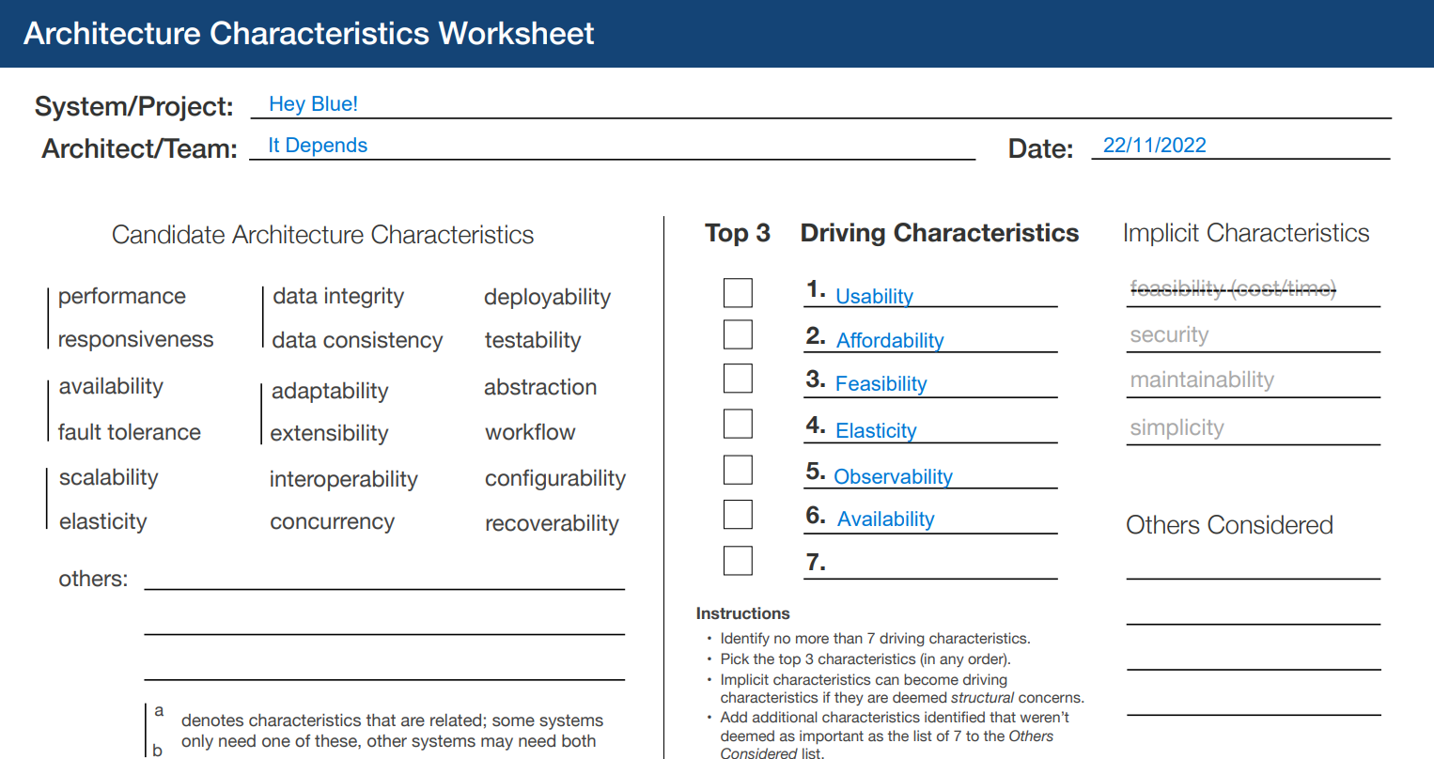
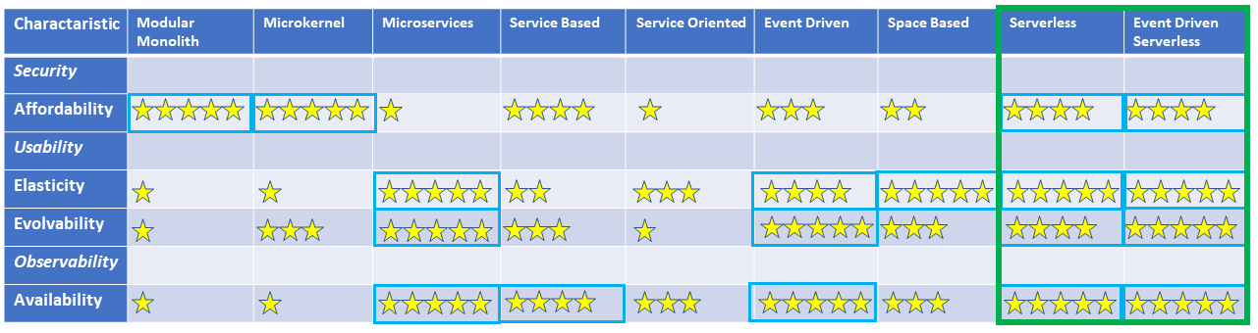
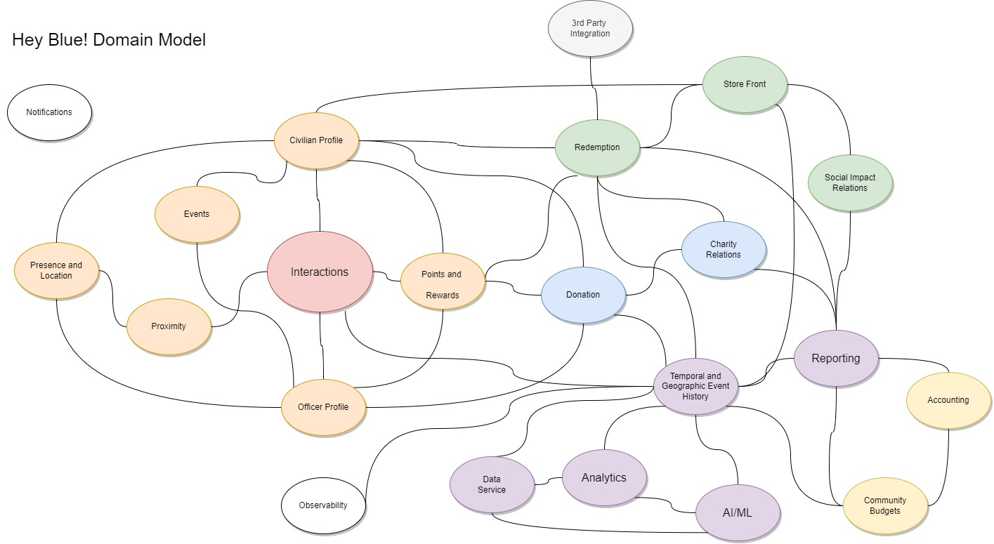

Slide 3


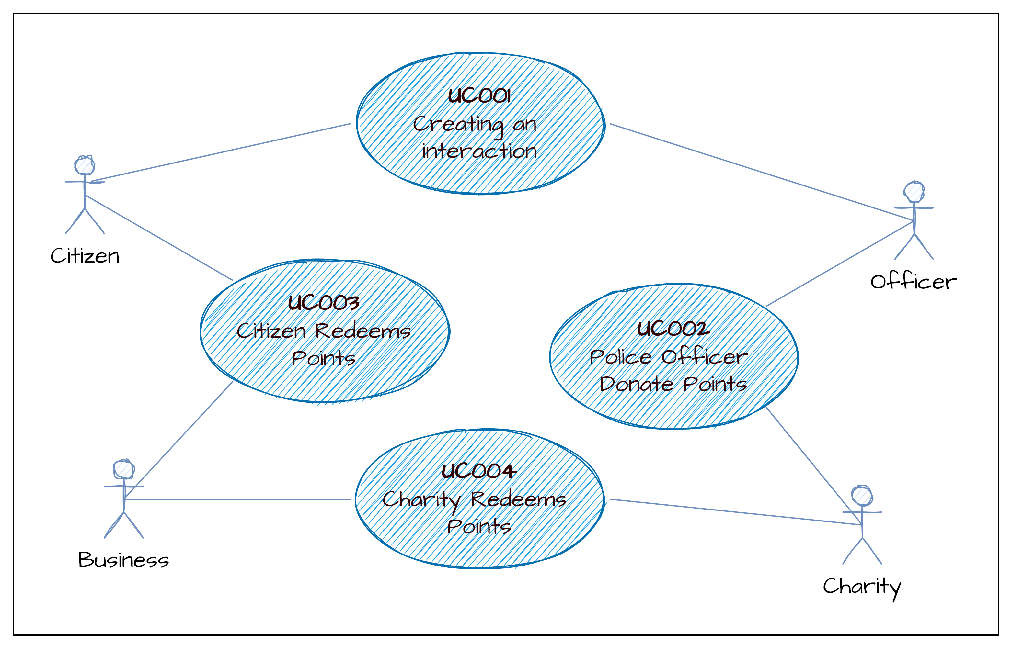

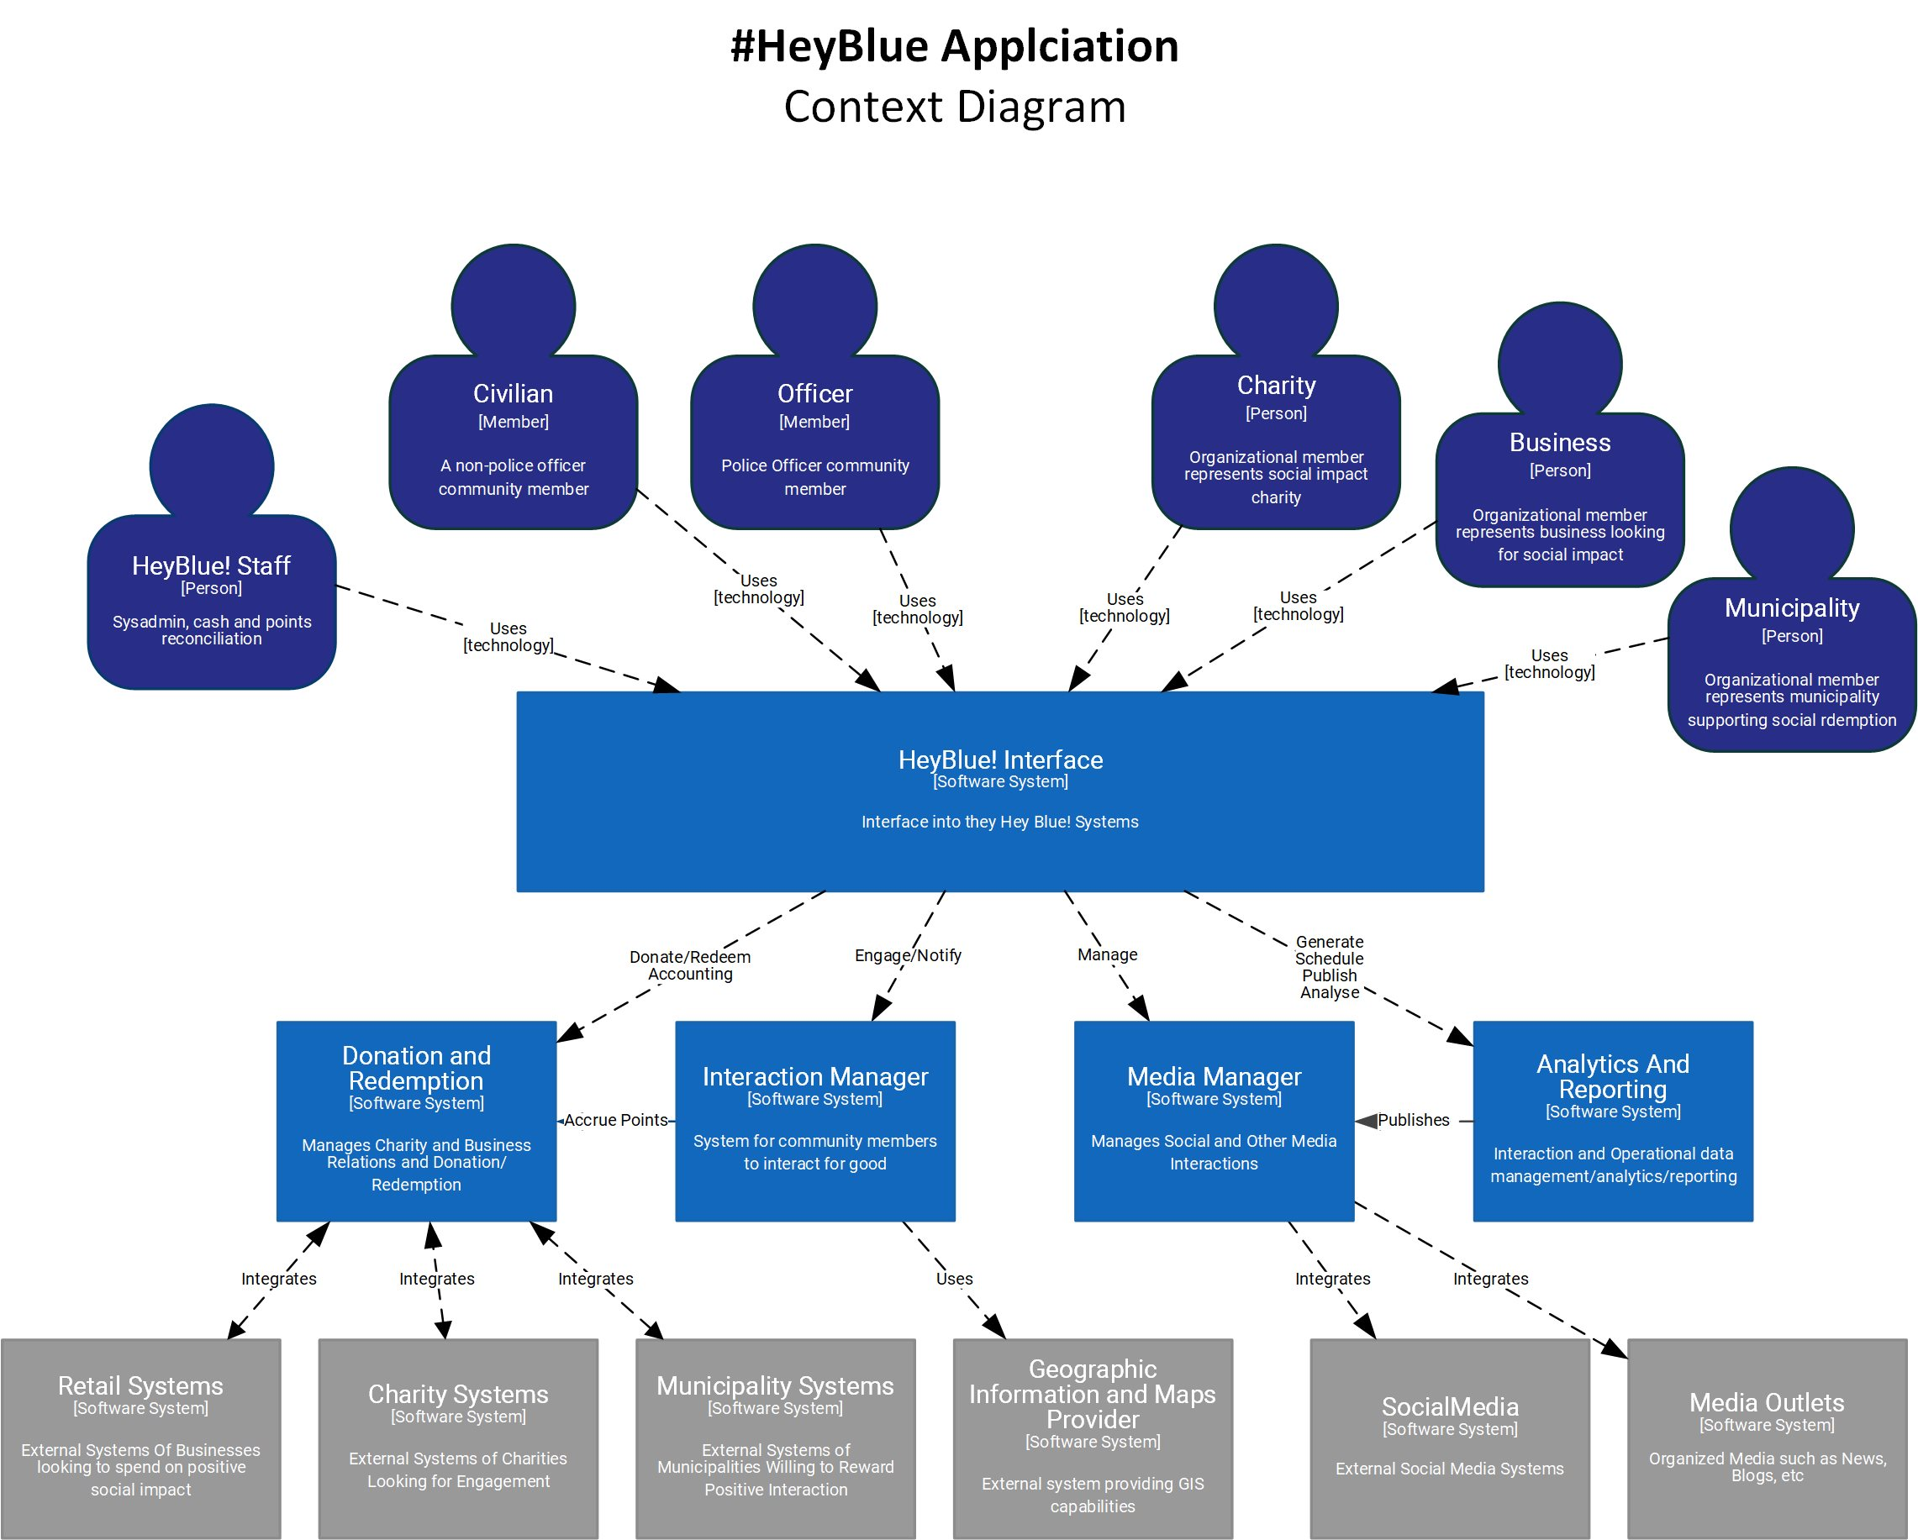
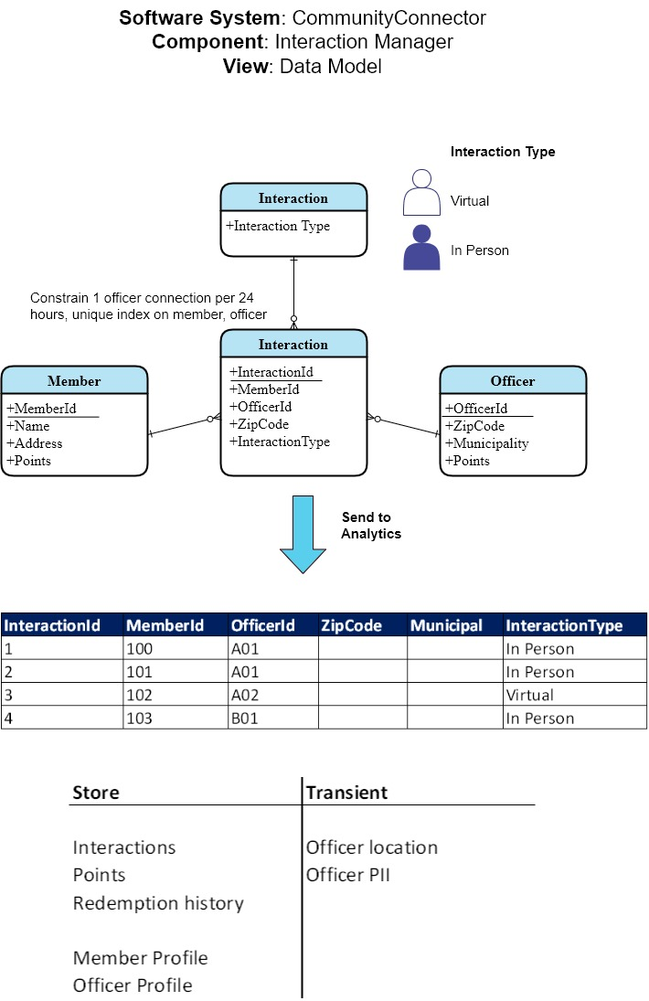
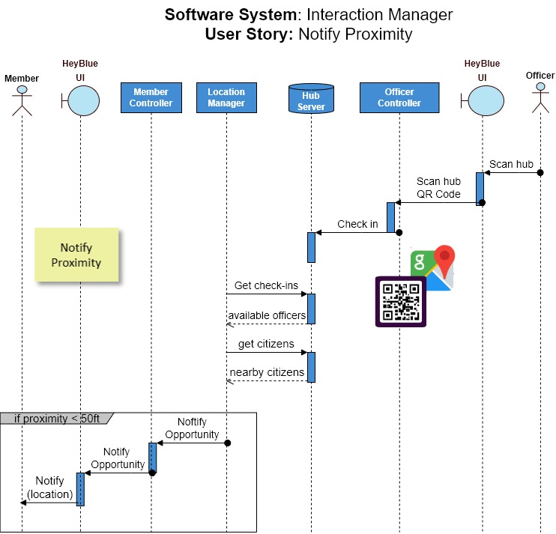
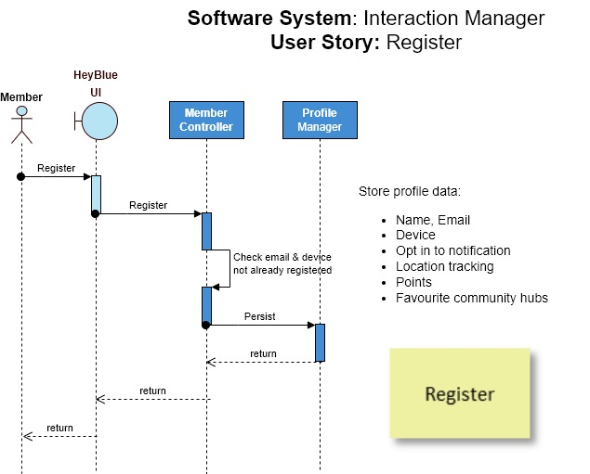
Connect the dots
ADRs
char
ADRs
Software System spcc
Straight through architecture

Slide 4
#HeyBlue User Story Map
Interact
Media
Donate & Redeem
Analytics
Register
Notify
Proximity
Interact
Earn Points
Share
Browse store
Redeem Points in store
Browse Charities
Donate points to charity
Send to analytics
Create profile for Citizen
Location Tracking
Proximity Alert
Calculate Rewards
Share to #HeyBlue feed
Retailer creates storefront
Spend management
Charity Registers
Send to charity
Store metrics
Create profile for Officer
Option to connect
Add rewards to profile
Share to Social Media
Update points
Present metrics
Update profile
Get Map
Purchase Items
Delete profile
Legend
Activities
User Stories
Task
Must have

Slide 5
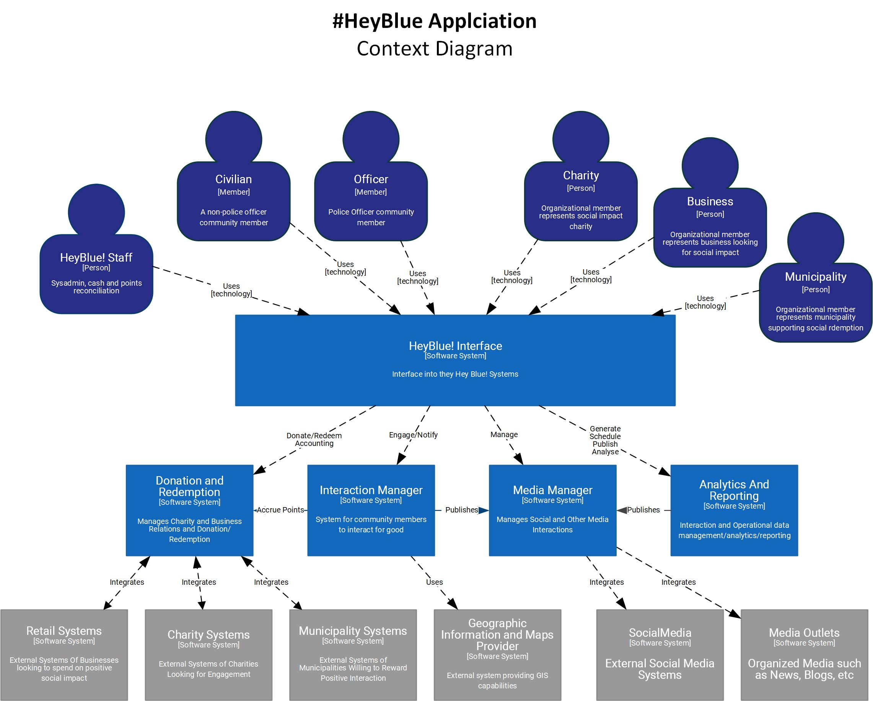
#HeyBlue System Context

