Slide 1

Lesson 1
Explore the dataset
Prepared by:
ENG. Khadija Bitar

Slide 2

Download UCI Student Performance Dataset
Go to: https://archive.ics.uci.edu/dataset/320/student+performance
Download the database (zip).
Extract files.
Use the file student-mat.csv.

Slide 3
Dataset Information
This data approach student achievement in secondary education of two Portuguese schools. The data attributes include student grades, demographic, social and school related features) and it was collected by using school reports and questionnaires. Two datasets are provided regarding the performance in two distinct subjects: Mathematics (mat) and Portuguese language (por). In [Cortez and Silva, 2008], the two datasets were modeled under binary/five-level classification and regression tasks. Important note: the target attribute G3 has a strong correlation with attributes G2 and G1. This occurs because G3 is the final year grade (issued at the 3rd period), while G1 and G2 correspond to the 1st and 2nd period grades. It is more difficult to predict G3 without G2 and G1, but such prediction is much more useful.

Slide 4
Explanation of the Attributes and the target variable
The target will add as name “pass”.
school - student's school (binary: "GP" - Gabriel Pereira or "MS" - Mousinho da Silveira)
sex - student's sex (binary: "F" - female or "M" - male)
age - student's age (numeric: from 15 to 22)
address - student's home address type (binary: "U" - urban or "R" - rural)
famsize - family size (binary: "LE3" - less or equal to 3 or "GT3" - greater than 3)

Slide 5
Explanation of the Attributes and the target variable
Pstatus - parent's cohabitation status (binary: "T" - living together or "A" - apart)
Medu - mother's education (numeric: 0 - none, 1 - primary education (4th grade), 2 – 5th to 9th grade, 3 – secondary education or 4 – higher education)
Fedu - father's education (numeric: 0 - none, 1 - primary education (4th grade), 2 – 5th to 9th grade, 3 – secondary education or 4 – higher education)

Slide 6
Explanation of the Attributes and the target variable
Mjob - mother's job (nominal: "teacher", "health" care related, civil "services" (e.g. administrative or police), "at_home" or "other")
Fjob - father's job (nominal: "teacher", "health" care related, civil "services" (e.g. administrative or police), "at_home" or "other")
reason - reason to choose this school (nominal: close to "home", school "reputation", "course" preference or "other")

Slide 7
Explanation of the Attributes and the target variable
guardian - student's guardian (nominal: "mother", "father" or "other")
traveltime - home to school travel time (numeric: 1 - <15 min., 2 - 15 to 30 min., 3 - 30 min. to 1 hour, or 4 - >1 hour)
studytime - weekly study time (numeric: 1 - <2 hours, 2 - 2 to 5 hours, 3 - 5 to 10 hours, or 4 - >10 hours)
failures - number of past class failures (numeric: n if 1<=n<3, else 4)
schoolsup - extra educational support (binary: yes or no)

Slide 8
Explanation of the Attributes and the target variable
famsup - family educational support (binary: yes or no)
paid - extra paid classes within the course subject (Math or Portuguese) (binary: yes or no)
activities - extra-curricular activities (binary: yes or no)
nursery - attended nursery school (binary: yes or no)
higher - wants to take higher education (binary: yes or no)
internet - Internet access at home (binary: yes or no)

Slide 9
Explanation of the Attributes and the target variable
romantic - with a romantic relationship (binary: yes or no)
famrel - quality of family relationships (numeric: from 1 - very bad to 5 - excellent)
freetime - free time after school (numeric: from 1 - very low to 5 - very high)
goout - going out with friends (numeric: from 1 - very low to 5 - very high)
Dalc - workday alcohol consumption (numeric: from 1 - very low to 5 - very high)

Slide 10
Explanation of the Attributes and the target variable
Walc - weekend alcohol consumption (numeric: from 1 - very low to 5 - very high)
health - current health status (numeric: from 1 - very bad to 5 - very good)
absences - number of school absences (numeric: from 0 to 93)# these grades are related with the course subject, Math or Portuguese:
G1 - first period grade (numeric: from 0 to 20)
G2 - second period grade (numeric: from 0 to 20)
G3 - final grade (numeric: from 0 to 20, output target)

Slide 11

Import necessary libraries
Open Jupyter then write the following code:
import pandas as pdimport sklearn
import matplotlib.pyplot as plt
import seaborn as snsimport streamlit

Slide 12
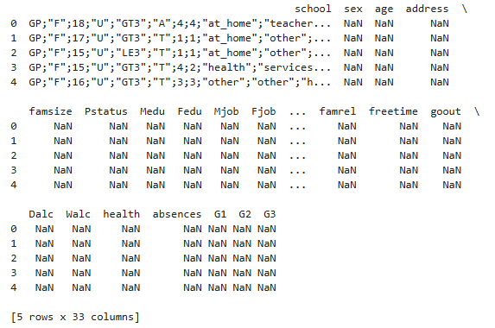
Read Dataset
# Read dataset
data = pd.read_csv('student-mat.csv’, sep = ‘;’)
# Show first five lines to ensure correct loading
print(data.head())

Slide 13
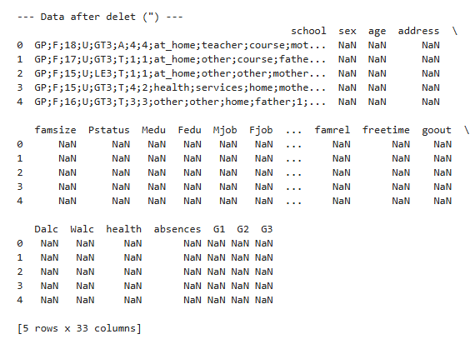
Dataset pre-processing
# Delete quotes
data['school'] = data['school'].str.replace('"', '', regex=False)
print("\n--- Data after delet (\") ---")
print(data.head())

Slide 14
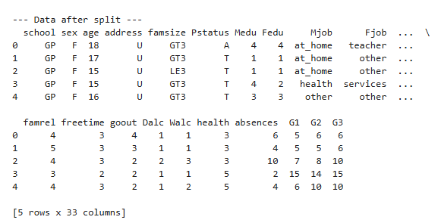
Dataset pre-processing
split_data = data['school'].str.split(';', expand=True)
# We can name the new columns if we want.
split_data.columns = [data.columns[i] for i in range(split_data.shape[1])]
print("\n--- Data after split ---")
print(split_data.head())

Slide 15
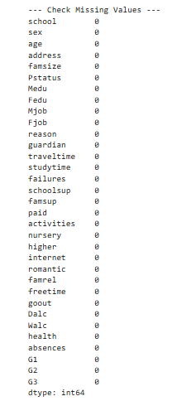
Dataset pre-processing
print("\n--- Check Missing Values ---")
print(split_data.isnull().sum())
Note that :there is no missing values

Slide 16
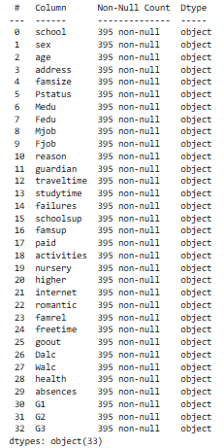
Dataset pre-processing
print(split_data.info())
# Convert columns to numeric
split_data['G1'] = pd.to_numeric(split_data['G1'], errors='coerce’)
split_data['G3'] = pd.to_numeric(split_data['G3'], errors='coerce’)
split_data['freetime'] = pd.to_numeric(split_data['freetime'], errors='coerce’)
split_data['failures'] = pd.to_numeric(split_data['failures'], errors='coerce')

Slide 17

The End
Any Question?

