Slide 1

Lesson 2
Build a simple model
Prepared by:
ENG. Khadija Bitar

Slide 2

Import necessary libraries
from sklearn.model_selection import train_test_split
from sklearn.linear_model import LogisticRegression
from sklearn.metrics import accuracy_score, classification_report, confusion_matrix
import numpy as np

Slide 3

Choose Features and Target
selected_features = [ 'freetime', 'failures', 'G1’]
X = split_data[selected_features]
y = split_data['pass']
We will predict whether a student will pass or fail from 'freetime, 'freetime, ‘G1 features.

Slide 4
Split Dataset to Train and Test
X_train, X_test, y_train, y_test = train_test_split(X, y, test_size=0.3, random_state=42, stratify=y)
Where:
test_size: This parameter specifies the proportion of the dataset to include in the test split. test set (30% in this case), and the remaining 70% will be for the training set.
random_state: This parameter controls the random seed used for shuffling the data before splitting.
Stratify: This parameter ensures that the proportion of classes in the target variable is roughly the same in both the training and test sets. When stratify=y, the function will attempt to maintain the same relative proportions of the classes present in target across X_train, X_test, y_train, and y_test.

Slide 5
Create a Logistic Regression model
Logistic Regression: It is a linear classification model, mainly used to solve binary classification problems.
Code: model = LogisticRegression(random_state=42, solver='liblinear’)
model.fit(X_train, y_train)
y_pred = model.predict(X_test)

Slide 6

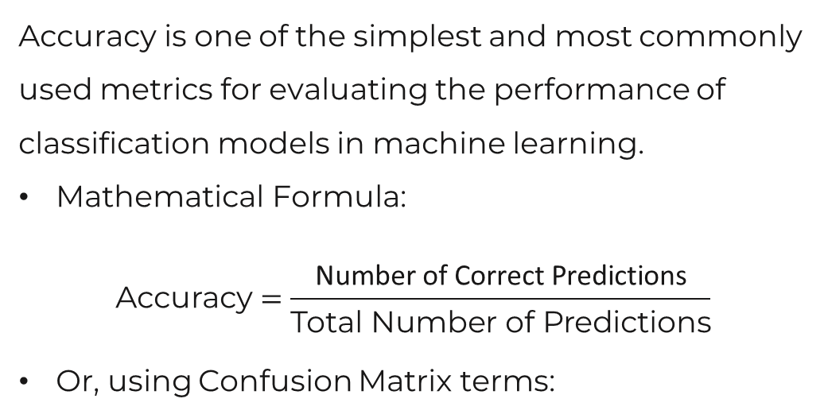
Accuracy
Accuracy is one of the simplest and most commonly used metrics for evaluating the performance of classification models in machine learning.
Mathematical Formula:
$$\text{Accuracy}=\frac{\text{Number} \text{of} \text{Correct} \text{Predictions}\text{​}}{\text{Total} \text{Number} \text{of} \text{Predictions}}$$
Or, using Confusion Matrix terms:
$$\text{Accurac}=\frac{\text{True} \text{Positives}\text{ (}\text{TP}\text{)+}\text{True} \text{Negatives}\text{ (}\text{TN}\text{)​}}{\text{True} \text{Positives}\text{ (}\text{TP}\text{)+}\text{True} \text{Negatives}\text{ (}\text{TN}\text{)+}\text{False} \text{Positives}\text{ (}\text{FP}\text{)+}\text{False} \text{Negatives}\text{ (}\text{FN}\text{)} }$$

Slide 7

The End
Any Question?

