Slide 1

Lesson 3
Analysis of results
Prepared by:
ENG. Khadija Bitar

Slide 2

Confusion matrix
The Confusion Matrix is a table used to evaluate the performance of a classification model. It provides a detailed breakdown of the types of errors the model makes, rather than just a single number like Accuracy. The confusion matrix shows the count of correct and incorrect predictions for each class.
It helps in understanding where the model is making mistakes.

Slide 3

Confusion matrix
The Four Key Elements:
True Positive (TP): The number of positive cases that the model correctly predicted as positive. (The model said "Positive," and it was actually "Positive").
True Negative (TN): The number of negative cases that the model correctly predicted as negative. (The model said "Negative," and it was actually "Negative").
False Positive (FP) - Type I Error: The number of negative cases that the model incorrectly predicted as positive. (The model said "Positive," but it was actually "Negative"). Also known as a "Type I Error."
False Negative (FN) - Type II Error: The number of positive cases that the model incorrectly predicted as negative. (The model said "Negative," but it was actually "Positive"). Also known as a "Type II Error."

Slide 4
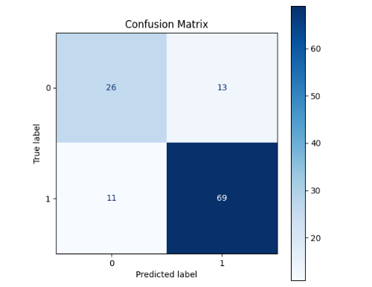
Show Confusion matrix
conf_matrix = confusion_matrix(y_test, y_pred)
fig, ax = plt.subplots(figsize=(6, 6))
cmp = ConfusionMatrixDisplay(confusion_matrix=conf_matrix, display_labels=model_pipeline.classes_)
cmp.plot(ax=ax, cmap=plt.cm.Blues)
ax.set_title('Confusion Matrix’)
plt.show()

Slide 5
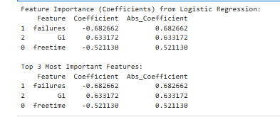
Show Feature Importance
feature_coefficients = model.coef_[0]
feature_names = X_train.columns
coefficients_df = pd.DataFrame({
'Feature': feature_names,
'Coefficient': feature_coefficients
})
coefficients_df['Abs_Coefficient'] = np.abs(coefficients_df['Coefficient’])
coefficients_df = coefficients_df.sort_values(by='Abs_Coefficient', ascending=False)
print(coefficients_df)
print(coefficients_df.head(3))

Slide 6

Model Limitations
Inherent Limitations of Logistic Regression:
Inability to Handle Complex Relationships: It may struggle to capture complex interactions between features.
Sensitivity to Outliers: Model coefficients can be significantly affected by outliers in the data.
Data-Related Limitations:
Data Size: The dataset is too small; the model may not be able to learn effectively and might be prone to overfitting.

Slide 7
Evaluating Fairness Using Fairlearn
from fairlearn.metrics import MetricFrame, demographic_parity_difference, equalized_odds_difference
sensitive_features = X_test[failures’]
print("\n---Evaluating Fairness Using Fairlearn (Example) ---\n")
dp_diff = demographic_parity_difference(y_true=y_test, y_pred=y_pred, sensitive_features=sensitive_features)
print(f"Demographic Parity Difference (failures): {dp_diff:.2f}")
eo_diff = equalized_odds_difference(y_true=y_test, y_pred=y_pred, sensitive_features=sensitive_features)

Slide 8
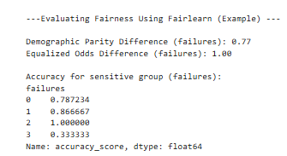
Evaluating Fairness Using Fairlearn
print(f"Equalized Odds Difference (sex): {eo_diff:.2f}")
metric_frame = MetricFrame(metrics=accuracy_score, y_true=y_test, y_pred=y_pred, sensitive_features=sensitive_features)
print("\nAccuracy for sensitive group (failures):")
print(metric_frame.by_group)

Slide 9

The End
Any Question?

