Slide 1

Lesson 4
Gradio Application
Prepared by:
ENG. Khadija Bitar

Slide 2

Import Libraries
import gradio as gr
import pandas as pd
import joblib
import numpy as np
# I saved model and featuers by this commands at the end of last lesson. joblib.dump(model, 'success_model.pkl’)
original_feature_names = X_train.columns.tolist()
joblib.dump(original_feature_names, 'original_feature.pkl')

Slide 3

Load the trained model and original feature names
try:
model = joblib.load(‘success_model.pkl’)
original_feature_names = joblib.load('original_feature_names.pkl')
print("Model and feature names loaded successfully.")
except FileNotFoundError:
print("Error: Model file or feature names not found. Please run Step 1 (model training and saving) first.") # You can exit or provide a default model to continue in development mode
exit() # Exit the program if files are not found

Slide 4
Define the prediction function
def predict_loan_approval(freetime, past_failures, g1_score):
input_data = pd.DataFrame([[freetime, past_failures, g1_score]], columns=['freetime', 'failures', 'G1’])
prediction_proba = model.predict_proba(input_data)[0] # Probability of each class
prediction_class = model.predict(input_data)[0] # Predicted class (0 or 1)
if prediction_class == 1:
result = "Student will succeed“
explanation = f"The model predicts Student success or failure with a probability of {prediction_proba[1]*100:.2f}%.“
explanation += "\nBased on the provided factors, you seem to have a good chance of success.“
else:
result = "Student will fail“
explanation = f"The model predicts loan non-approval with a probability of {prediction_proba[0]*100:.2f}%."
explanation += "\nSome factors may reduce the chance of success."

Slide 5
Define the prediction function
if freetime < 2:
explanation += "\nObservation: Low Free time might have a negative impact.“
if past_failures > 0:
explanation += "\nObservation: Previous failures might have a negative impact.“
if g1_score < 10:
explanation += "\nObservation: Lower previous grades might affect success chances.“
return result, explanation

Slide 6
Build the Gradio interface
iface = gr.Interface(
fn=predict_loan_approval,
inputs=[
gr.Slider(minimum=0, maximum=5, step=1, label="Free Time (hours per week)", value=2),
gr.Slider(minimum=0, maximum=3, step=1, label="Previous Failures", value=0),
gr.Slider(minimum=0, maximum=20, step=1, label="Previous Grade G1", value=10),
],
outputs=[
gr.Textbox(label="Prediction Result"),
gr.Textbox(label="Explanation of Prediction")
],
title="Predicting student success or failure",
description="Enter student data to predict whether or not they will pass, along with an explanation of the prediction.",
flagging_mode="auto" # Allows users to flag results (optional)
)

Slide 7

Launch the app
iface.launch(share=True)
You can test the app on public URL: https://40b9fb8ea9095d677f.gradio.live
This share link expires in 1 week.
You can launch the app on local URL if you follow the steps.

Slide 8
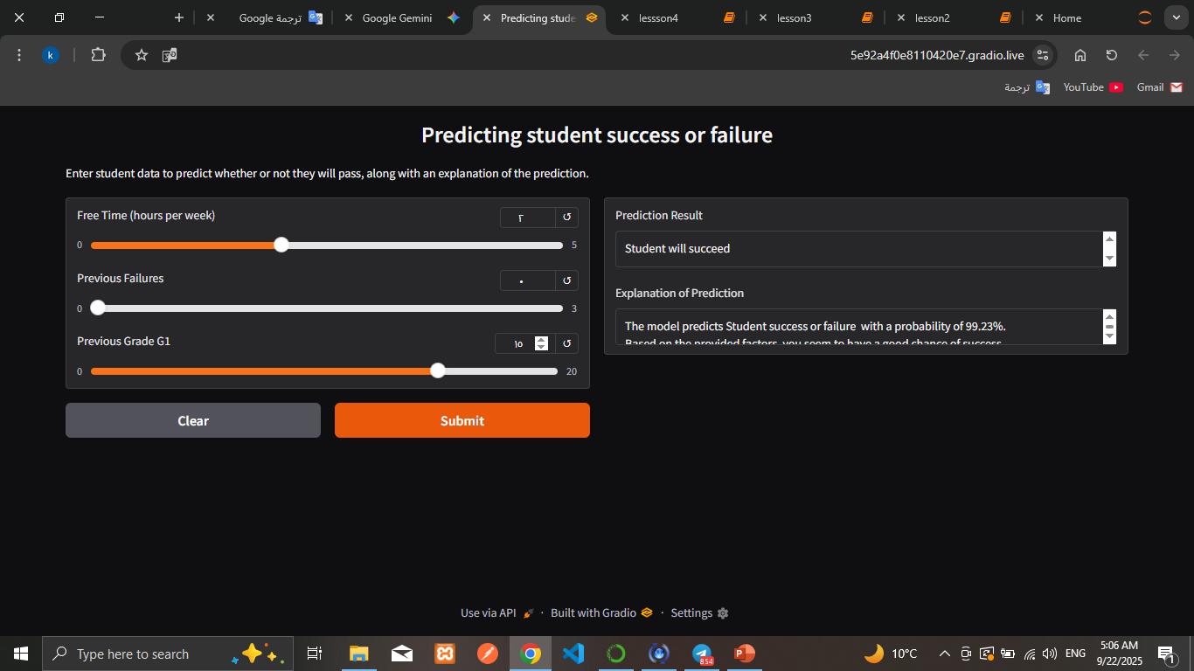
Launch the app

Slide 9

The End
Any Question?

