Slide 1
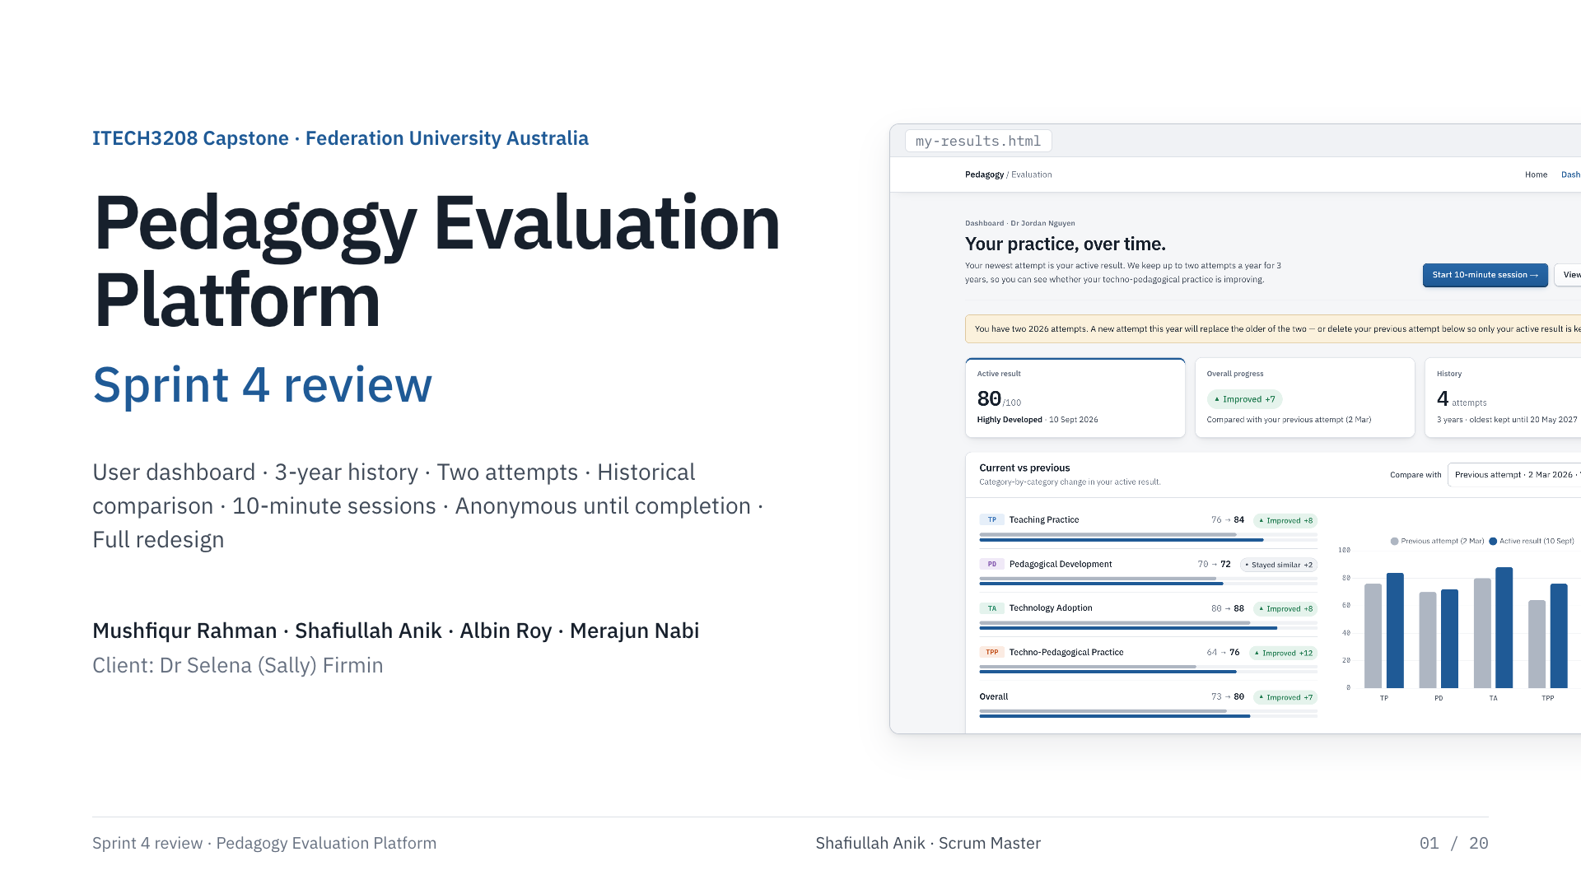
Notes:
Shafiullah Anik · Scrum Master
Good morning. This is our Sprint 4 review for the Pedagogy Evaluation Platform. Six backlog items, a full redesign and a production recovery — all shipped and live. Albin covers what was asked for, Mushfiqur shows how it works, Merajun covers testing, and I close with handover and next steps.

Slide 2
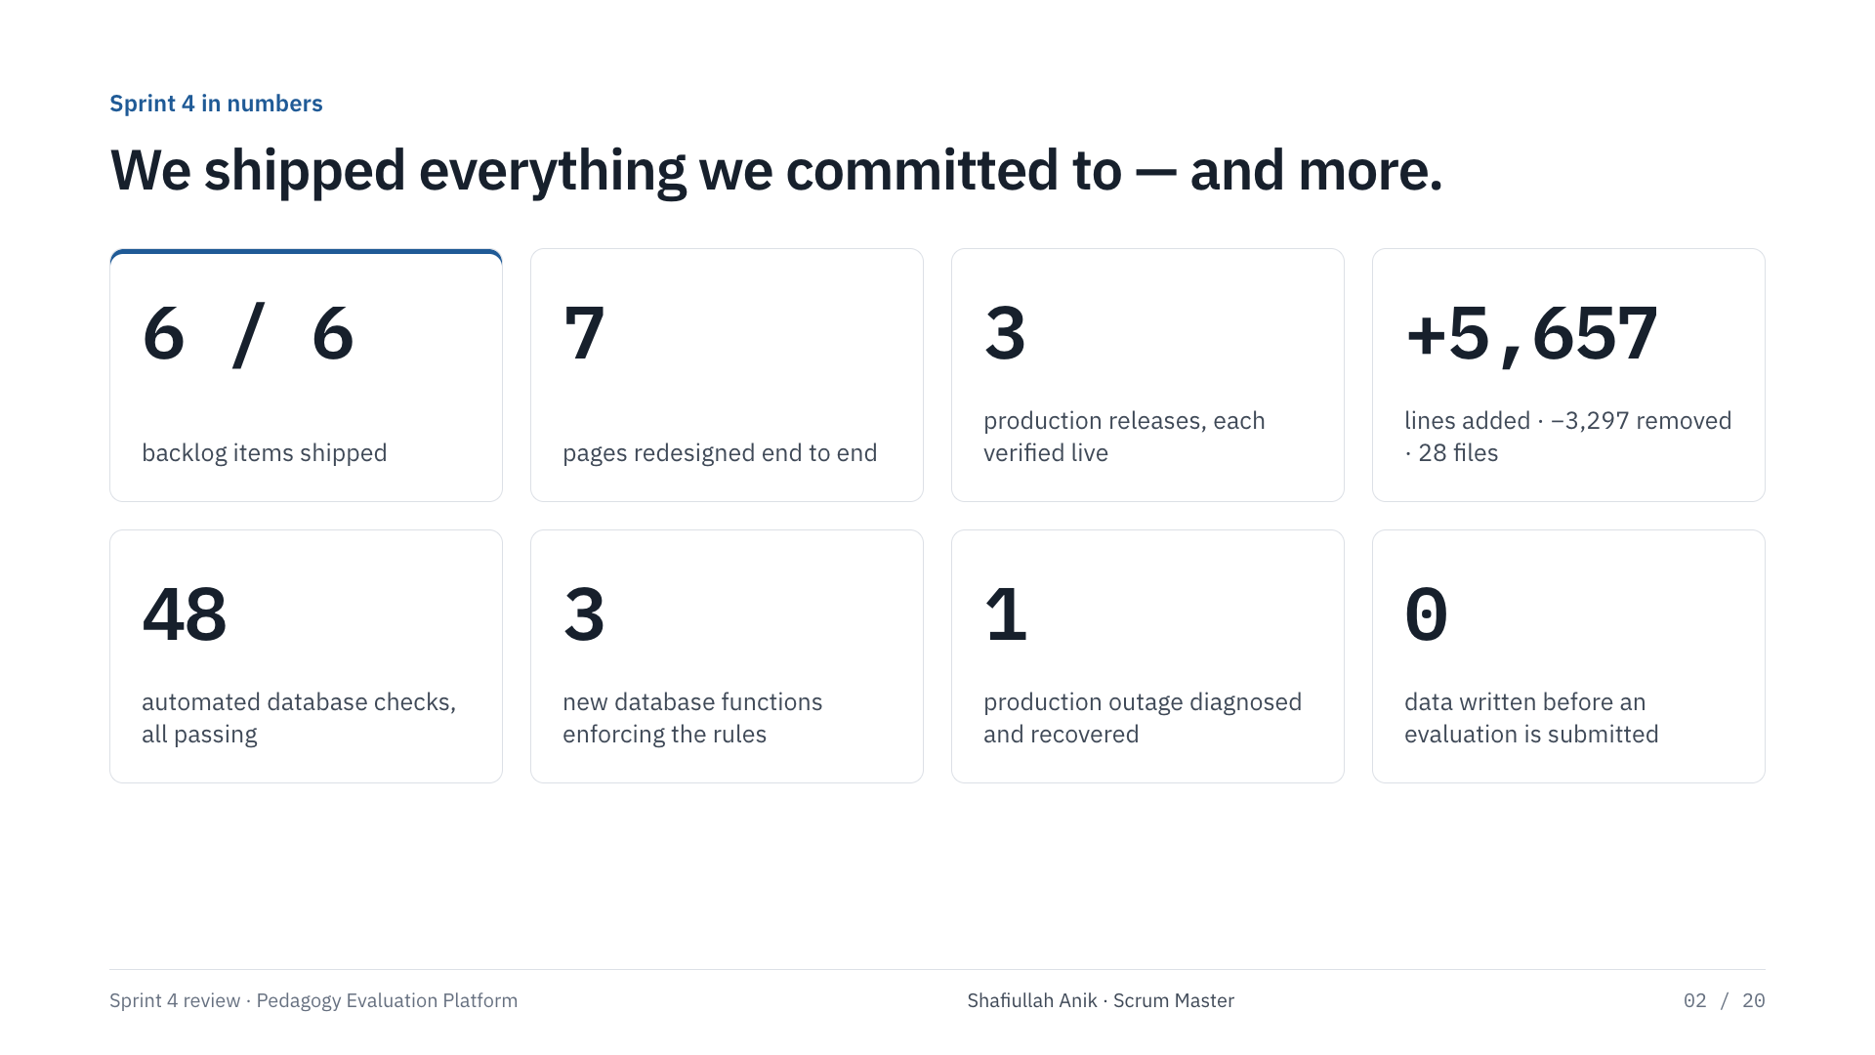
Notes:
Shafiullah Anik · Scrum Master
These are the numbers from the repository, not estimates. 3 production releases, 28 files changed, about 5,657 lines added and 3,297 removed. Every backlog item shipped, every page redesigned, and 48 automated database checks pass on the final migration. We also recovered the live platform after its database went down.

Slide 3
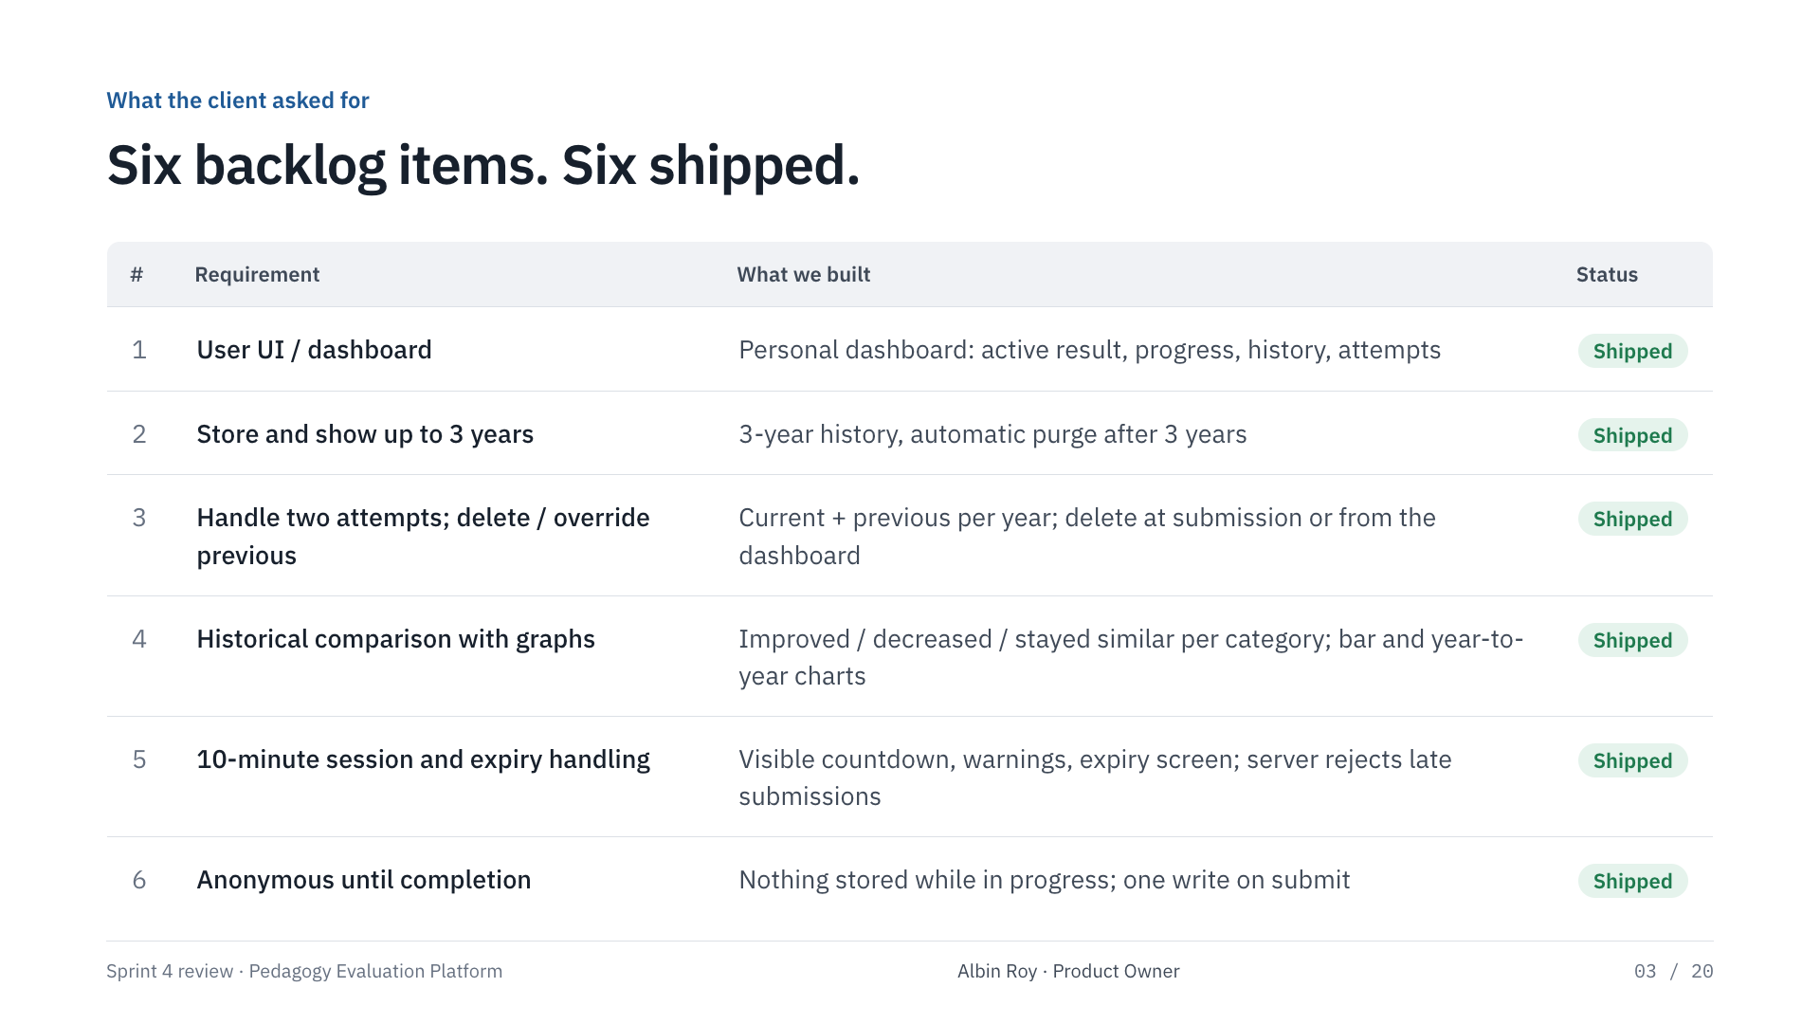
Notes:
Albin Roy · Product Owner
These six items came out of sprint planning with Dr Firmin. I will not read them — the point is the right-hand column: every one is shipped and live. I will show the user-facing ones, Mushfiqur covers the technical side.

Slide 4

Notes:
Albin Roy · Product Owner
This is the same page before and after. The old design looked impressive but read like a template: dark background, decorative animation, a custom cursor. For an academic research tool that staff will use once a year, clarity matters more. The new design is light, calm and readable, uses real typography and only uses colour to carry meaning.

Slide 5
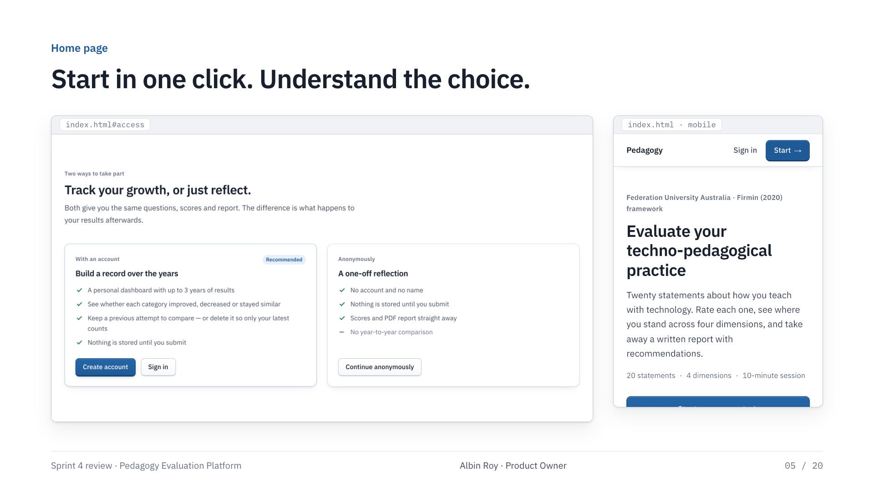
Notes:
Albin Roy · Product Owner
Two things on the home page. First, the first real statement is right there — you can answer it before signing up, and it carries into the assessment. Second, we explain the two ways to take part in plain language: with an account you get history and comparison; anonymously nothing is stored until you submit.

Slide 6
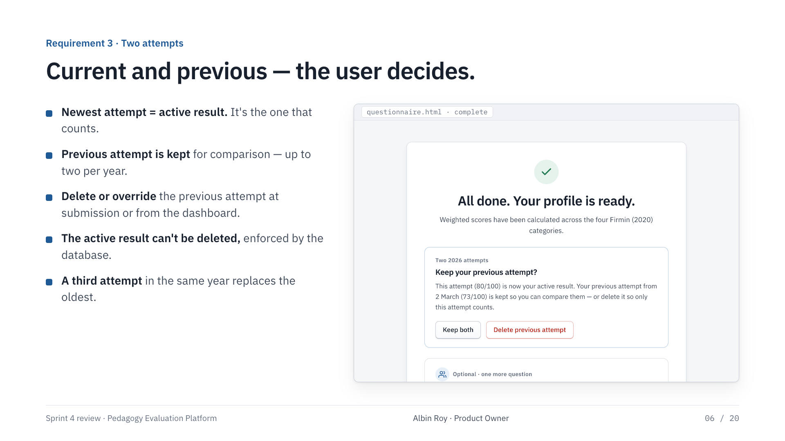
Notes:
Albin Roy · Product Owner
The client asked us to handle two attempts properly. Your newest attempt is always your active result. The previous one is kept so you can compare. Right after submitting a second attempt you choose: keep both, or delete the previous one so only the current attempt counts. You can also delete it later from the dashboard. Your active result can never be deleted by accident.

Slide 7
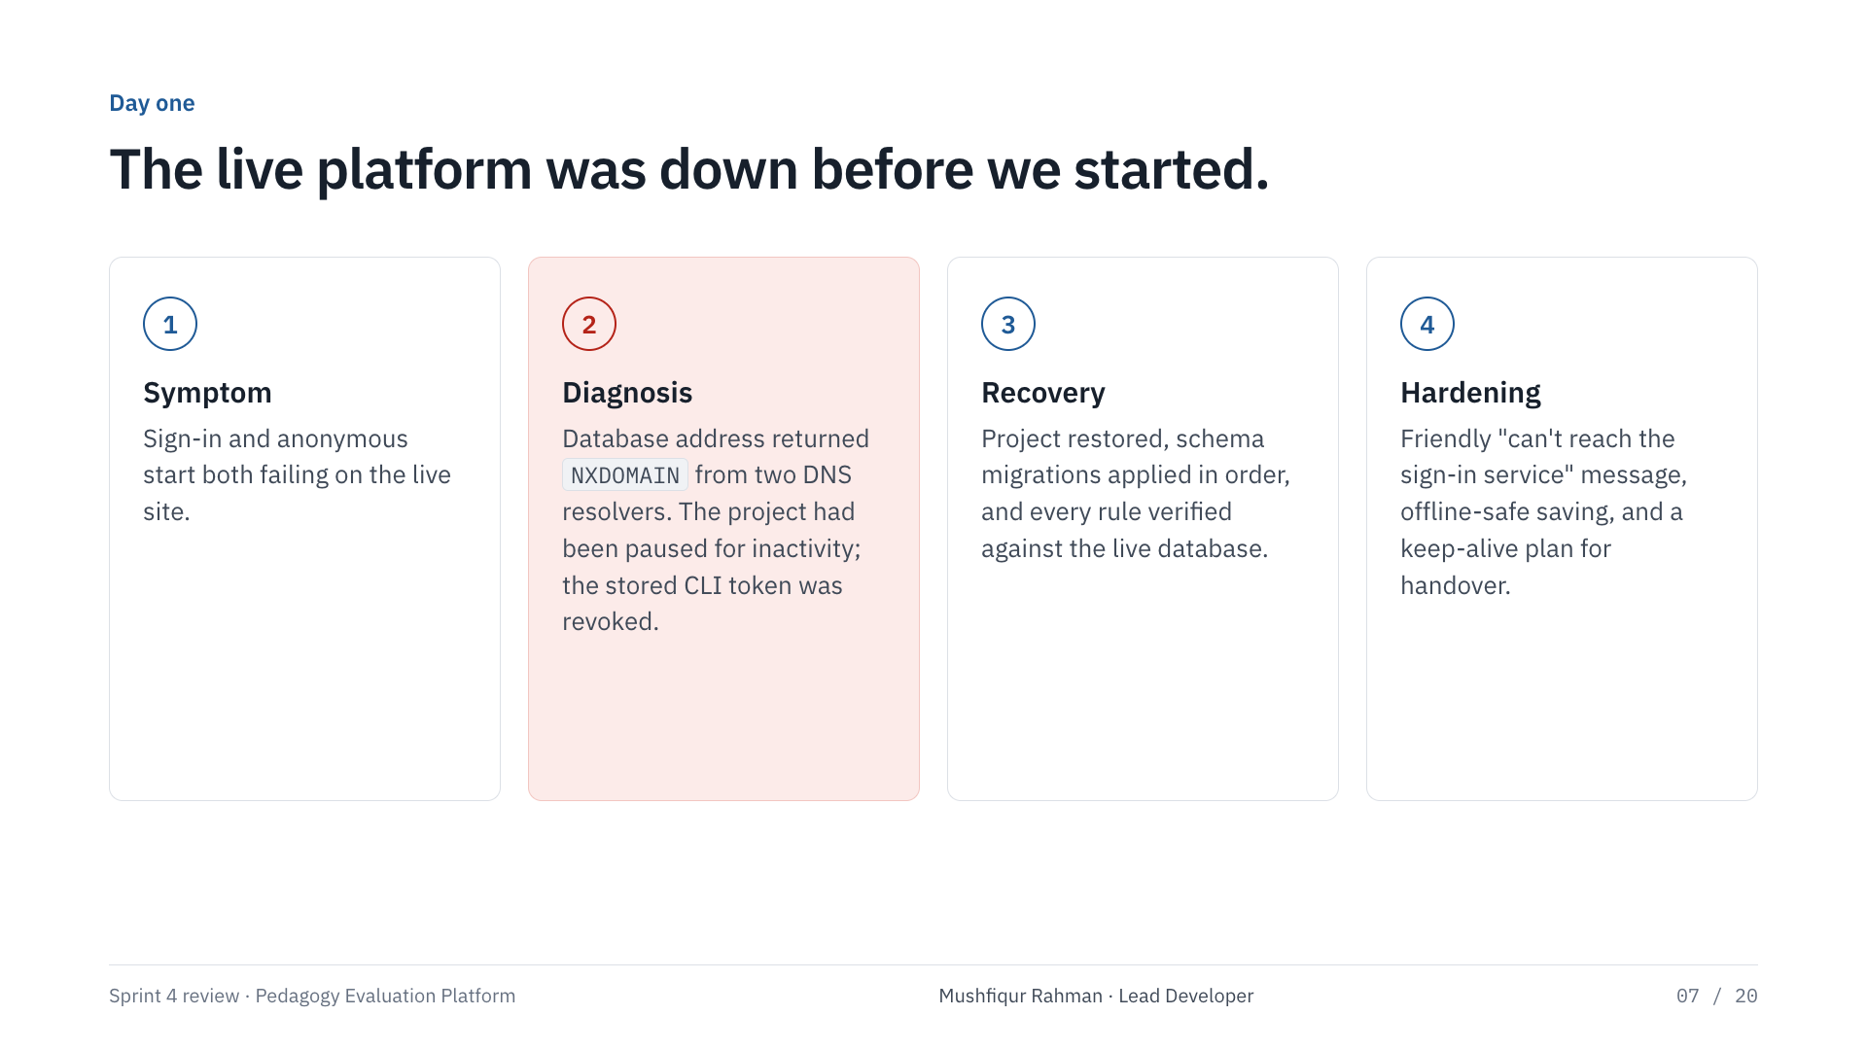
Notes:
Mushfiqur Rahman · Lead Developer
Before we could build anything, the live platform was broken — sign-in and anonymous mode both failed. The cause was not our code: the Supabase database had been paused for inactivity, so its address no longer existed. We confirmed it with two DNS resolvers, restored the project, and verified it end to end. We also found the deploy pipeline stuck during a GitHub Pages outage and re-triggered it. Lesson: free-tier databases pause after a week, and we have a plan for that in the handover section.

Slide 8
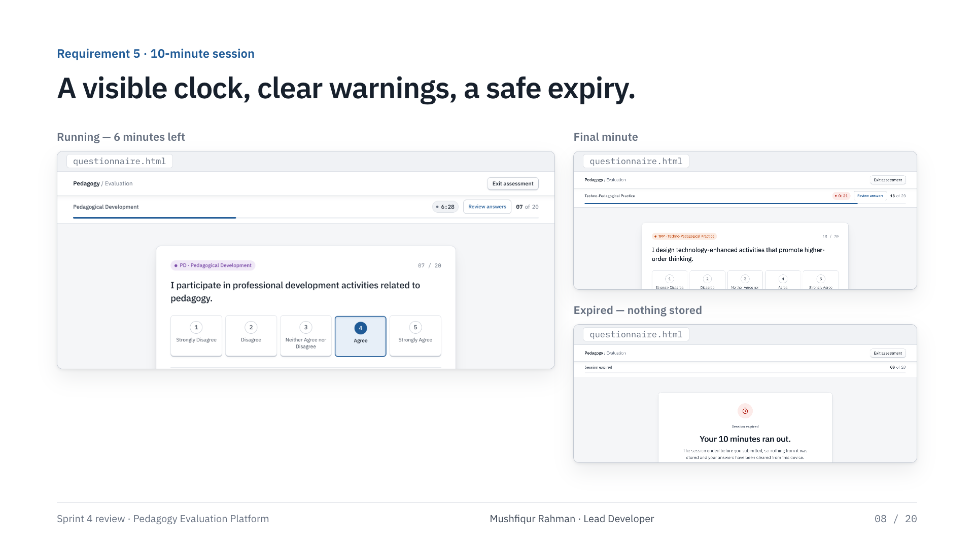
Notes:
Mushfiqur Rahman · Lead Developer
Every evaluation is a 10-minute session. The clock starts when you begin and survives a refresh or leaving the page. At two minutes it turns amber, at one minute red, and screen readers are told. When time runs out the unsubmitted answers are cleared and nothing is stored. The database checks the start time too, so the limit cannot be bypassed from the browser.

Slide 9
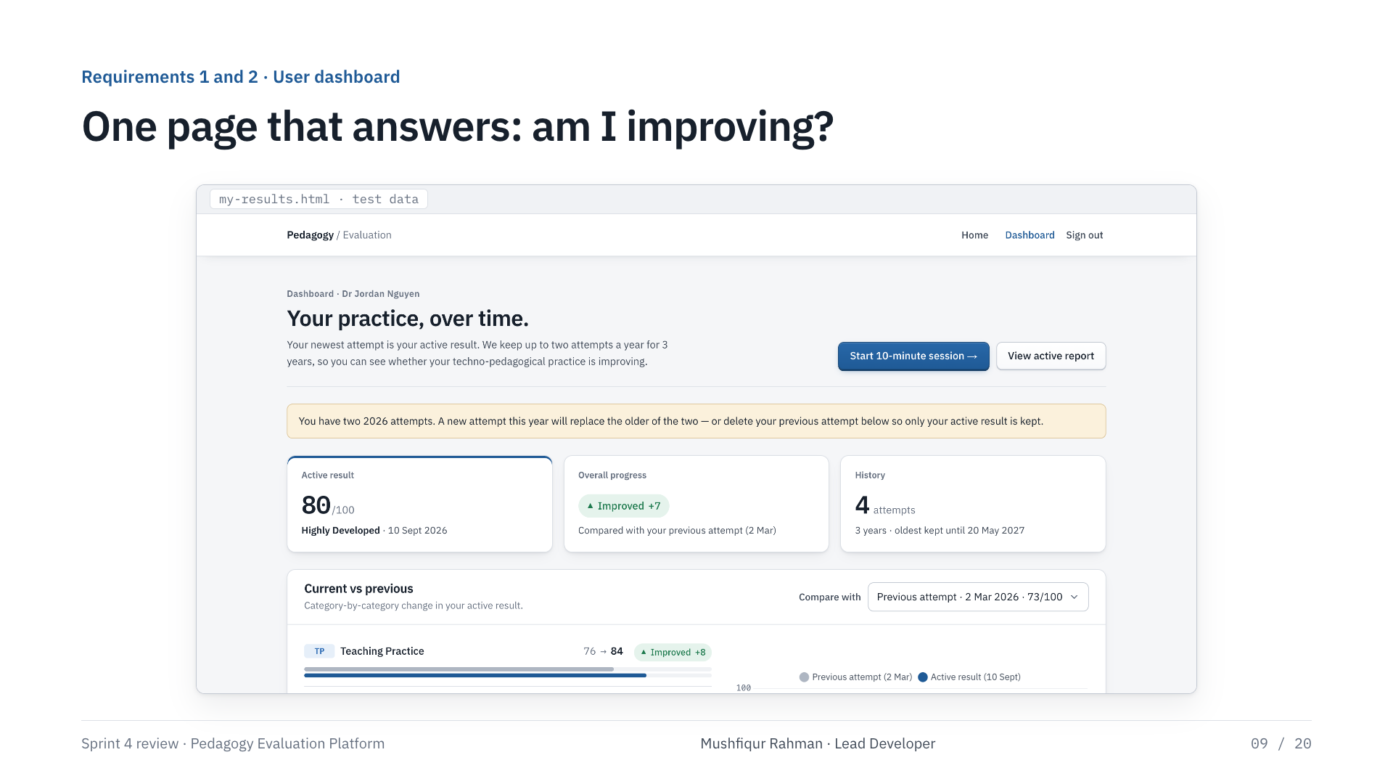
Notes:
Mushfiqur Rahman · Lead Developer
This is the user dashboard. Top row: the active result, whether overall practice improved, and how much history is stored and until when. Everything below is built from real stored attempts — the screenshot uses test data.

Slide 10
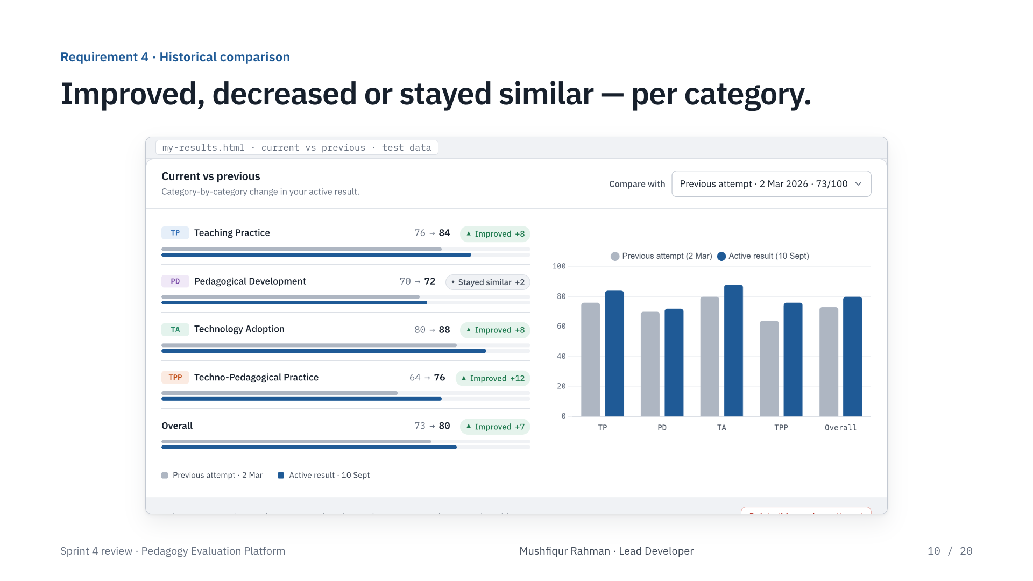
Notes:
Mushfiqur Rahman · Lead Developer
Historical comparison. Pick any earlier attempt from the dropdown and every category shows whether it improved, decreased or stayed similar. A change of two points or less counts as similar, so tiny differences are not over-read. The bar chart shows the same comparison visually.

Slide 11
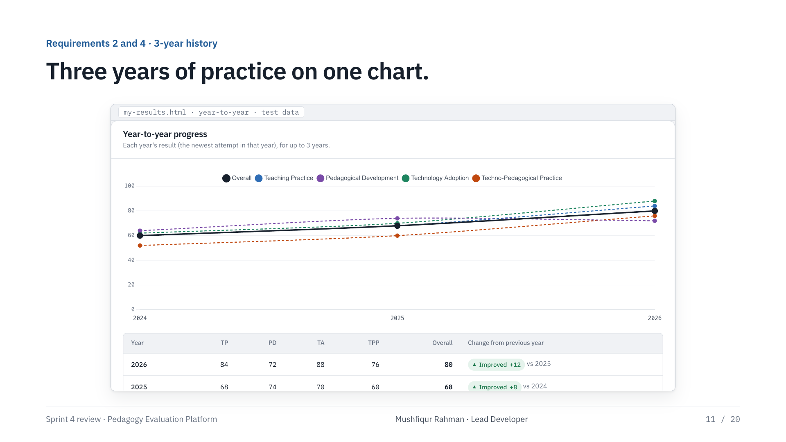
Notes:
Mushfiqur Rahman · Lead Developer
Year-to-year: each year’s result, for up to three years. The bold line is the overall score, the dashed lines are the four categories, and the table says in words whether each year improved on the last.

Slide 12
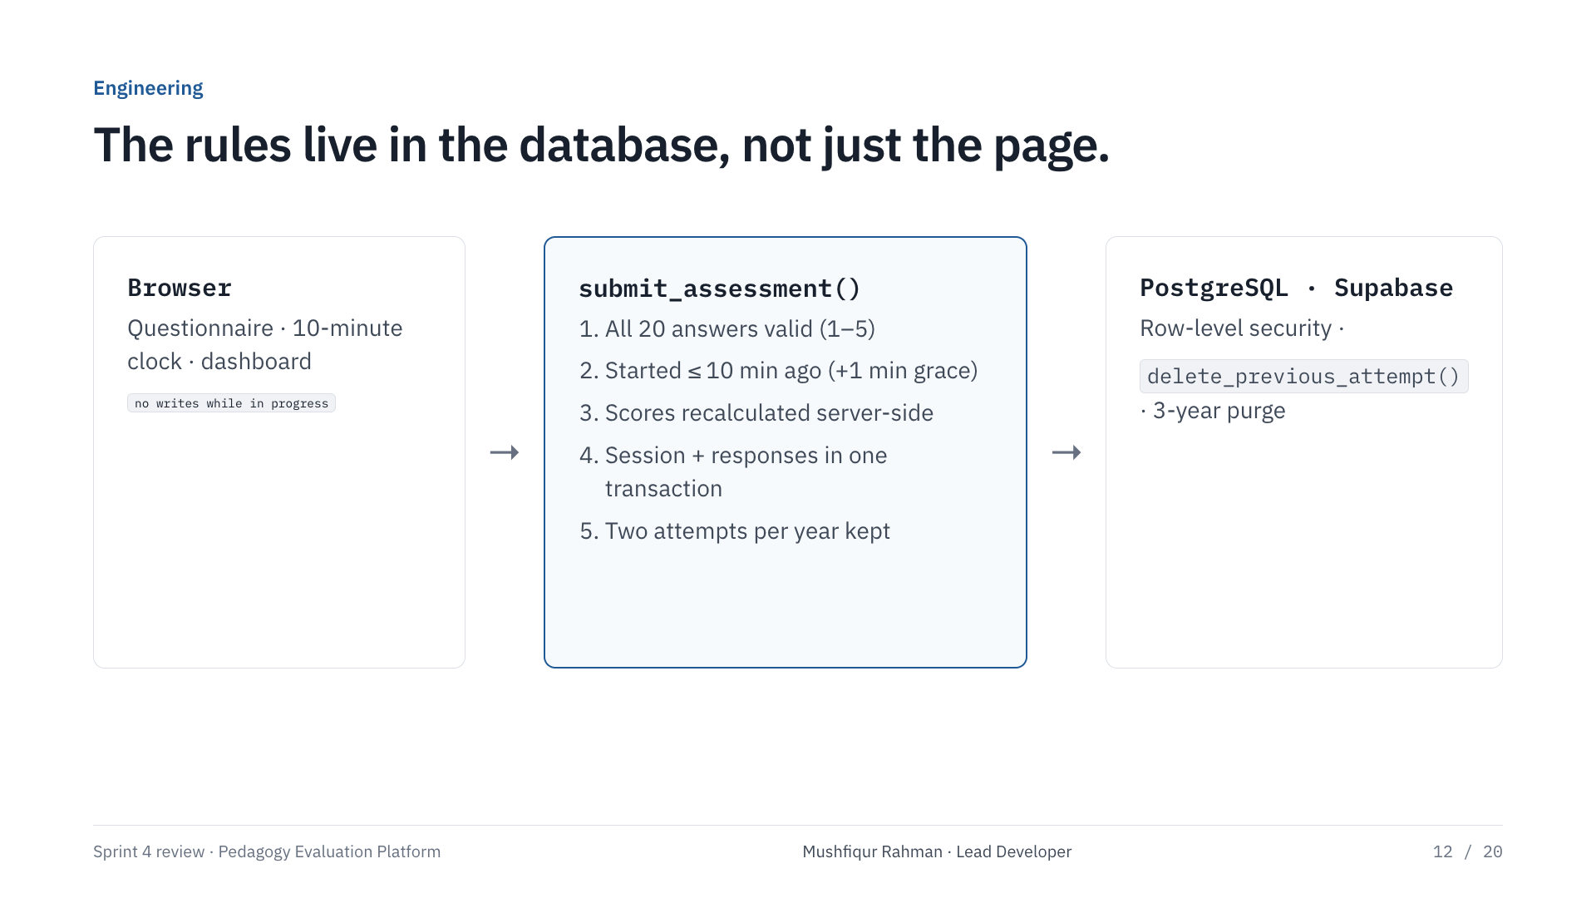
Notes:
Mushfiqur Rahman · Lead Developer
Under the hood, the rules are enforced in the database, not just the browser. There is one write path, submit_assessment. It checks all twenty answers, recalculates the scores itself, enforces the ten-minute limit, stores everything in one transaction, and applies the two-attempt rule. A separate function deletes previous attempts and refuses to delete the active one. Data older than three years is purged automatically.

Slide 13
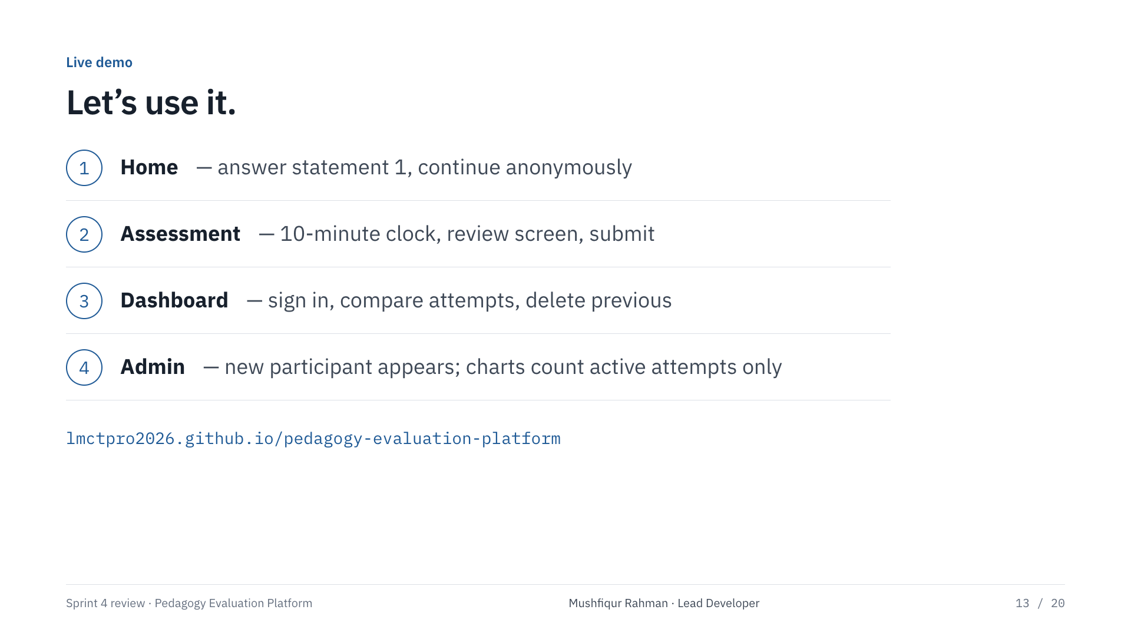
Notes:
Mushfiqur Rahman · Lead Developer
Live demo, about three minutes. One: answer the first statement on the home page and continue anonymously. Two: show the timer and the review screen, submit. Three: sign in as a test account, show the dashboard, switch the comparison, delete a previous attempt. Four: open the admin dashboard. If the network fails, these slides are the fallback.

Slide 14
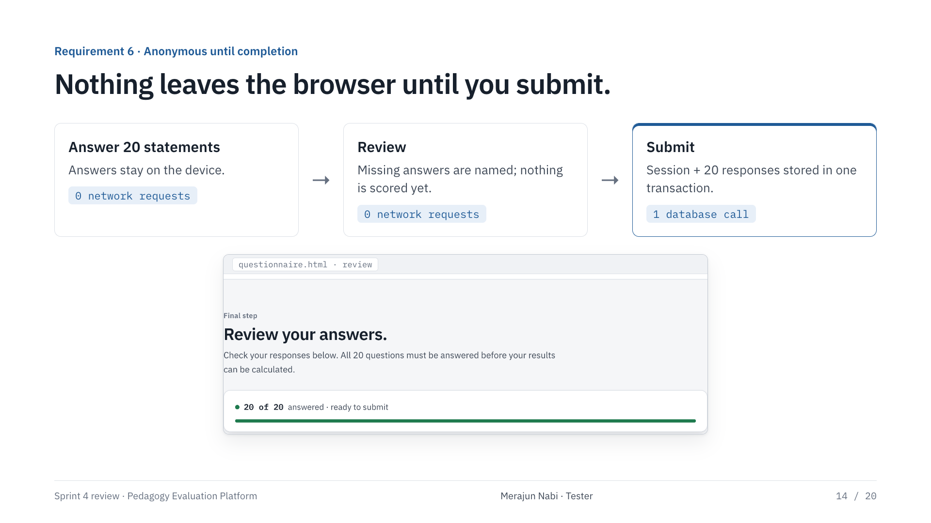
Notes:
Merajun Nabi · Tester
For the anonymous-until-completion requirement I wanted proof, not a promise. I monitored every network request during a full run. Zero requests leave the browser while the participant answers. Exactly one database call happens on submit, and it stores the session and all twenty answers together. If the session expires, nothing is ever sent.

Slide 15
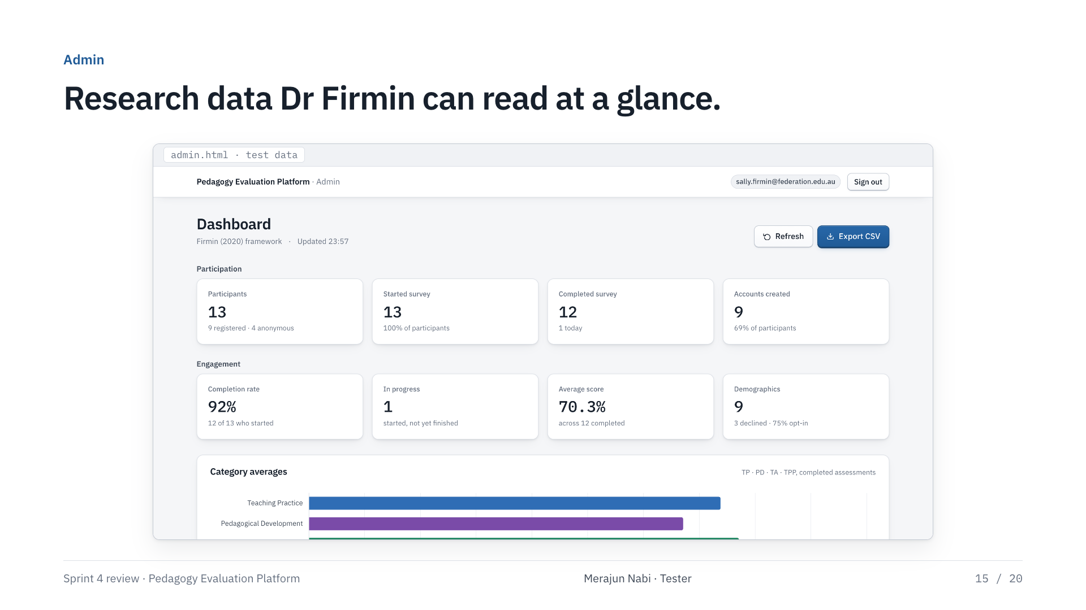
Notes:
Merajun Nabi · Tester
The admin dashboard was redesigned too, and it now counts only each participant’s active attempt per year, so nobody is averaged in twice when they keep a previous attempt.

Slide 16
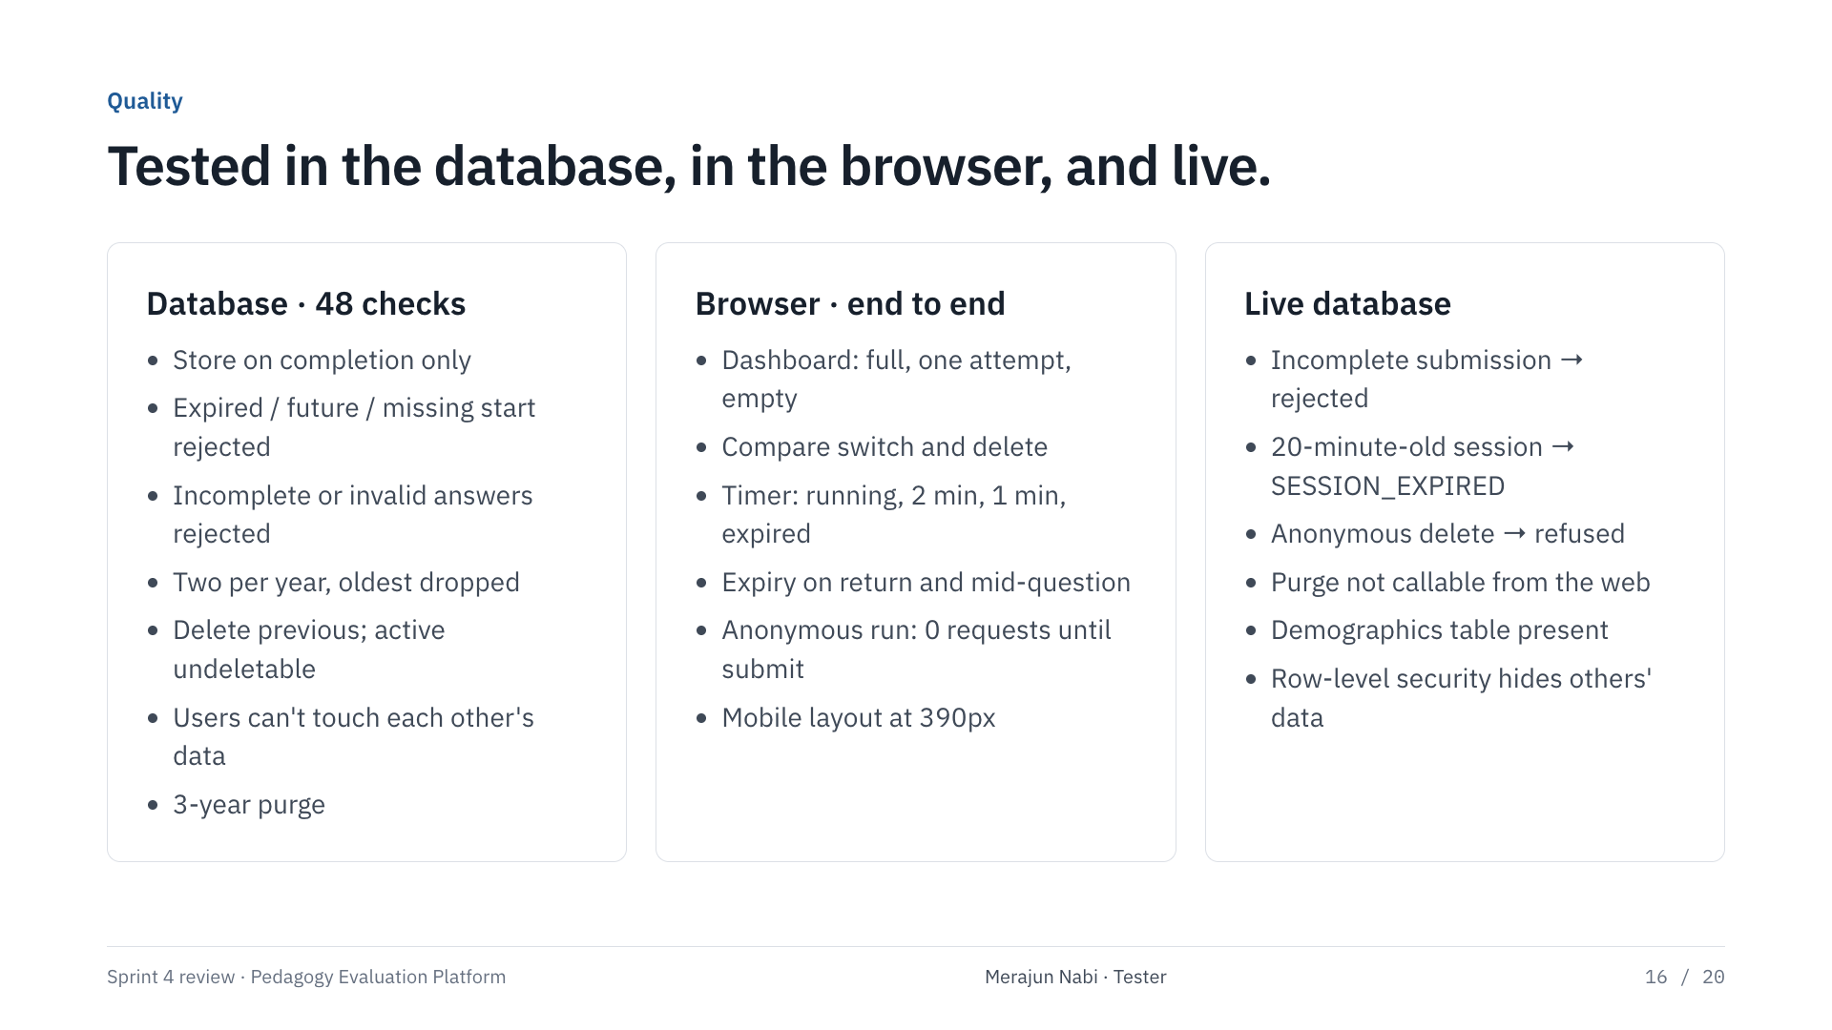
Notes:
Merajun Nabi · Tester
How we tested. The migration was run against the full schema chain in a real Postgres engine with mocked authentication — forty-eight checks, both on a fresh database and on top of the earlier draft, each run twice. In the browser we tested every dashboard state, the timer at each threshold, expiry mid-question, and a full anonymous run with network monitoring. Then we verified the live database directly with requests that cannot write data.

Slide 17
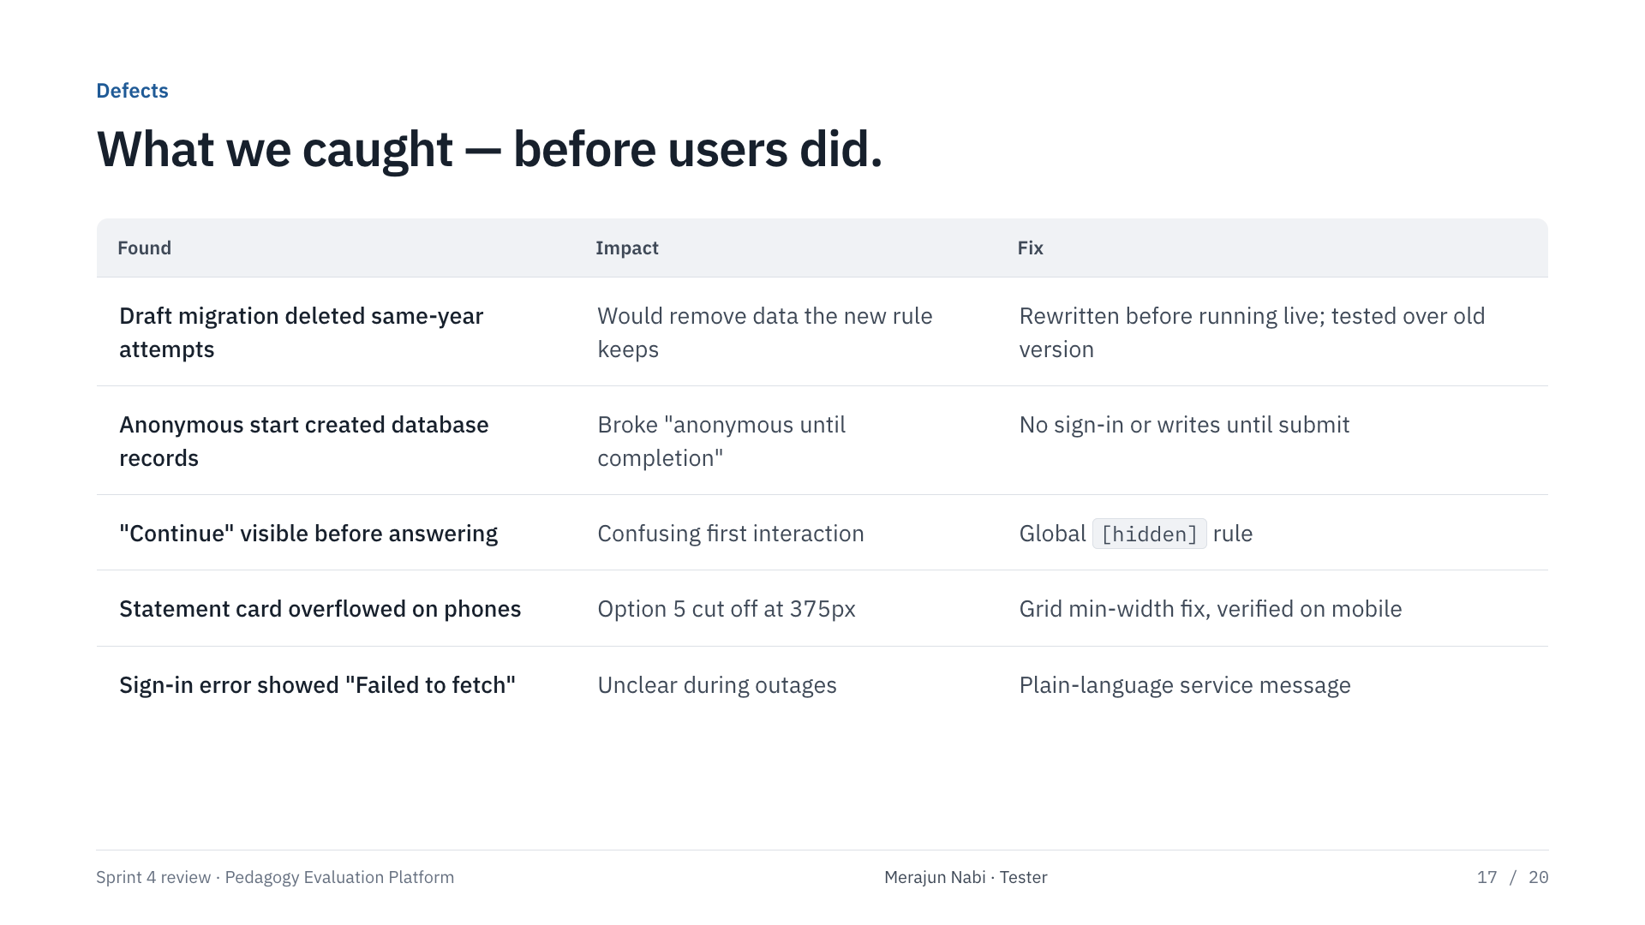
Notes:
Merajun Nabi · Tester
Defects we found and fixed during the sprint. The honest one first: the first version of the attempt migration would have deleted same-year attempts, which the refined requirement wanted kept. We caught it before it ran on the live database and rewrote it. We also fixed a button that showed before it should, a card that overflowed on phones, and anonymous mode quietly creating database records at the start.

Slide 18
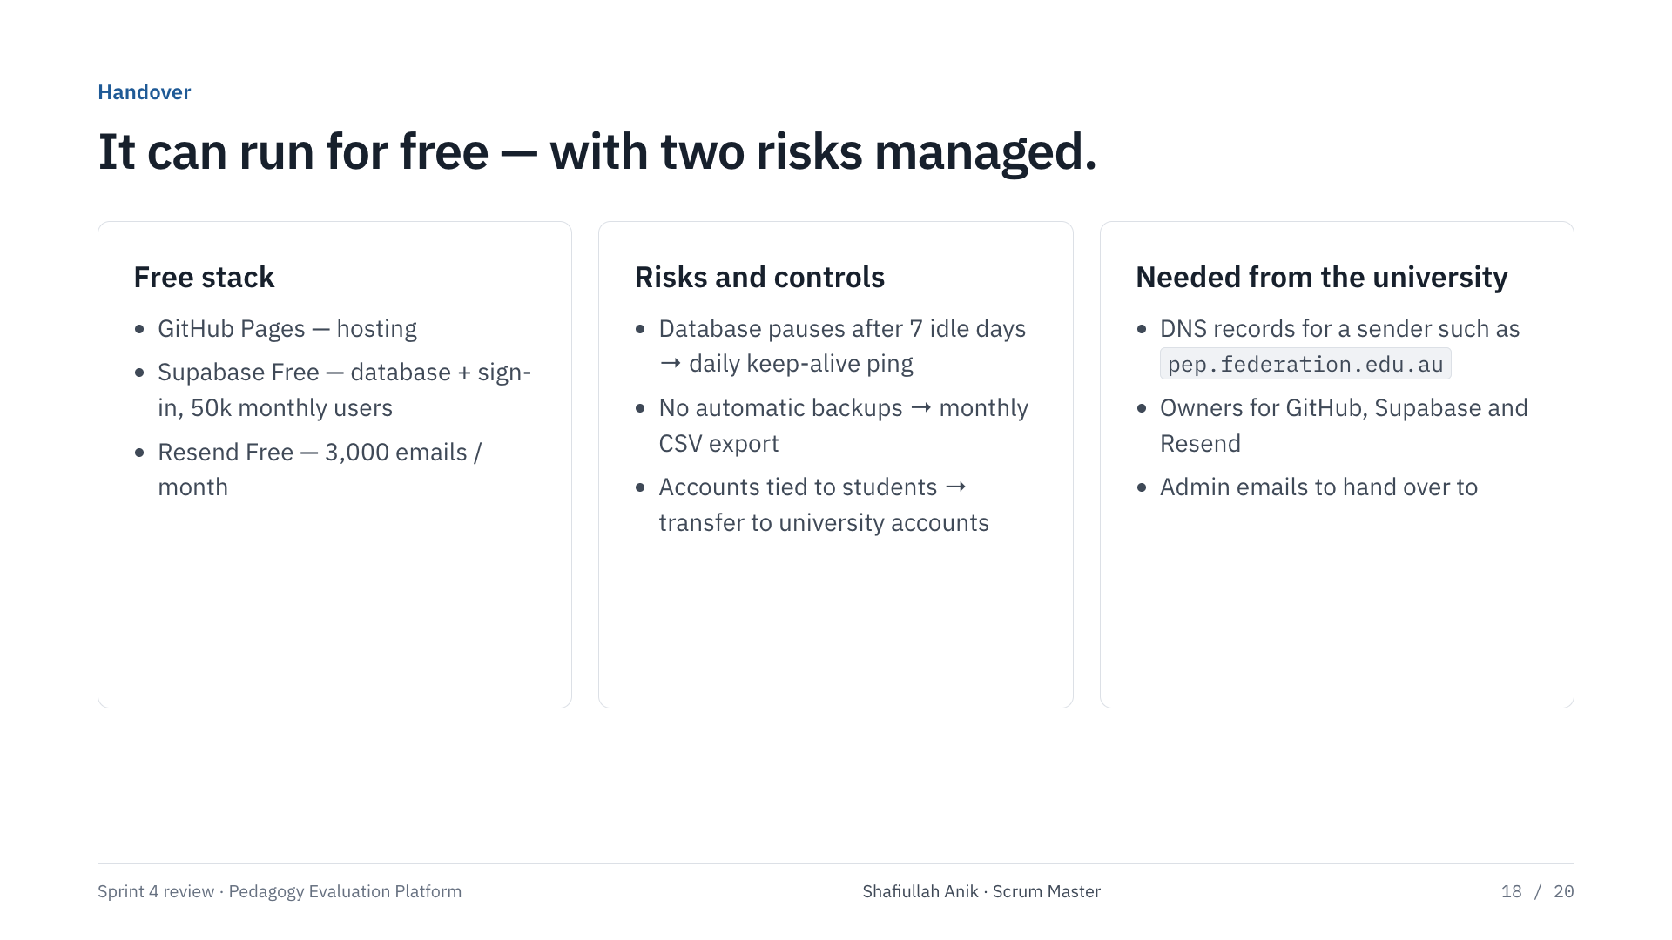
Notes:
Shafiullah Anik · Scrum Master
Handover. The platform can run for free. GitHub Pages hosts the site, Supabase free covers fifty thousand monthly users, Resend free covers three thousand emails a month. Two risks to manage: the free database pauses after a week of inactivity, which is exactly what happened to us, so we set up a daily keep-alive ping; and there are no automatic backups on free, so Dr Firmin exports a CSV monthly. For email to reach any participant, we need university IT to verify a sender domain — that is a ten-minute DNS change.

Slide 19
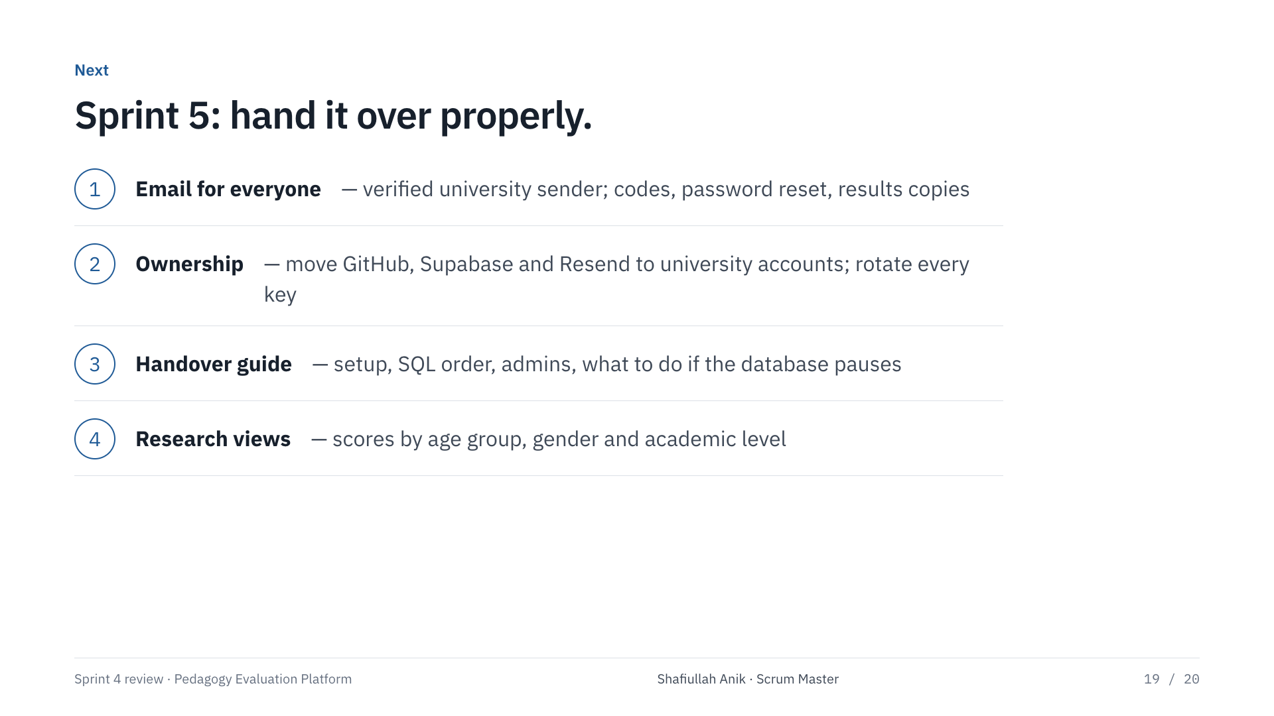
Notes:
Shafiullah Anik · Scrum Master
Next sprint: university sender domain so verification and results emails reach everyone, handover to university-owned accounts with rotated keys, a handover guide, and cross-tabulating scores by demographics in the admin dashboard. Then questions.

Slide 20

Notes:
All four
Route questions by topic: scope and requirements to Albin, technical and build to Mushfiqur, testing to Merajun, timeline and handover to Shafiullah.

