Slide 1
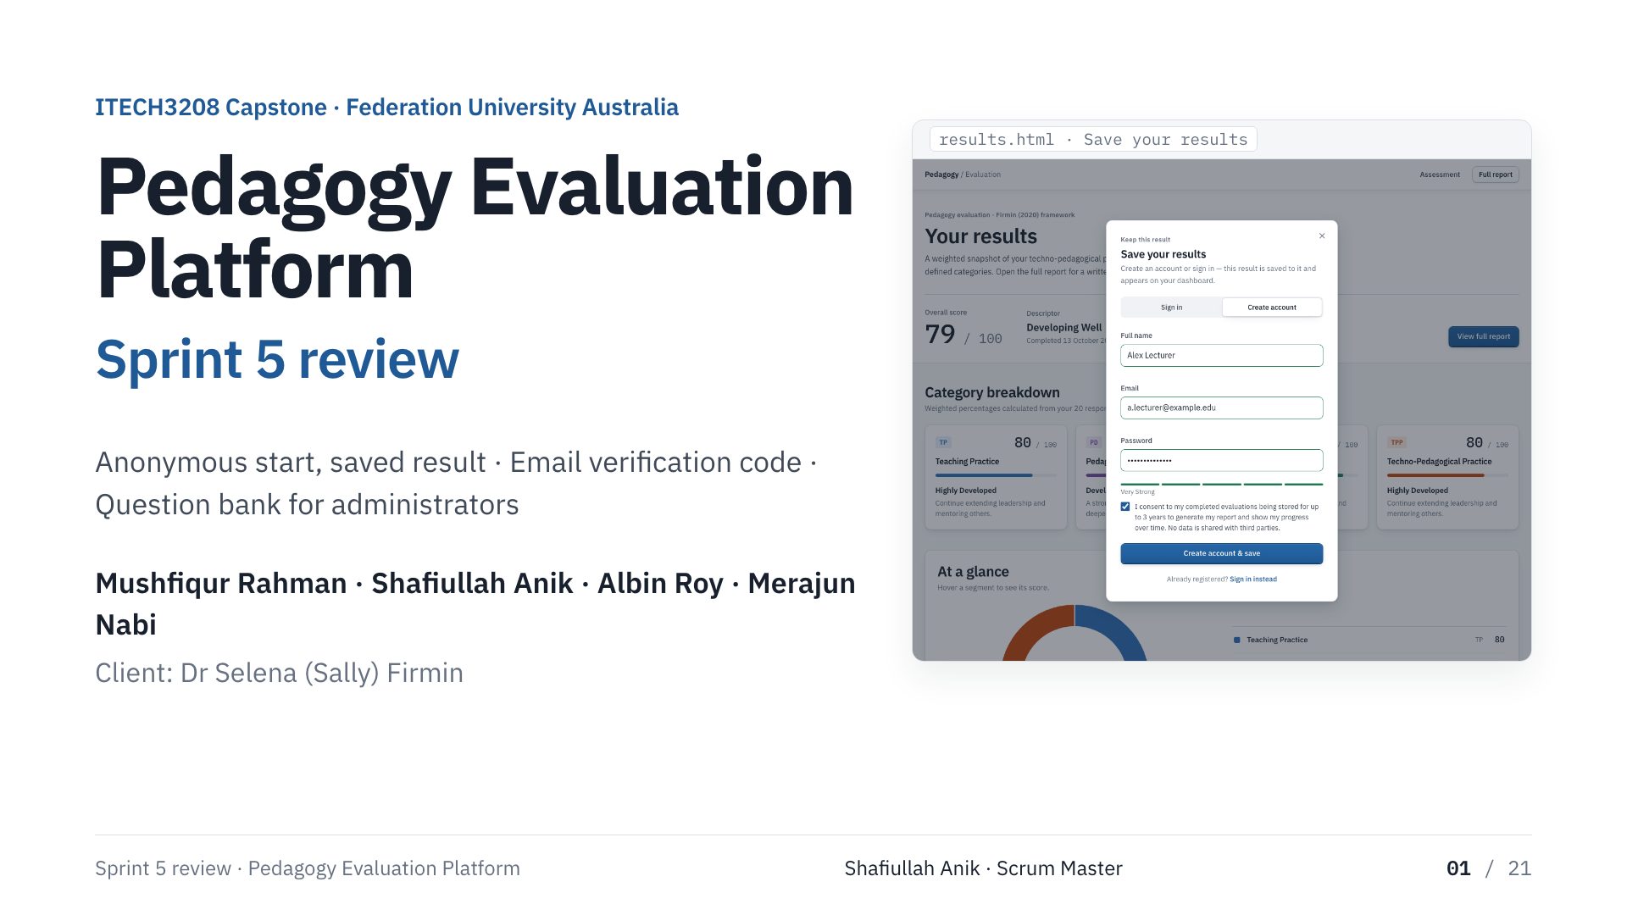
Notes:
Shafiullah Anik · Scrum Master
Good morning. This is our Sprint 5 review for the Pedagogy Evaluation Platform. Dr Firmin confirmed two requirements for this sprint — saving an anonymous result to an account, and verifying new accounts with an emailed code — and asked for a question bank part-way through. All three are built, deployed and live. Albin shows what a participant sees, Mushfiqur how it works underneath, Merajun how we tested it, and I close with handover.

Slide 2
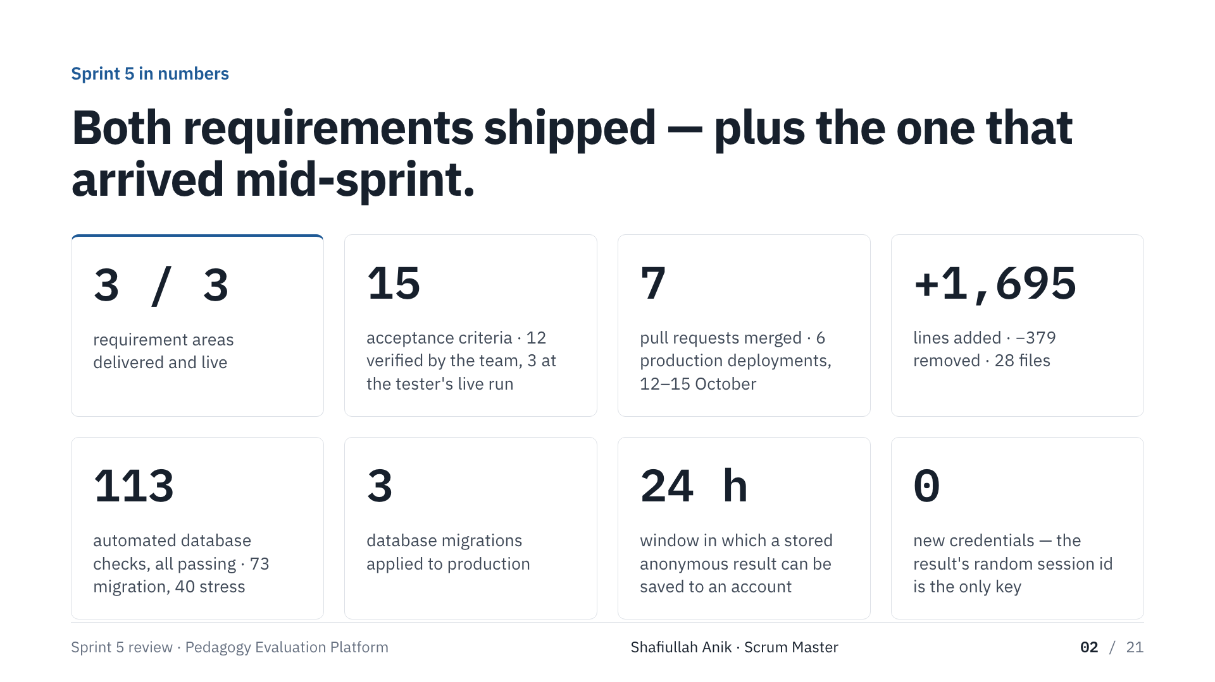
Notes:
Shafiullah Anik · Scrum Master
These numbers come from the repository and the live system. Three of three requirement areas. Fifteen acceptance criteria — twelve verified by the team, three waiting on the tester's live run. Seven pull requests, six production deployments across 12 to 15 October. One hundred and thirteen automated database checks, including forty stress checks. Three migrations applied to the live database. Zero new credentials: the only key to a result is the random id it already had.

Slide 3
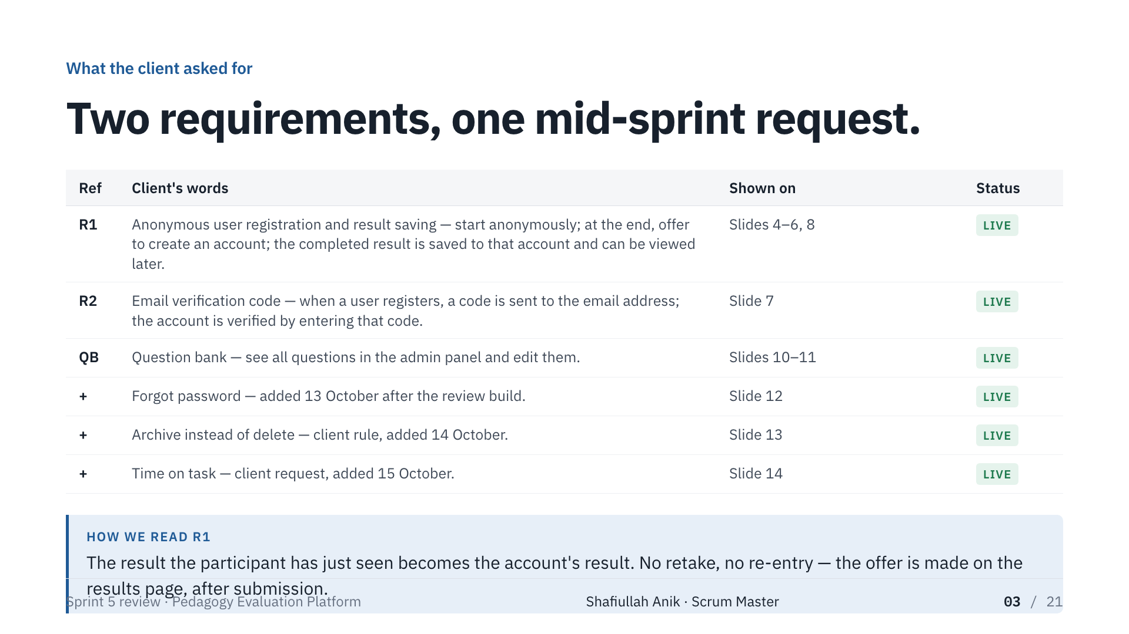
Notes:
Shafiullah Anik · Scrum Master
The client's words, and where you'll see each one. One reading to be explicit about: requirement one means the result the participant has just seen becomes the account's result. Nobody retakes the evaluation to keep it. Hand to Albin.

Slide 4
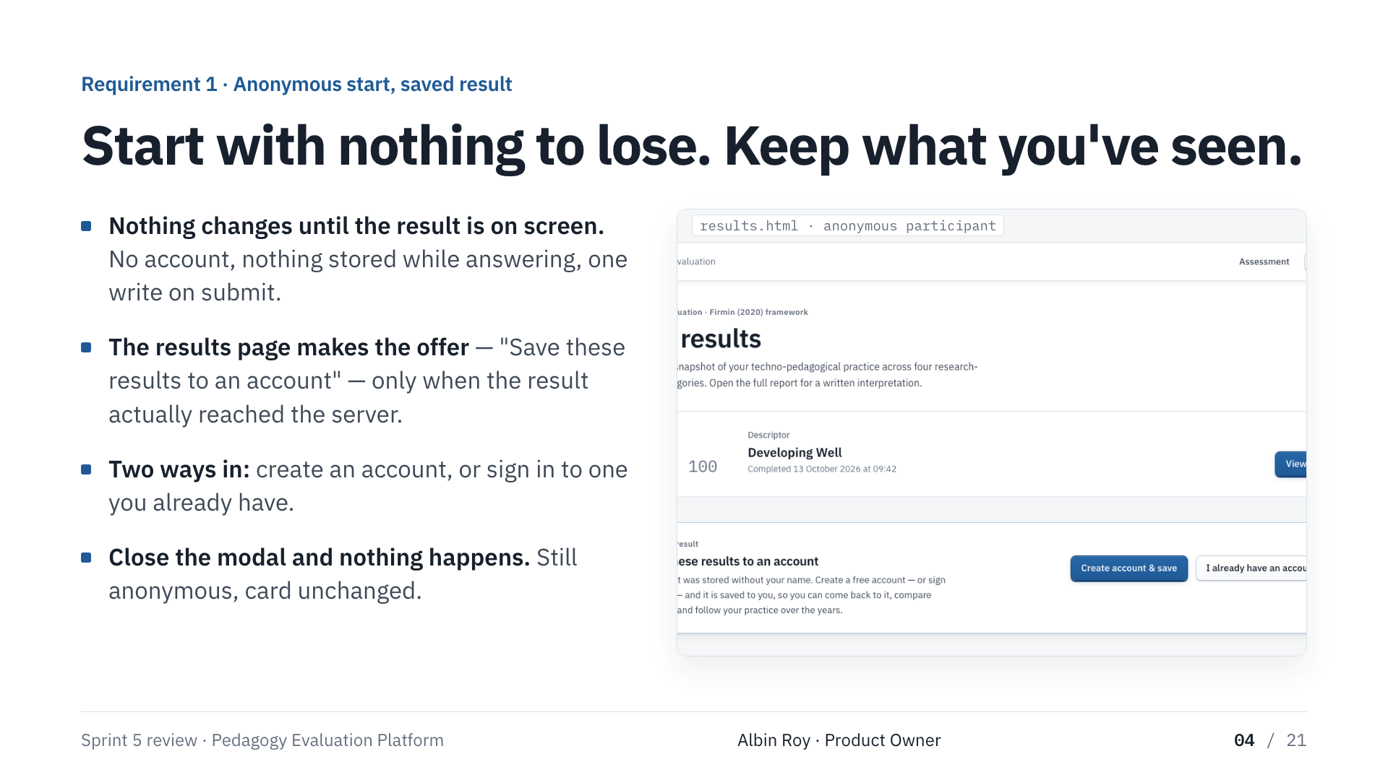
Notes:
Albin Roy · Product Owner
Nothing changes for the anonymous participant until their result is on screen. No account, nothing stored while they answer, one write when they submit. Then the results page makes the offer: save these results to an account. It only appears when the result reached the server. Two ways in: create an account, or sign in. Close the modal and nothing happens.

Slide 5
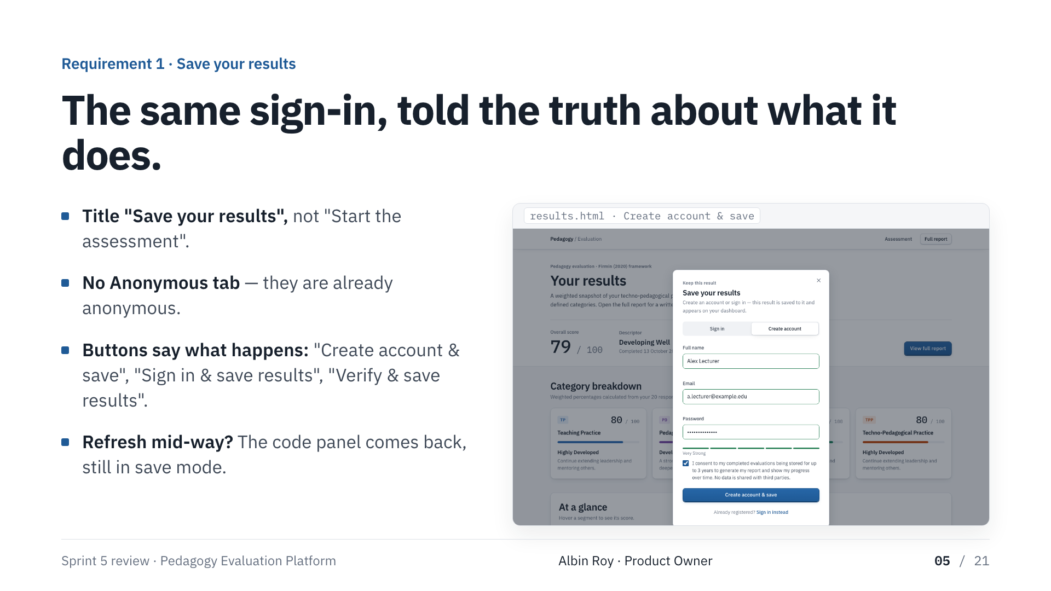
Notes:
Albin Roy · Product Owner
The same sign-in modal, but it tells the truth about what it's doing. Title 'Save your results'. No Anonymous tab. Every button says what happens. Refresh half-way through the code and the code panel comes back, still in save mode.

Slide 6
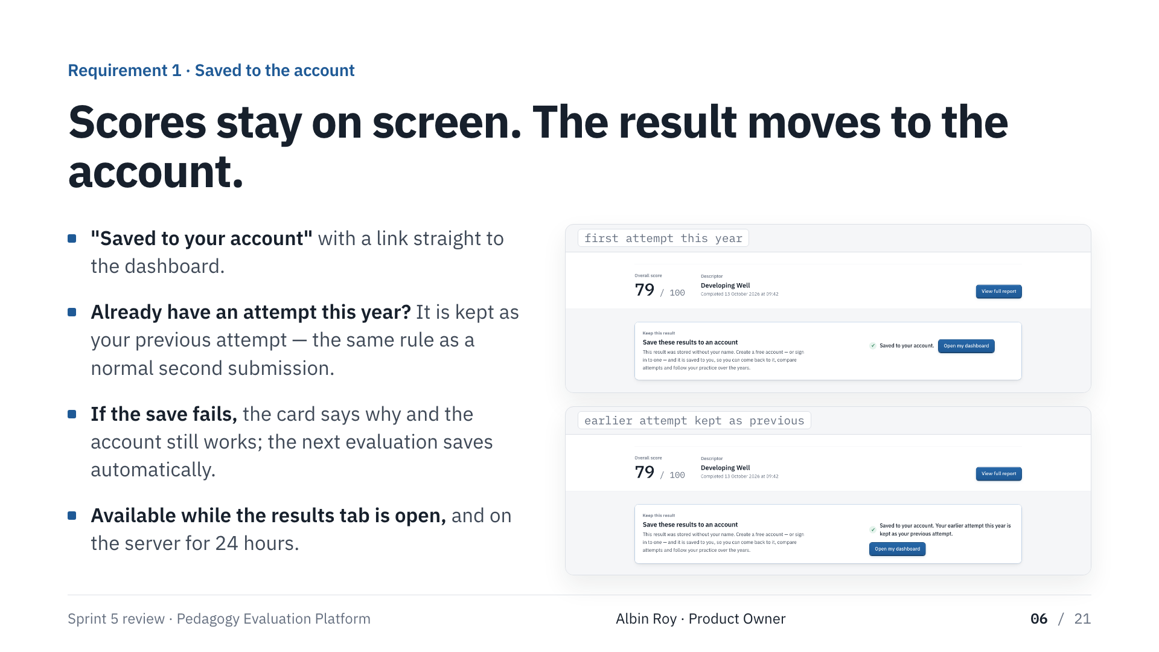
Notes:
Albin Roy · Product Owner
After the code, or after signing in: 'Saved to your account', and a link to the dashboard. The scores never moved. If they already had an attempt this year it is kept as the previous attempt — the two-attempts rule from Sprint 4 applies unchanged. If the save fails, the card says why and the account still works.

Slide 7
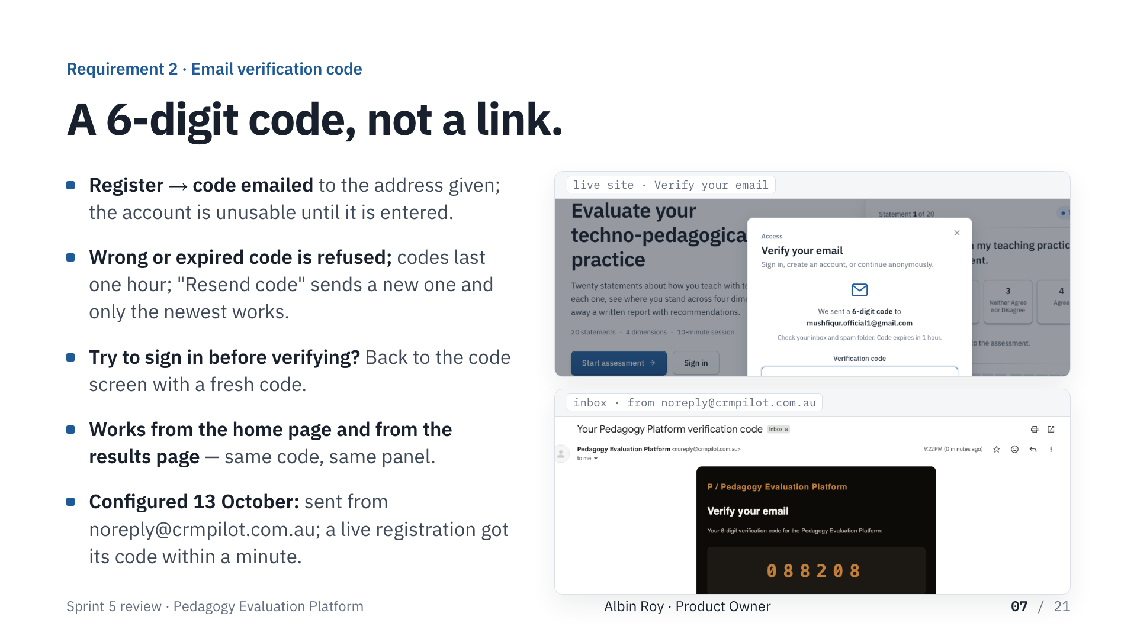
Notes:
Albin Roy · Product Owner
Register, and a six-digit code goes to the address given. Wrong or expired code refused; codes last an hour; resend sends a new one and only the newest works. Sign in before verifying and you're back on the code screen with a fresh code. Works from the home page and the results page. The sender was configured on 13 October — codes come from noreply@crmpilot.com.au on a verified domain, and a live registration received its code within a minute. Hand to Mushfiqur.

Slide 8
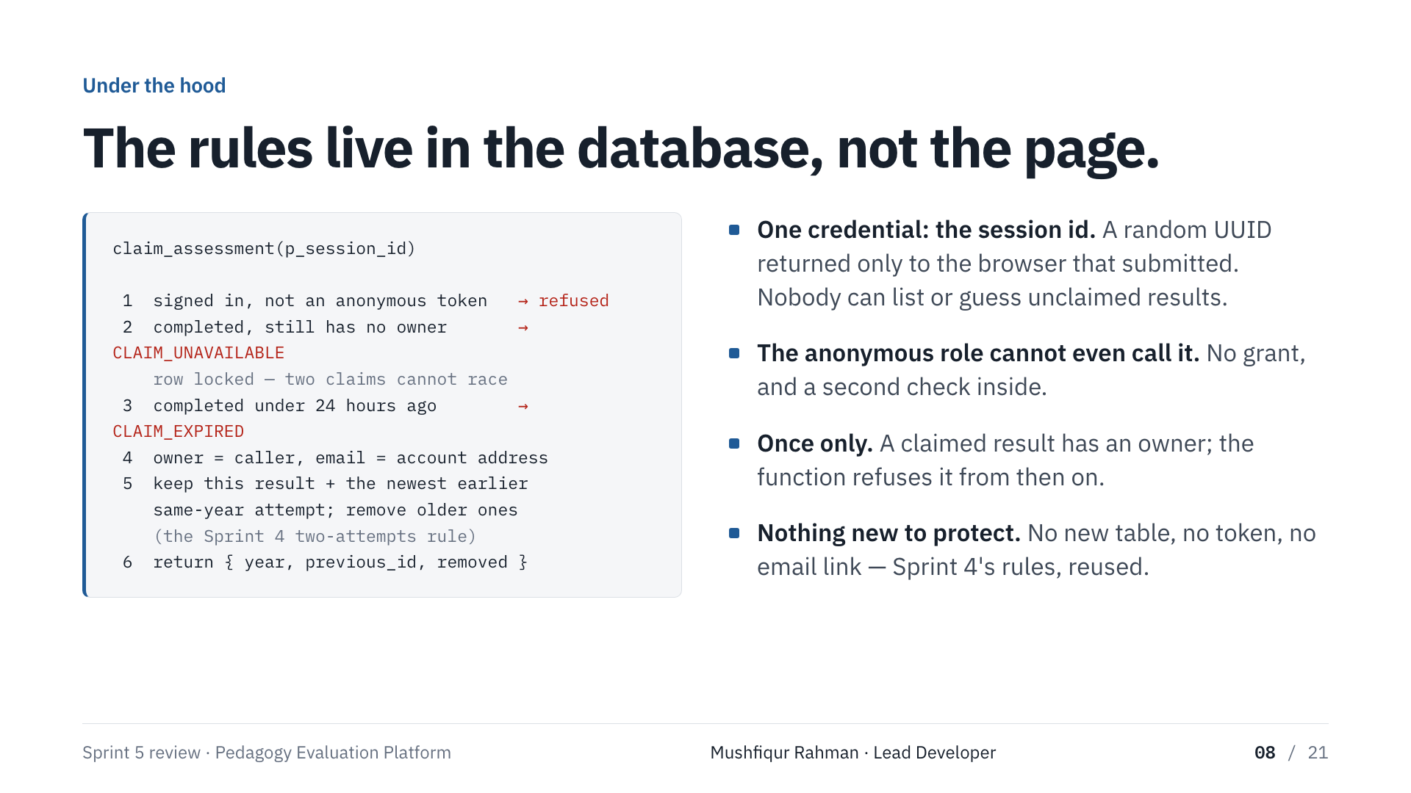
Notes:
Mushfiqur Rahman · Lead Developer
The rules are enforced by the database, not the page. One function: caller signed in and not anonymous; result complete and unowned, row locked; completed under 24 hours ago; set the owner; apply the two-attempts rule. The only credential is the result's random session id, returned only to the browser that submitted. Nobody can list unclaimed results, and the anonymous role can't call the function. No new table, no token, no email link.

Slide 9
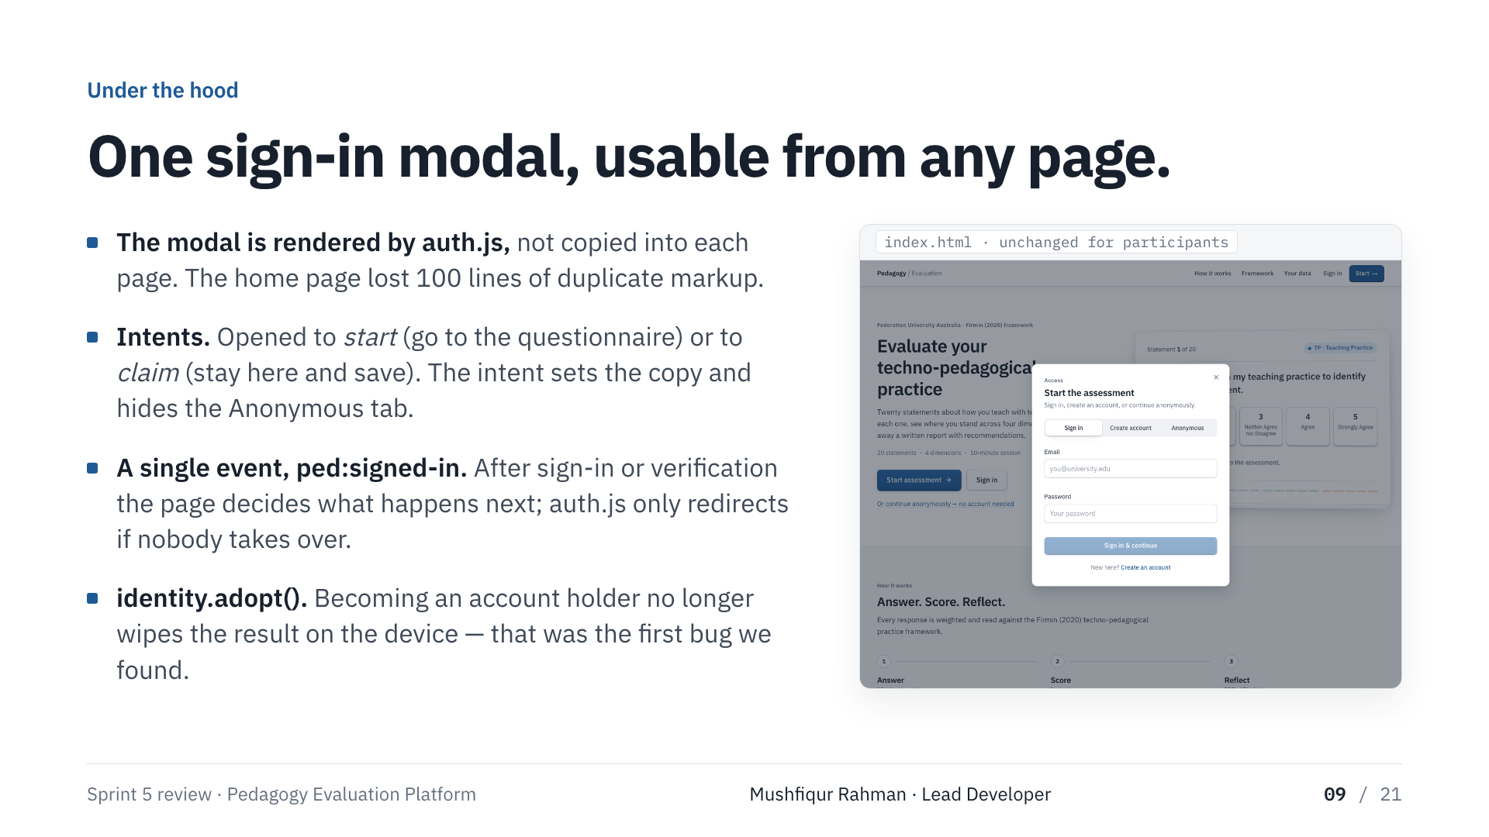
Notes:
Mushfiqur Rahman · Lead Developer
The modal is rendered by one script, so any page can open it. It's opened with an intent — start, or save this result — which sets the copy and hides the Anonymous tab. After sign-in one event tells the page what happened and the page decides what's next. And identity.adopt(): becoming an account holder used to wipe the result off the device — right for a shared computer, wrong for the same person keeping their result. First bug we found.

Slide 10
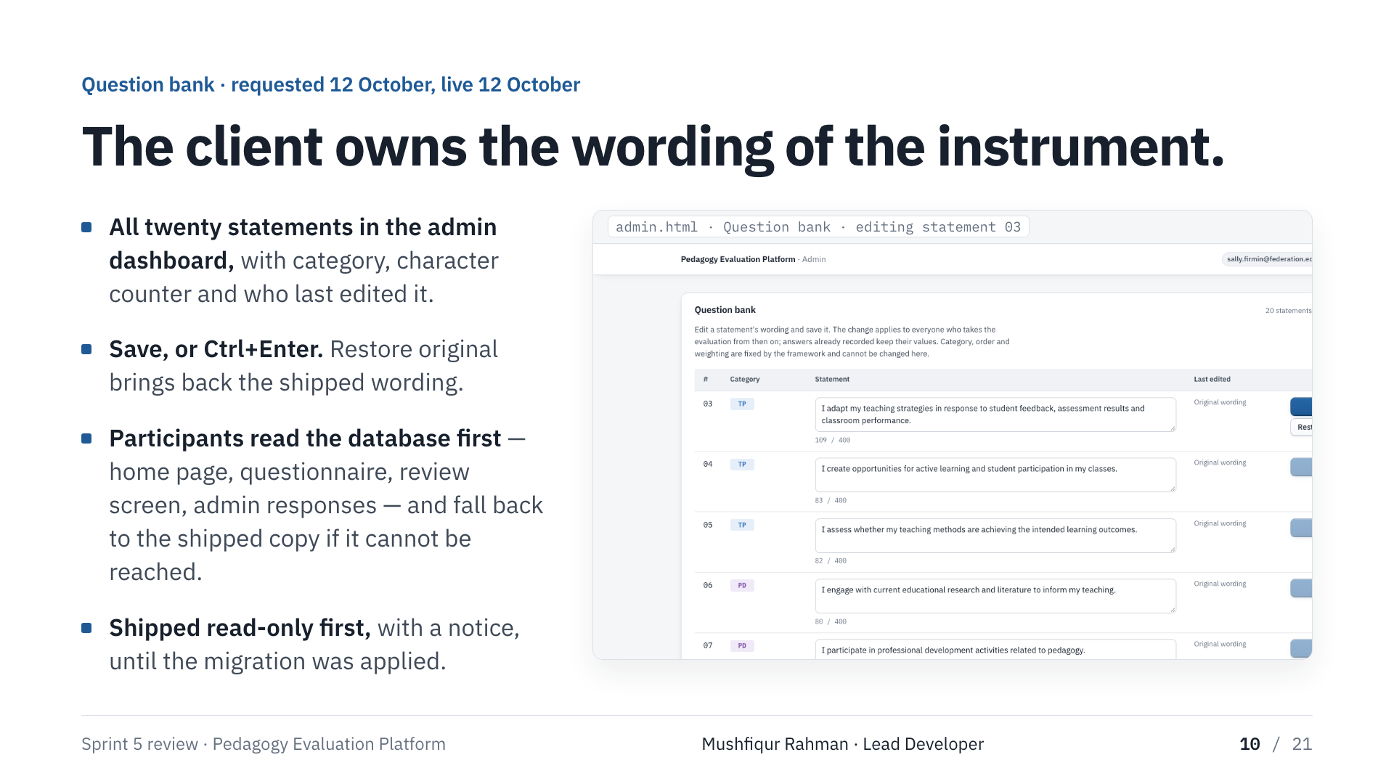
Notes:
Mushfiqur Rahman · Lead Developer
Requested 12 October, live 12 October, because the admin dashboard and the migration pattern were already there. All twenty statements, category, counter, who last edited. Save or Ctrl+Enter; Restore original. Participants read the database wording first and fall back to the shipped copy, so the evaluation never waits on it.

Slide 11
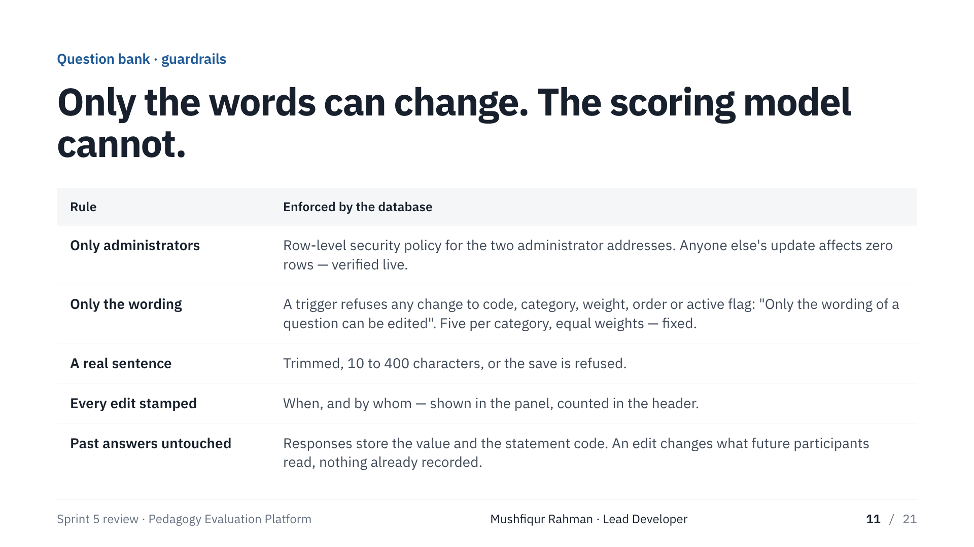
Notes:
Mushfiqur Rahman · Lead Developer
Only administrators, by row-level security — anyone else's update affects zero rows, checked live. Only the wording: a trigger refuses changes to category, order, weight or active flag. Wording must be a real sentence. Every edit stamped. Answers already recorded are untouched. Whether a reworded statement means the same is a research judgement — the platform records who changed what and when.

Slide 12
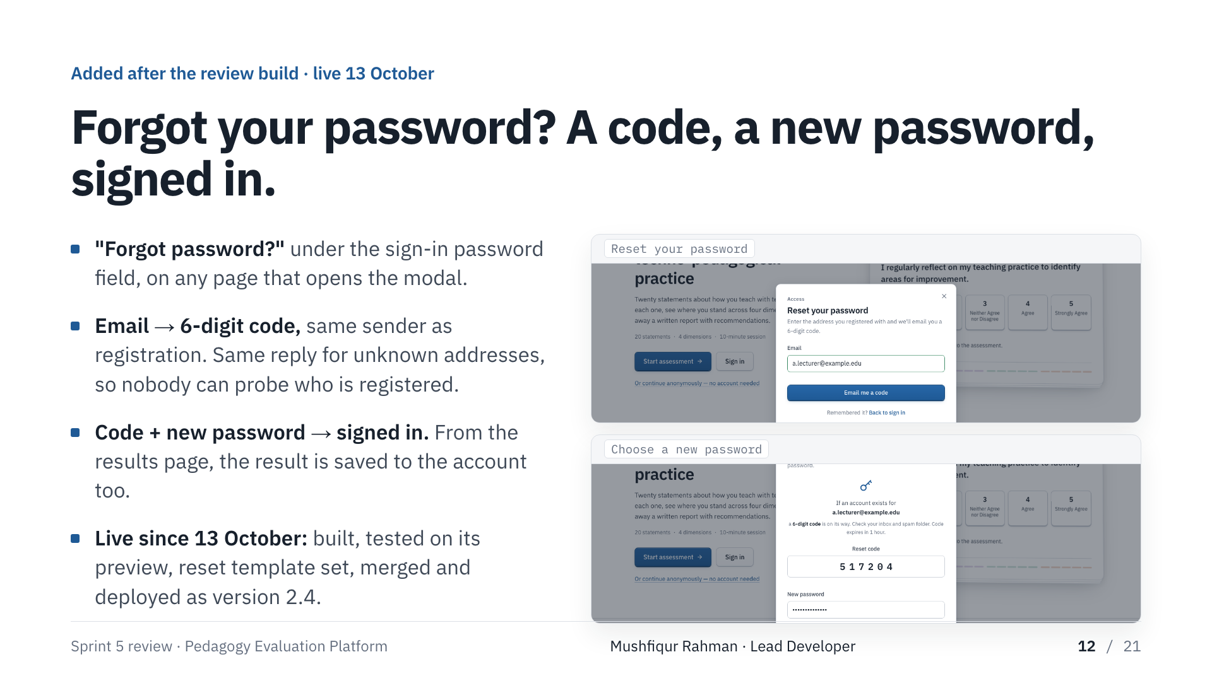
Notes:
Mushfiqur Rahman · Lead Developer
One more thing, added after the review build. The sign-in panel had no way to recover an account. Now: Forgot password, enter your address, a six-digit code arrives from the same sender as registration — and the reply is the same for an unknown address, so nobody can probe who is registered. Enter the code and a new password and you're signed in; from the results page the result is saved to the account as well. Built, tested on its preview, the reset template set in the dashboard, merged and live as version 2.4 — all on the thirteenth.

Slide 13
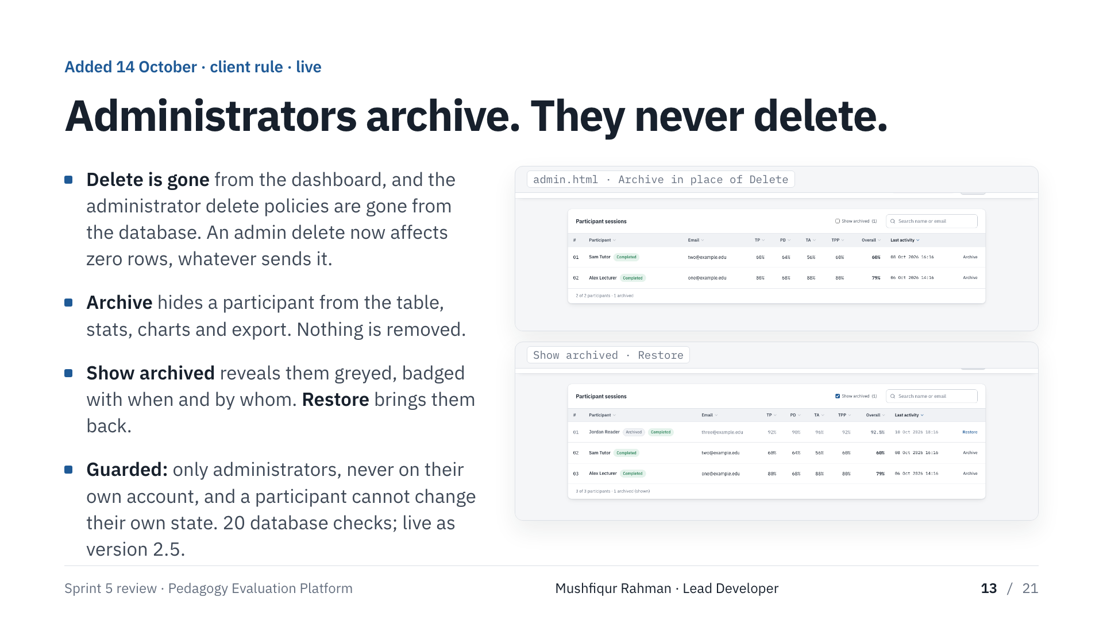
Notes:
Mushfiqur Rahman · Lead Developer
A rule from the client, added on the fourteenth: administrators archive, they never delete. Delete is gone from the dashboard and the administrator delete policies are gone from the database, so an admin delete affects zero rows whatever sends it. Archive hides a participant from the table, stats, charts and export; nothing is removed. Show archived reveals them with when and by whom, and Restore brings them back. Only administrators, never on their own account, and a participant can't change their own state. Twenty database checks. The migration is applied, it's merged and live as version 2.5, all on the fourteenth.

Slide 14
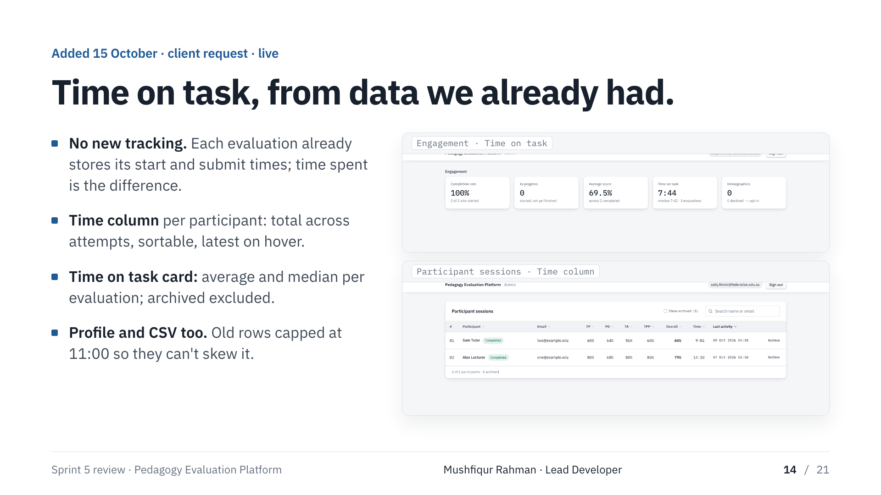
Notes:
Mushfiqur Rahman · Lead Developer
A request from Dr Firmin the evening before this session: show how long each participant spent. No new tracking was needed — every stored evaluation already records when its ten-minute session began and when it was submitted, so the time spent is the difference. A Time column per participant, totalled and sortable; a Time on task card with the average and the median per completed evaluation; the same figure in the profile and the CSV. Old rows are capped at the eleven-minute limit so they can't skew it. Live as version 2.6.

Slide 15
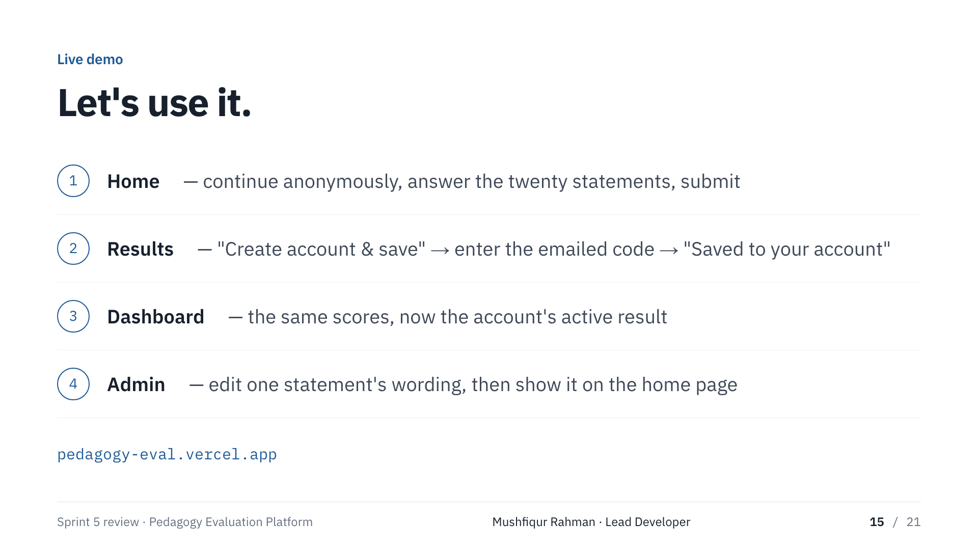
Notes:
Mushfiqur Rahman · Lead Developer — live demo
One: home, continue anonymously, answer, review, submit — nothing stored until now. Two: results, Create account & save, enter the emailed code, Saved to your account. Three: dashboard — same scores, now the active result. Four: admin, edit statement 3, save, show it on the home page. If anything fails: we use the slides, same build. Hand to Merajun.

Slide 16
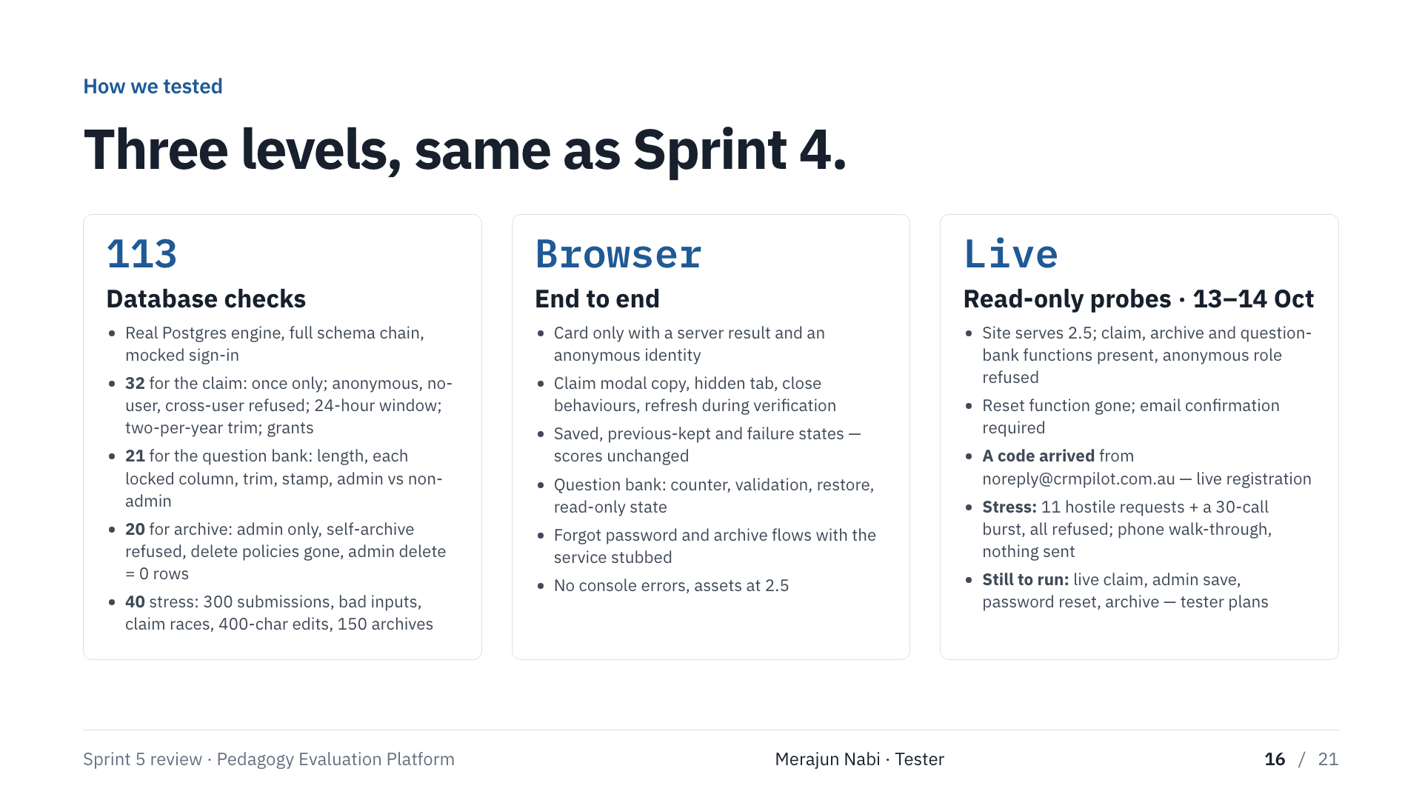
Notes:
Merajun Nabi · Tester
Three levels. One hundred and thirteen database checks in a real Postgres engine — 32 for the claim, 21 for the question bank, 20 for archive, and 40 stress checks with bulk data, bad inputs and races — including refusals a browser never exercises. On the live service we fired eleven hostile requests and a burst of thirty; all refused, nothing written. And we walked the whole journey on a phone-sized screen. In the browser, every state of the card and modal. On the live system, read-only: version 2.5, the claim function refuses the anonymous role, audit columns present, anonymous edit changes zero rows. And a live registration received its code from the project sender on 13 October. Still to run: a live claim and a real administrator save — three of twelve criteria.

Slide 17
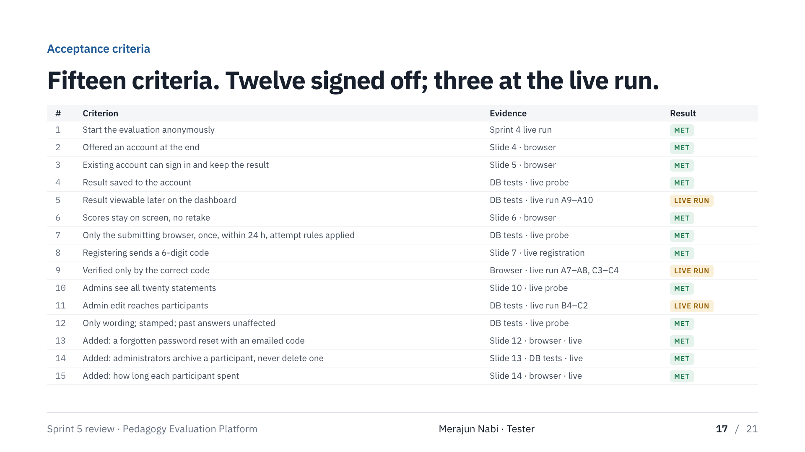
Notes:
Merajun Nabi · Tester
Our sign-off. Fifteen criteria, twelve from the client's wording plus the three additions. Twelve met with evidence shown, a database test or the live registration. The three marked live run are the claim and the real administrator save — scripts written step by step, mine to close. Pause two seconds; don't read the rows.

Slide 18
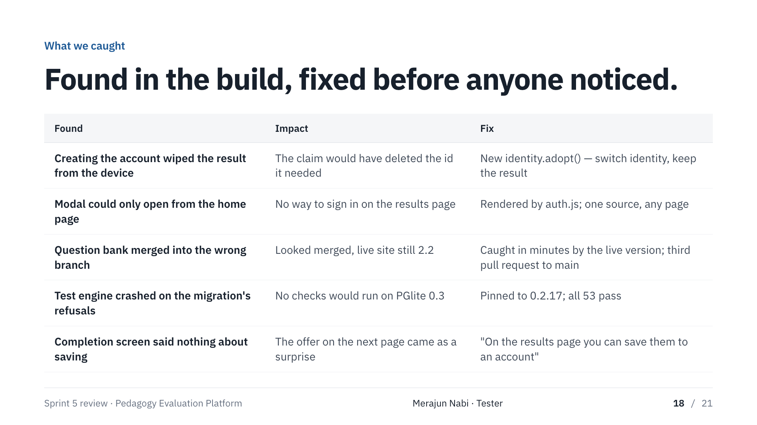
Notes:
Merajun Nabi · Tester
Five things found in the build, fixed before release. Creating the account would have wiped the result off the device — the claim would have deleted the id it needed. And a process catch: the question bank merged seven seconds too early onto an already-merged branch, so the live site stayed on the old version; the live-version check caught it within minutes. Hand to Shafiullah.

Slide 19
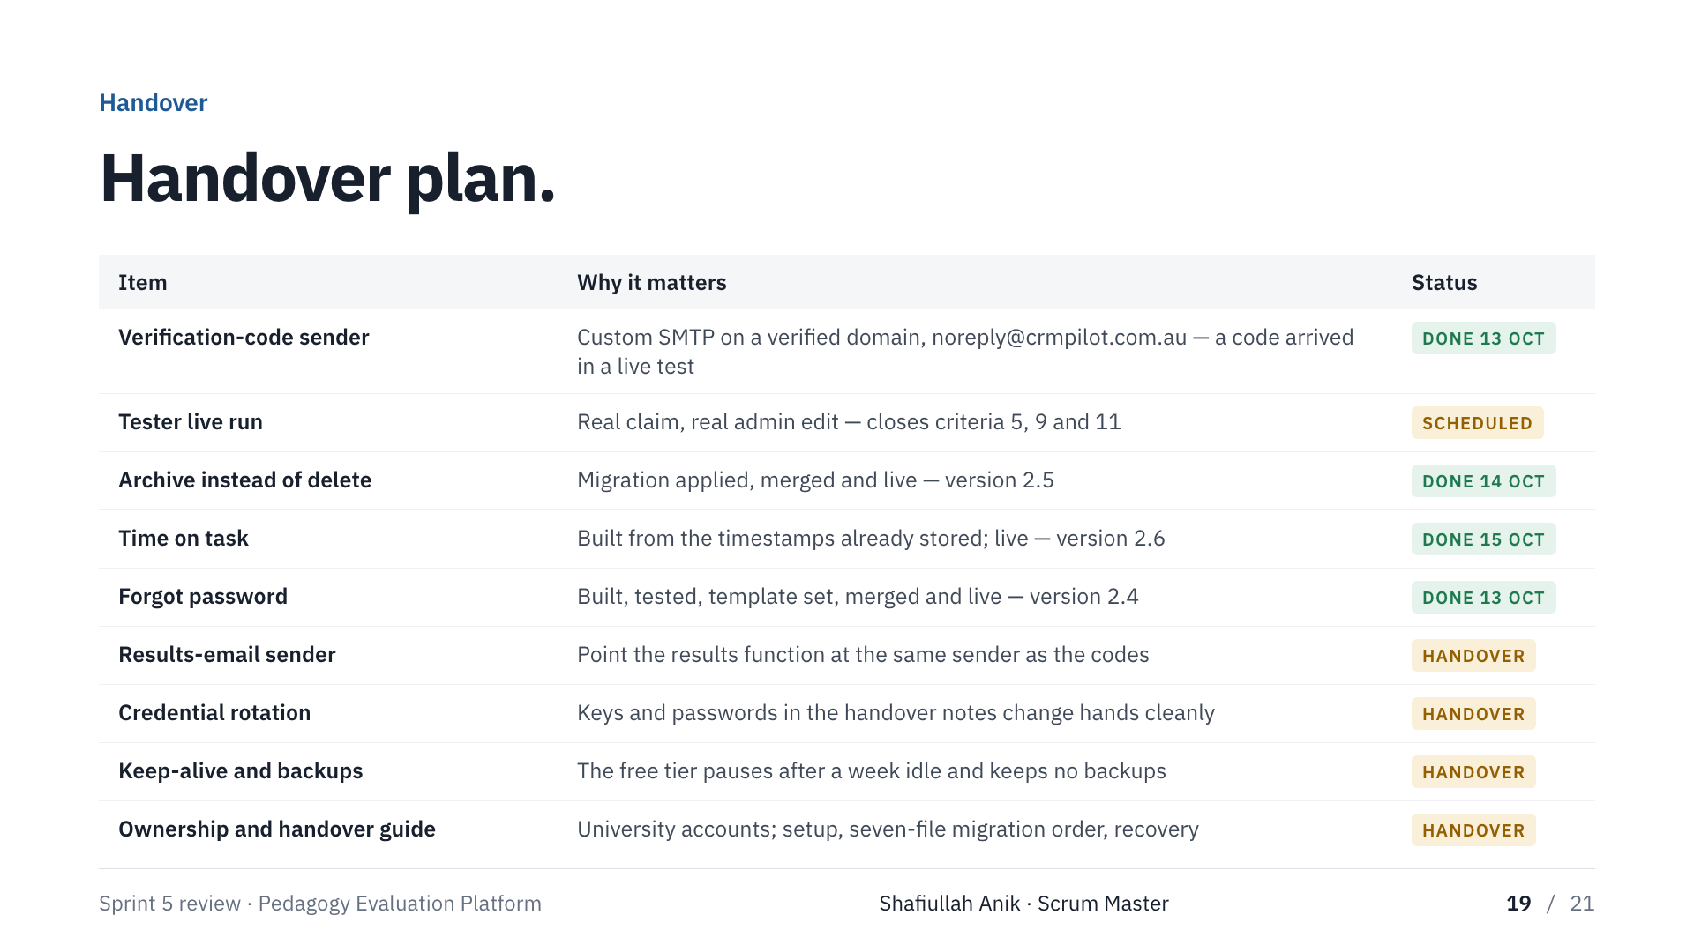
Notes:
Shafiullah Anik · Scrum Master
The product is done. The operations are not. The verification-code sender is done — codes arrive from noreply@crmpilot.com.au. Merajun's live run is pending. Forgot password is live. The results function still needs the same sender. Credentials in the handover notes must be rotated. The free database pauses after a week idle and keeps no backups. Ownership and the written guide are still to come.

Slide 20
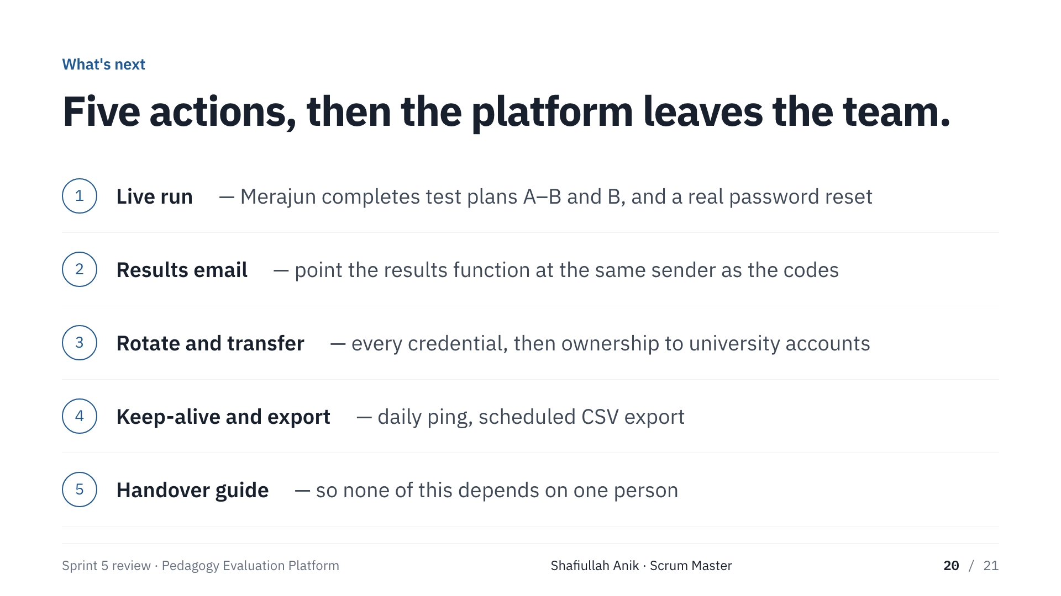
Notes:
Shafiullah Anik · Scrum Master
Five actions in order: the live run; the results-email sender; rotate every credential and transfer ownership; daily keep-alive and a scheduled export; the handover guide. That's Sprint 5 — happy to take questions.

Slide 21
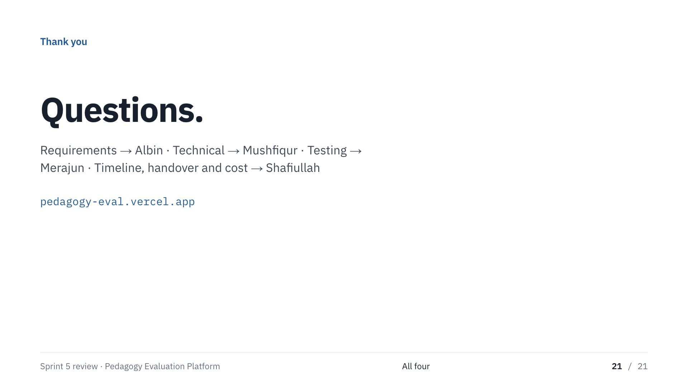
Notes:
All four
Route questions by topic: requirements to Albin, technical to Mushfiqur, testing to Merajun, timeline, handover and cost to Shafiullah.

