Slide 1

E/L A02 CAREER INTELLIGENCE
ITECH3209 PROJECT 2
SPRINT 3 - PRESENTATION
Name: - Hetkumar Umeshbhai Patel
Student ID: - 30391427

Slide 2
Hetkumar Patel
I have tested the files such as profile page, about page, index page.
Collaborate with team members and stakeholder
As discussed with the client, Some sort of interface of the page has been changed.
Validate input before submitting to back end
After getting feedback, few major errors have solved as suggested by the client.
Enhance application for maximum speed and scalability
Errors that were identified during last week have solved

Slide 3
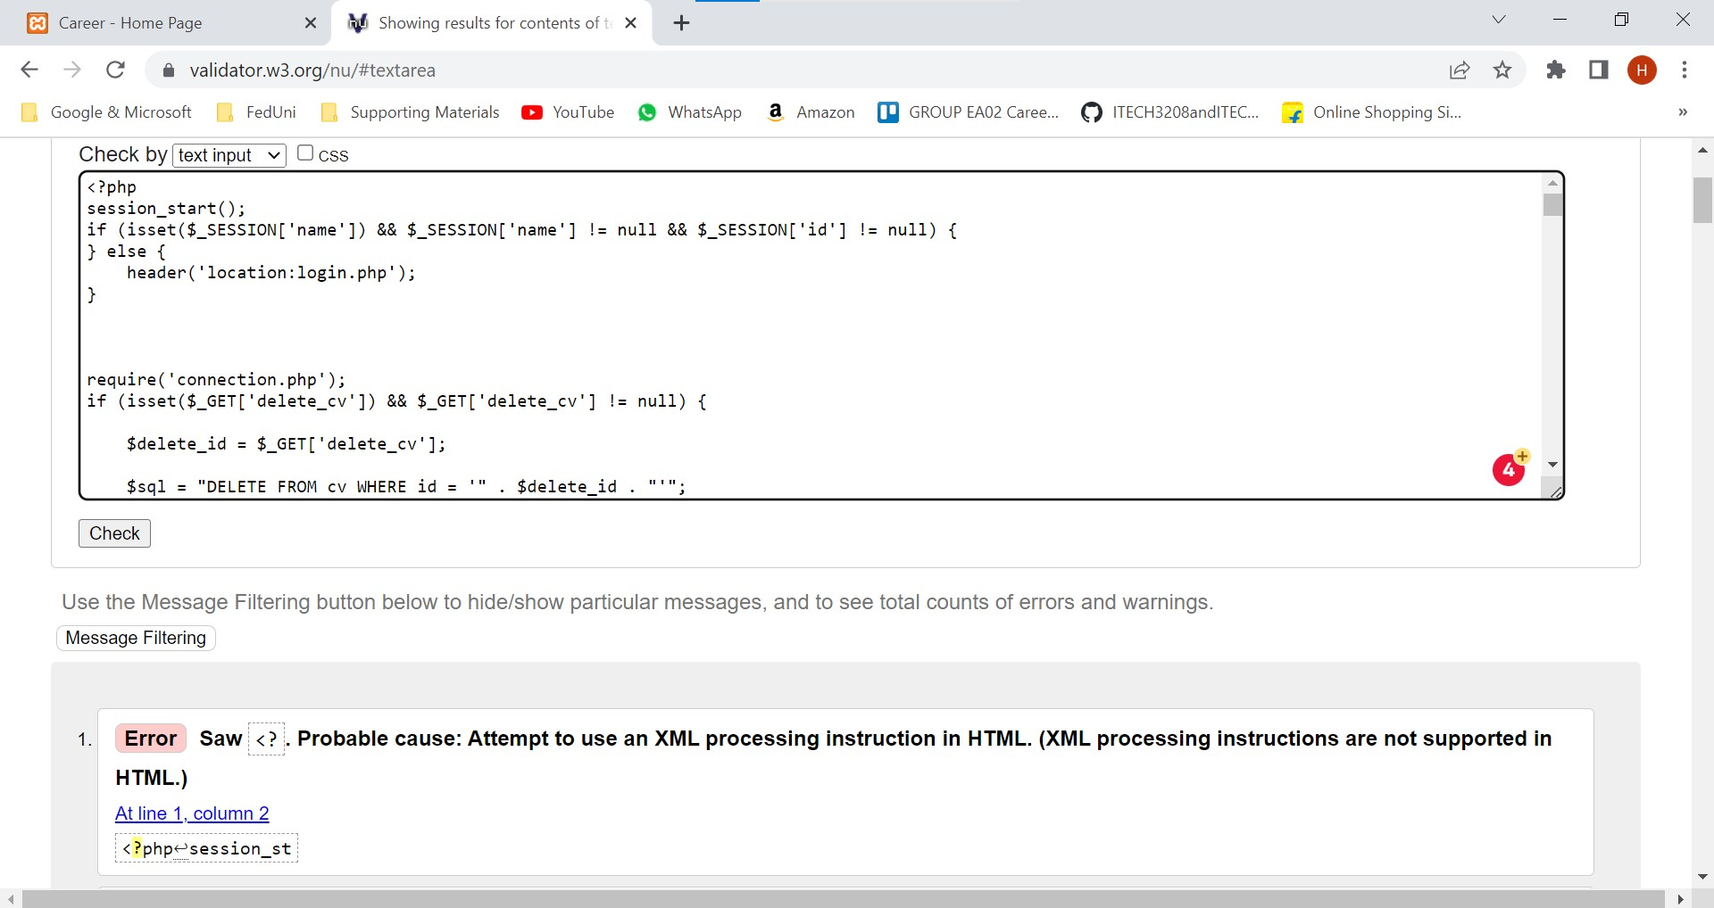
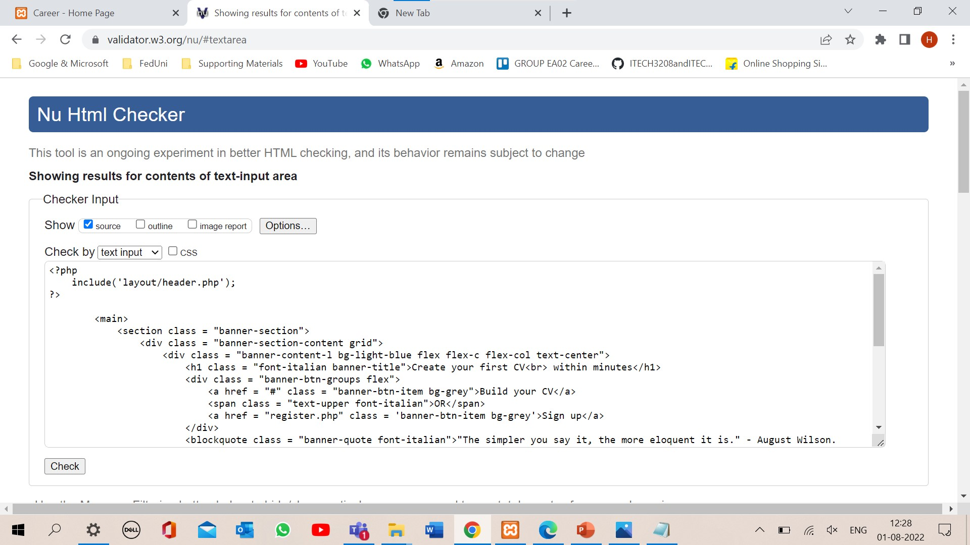
Testing

Slide 4
Testing

Slide 5
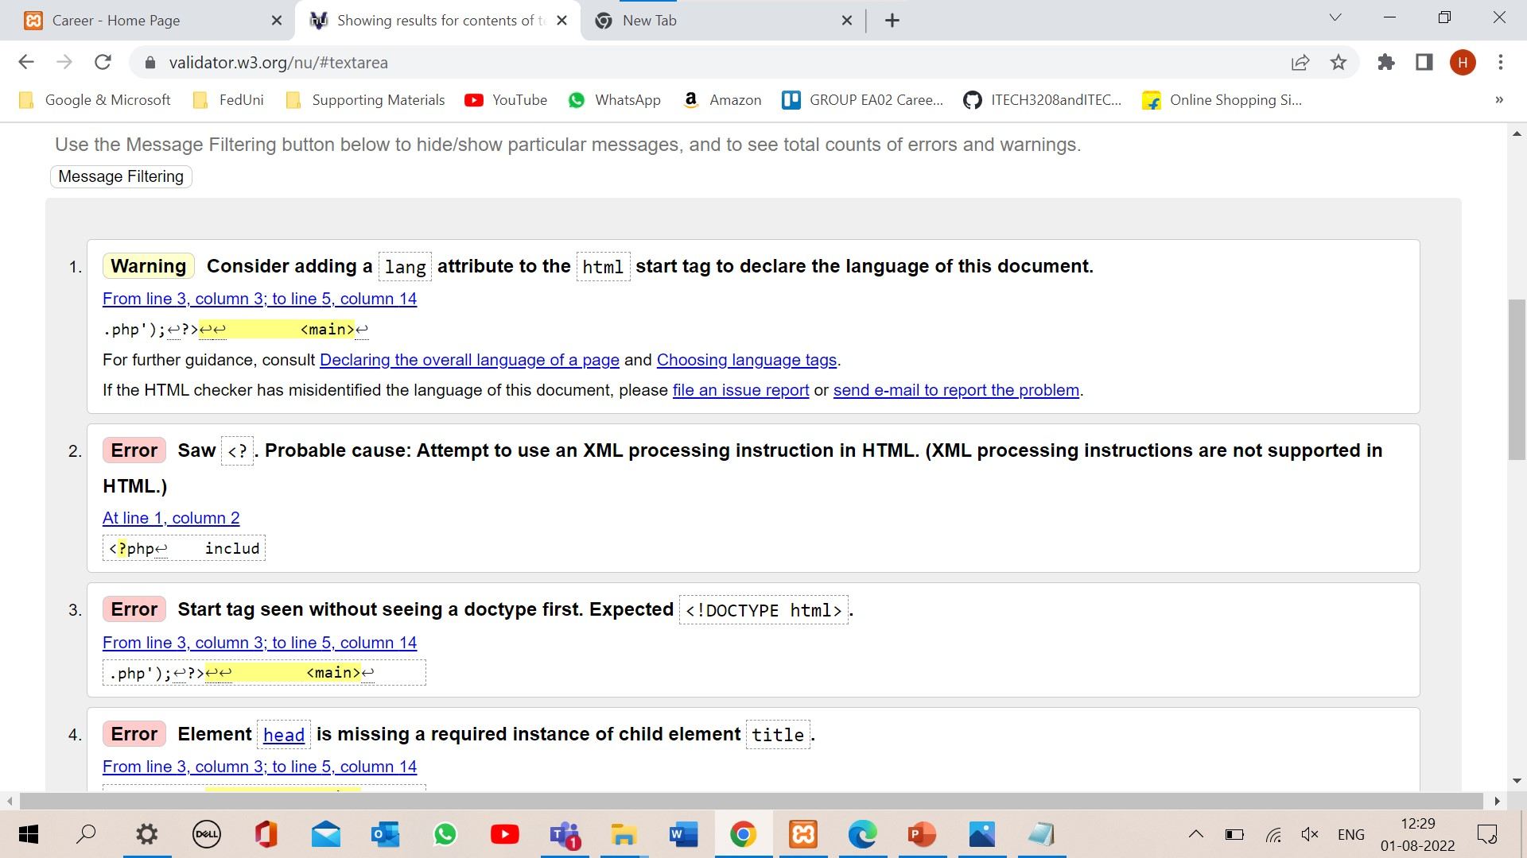
Testing

Slide 6
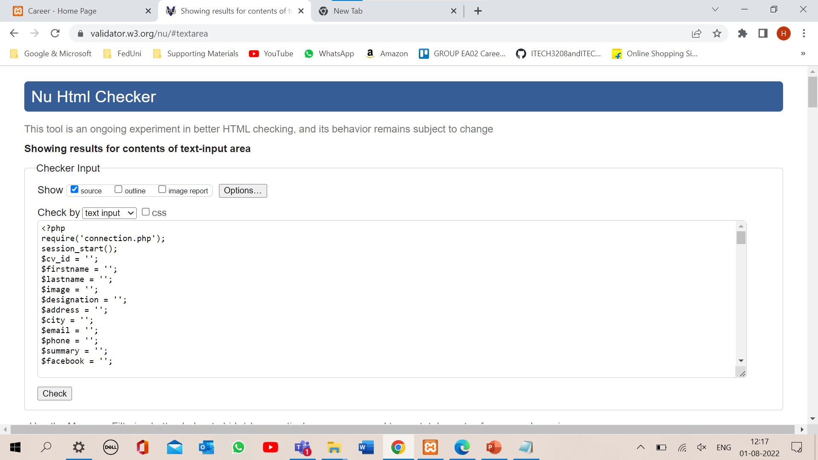
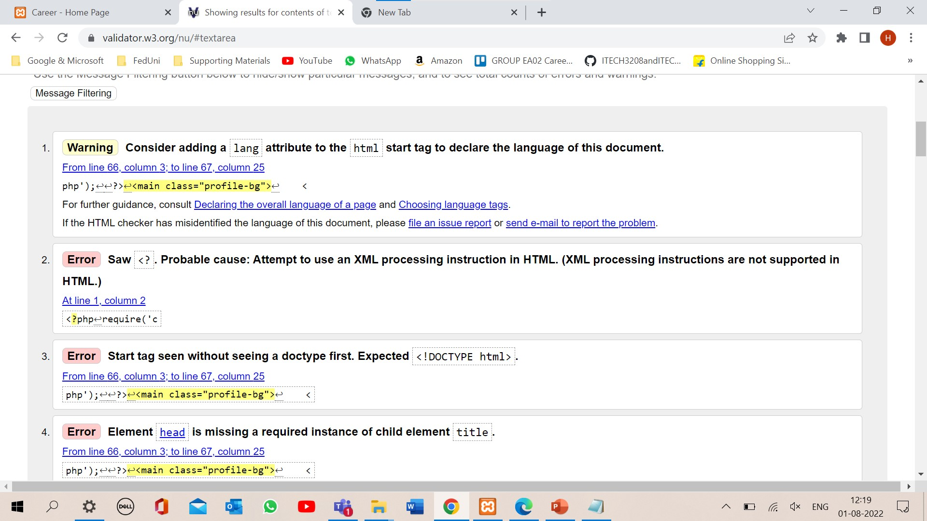
Testing

Slide 7
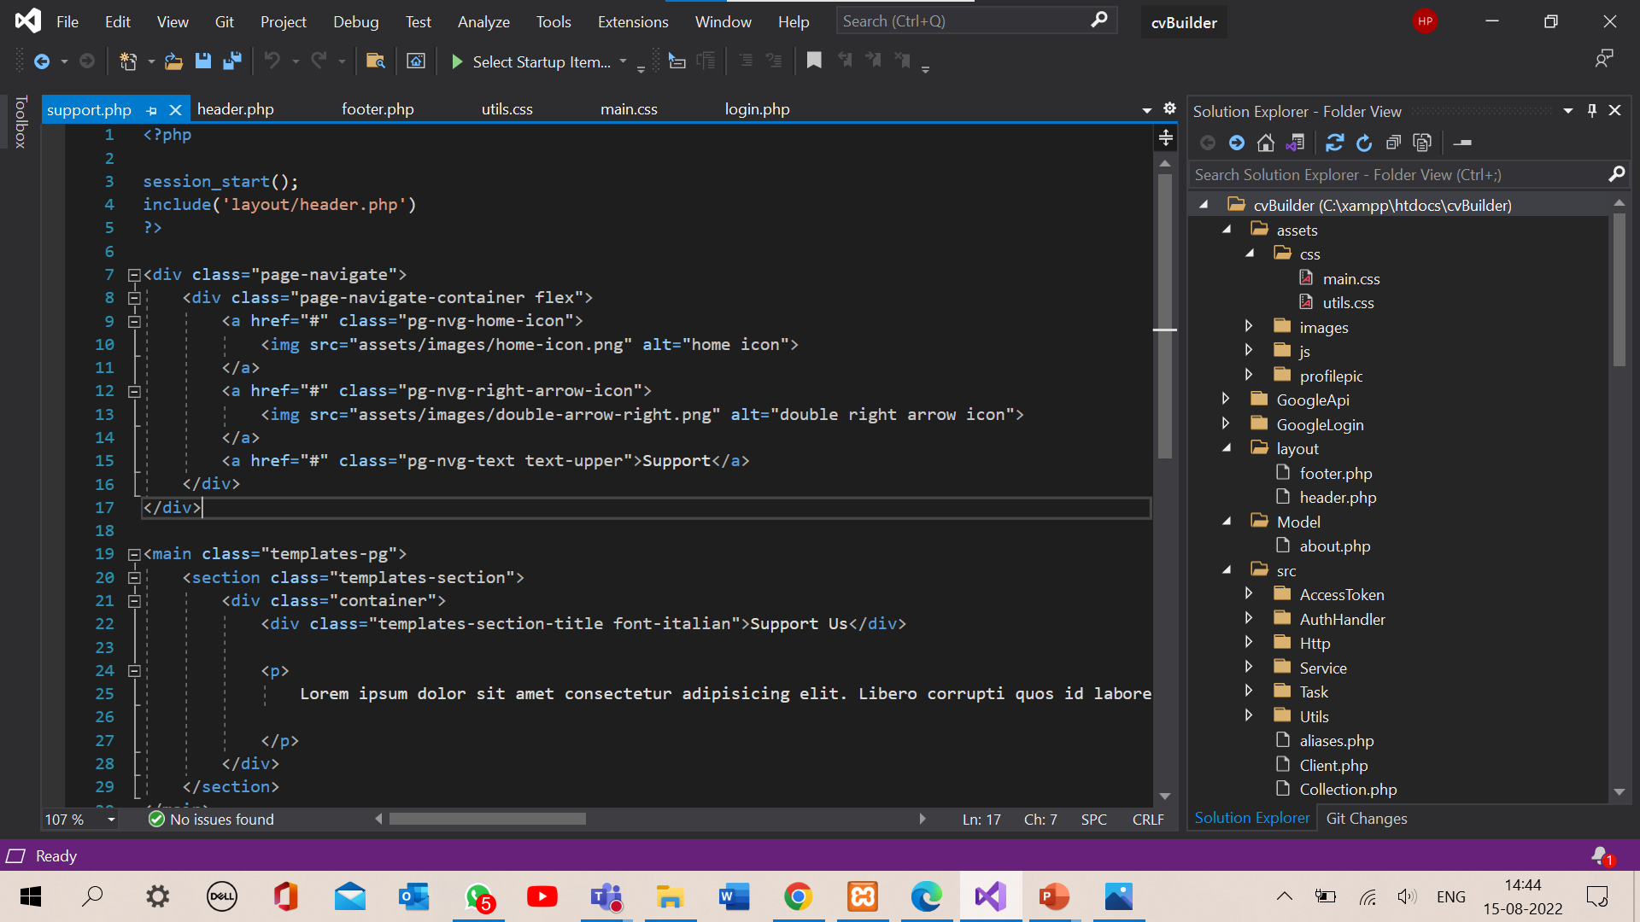
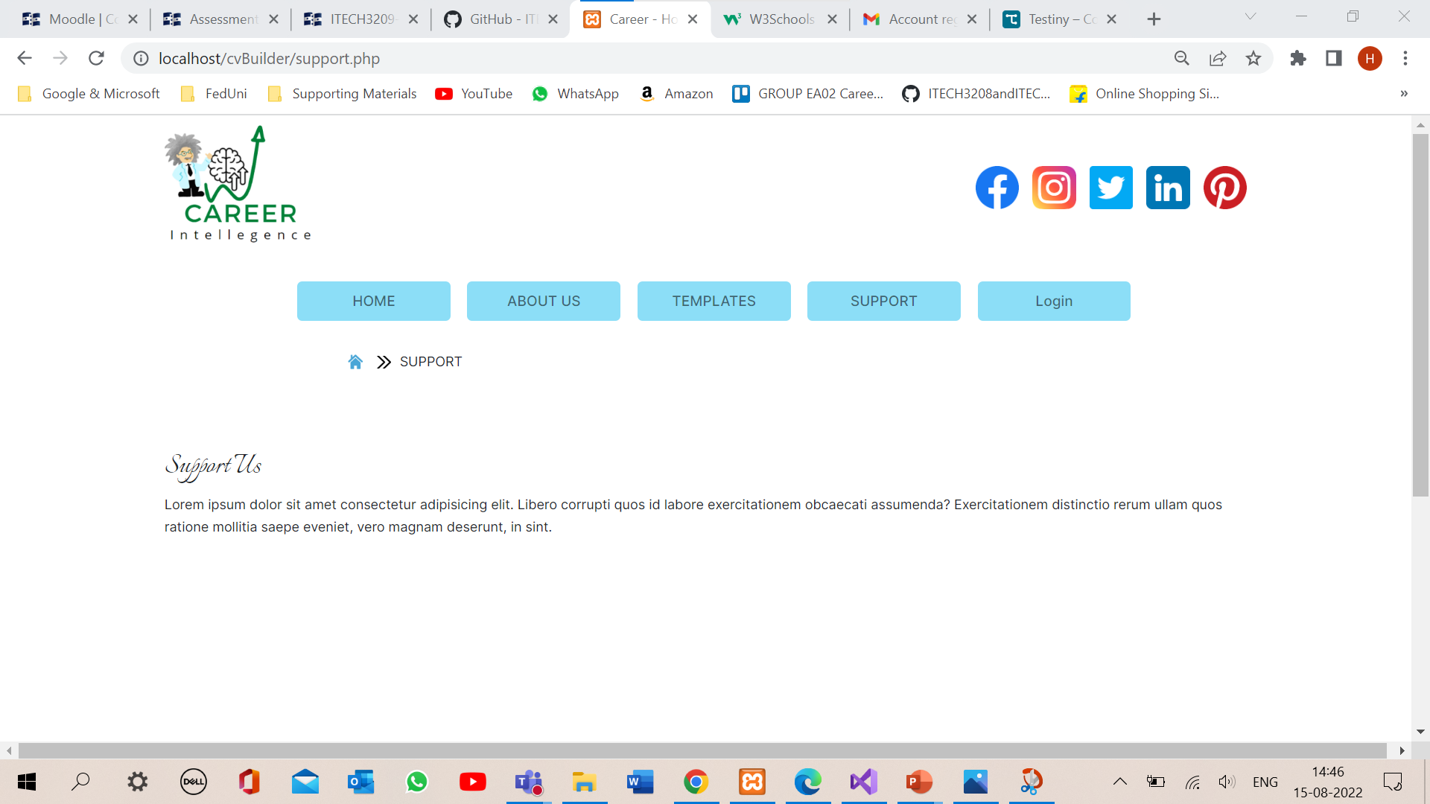
Support Us Page

Slide 8

Thank You

