Slide 1


Project – X02 Employability Assessment Toolkit
Muhammad Daniyal (30385522)
Sukhtindervir Kaur (30383565)
Suraj Mahat (30391411)
Roshan Shrestha (30385741)
Pratik Lamichhane (30386632)

Slide 2
SURAJ MAHAT
INTRODUCTION

Slide 3
TABLE OF CONTENTS
INTRODUCTION
PROJECT BACKGROUND
DEMONSTRATION & METHODOLOGY
FEEDBACK
CHANGES MADE TO PROJECT
CONCLUSION
DISCUSSION OF FUTURE WORK
CRITICAL REFLECTION

Slide 4
INTRODUCTION – Team Members
PRODUCT OWNER
(Database Administrator & Web developer)
SCRUM MASTER
(Software Developer & Tester)
TEAM MEMBERS (Application Developers)
Suraj Mahat
Roshan Shrestha
Pratik Lamichhane
Sukhtindervir Kaur
Muhammad Daniyal

Slide 5
INTRODUCTION - Clients
PROJECT DIRECTOR – Supriyo Chaudhuri (Chief Learning Officer), based in the UK
Anirudh Phadke (Head of Digital Content), currently based in Delhi
Marketa Mojzisova (E/L Programme Manager), currently based in Melbourne

Slide 6
INTRODUCTION – Project Overview
Development of employability assessment portal:
Career assessment tool
CV assessment tool
Career development planning tool
Students
Job seekers
Stakeholders
These tools will help:
Tools:
Database
Registration & Login
Contact form & Feedback

Slide 7
INTRODUCTION - Tools
Communication
MS Teams
Google Meet
WhatsApp
Messenger
Documentation
MS Word
Google Docs
Project Management
GitHub (Code management)
Trello

Slide 8
INTRODUCTION - Technologies Used
HTML5, CSS3, JavaScript, J Query
MySQL, PHP, PhpMyAdmin, Laravel
Moodle LMS, MD5

Slide 9
ROSHAN SHRESTHA
PROJECT BACKGROUND

Slide 10

BACKGROUND
Initiative by employability.life
Preparing learners for career success in industry
Partnerships with large corporations to recruit at scale
Partnerships with sector-specific (such as IT) employment agencies in individual local markets
Helps stakeholders, students, job seekers

Slide 11
BACKGROUND – Previous Sprints
Sprints | Activities | Start date | End date | Total Time (DAYS)
Sprint 1 | Sprint meeting | 4/16/2022 | 4/16/2022 | 21
 | Defining requirements | 4/17/2022 | 4/18/2022
 | Researching | 4/19/2022 | 4/22/2022
 | Wireframing | 4/23/2022 | 4/27/2022
 | Prototyping | 4/28/2022 | 5/1/2022
 | Follow up sprint meeting | 5/1/2022 | 5/1/2022
 | Documetation | 4/30/2022 | 5/5/2022
 | Testing | 5/1/2022 | 5/3/2022
 | Review meeting | 5/6/2022 | 5/6/2022
 | Retrospective meeting | 5/7/2022 | 5/7/2022
Sprint 2 | Sprint meeting | 5/11/2022 | 5/11/2022 | 20
 | Defining requirements | 5/12/2022 | 5/14/2022
 | Researching | 5/15/2022 | 5/18/2022
 | Database development | 5/20/2022 | 5/25/2022
 | Code development | 5/26/2022 | 5/27/2022
 | Review meeting | 5/27/2022 | 5/27/2022
 | Follow up sprint meeting | 5/28/2022 | 5/28/2022
 | Testing | 5/29/2022 | 5/29/2022
 | Documetation | 5/20/2022 | 6/1/2022
 | Retrospective meeting | 5/31/2022 | 5/31/2022

Slide 12
PROJECT TIMELINE - Current
Sprint 3 | Defining requirements | 2 days |  | 18
 | Researching | 2 ½ days
 | Designing forms and queries | 3 ½ days
 | Follow up sprint meeting | 1 day
 | Documentation | 4 days
 | Testing | 2 days
 | Review meeting | 1 day
 | Retrospective meeting | 1 day
 | Sprint meeting | 1 day
Sprint 4 | Defining requirements | 1 day |  | 20 ½
 | Designing interface | 4 ½ days
 | Code development | 5 ½ days
 | Follow up sprint meeting | 1 day
 | Documentation | 3 days
 | Testing and evaluating prototype | 2 ½ days
 | Review meeting | 1 day
 | Retrospective meeting | 1 day
 | Sprint meeting | 1 day
Sprint 5 | Defining requirements | 2 days |  | 21
 | Researching | 2 ½ days
 | Final documentation | 3 ½ days
 | Code development | 4 days
 | Follow up sprint meeting | 1 day
 | Incorporate user feedback | 3 days
 | Deploy system | 2 days
 | Review meeting | 1 day
 | Retrospective meeting | 1 day

Slide 13
MUHAMMAD DANIYAL
DEMONSTRATION & METHODOLOGY

Slide 14
DEMONSTRATION - Project Overview
Employability assessment website
Registration page
Login page
Home page
Portal’s page
CV assessment toolkit
Career assessment toolkit
Career development planning toolkit
Project page
About page
Contact form
Sign out page

Slide 15

DEMONSTRATION – Critical Improvements
During sprint 3, we focused on
Responsive web design
Designing intuitive interface
Functionality of email forwarding
Login with Google functionality
Fetching user Google account information
Improvements in Assessment Portals

Slide 16
DEMONSTRATION – Responsive web design
Used media queries
Compatible for mobile devices
Compatible for PCs
Compatible for Laptop devices
Compatible for Ipad devices

Slide 17
DEMONSTRATION – Designing Interface
Used Bootstrap imported style sheets
Used Font awesome imported style sheets
<link rel="stylesheet" href="https://stackpath.bootstrapcdn.com/font-awesome/4.7.0/css/font-awesome.min.css">
<link href="https://fonts.googleapis.com/css?family=Lato:300,400,700&display=swap" rel="stylesheet">
<link rel="stylesheet" href="https://preview.colorlib.com/theme/bootstrap/login-form-20/css/A.style.css.pagespeed.cf.eQk9-CoeFP.css">
<link rel="stylesheet" href="https://cdnjs.cloudflare.com/ajax/libs/font-awesome/5.13.0/css/all.min.css">

Slide 18
DEMONSTRATION – Email Forwarding
Creating form
Set method = “POST”
Adding input field with type = “email”, value = “@”, required, name = “email”
Setting up back-end and PHP scripts

Slide 19
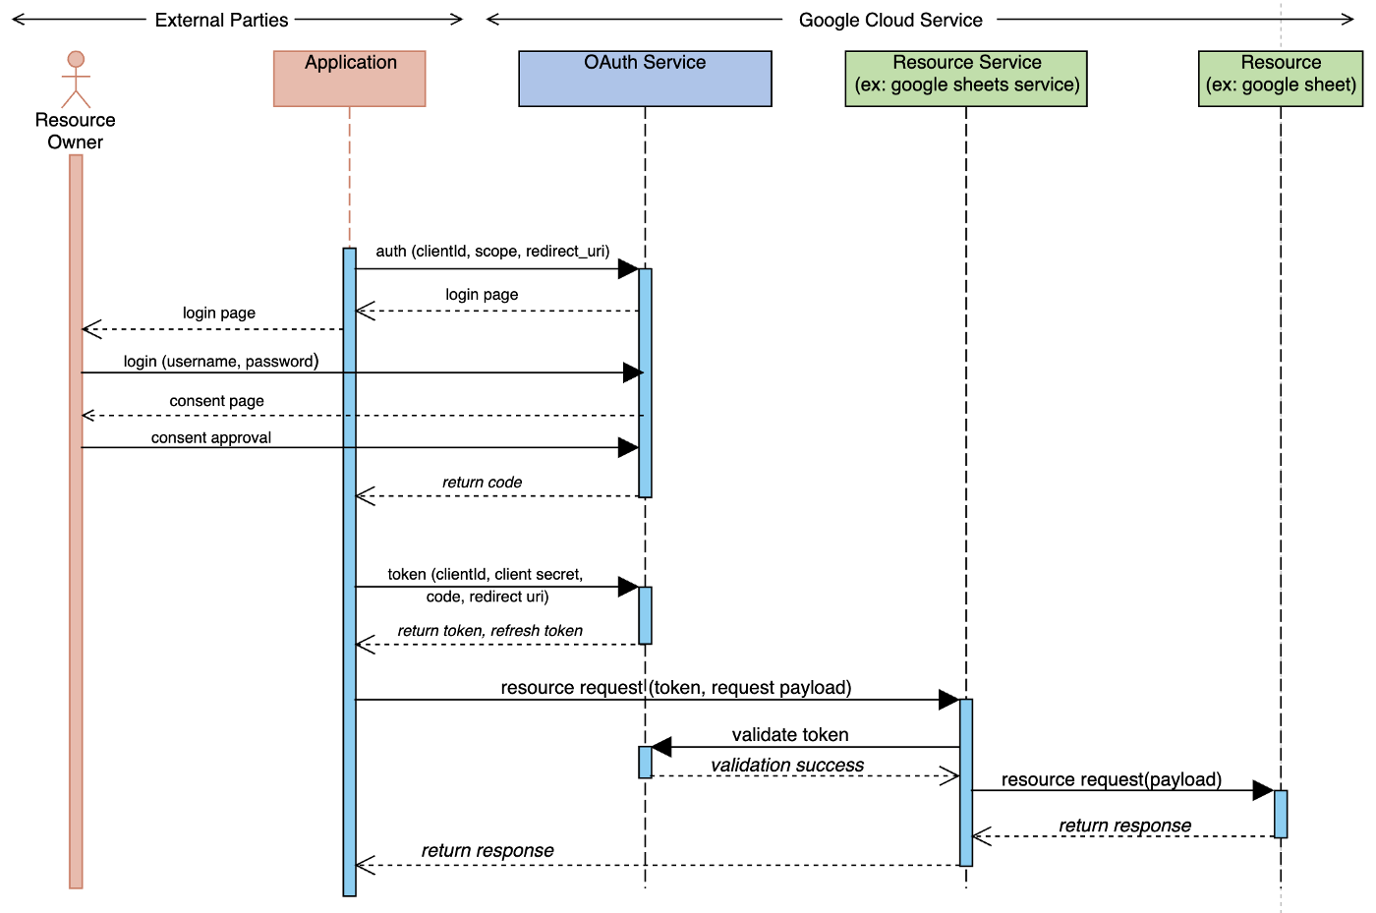
DEMONSTRATION – Login with Google functionality
Obtain
Obtain OAuth 2.0 credentials from the Google API Console
Examine
Examine scopes of access granted by the user
Obtain
Obtain an access token from the Google Authorization Server
Send
Send the access token to an API
Refresh
Refresh the access token

Slide 20
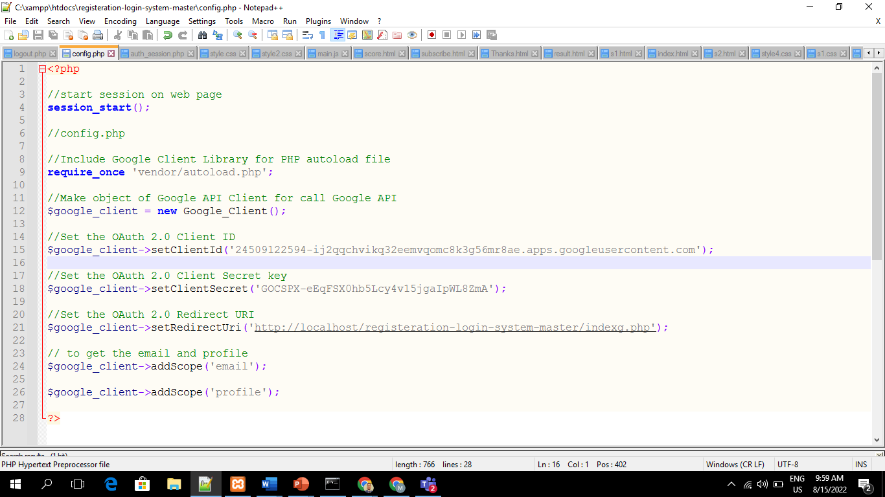
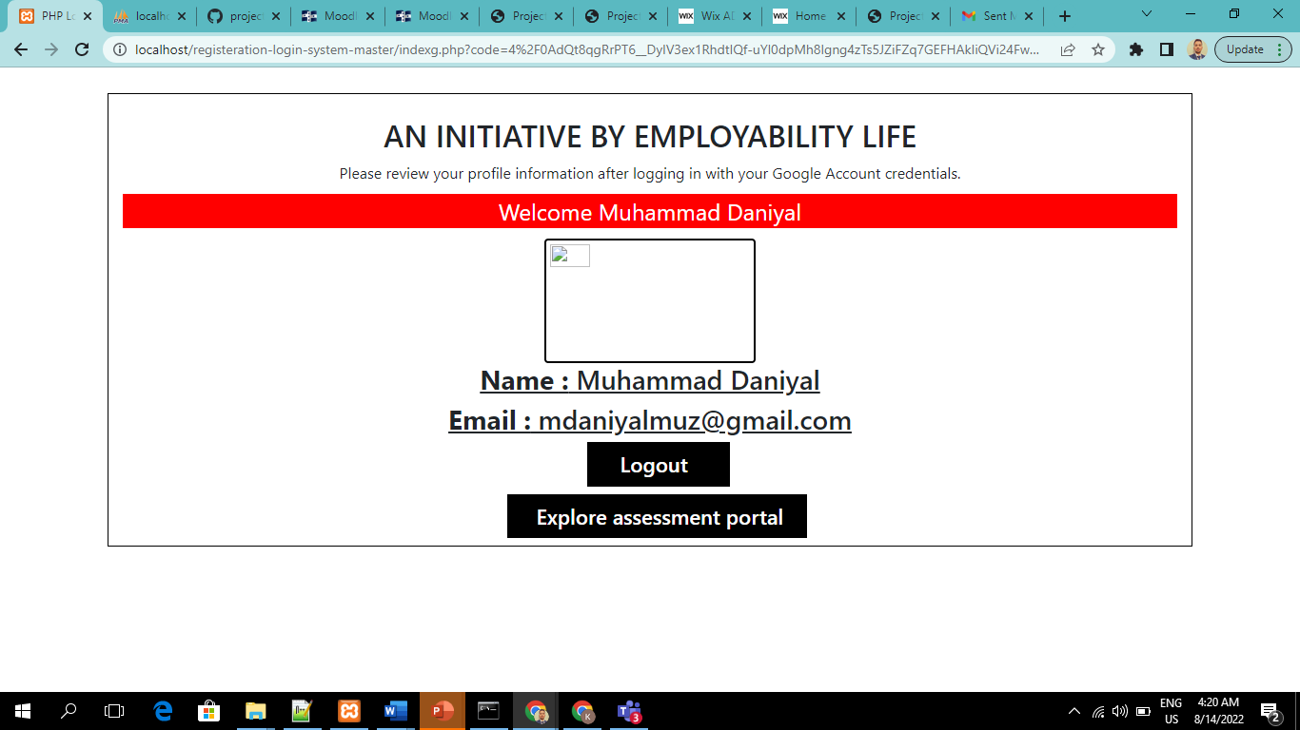
DEMONSTRATION – Fetching user Google account information
Setup config.php file
Setup auth_session.php file
Setup login.php file for “Login with Google account” button
Set Client ID & Secret Keys
Set RedirectURI
Add scope
Download composer and export the “Vendor” folder

Slide 21

Demonstration
Employability Assessment Portal
http://127.0.0.1/registeration-login-system-master/registration.php
Testing
https://app.testiny.io/p/1/dashboard
GitHub
https://github.com/ITECH3208andITECH3209feduni/project-repo-project-x02
Trello
https://trello.com/itech3208projectx02team

Slide 22
SUKHTINDERVIR KAUR
FEEDBACK & CHANGES MADE TO THE PROJECT

Slide 23
CHANGES MADE TO PROJECT
Fully responsive design
Changes in website pages using bootstrap imported stylesheets
Login with Google account functionality
Login with LinkedIn (in progress)
Manual feedback on submitted resumes in CV assessment tool
Back-end Question bank for Career assessment and career development planning tools
Chat-bot functionality

Slide 24
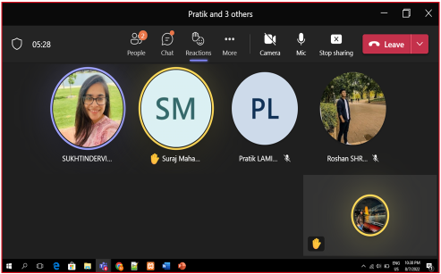
Stand-up Meeting 1
Date and time: 24/07/2022, 11:00 am – 11:45am
Venue: MS Teams Conversation
Attendees: Muhammad Daniyal (Product owner), Sukhtindervir Kaur (Scrum master), Suraj Mahat (team member), Roshan Shrestha (team member) and Pratik Lamichhane (team member
Agenda:
Defining requirements
To discuss the progress of project sprints
Testing was assigned to Sukhtindervir Kaur.

Slide 25
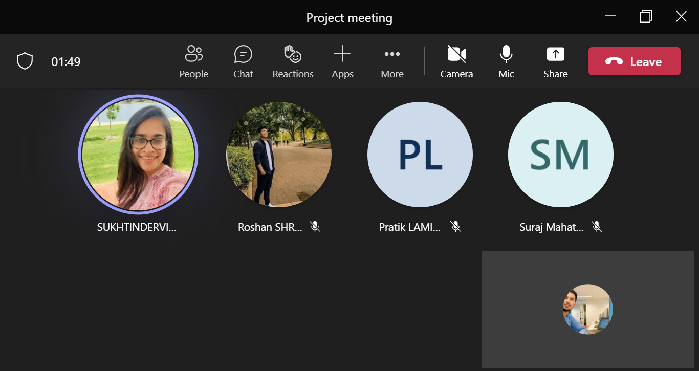
Stand-up Meeting 2
Date and time: 25/07/2022, 5:00 am – 5:30am
Venue: MS Teams Conversation
Attendees: Muhammad Daniyal (Product owner), Sukhtindervir Kaur (Scrum master), Suraj Mahat (team member), Roshan Shrestha (team member) and Pratik Lamichhane (team member
Agenda:
To discuss the test results and showcase project progress so far
To discuss GitHub repository file management

Slide 26
Stand-up Meeting 3
Date and time: 27/08/2022, 5:00 pm – 5:30 pm
Venue: MS Teams Conversation
Attendees: Muhammad Daniyal (Product owner), Sukhtindervir Kaur (Scrum master), Suraj Mahat (team member), Roshan Shrestha (team member) and Pratik Lamichhane (team member
Agenda:
To display new changes in site
To display responsive design by Muhammad Daniyal
To discuss login with google functionality by Muhammad Daniyal
Testing tool was introduced by Sukhtindervir Kaur
To discuss the tools progression
https://australiantmc-my.sharepoint.com/:v:/g/personal/30385522_students_atmc_edu_au/Ea6Y9StJaGVDmPRn7DWKIHsBqlDmUEJ3rTbgZ5A5Nhs0UA

Slide 27
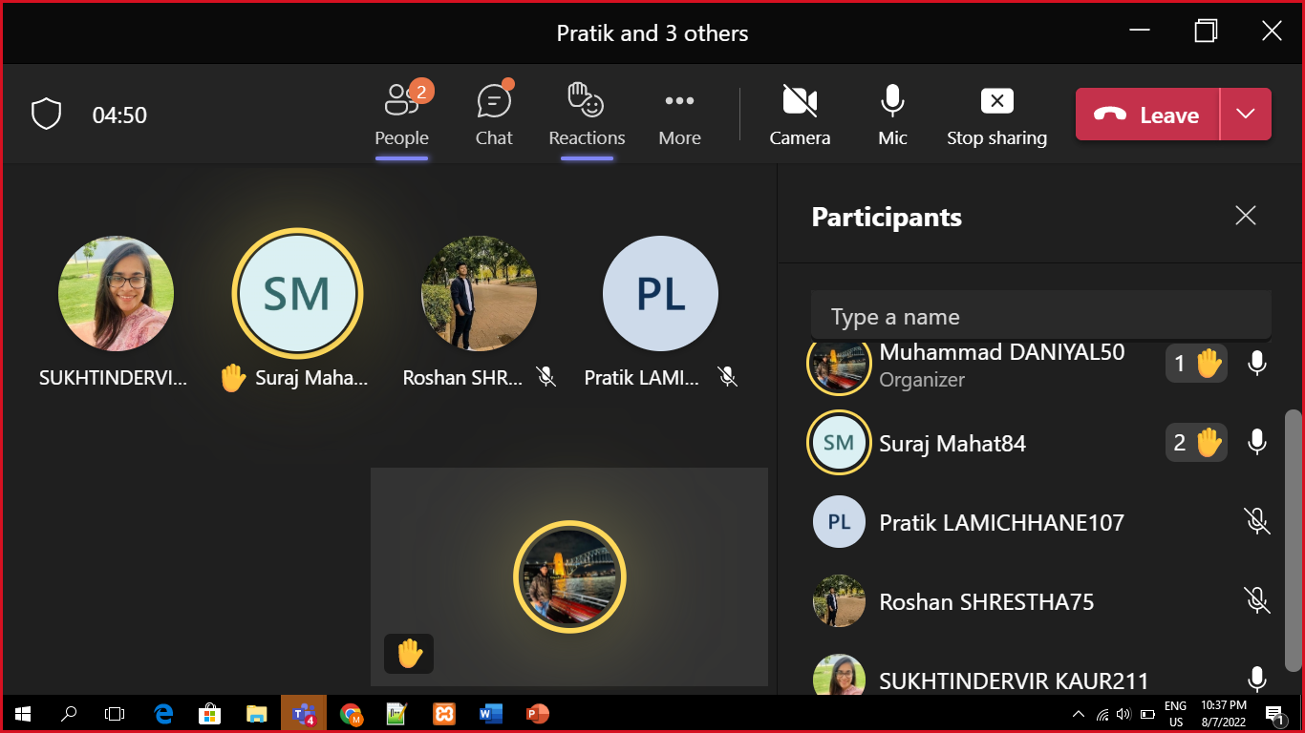
Stand-up Meeting 4
Date and time: 07/08/2022, 10:30 pm – 11:30pm
Venue: MS Teams Conversation
Attendees: Muhammad Daniyal (Product owner), Sukhtindervir Kaur (Scrum master), Suraj Mahat (team member), Roshan Shrestha (team member) and Pratik Lamichhane (team member)
Agenda:
Show-cased individual work
Provided feedback
Welcomed recommendations

Slide 28
Review Meeting
Date and time: 10/08/2022, 3:00 pm – 3:30pm
Venue: MS Teams Conversation
Attendees: Anirudh Phadke (Client), Muhammad Daniyal (Product owner), Sukhtindervir Kaur (Scrum master), Suraj Mahat (team member), Roshan Shrestha (team member) and Pratik Lamichhane (team member)
Agenda:
Agenda item 1: Demonstration
Agenda item 2: Feedback
https://australiantmc-my.sharepoint.com/:v:/g/personal/30383565_students_atmc_edu_au/EUtf5ptOd7FBkpwjx8tZpysBJVwy5vO2iRerdUq08zlx3A

Slide 29
Retrospective Meeting
Date and time: 12/08/2022, 10:30 pm – 11:00pm
Venue: MS Teams Conversation
Attendees: Muhammad Daniyal (Product owner), Sukhtindervir Kaur (Scrum master), Suraj Mahat (team member), Roshan Shrestha (team member) and Pratik Lamichhane (team member)
Apology:
Roshan Shrestha
Agenda:
Agenda item 1: What went well?
Agenda item 2: What could be improved?
Agenda item 3: What can we do?
Agenda item 4: What is not in our control?
https://australiantmc-my.sharepoint.com/:v:/g/personal/30391411_students_atmc_edu_au/ERhr8Fr9SDlKmOMdVEuIFXwBG4K2aO-_Qqv5xisL0GnI3g

Slide 30
Client’s Feedback
Request to use back-ends question bank for quizzes'
Design improvements
Client was happy
He encouraged our work

Slide 31
PRATIK LAMMICHANNE
CONCLUSION, FUTURE WORK & CRITICAL REFLECTION

Slide 32
Conclusion and upcoming work
This sprint so far went well and learned many things.
US1: As a user, I want to login with LinkedIn button so that I don’t have to fill-up information.
US2: As a user, I want to access scoring page for my given tests so that I can see results.
US3: As a user, I want to live chat with agent so that I can get answers to questions.
US4: As a user, I want to go to FAQs page so that I can get answers to my enquiries.
US5: As a user, I want to go to search through site so that I don’t have to navigate for information.
US6: As a user, I want to get feedback on my resume so that I can improve my skills.
US7: As a user, I want to get in touch with an expert so that I can discuss about my career opportunities.

Slide 33
Critical Reflection
What went wrong?
Communication between team could have been improved.
Conflicts could have been managed well.
Less contribution from some of the group members.
Could have worked better on Assessment portals.
How is it being addressed?
Started working on back-end questionnaire development.
Everyone is contributing well.
Developed responsive web design.
Conflicts are being managed properly.
What went right?
Tasks were completed before allocated time.
Client meeting went well.
Iteration documentation was completed.
Assessment portal demonstration went well.

Slide 34
THANK YOU ANY QUESTIONS?

