Slide 1
Overview of Metamaterials
KyungHee University
이진영

Slide 2
Introduction

Slide 3
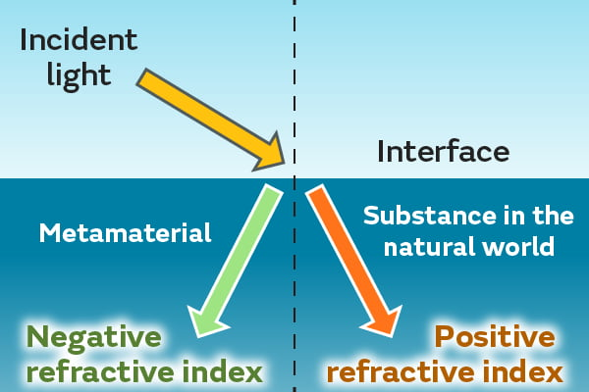
What are Metamaterials?
1. Introduction
Definition of Metamaterials :
  Metamaterials are artificially created materials that emerge from designing “meta-atoms”, artificial structures not directly observed in nature, to realize unprecedented physical properties.
  Originating in electromagnetic fields such as optics, the term garnered significant attention through applications like negative refractive index and stealth technology.
Introduction of Mechanical Metamaterials:
  The concept of metamaterials has been extended into mechanical domains.
  In materials engineering and applied mechanics, there have long been efforts to design materials by combining different substances or using porous honeycomb and foam structures.
  However, advancements in technology now make it possible to precisely fabricate three-dimensional structures on the micrometer scale, enabling the direct realization of structures with desired physical properties.
  Mechanical metamaterials derive their properties from the geometric arrangement of unit cells, allowing for characteristics rarely seen in natural materials such as “lightweight yet rigid structures,” “increased volume upon compression,” and “selective attenuation or transmission of stress in specific directions or regions.”
1) murata. What Are Metamaterials That Expand Possibilities with Behavior Not Found in Substances in the Natural World?. articles. 2024,08,07. https://article.murata.com/en-global/article/what-is-a-metamaterial.

Slide 4

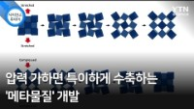
What are Metamaterials?
1. Introduction
YTN. (2022,06,08). 투명 망토를 실현시킬 새로운 물질의 원리. YouTube. https://www.youtube.com/shorts/riPIvBNCiA4
YTN. (2019,05,13). 압력 가하면 특이하게 수축하는 ‘메타물질＇개발 / YTN 사이언스. YouTube. https://www.youtube.com/watch?v=BSXOcCnFNvQ

Slide 5
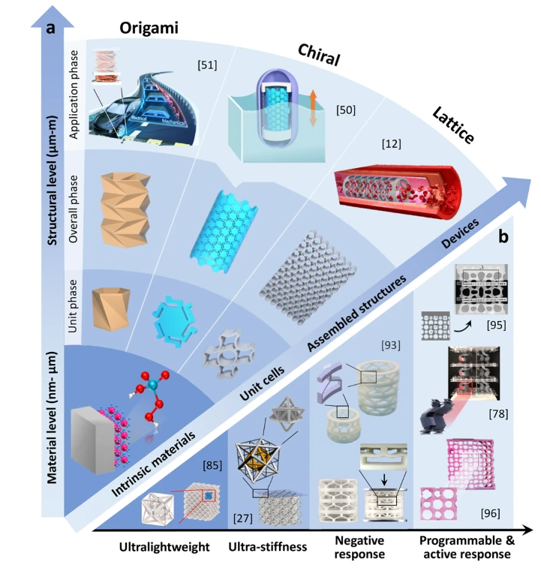
Research Keywords
1. Introduction
Keywords :
  Unit cells
  Stiffness
  Negative Poisson’s ratio
  Negative compressibility
  Programmable Response
1) Jiao, P., Mueller, J., Raney, J.R. et al. Mechanical metamaterials and beyond. Nat Commun 14, 6004 (2023).

Slide 6
Basic
Knowledge of
Metamaterial

Slide 7
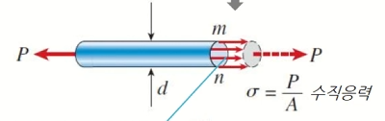

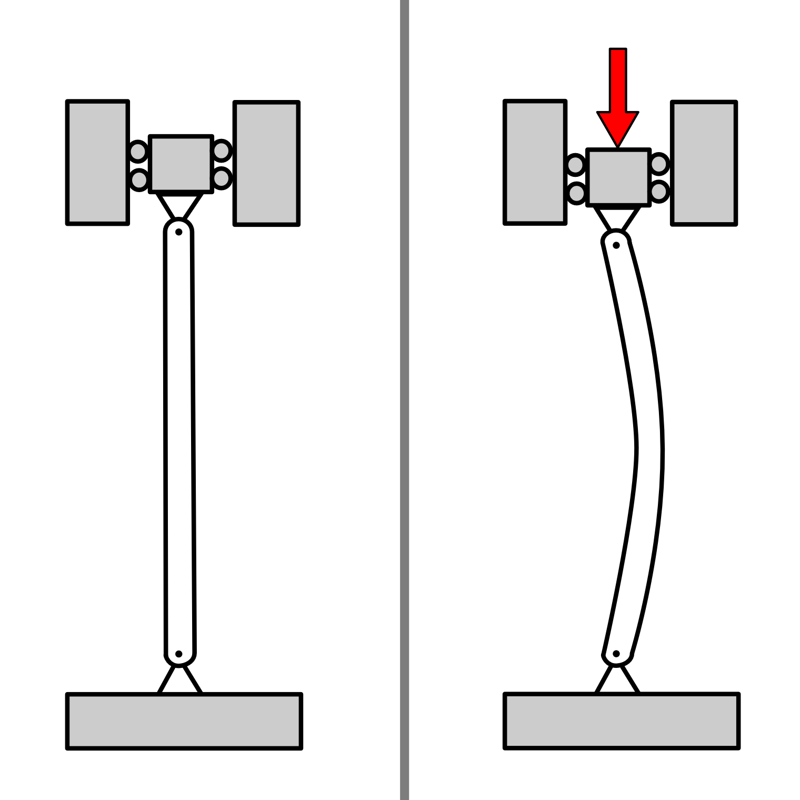

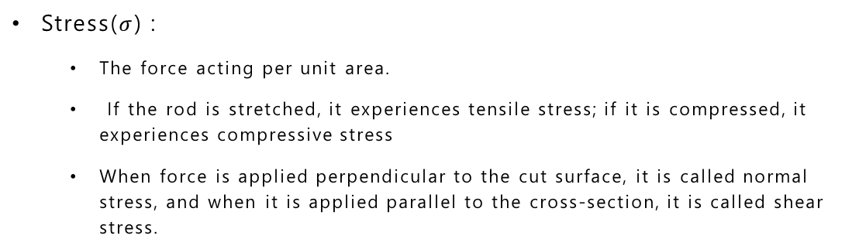
Stress & Strain
2. Basic Knowledge of Metamaterial
Stress($σ$) :
  The force acting per unit area.
  If the rod is stretched, it experiences tensile stress; if it is compressed, it experiences compressive stress
  When force is applied perpendicular to the cut surface, it is called normal stress, and when it is applied parallel to the cross-section, it is called shear stress.
Strain:
  The amount of elongation per unit length
  Under tension, this value is positive, and under compression, it becomes negative.
  There is no distinct unit (mm/m, $μ$m/m, in/in, %)
Buckling :
  Buckling is a phenomenon in which a structure under compressive load suddenly bends or fails upon exceeding a certain threshold
  In metamaterials, buckling is deliberately engineered to create unique mechanical properties.
1) Smart Desgin Lab. (2020,03,08). 고체역학 Ch1. YouTube. https://youtu.be/GuiGDH6_GOw?si=O7IOqxes3wZUISw_.

Slide 8
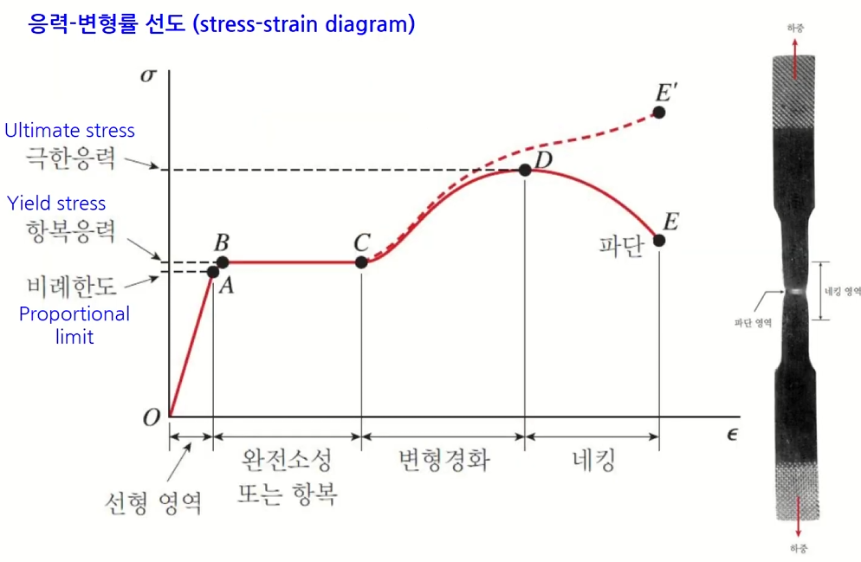
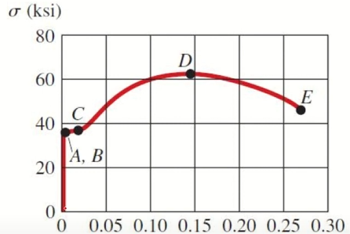
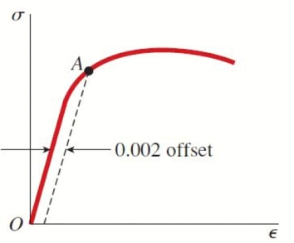
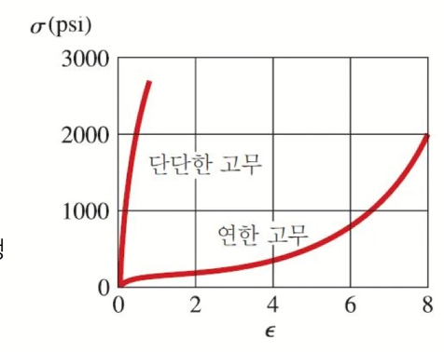
Stress & Strain
2. Basic Knowledge of Metamaterial
Stress–Strain Curve:
  Segment OA: Here, stress and strain exhibit a linear, proportional relationship. The slope of this region is called the elastic modulus.
  Point A is referred to as the proportional limit. If there is no clearly defined yield point, we shift the linear portion by 0.2% on the strain axis, and where that shifted line intersects the curve is taken as point A.
  Point B (Yield Point): At this point, the material no longer maintains pure elasticity and begins permanent deformation.
  Point D (Ultimate Stress): This is the peak stress that the material can withstand the highest point of the curve.
  Point E (Fracture Point): The material breaks at this stress value, indicating complete failure.
  Rubber Materials: Rubber can maintain a linear stress–strain relationship up to a very large strain.
1) Smart Desgin Lab. (2020,03,08). 고체역학 Ch1. YouTube. https://youtu.be/GuiGDH6_GOw?si=O7IOqxes3wZUISw_.

Slide 9
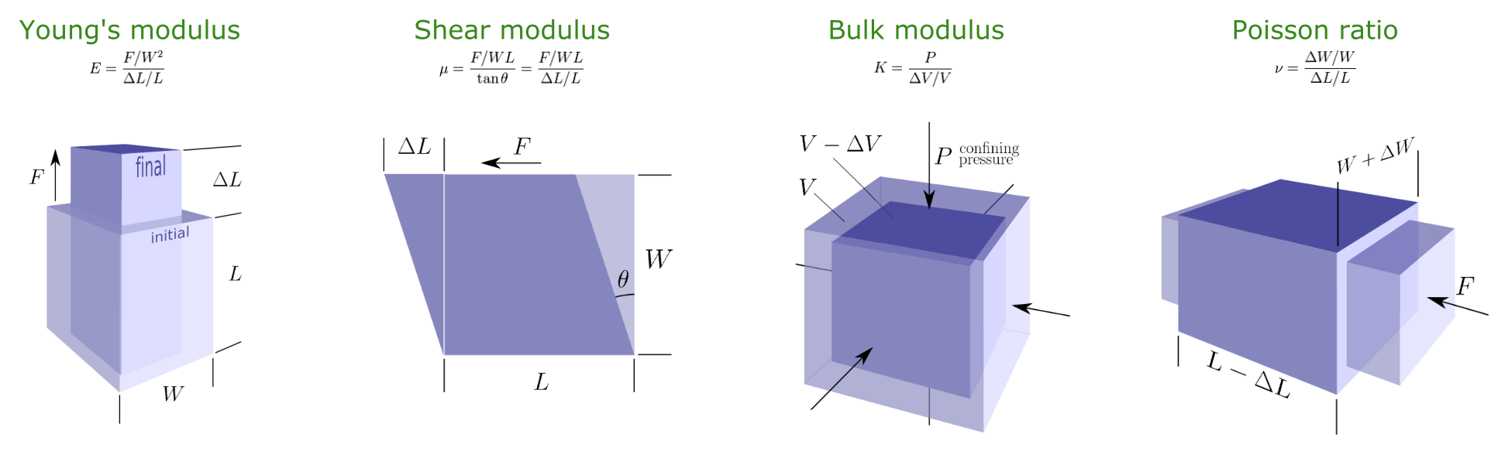
Elastic Modulus
2. Basic Knowledge of Metamaterial
Young’s modulus (E) :
  A material’s stiffness under axial loads, higher values indicate a stiffer material.
Shear modulus(G):
  A material’s ability to resist torsional deformation. Liquids have G=0, solids have G>0, and pentamode materials exhibit G≪K—indicating strong resistance to compression but weak resistance to twisting.
Bulk modulus(K):
  A material’s resistance to compressive deformation. For example, solids have a large K value, whereas gases have a very small one.
Poisson’s ratio($v$):
  The ratio describing how much a material contracts or expands in the transverse direction when stretched along one axis.
1) Matt Hall.All the elastic moduli. Agile. 2016,04,028. https://agilescientific.com/blog/2016/4/28/all-the-elastic-moduli.

Slide 10
Classification
of
Mechanical
Metamaterials

Slide 11
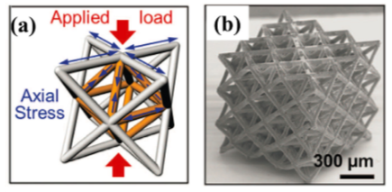
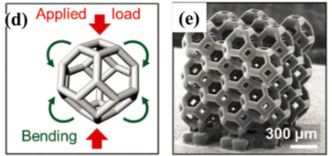
Stiffness (E)-Based Metamaterials
3. Classification and Design Methods of Mechanical Metamaterials
Micro-nano lattices :
  This structure refers to an ultra-lightweight lattice composed of micro- or nanoscale pillars or beams tessellated in three dimensions.
  With advancements in 3D printing and nanofabrication technology, it has become feasible to realize such intricate geometries, making them highly promising..
  Depending on factors like relative density and the spatial arrangement of unit cells, the stiffness of this metamaterial can vary..
  can be classified into open-cell or closed-cell configurations based on topology, and the structures themselves may arise randomly or be deliberately ordered like a honeycomb.
  Representative examples include the octet-truss geometry, typically made of metals or ceramics, and the bend-dominated tetrakaidecahedron geometry, often formed as cubic Kelvin foam.
Zheng, X., Lee, H., Weisgraber, T. H., Shusteff, M., DeOtte, J., Duoss, E. B., ... & Spadaccini, C. M. (2014). Ultralight, ultrastiff mechanical metamaterials. Science, 344(6190), 1373-1377.

Slide 12
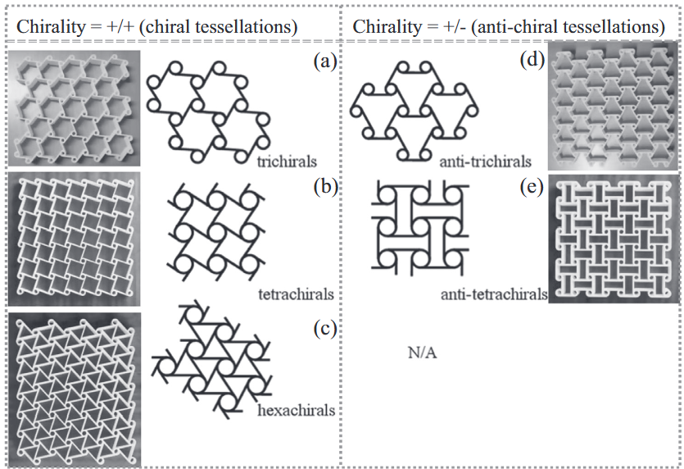
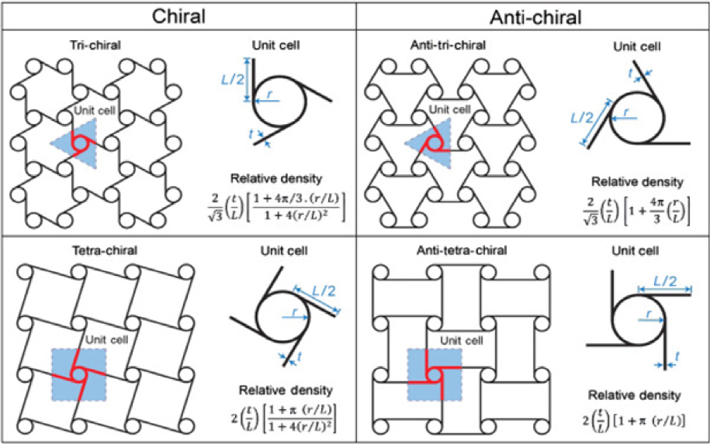
Stiffness (E)-Based Metamaterials
3. Classification and Design Methods of Mechanical Metamaterials
Chiral / anti-Chiral:
  Chiral structures can be formed in left-handed or right-handed versions, which are mirror images of each other but cannot be superimposed.
  The unit cell of such a structure consists of a central cylinder functioning as a node, with multiple tangential ligaments attached around it in a rotationally symmetric arrangement.
  These unit cells can be divided into two systems: chiral and anti-chiral. If the nodes are arranged in the same direction (left-left or right-right), it is called a chiral structure; if they are arranged in opposite directions (left-right), it is called an anti-chiral system.
  Under compression, the node rotates and the ligaments bend inward, while under tension, they unfold, potentially exhibiting a negative Poisson’s ratio.
  Recent research on hexachiral and tetrachiral lattices is active, and these lattices can also be applied in acoustic metamaterials.
1) Yu, X., Zhou, J., Liang, H., Jiang, Z., & Wu, L. (2018). Mechanical metamaterials associated with stiffness, rigidity and compressibility: A brief review. Progress in Materials Science, 94, 114-173.

Slide 13
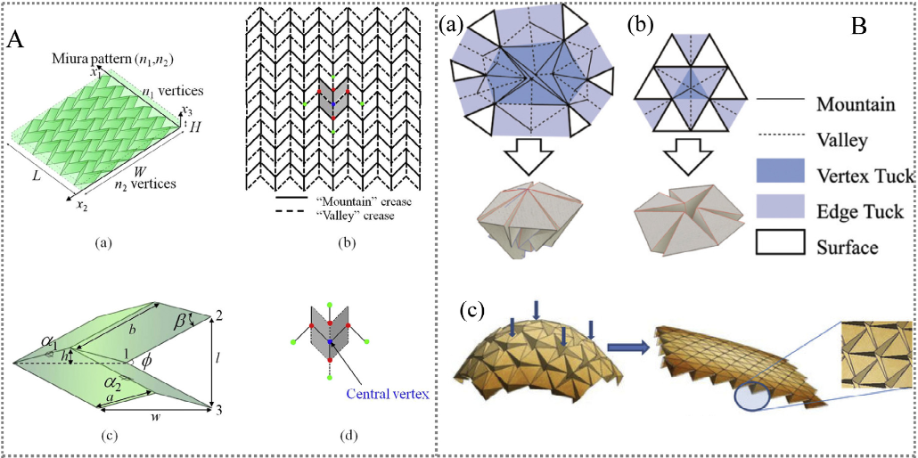
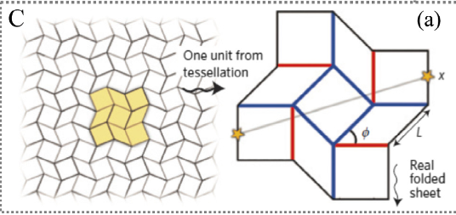
Stiffness (E)-Based Metamaterials
3. Classification and Design Methods of Mechanical Metamaterials
Origami structure:
  Origami metamaterials incorporate predetermined crease lines into thin materials, enabling them to be folded or unfolded in specific ways to endow unique functionalities. These structures are lightweight and can exhibit large variations in elastic energy through folding, often possessing multiple stable states.
  Miura-Ori patterns were originally devised to achieve negative Poisson’s ratio. Each unit cell is a parallelogram, allowing the pattern to fold almost flat and minimize volume, then fully unfold at once.
  Ron Resch patterns, on the other hand, employ non-periodic and intricately arranged folds that leverage cooperative deformations among unit cells. Under external force, the structure may fold continuously into a highly complex shape or collapse toward a near-flat configuration.
  A related approach is Kirigami, which not only folds the material but also cuts it, creating shapes determined by the placement of cuts and the resulting expansions and contractions. This approach can achieve more complex deformations than Origami alone.
1) Yu, X., Zhou, J., Liang, H., Jiang, Z., & Wu, L. (2018). Mechanical metamaterials associated with stiffness, rigidity and compressibility: A brief review. Progress in Materials Science, 94, 114-173.

Slide 14
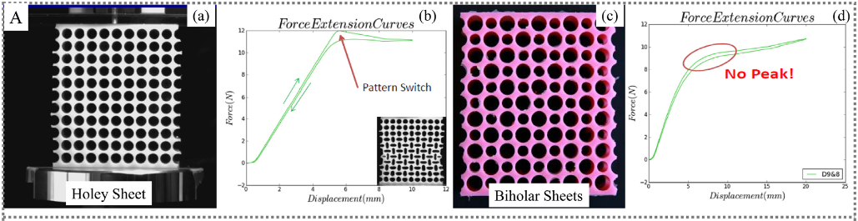
Stiffness (E)-Based Metamaterials
3. Classification and Design Methods of Mechanical Metamaterials
Pattern Transform:
  A structure featuring a specific hole pattern can exhibit adjustable stiffness when deformed. Once the material undergoes a certain level of compressive strain, the stress–strain behavior changes abruptly in a phase transition. Multiple cells collectively buckle, rearranging themselves to form a new structural topology.
  The outcome depends on the shape (e.g., circular vs. elliptical) and arrangement (e.g., square vs. triangular lattice) of the holes, which determine the onset and nature of the instability.
  Two representative patterns are the holy sheet and the biholar sheet.
    The holy sheet is a 2D elastic sheet with uniformly sized holes arranged in a regular pattern, transforming under compression as the holes deform into ellipses.
    Meanwhile, the biholar sheet has two differently sized circular holes, leading to more complex rotations and twists. This design can be “programmed” to achieve specific deformation behaviors if desired.
Bertoldi K, Reis PM, Willshaw S, Mullin T. Negative Poisson’s ratio behavior induced by an elastic instability. Adv Mater 2010;22:361–6.
MULLIN, Tom, et al. Pattern transformation triggered by deformation. Physical review letters, 2007, 99.8: 084301.

Slide 15
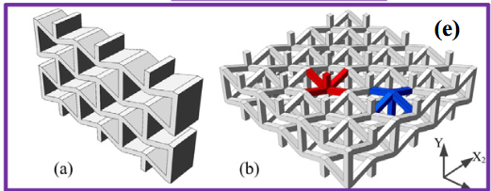
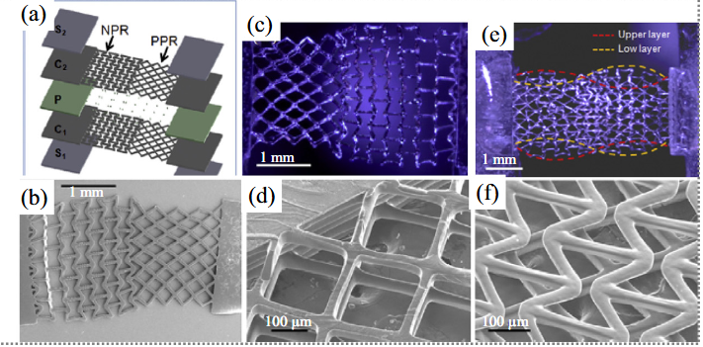
Poisson’s ratio(𝑣) - Based Metamaterials
3. Classification and Design Methods of Mechanical Metamaterials
Auxetic metamaterials:
  The term “Auxetic,” introduced by K.E. Evans, refers to materials with a negative Poisson’s ratio. Such materials can be categorized as either fully auxetic, having a Poisson’s ratio that is zero or negative in all directions, or partially auxetic, where the Poisson’s ratio can be positive or negative depending on the deformation direction.
  In partially auxetic structures, the crystal shape or structural inhomogeneity may result in direction-dependent Poisson’s ratios even within the same material.
  Under an applied load or deformation, the Poisson’s ratio may switch from negative in one range to positive in another, allowing engineers to program the mechanical properties over a specified deformation window.
1) WANG, Xin-Tao; LI, Xiao-Wen; MA, Li. Interlocking assembled 3D auxetic cellular structures. Materials & Design, 2016, 99: 467-476.
2) SOMAN, Pranav, et al. Spatial tuning of negative and positive Poisson’s ratio in a multi-layer scaffold. Acta biomaterialia, 2012, 8.7: 2587-2594.

Slide 16
Metamaterial
Applications
in HCI

Slide 17
Research Questions from a HCI Perspective
4. Metamaterial Applications in HCI
Research Question :
  How can we leverage the reconfigurable nature of mechanical metamaterials
  Can mechanical metamaterial structures be combined with sensor modules to accurately detect forces, contact points, or wear states, thus enabling next-generation HCI devices with enhanced sensing capabilities?
  How can we harness the unique balance of flexibility (e.g., through negative Poisson’s ratio) and high stiffness in mechanical metamaterials to create wearable HCI devices that are both comfortable and durable?
  If mechanical metamaterials can dynamically adjust their stiffness or structural patterns in real time, how can we integrate these adaptive features into interaction scenarios to provide more personalized user experiences?

Slide 18
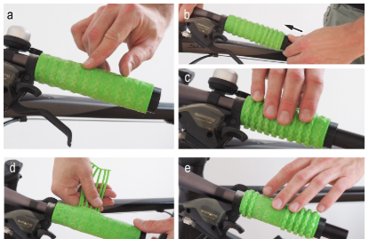
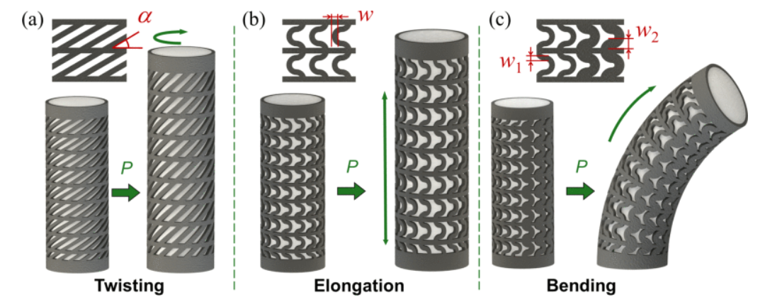
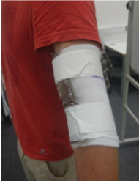
Significance of Metamaterials in Human-Computer Interaction
4. Metamaterial Applications in HCI
Shape-changing UI :
  Conventional HCI has mainly provided interactions by modifying displays and digital visual information.
  By using metamaterials, the actual physical material or surface itself can be deformed, expanding the range of interactions (e.g., tactile feedback, adjustable grip).
Soft Robotics, Wearable Device :
  Can be applied in controlling compression or support levels in wearable devices, and in implementing foldable robotic joints.
  Using specific metamaterial structures, it is possible to design stable yet flexible housings or sensor–actuator integrated systems.
1) Ion, A., Kovacs, R., Schneider, O. S., Lopes, P., & Baudisch, P. (2018, April). Metamaterial textures. In Proceedings of the 2018 CHI conference on human factors in computing systems (pp. 1-12).
2) D. Wang, C. Jiang and G. Gu, "Modeling and Design of Lattice-Reinforced Pneumatic Soft Robots," in IEEE Transactions on Robotics, vol. 40, pp. 606-623, 2024.

Slide 19
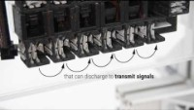
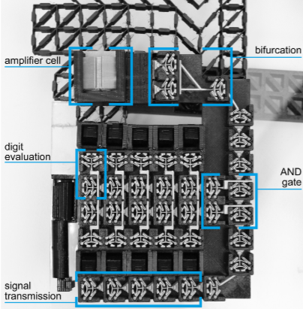
Related works
4. Metamaterial Applications in HCI
Digital Mechanical Metamaterials :
  Author : Alexandra Ion, Ludwig Wall, Robert Kovacs, and Patrick Baudisch
  Conference : CHI 2017
  Design : The cell is designed as a bit cell that can maintain two discrete states, and chaining multiple such cells together allows them to function as a logic circuit.
  Application : This study broadens the applications of 3D-printed objects by enabling the creation of fully mechanical systems with computational capabilities in environments where electronic components are either impractical or undesirable.
1) Ion, A., Wall, L., Kovacs, R., & Baudisch, P. (2017, May). Digital mechanical metamaterials. In Proceedings of the 2017 CHI Conference on Human Factors in Computing Systems (pp. 977-988).

Slide 20
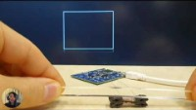
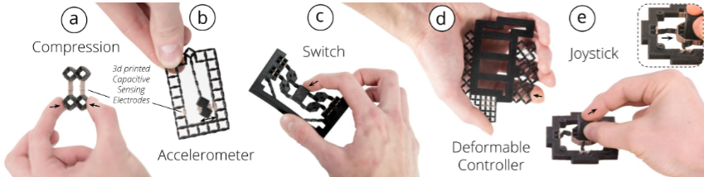
Related works
4. Metamaterial Applications in HCI
MetaSense: Integrating Sensing Capabilities into Mechanical Metamaterial:
  Author : Gong, J., Seow, O., Honnet, C., Forman, J., & Mueller, S.
  Conference : UIST 2021
  Design : After defining the cell’s size and thickness, the cell is fabricated using a conductive material. Then, when external forces such as compression or tension are applied, changes in both the distance between the cell walls and the overlapping area are measured via resonance.
  Application : It can be used as a controller or input device capable of detecting both the magnitude and direction of applied force.
1) Gong, J., Seow, O., Honnet, C., Forman, J., & Mueller, S. (2021, October). MetaSense: Integrating sensing capabilities into mechanical metamaterial. In The 34th annual ACM symposium on user interface software and technology (pp. 1063-1073).

Slide 21
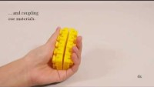
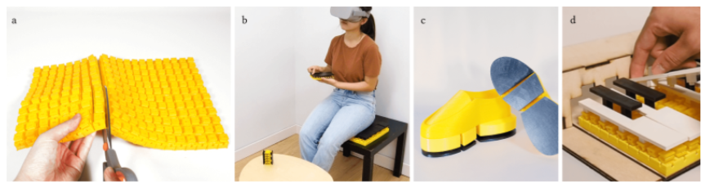
Related works
4. Metamaterial Applications in HCI
Reconfigurable Elastic Metamaterials:
  Author : Yang, W. Y., Zhuang, Y., Darcy, L. A., Liu, G., & Ion, A.
  Conference : UIST 2022
  Design : Unit cells classified as “Spring Cells” and “Damper Cells” are fabricated, then combined and arranged in a particular way to design a structure with targeted elastic and impact&absorption properties.
  Application : Combined in various configurations and applied to products such as shoe insoles and piano keys. An interface is provided so that users can directly adjust the setup, enabling them to achieve the desired elastic properties
1) Yang, W. Y., Zhuang, Y., Darcy, L. A., Liu, G., & Ion, A. (2022, October). Reconfigurable elastic metamaterials. In Proceedings of the 35th Annual ACM Symposium on User Interface Software and Technology (pp. 1-13).

Slide 22
In My
Works

Slide 23
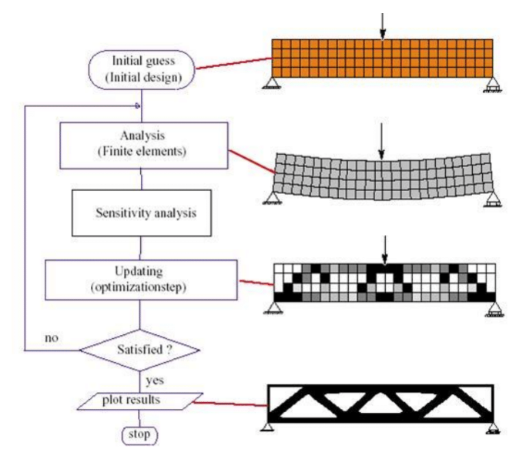
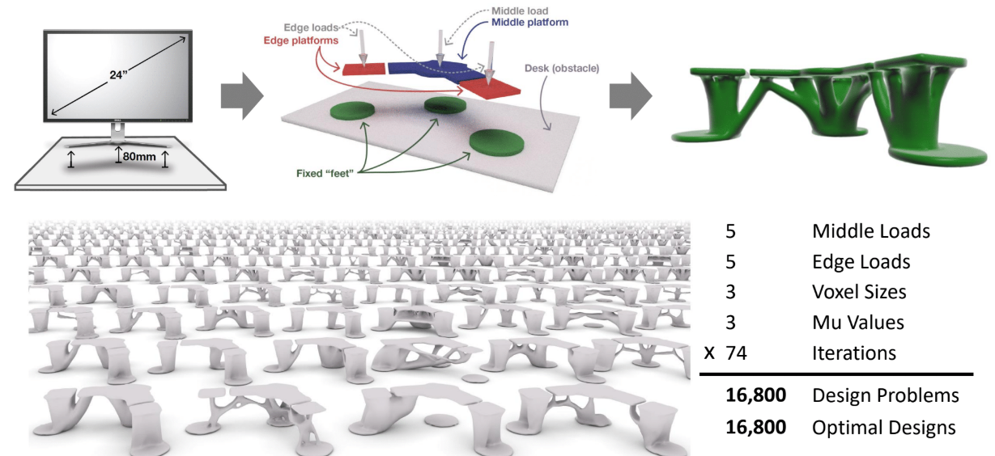
Topology Optimization
5. My work
Definition :
  A technique that mathematically optimizes the arrangement of materials and structural elements to meet specific design objectives, reconfiguring the structure accordingly.
  After defining the design space and boundary/load conditions, an algorithm determines where material is needed and where it is not , thereby identifying an efficient shape.
Bendsøe, M. P., and Sigmund, O., 2003, Topology Optimization: Theory, Methods and Applications, Springer,Berlin
Matejka, J.,Glueck, M.,Bradner, E.,Hashemi, A., Grossman, T., & Fitzmaurice, G. (2018, April). Dream Lens: Exploration and Visualization of Large-Scale Generative DesignDatasets. InProceedings of the 2018 CHI Conference on Human Factors in Computing Systems(p. 369).ACM

Slide 24
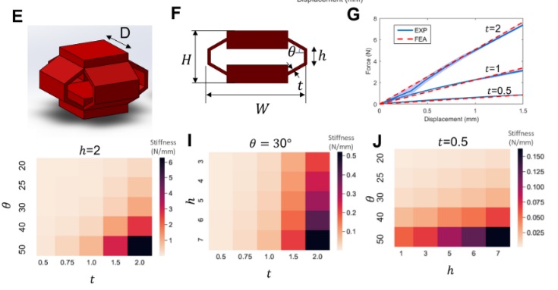
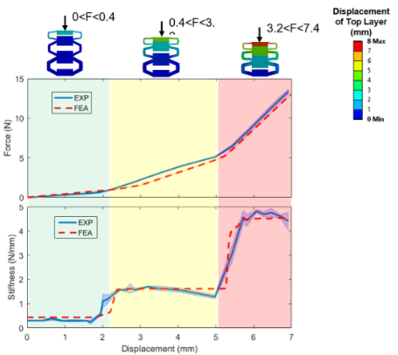
Core Idea
5. My Work
Step 1: Select certain structures as unit cells and parametrize their components. Using those parameters, generate multiple variations of the unit cells.
Step 2: For each variation generated, collect the material property data, such as stress–strain or force–displacement curves that change with parameter variation, into a dataset.
Step 3: Based on this dataset, design a reverse engineering machine learning model (e.g., using a neural network or reinforcement learning) which, given the user’s desired material properties as input, outputs the corresponding unit cell parameters..
1) MOHAMMADI, Alireza, et al. Flexible mechanical metamaterials enabling soft tactile sensors with multiple sensitivities at multiple force sensing ranges. Scientific reports, 2021, 11.1: 24125.

Slide 25
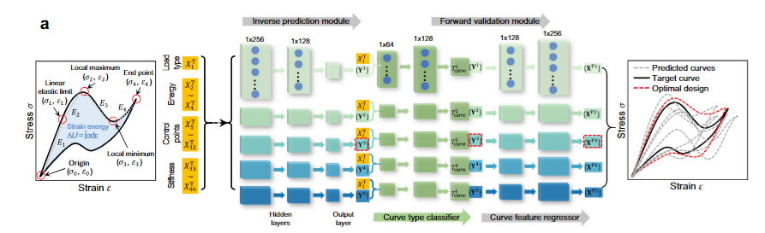
First Workflow
5. My Work
Primary Research Goal:
  Using an artificial neural network, determine the optimal parameters that produce the target stress–strain curve.
Structure:
  1. First, features are extracted from the stress–strain curve and fed into the neural network (NN).
  2. The NN then outputs both the cell parameters and the curve type information.
  3. These parameters are used to reconstruct the curve. The model simultaneously produces five such reconstructions; the average of these five curves becomes the final predicted result.
  4. The difference between the predicted curve and the actual target curve is treated as the loss, which is used to train the model.

Slide 26
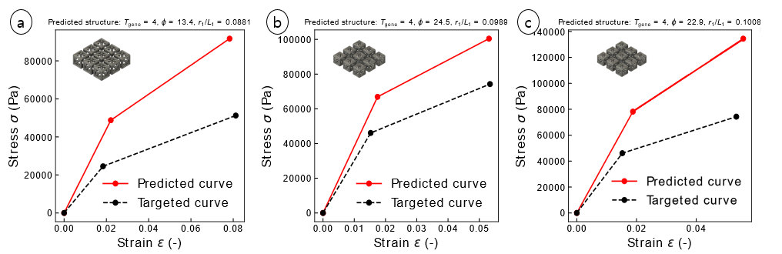
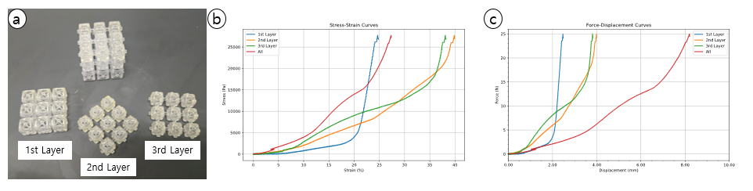
First Workflow - Result
5. My Work
Results:
  The loss between the predicted and actual graphs was large, indicating that the model did not successfully optimize. Additionally, the measured stress–strain curves differed from the model’s predictions.
  However, stacking multiple structural cells with varying data produced graphs showing different stiffness values in different compression ranges.
Conclusion:
  The model failed primarily due to an insufficient dataset.
  Acquiring more extensive data is necessary to improve the accuracy of the model and enhance prediction performance.

Slide 27
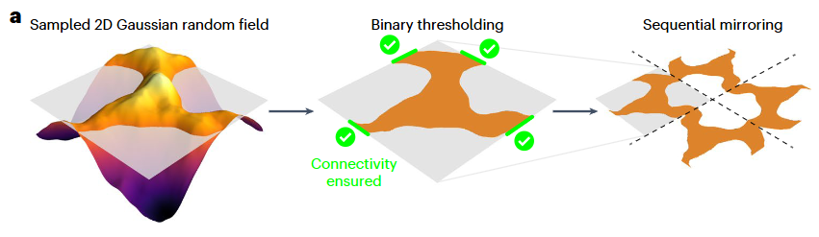
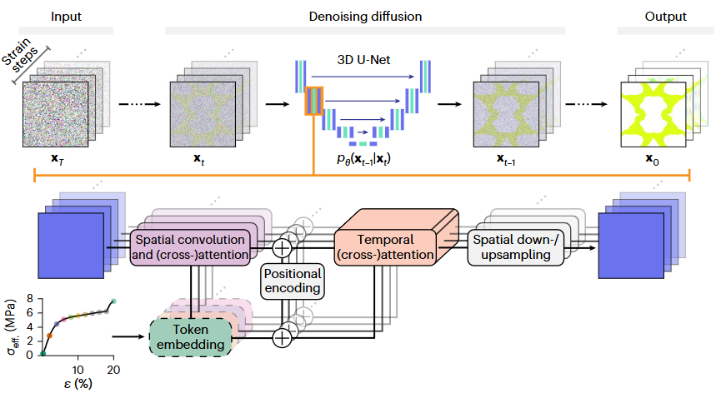
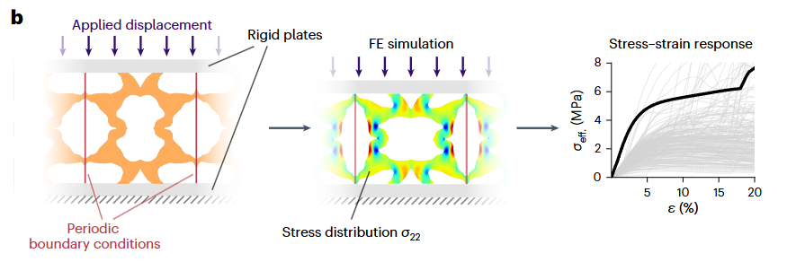
Second Workflow
5. My Work
Secondary Research Objective:
  Utilize simulations (e.g., FEM) to augment the dataset and enable more accurate predictions.
Structure:
  1. Generate random unit cells using a Gaussian random field, then run FE simulations on each to obtain its stress–strain response.
  2. During compression, extract both the stress–strain data and images capturing the internal stress distribution.
  3. Use these extracted datasets to train a model with diffusion and attention mechanisms to learn how the unit cells respond to stress.
  4. When a desired stress–strain curve is provided to the trained model, it generates a unit cell capable of exhibiting that response.
1) BASTEK, Jan-Hendrik; KOCHMANN, Dennis M. Inverse design of nonlinear mechanical metamaterials via video denoising diffusion models. Nature Machine Intelligence, 2023, 5.12: 1466-1475.

Slide 28
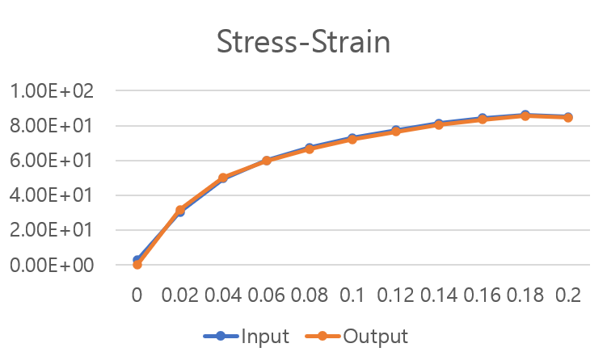
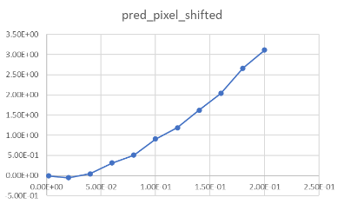
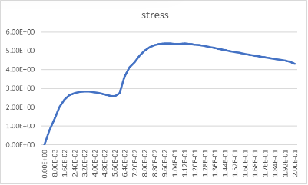
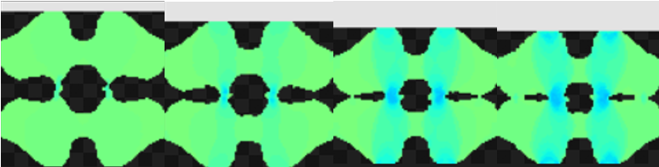


Second Workflow
5. My Work
Intermediate results:
  When validating with Abaqus-based simulations for the generated unit cells, a typical stress–strain curve as input yielded a curve similar to the input data. However, when a second-order curve—resembling hyperelastic behavior—was used as input, the output was different.
  When the quadratic function was used as input, the generated unit cell was not a single, continuous structure but instead became a disjointed one.
1) BASTEK, Jan-Hendrik; KOCHMANN, Dennis M. Inverse design of nonlinear mechanical metamaterials via video denoising diffusion models. Nature Machine Intelligence, 2023, 5.12: 1466-1475.

Slide 29
Q&A

