Slide 1
Inverse Design of Nonlinear Mechanical Metamaterial
2026.04.22
경희대학교 소프트웨어융합학과
이진영

Slide 2
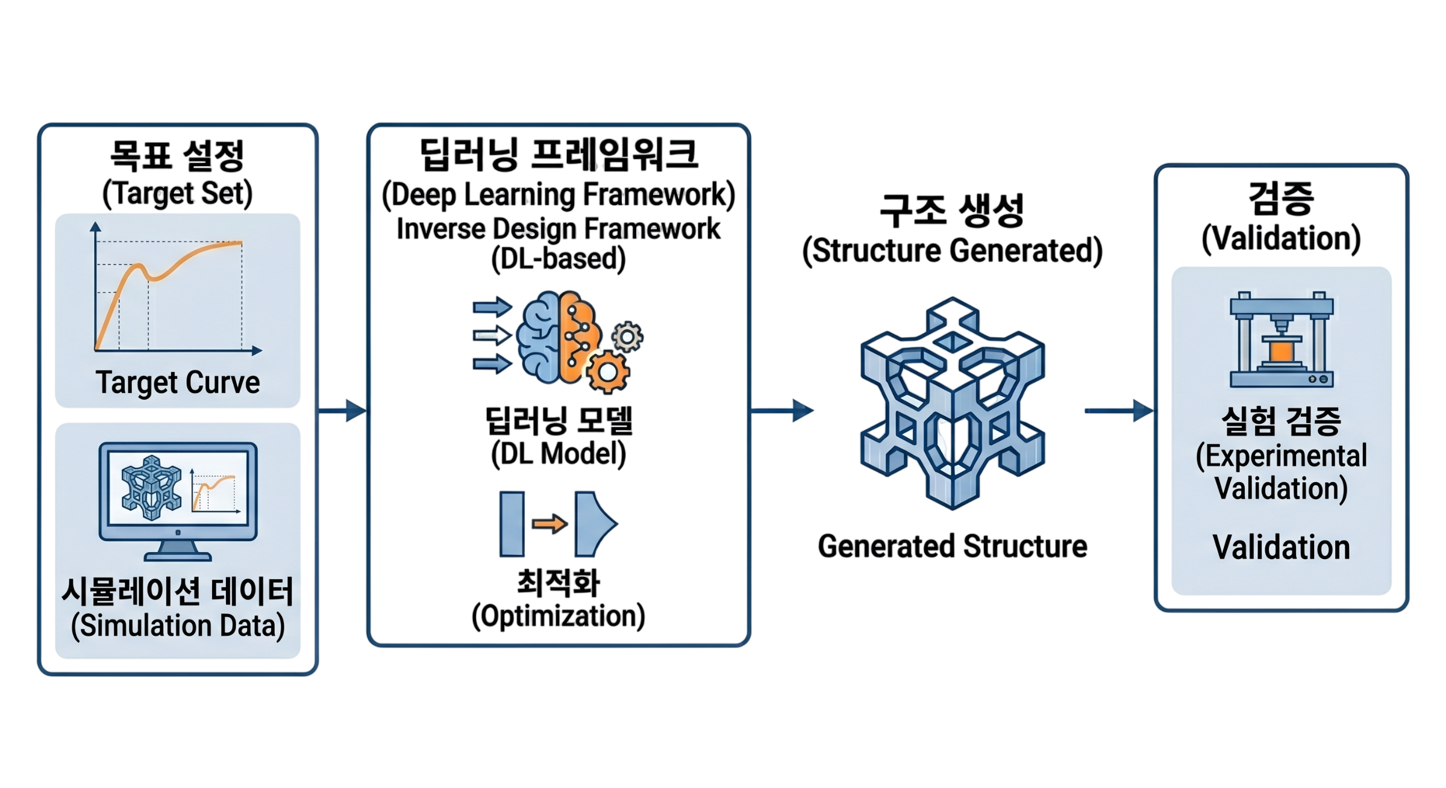
Research Goal
Research Goal :
Nonlinear target curve를 구현하는 구조를 가진 Metamaterial inverse design framework 구축
학습 데이터 :
  무작위 Cell Geometry
  Geometry의 FE simulation data
Inference Input/Output :
  Input : Target Stress-strain curve
  Output : Nonlinear mechanical metamaterial structure

Slide 3
Overview
Completed
Current bottlenecks
Help Requested
Author-provided checkpoint 기반 inference 및 FE evaluation pipeline 검증
Compression test 완료 및 material data 확보
53,008 geometries 생성 시도 / 4,614 usable FE runs 확보
Preliminary training / inference 수행
Hyperelastic fitting 결과가 안정적이지 않음
Usable data rate가 낮음
→ paper scale 대비 약 8.7%
Nonlinear target에서 FE evaluation mismatch 관찰
1. Abaqus step / solver / BC / contact setting 검토
2. FE failure case analysis
3. Abaqus material property 사용 타당성 검토
4. Flexible 80A compression data 기반 material fitting 방식 검토
5. Silicone 40A, Elastic 50A 등 3Dprintable material 확장 가능성 검토

Slide 4
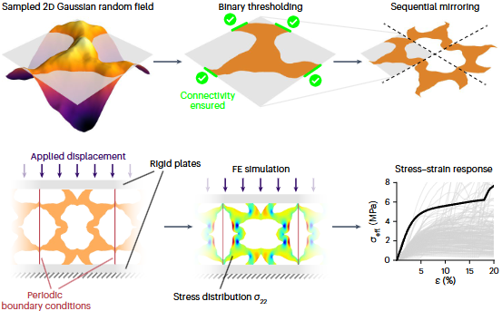
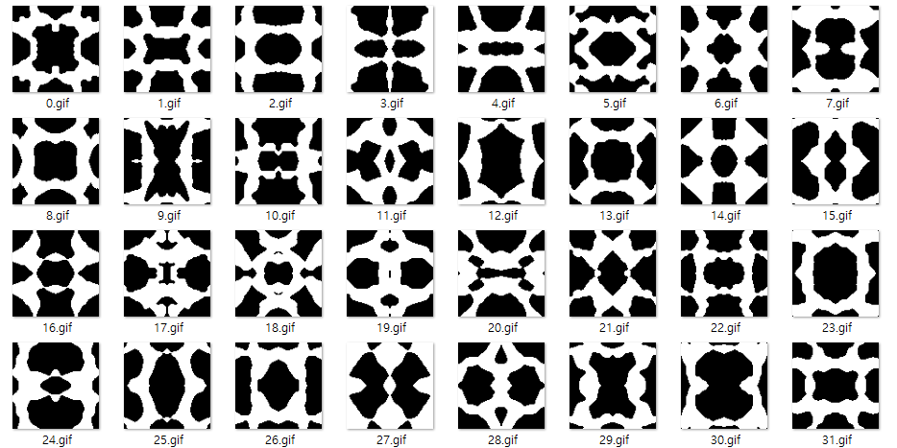
Baseline Framework
Random Geometry → FE Response Dataset
Baseline dataset generation
1. 1/4 unit cell을 gaussian random field 기반으로 생성
2. Border connectivity를 만족하는 geometry만 사용
3. Sequential Mirroring 으로 full unit cell 구성
4. 각 geometry에 대해 Abaqus FE simulation 수행
5. Stress–strain curve와 full-field response를 dataset으로 저장
Takeaway:
  각 geometry의 FE response를 안정적으로 얻는 것이 핵심
Dataset generation pipeline
Generated Geometries
J. H. Bastek and D. M. Kochmann. Inverse design of nonlinear mechanical metamaterials via video denoising diffusion models. Nature Machine Intelligence, 5, 12 (2023), 1466–1475.

Slide 5








Baseline Framework
Full-field Response as Video-like Data(gif)
Abaqus output preprocessing
For each geometry:
  모든 데이터는 0–20% strain range에서 11개의 strain step으로 저장
  데이터는 lagrangian 좌표계에 저장
  각 필드는 96 × 96 그리드에 투영
  필드의 시퀀스는 비디오와 유사한 데이터(gif)로 처리
Stored Channels:
  σ₂₂ (Normal Stress in the Vertical Direction)
  σ_{mises} (Von Mises Stress)
  u₁ (Displacement in X-direction)
  u₂ (Displacement in Y-direction)
Generated data
a
b
c
d
a
b
c
d
J. H. Bastek and D. M. Kochmann. Inverse design of nonlinear mechanical metamaterials via video denoising diffusion models. Nature Machine Intelligence, 5, 12 (2023), 1466–1475.

Slide 6
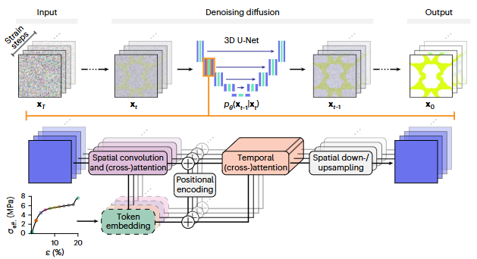
Baseline Framework
Inverse Design Model Architecture
53,007개의 structure–response 쌍을 학습
Input Condition :
  Target Stress–strain curve
Model Architecture:
  3D U-Net–based Video Diffusion Model
Input:
  Geometry의 {σ₂₂, σ_{mises} ,u₁, u₂} GIF 데이터
  Geometry의 stress-strain 데이터
J. H. Bastek and D. M. Kochmann. Inverse design of nonlinear mechanical metamaterials via video denoising diffusion models. Nature Machine Intelligence, 5, 12 (2023), 1466–1475.

Slide 7








Completed
Checkpoint-based Inference result
Author-provided checkpoint와 Baseline Material Property를 사용하여 target stress–strain curve 조건에서 geometry를 생성함.
생성된 geometry에 대해 Abaqus FE evaluation을 수행하여,
실제 stress–strain response가 target과 일치하는지 확인함.
Plastic yielding target:
  Target, predicted response, FE evaluation이 전반적으로 유사한 경향을 보임
Quadratic-shaped target:
  Predicted response는 target shape을 일부 반영함
  그러나 FE revaluation 결과는 target과 큰 차이를 보임

Slide 8
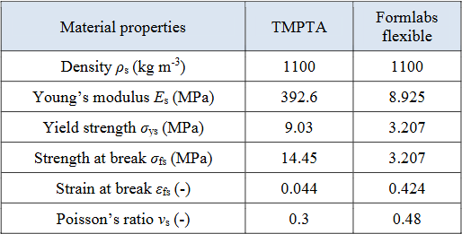
Completed
Real-material Extension: What Changed from Baseline
Abaqus Python Script에서 사용된 물성:
  Young's Modulus
  Poisson's Ratio
  Density
  Yield Stress
  Plastic Strain
  Hyperelastic coefficients
Category
Baseline
Ours
Material
Thermoplastic acetal homopolymer resin (Delrin) based calibrated material
Flexible 80A
Material data
Baseline property table
Flexible 80A property from literature
Reason
Stable reference dataset
Our hyperelastic fitting is unstable
Flexible 80A property
FE data volume
53,007 structure-response pairs
4,614 completed runs
J. H. Bastek and D. M. Kochmann. Inverse design of nonlinear mechanical metamaterials via video denoising diffusion models. Nature Machine Intelligence, 5, 12 (2023), 1466–1475.
Ha, C. S., Bauchy, M., & Zheng, X. Rapid inverse design of metamaterials based on prescribed mechanical behavior through machine learning. Nature Communications. (2023)

Slide 9
Completed
Dataset Generation Results
Geometry requested
Interrupted
53,008
40,149
Usable simulations
4,614
Missing FE output
Failed
6,837
2,403
paper training scale 53,008 대비 약 8.7%
0%
8.7%
100%
Train / Validation split
3,229 / 1,385

Slide 10
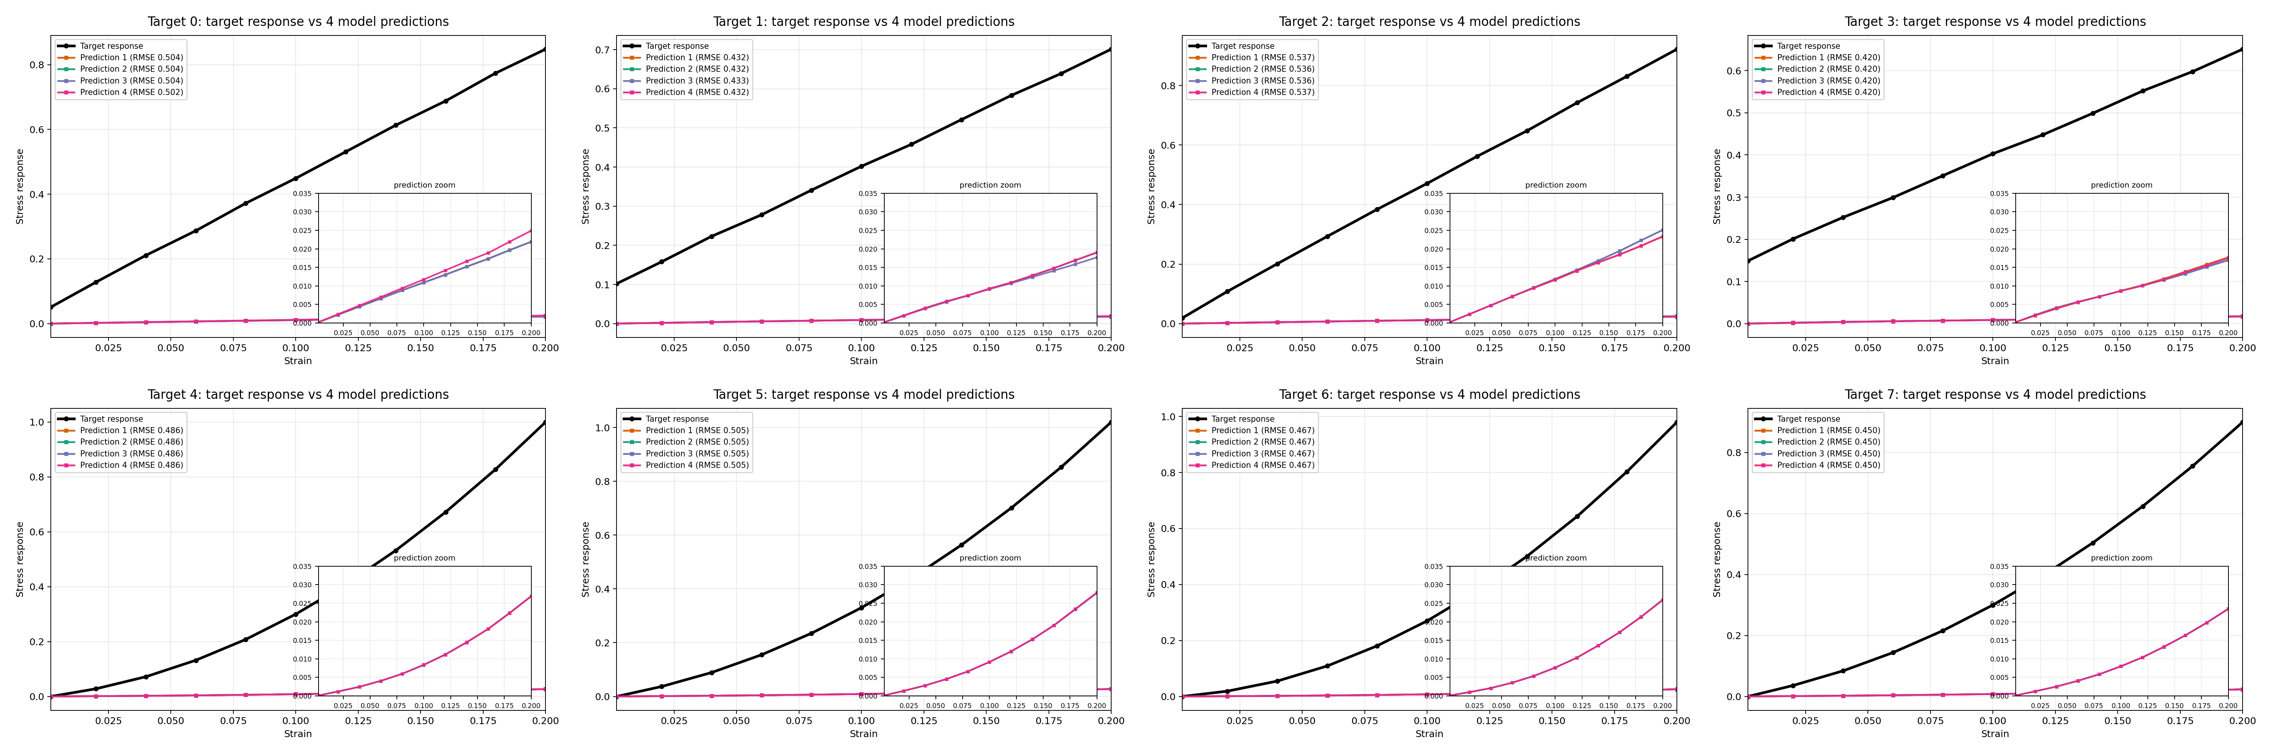

Completed
Preliminary Result after Real-material Dataset Training
Target response & gif results
Validation Setup :
4 linear + 4 quadratic targets, target당 4개 candidate 생성
Obsevation :
Quadratic target coefficient만 변경했을 때 유사 geometry 반복 생성
출력 stress는 입력 stress보다 전반적으로 낮은 수준으로 나타났다
Caution :
FE re-evaluation 전이므로 실제 response mismatch는 미확정

Slide 11
Completed
Preliminary Result after Real-material Dataset Training
Target response & gif results
Validation Setup :
4 linear + 4 quadratic targets, target당 4개 candidate 생성
Obsevation :
Quadratic target coefficient만 변경했을 때 유사 geometry 반복 생성
출력 stress는 입력 stress보다 전반적으로 낮은 수준으로 나타났다
Caution :
FE re-evaluation 전이므로 실제 response mismatch는 미확정

Slide 12
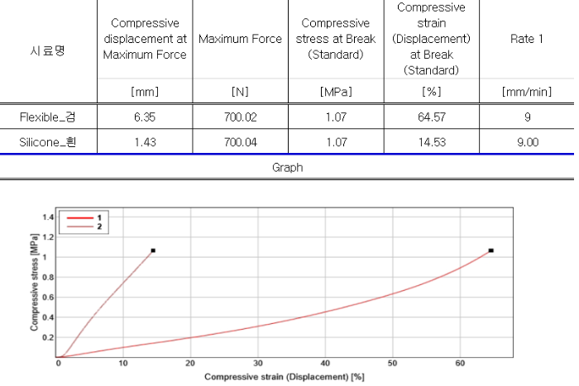
Issue
Hyperelastic Coefficient
Compression test
  Specimen:
    Cylinder specimen
  Diameter: 28.6 ± 0.1 mm
  Thickness: 12.5 ± 0.5 mm
  Equipment:
    Instron 5943
  Measured output:
    Force–displacement curve
    Stress–strain curve
1. Compression Test Result
J. H. Bastek and D. M. Kochmann. Inverse design of nonlinear mechanical metamaterials via video denoising diffusion models. Nature Machine Intelligence, 5, 12 (2023), 1466–1475.

Slide 13
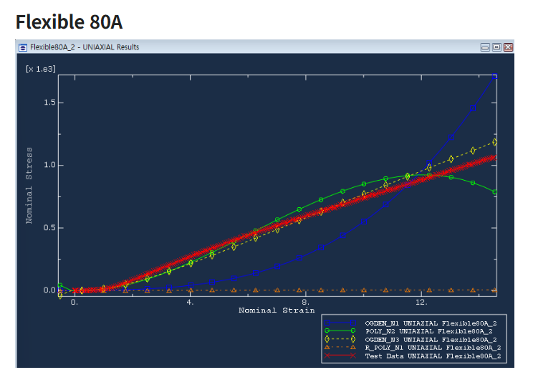
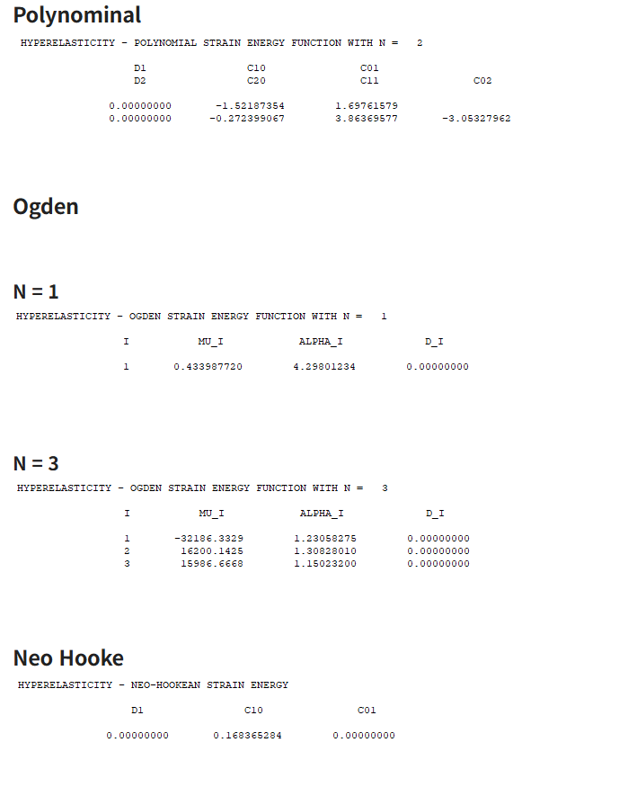
Issue
Hyperelastic Coefficient
Compression test
  → curve preprocessing
  → Abaqus hyperelastic fitting
  → metamaterial simulation
Observed issue:
  Hyperelastic coefficient 추정 결과가 불안정함
  FE response가 measured curve를 안정적으로 재현하지 못함
  따라서 dataset generation에 바로 적용하기 어려움
Feedback needed:
  적절한 Hyperelastic model 선택
  stress–strain vs force–displacement fitting 기준 검토
1. Hyperelastic Coefficient Estimation Result
J. H. Bastek and D. M. Kochmann. Inverse design of nonlinear mechanical metamaterials via video denoising diffusion models. Nature Machine Intelligence, 5, 12 (2023), 1466–1475.

Slide 14
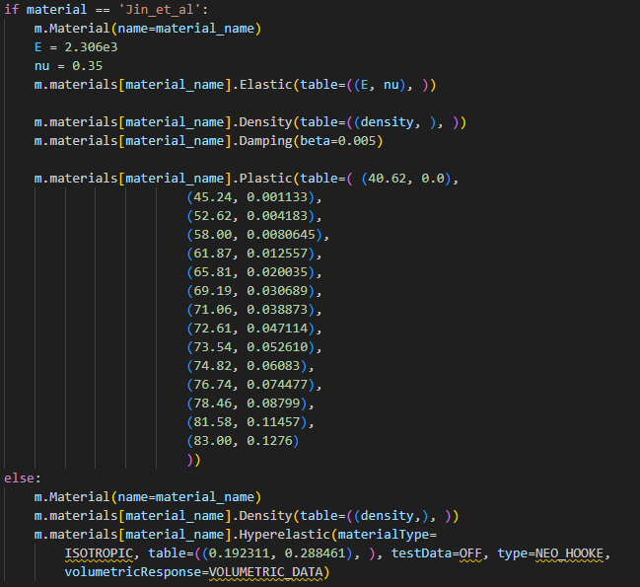
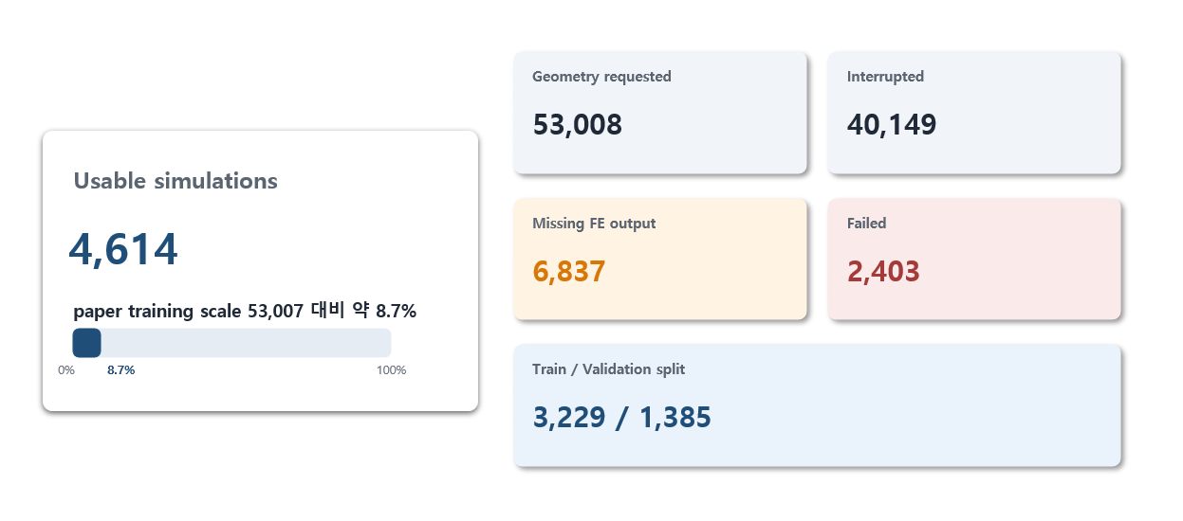
Issue
Abaqus pipeline
What we know
  53,008 geometries generated
  4,614 usable FE outputs→ usable rate: 8.7%
  Nonlinear targets show FE re-evaluation mismatch
What we suspect
  Abaqus simulation setup
  Material model mismatch
  Dataset size may be too small for nonlinear target learning.
What we need help with
  Abaqus simulation setup review
  Material Property is suitable?
  Failure case classification
  Minimum FE validation protocol
Code : abaqus_script.py(line 330)
J. H. Bastek and D. M. Kochmann. Inverse design of nonlinear mechanical metamaterials via video denoising diffusion models. Nature Machine Intelligence, 5, 12 (2023), 1466–1475.

Slide 15
Summary
Completed
Current bottlenecks
Help Requested
Author-provided checkpoint 기반 inference 및 FE evaluation pipeline 검증
Compression test 완료 및 material data 확보
53,008 geometries 생성 시도 / 4,614 usable FE runs 확보
Preliminary training / inference 수행
Hyperelastic fitting 결과가 안정적이지 않음
Usable data rate가 낮음
→ paper scale 대비 약 8.7%
Nonlinear target에서 FE evaluation mismatch 관찰
1. Abaqus step / solver / BC / contact setting 검토
2. FE failure case analysis
3. Abaqus material property 사용 타당성 검토
4. Flexible 80A compression data 기반 material fitting 방식 검토
5. Silicone 40A, Elastic 50A 등 3Dprintable material 확장 가능성 검토

Slide 16
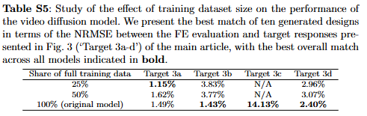
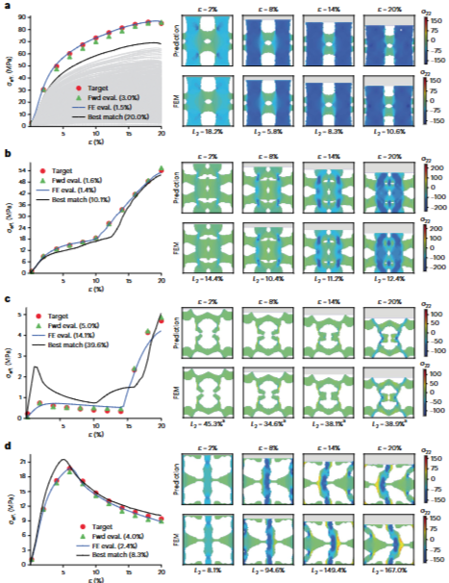
Appendix
Dataset size discussion
Paper evidence
  Baseline paper에서는 학습 데이터가 줄어들면 성능이 저하된다고 보고.
  Nonlinear target case는 데이터 크기에 더 민감.
Paper evidence : Supplementary Table S5 & Fig. 3
Our situation
  현재 사용 가능한 데이터: 4,614개
  이는 baseline 학습 규모의 8.7%에 해당
  현재의 usable rate를 기준으로 baseline 규모를 맞추려면, 약 609,000개의 simulation을 요청해야 한다.
Implication
  simulation 성공률을 높여 dataset이 확보가 되면 모델 성능이 나아질 수 있음
J. H. Bastek and D. M. Kochmann. Inverse design of nonlinear mechanical metamaterials via video denoising diffusion models. Nature Machine Intelligence, 5, 12 (2023), 1466–1475.

Slide 17
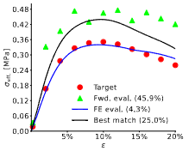
Appendix
Baseline Generalization Requires a Reliable FE Dataset
Paper evidence
  Baseline model은 경우에 따라, FE evaluation 기준으로 볼 때 nearest dataset sample보다 target에 더 가까운 structure를 생성했다.
  이는 단순한 dataset retrieval를 넘어서는 어느 정도의 generalization 가능성을 시사한다.
Paper evidence : Supplementary Figure S11
Implication
  현재 다른 stress 범위의 데이터를 따라가지 못하지만 material property와 simulation stability를 정상화하면 target curve에 대한 error가 감소할 수 있다.
J. H. Bastek and D. M. Kochmann. Inverse design of nonlinear mechanical metamaterials via video denoising diffusion models. Nature Machine Intelligence, 5, 12 (2023), 1466–1475.

Slide 18
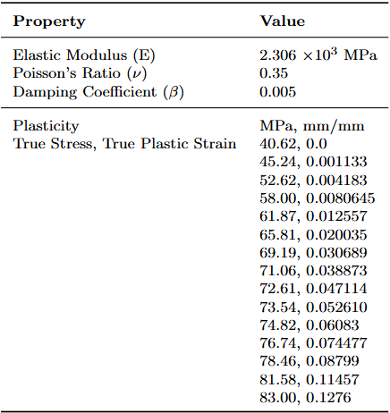
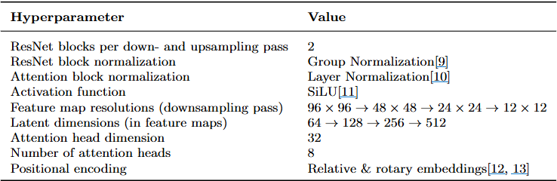
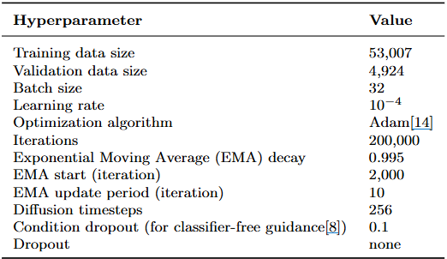
Appendix
Baseline
Baseline hyperparameter
J. H. Bastek and D. M. Kochmann. Inverse design of nonlinear mechanical metamaterials via video denoising diffusion models. Nature Machine Intelligence, 5, 12 (2023), 1466–1475.
Ha, C. S., Bauchy, M., & Zheng, X. Rapid inverse design of metamaterials based on prescribed mechanical behavior through machine learning. Nature Communications. (2023)

Slide 19
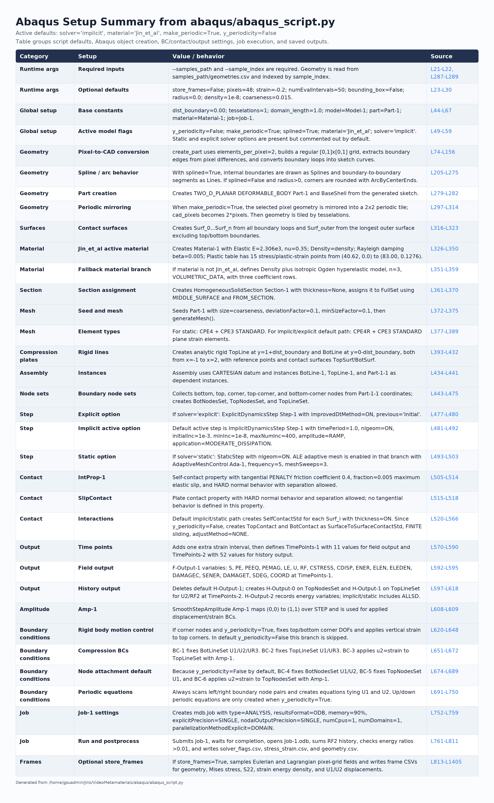
Appendix
Baseline Model Hyperparameter
J. H. Bastek and D. M. Kochmann. Inverse design of nonlinear mechanical metamaterials via video denoising diffusion models. Nature Machine Intelligence, 5, 12 (2023), 1466–1475.

