Slide 1
Architecture

Slide 2
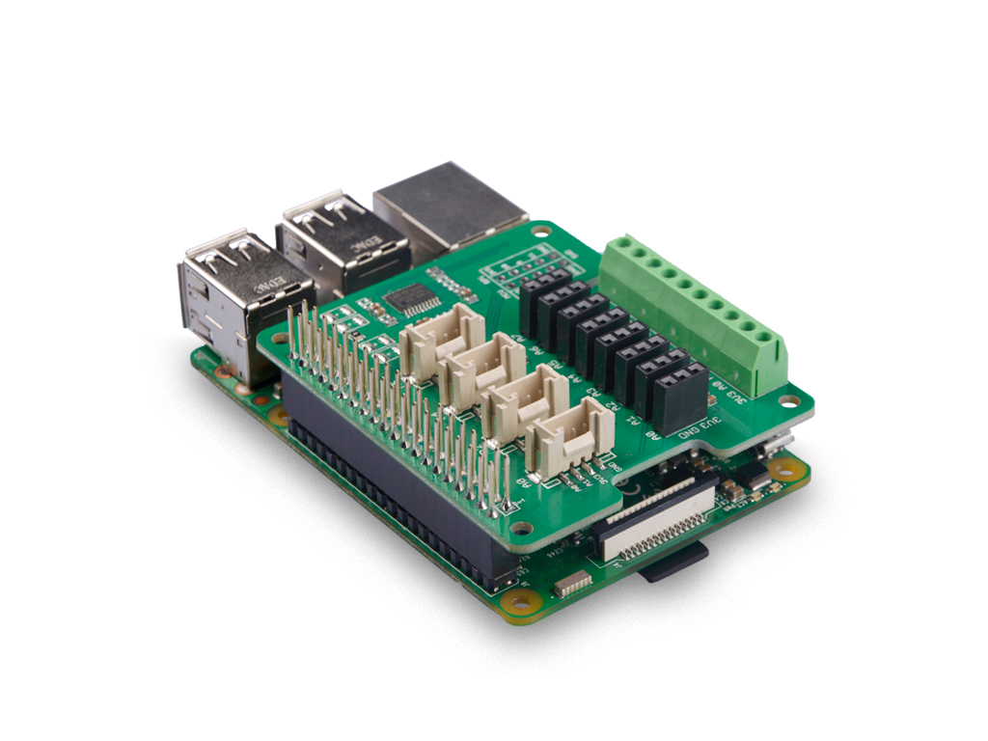
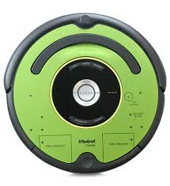
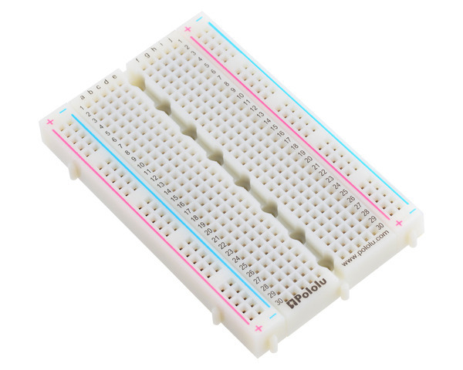
Hardware Stack
Digital and analog voltage levels: 3.3V
Allows for building on board
Circuits
http://wiki.seeedstudio.com/8-Channel_12-Bit_ADC_for_Raspberry_Pi-STM32F030/

Slide 3
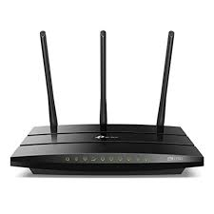
Connection
Set the network name to an idiosyncratic value.
Set each raspberry to a unique name, with a label on the robot. This allows looking up the ip addresses of each robot on the router side.
https://thepihut.com/blogs/raspberry-pi-tutorials/19668676-renaming-your-raspberry-pi-the-hostname

