Slide 1




IT-Experts Foundation
Code, For Change The World
IT-Experts Foundation
itexperts127001@gmail.com
Code, For Change The World
@_itexperts_

Slide 2


Java
Q1: What is Java?
Q2: Why Java is so popular programming Language?
Q3: How to start learning java?
Q4: What should I know before Learning java?
IT-Experts Foundation
itexperts127001@gmail.com
Code, For Change The World
@_itexperts_

Slide 3
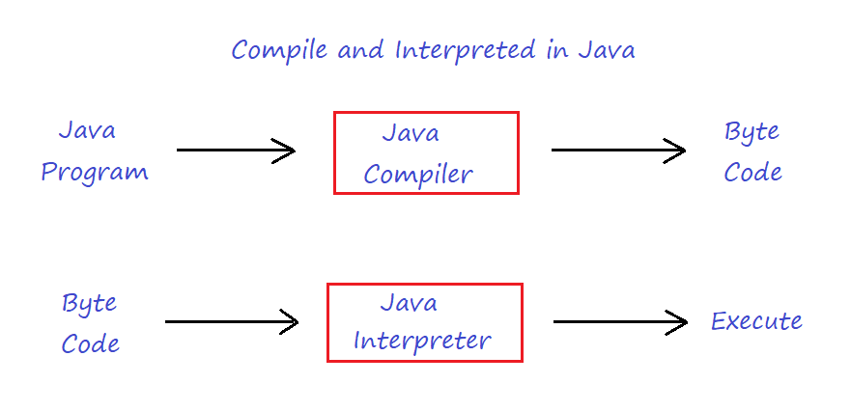
-> Java
Java is a Procedural Programming language with Object Oriented features.
Java follows OOPs Concept.
Java was developed as a part of the Green Project named as “OAK” under Sun Microsystems.
Java was initiated by James Goasling and his team in 1991 named as “OAK” and at the time of release its name changed to “Java” in 1995.
Some Characteristics of Java are
Simple
Compile and Interpreted
Portable and Platform
Independent
Secure and Robust
IT-Experts Foundation
itexperts127001@gmail.com
Code, For Change The World
@_itexperts_

Slide 4
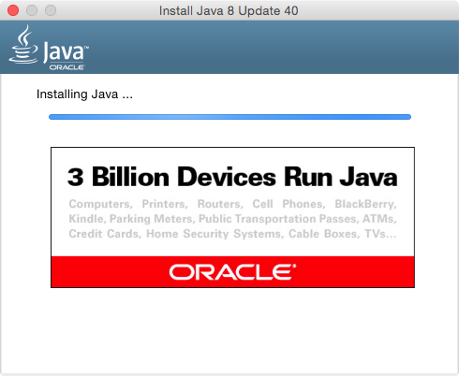
-> Java
Before learning Java we should know about OOPs Concept in Java.
They are as Follows:
Classes and Object
Encapsulation
Abstraction
Polymorphism
Inheritance
-> So Now We will Create Our First Program in Java.
IT-Experts Foundation
itexperts127001@gmail.com
Code, For Change The World
@_itexperts_

Slide 5

Doubts ?
Any Questions Feel
Free to Ask
itexperts127001@gmail.com
@_itexperts_
IT-Experts Foundation
itexperts127001@gmail.com
Code, For Change The World
@_itexperts_

Slide 6





Like
Share
Thank You
Happy Coding!!!
IT-Experts Foundation
itexperts127001@gmail.com
Code, For Change The World
@_itexperts_

