Slide 1
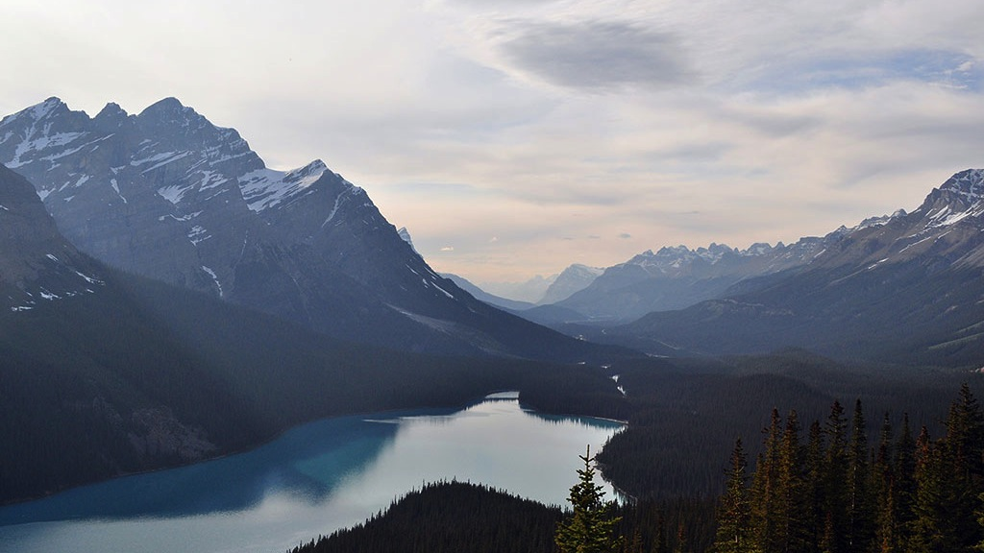

Docker in CI/CD pipeline
Robert Krisztian Horvath

Slide 2
Agenda
1
Docker basics
2
Create Images and Instances
3
Docker management
4
Docker in CI/CD pipeline (best practices)

Slide 3
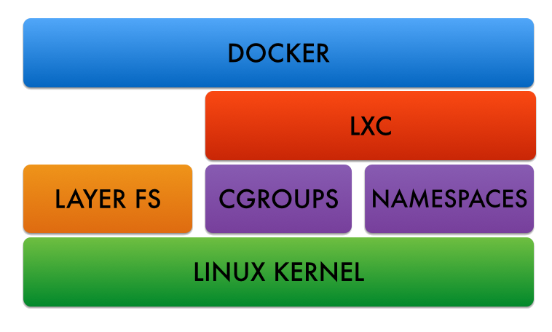
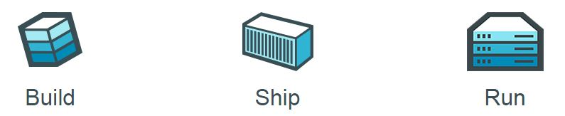
Docker basics - Technologies
1
Technologies
Kernel features to separate resources (processes, networks)
Kernel features to control resources (cpu, memory)
Own Root Filesystem
2
LXC vs. Docker
RootFS vs. Image
LayerFS store changes (like Git)
Docker is portable
Docker is for “run something ONCE and exit” (originally run’n’drop)
Anywhere

Slide 4
Docker basics – AUFS Layers
Image vs. Container/Instance
Image is NOT a container
Baseline to run a container
Image looks like an installed and unchangeable VM machine
RO (image) layers and RW (container) layer
Image is a tagged collection of read-only layers
ImageZ
ImageX
run
ContainerZ (rw)
commit
Change 5 (ro)
Change 4 (ro)
ImageY
tag
Change 3 (ro)
Change 2 (ro)
Change 1 (ro)

Slide 5
Create Images and Instances - Commands
Commands | Image | Container
Create | ‘pull’: get an image ‘build’: create from Dockerfile
List | ‘images’ : show all images | ‘ps’ : show running containers ‘ps -a’ : show all (stopped also)
Run | ‘run’ : start a container using an image | ‘start’ : start a previously stopped container
Delete | ‘rmi’ : delete image | ‘rm’: delete container
Examine Layers | ‘history’ : list all layers | ‘diff’ : list content of the last change (rw layer)

Slide 6
Docker IaaS
What we need | What we have
Share file system resources | Docker Volumes
Share network resources | Docker networks Docker ports
Inject parameters | Docker parameters for ENVs, Hostnames, etc.
Uninterrupted service | Entrypoint scripts Supervisord as Init system

Slide 7
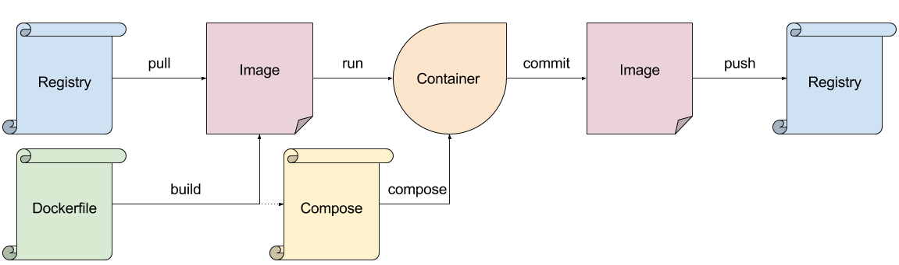
Docker management

Slide 8
Docker in CI/CD Pipeline
1
Continuous Integration
Use an Image as a standard base for all building operations for everyone
Use an Image for tests
Use compose to bring up infrastructure for integration tests (different infra for different test types, eg.: smoke test vs. journey tests)
Drop immediately after build and test
Docker Image shouldn’t be an artifact !!!
2
Continuous Delivery
Use compose to build environments (DEV/QA/Pre-PROD/etc)
Deploy / Test / Commit / Push / Drop
Docker Image could be an artifact

Slide 9
Demo
1
Pull Image
2
Run Image / Interact with Container
3
Create new image with the changes
4
Show changes / Tag changes
5
Remove Instance / Remove Image

