Slide 1


Slide 2
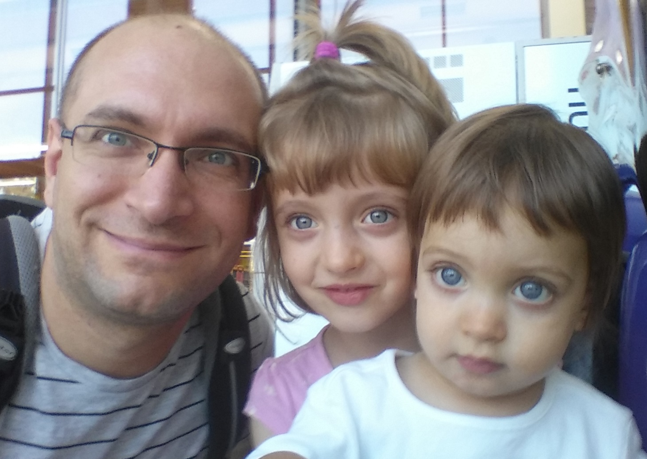
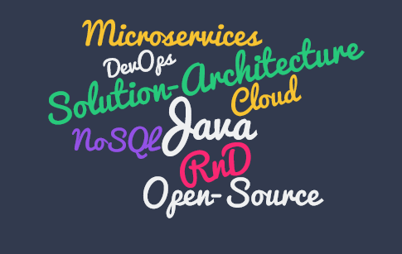

Who am I?
Oresztész Margaritisz
Lead Software Engineer

Slide 3
What is DC/OS?
Operating system for your datacenter
Unified API for distributed & cloud computing

Slide 4
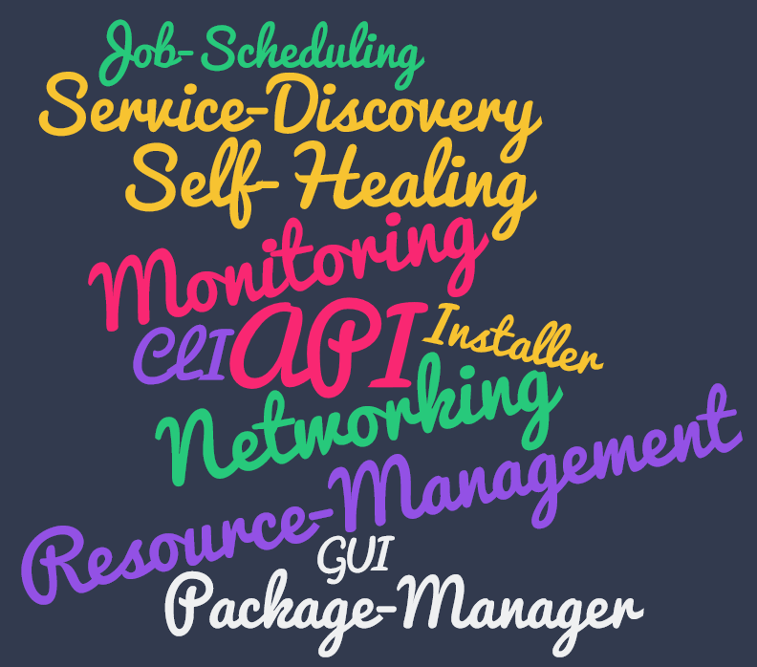
Key Features

Slide 5
Why DC/OS?
Distributed computing is hard and error-prone
Impossible to maintain by humans
Custom solutions are expensive
Cloud agnosticity is very hard

Slide 6


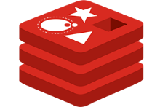
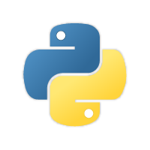


Why DC/OS?

Slide 7

Why DC/OS?

Slide 8


Why DC/OS?

Slide 9



10,000 foot view
AWS
Networking
Azure
Orchestration
Google Cloud
Monitoring
Service Registry
Bare Metal

Slide 10
10,000 foot view
User Space
process
process
service
process
service
service
process
process
process
System Components
Kernel Space
Mesos Agent
Mesos Agent
Mesos Agent
Mesos Agent
Mesos Master
Mesos Master
Mesos Master

Slide 11


zk
zk
Hadoop scheduler
Marathon scheduler
zk
Mesos Master
Standby Master
Standby Master
Mesos Agent
Mesos Agent
Mesos Agent
Hadoop executor
Marathon executor
Hadoop executor
Marathon executor
task
task
task
task

Slide 12

Framework 1
Framework 2
Job 1
Job 2
Job 1
Job 2
FW Scheduler
FW Scheduler
<s1, 4cpu, 4gb … >
2
3
<task1, s1, 2cpu, 1gb … >
<task2, s1, 1cpu, 2gb … >
Mesos Master
<s1, 4cpu, 4gb … >
1
4
<fw1, task1, 2cpu, 1gb … >
<fw1, task2, 1cpu, 2gb … >
Mesos Agent
Mesos Agent
Executor
Task
Task

Slide 13



Slide 14
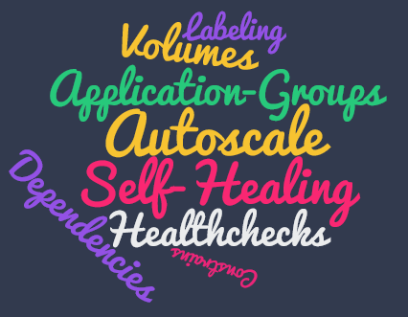

Slide 15
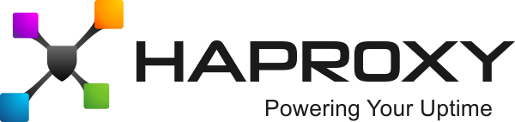
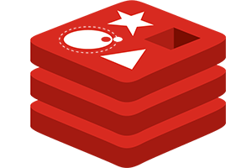
Demo

Slide 16


Slide 17


