Slide 1
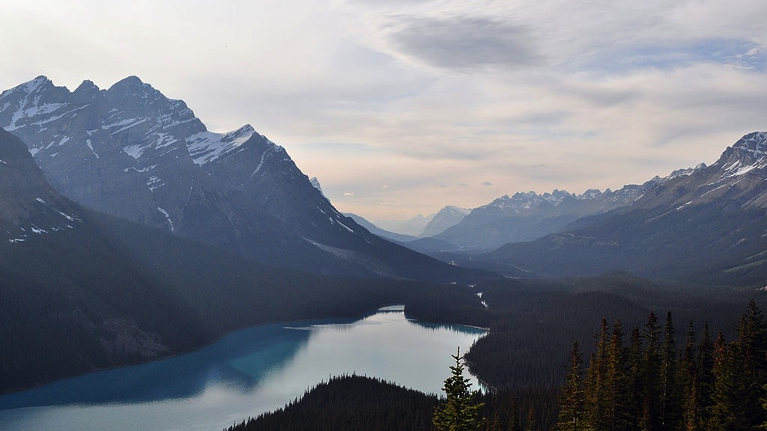

Docker in CI/CD pipeline
Robert Krisztian Horvath

Slide 2
Agenda
1
Docker basics
2
Create Images and Instances
3
Docker management
4
Docker in CI/CD pipeline

Slide 3
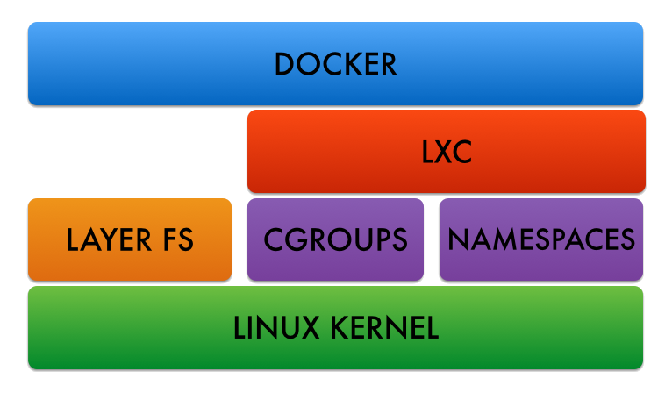
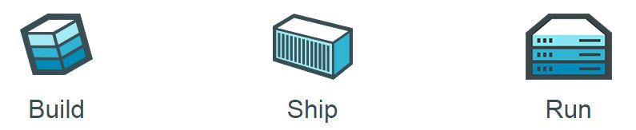
Docker basics - Technologies
1
Technologies
Kernel features to separate resources (processes, networks)
Kernel features to control resources (cpu, memory)
Own Root Filesystem
2
LXC vs. Docker
RootFS vs. Image
LayerFS store changes (like Git)
Docker is portable
Docker is for “run something ONCE and exit” (originally run’n’drop)
Anywhere

Slide 4
Docker basics – AUFS Layers
Image vs. Container/Instance
Image is NOT a container
Baseline to run a container
Image looks like an installed and unchangeable VM machine
RO (image) layers and RW (container) layer
Image is a tagged collection of read-only layers
ImageZ
ImageX
run
ContainerZ (rw)
commit
Change 5 (ro)
Change 4 (ro)
ImageY
tag
Change 3 (ro)
Change 2 (ro)
Change 1 (ro)

Slide 5
Create Images and Instances - Commands
Commands | Image | Container
Create | ‘pull’: get an image ‘build’: create from Dockerfile
List | ‘images’ : show all images | ‘ps’ : show running containers ‘ps -a’ : show all (stopped also)
Run | ‘run’ : start a container using an image | ‘start’ : start a previously stopped container
Delete | ‘rmi’ : delete image | ‘rm’: delete container
Examine Layers | ‘history’ : list all layers | ‘diff’ : list content of the last change (rw layer)

Slide 6
Docker IaaS
What we need | What we have
Share file system resources | Docker Volumes
Share network resources | Docker networks Docker ports
Inject parameters | Docker parameters for ENVs, Hostnames, etc.
Uninterrupted service | Entrypoint scripts Supervisord as Init system

Slide 7
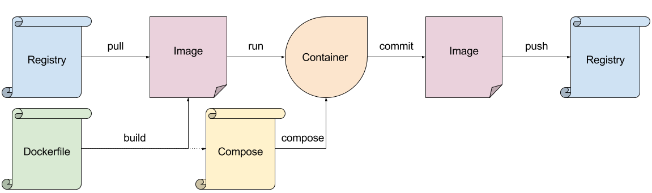
Docker management

Slide 8
Docker in CI/CD Pipeline
1
Continuous Integration
Use an Image as a standard base for all building operations for everyone
Use an Image for tests
Use compose to bring up infrastructure for integration tests e.g.
Drop immediately after build and test
Docker Image shouldn’t be an artifact !!!
2
Continuous Delivery
Use compose to build environments (DEV/QA/Pre-PROD/etc)
Deploy / Test / Commit / Push / Drop
Docker Image could be an artifact

Slide 9
Demo
1
Pull Image
2
Run Image / Interact with Container
3
Create new image with the changes
4
Show changes / Tag changes
5
Remove Instance / Remove Image

