Slide 1
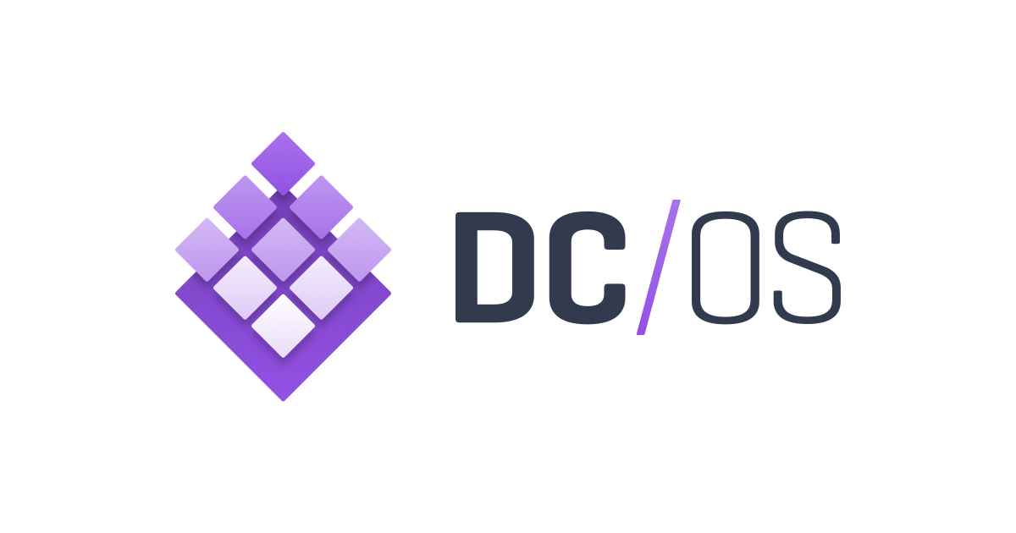

Slide 2
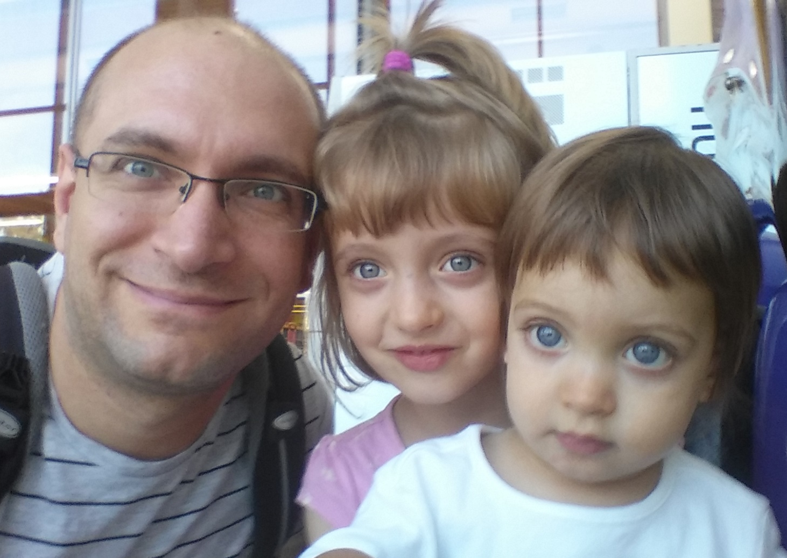
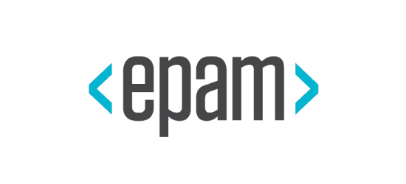
Who am I?
Lead Software Engineer
Java & Open Source tools
Cloud computing
Microservices
DevOps
Solution Architecture
RnD & Innovation

Slide 3
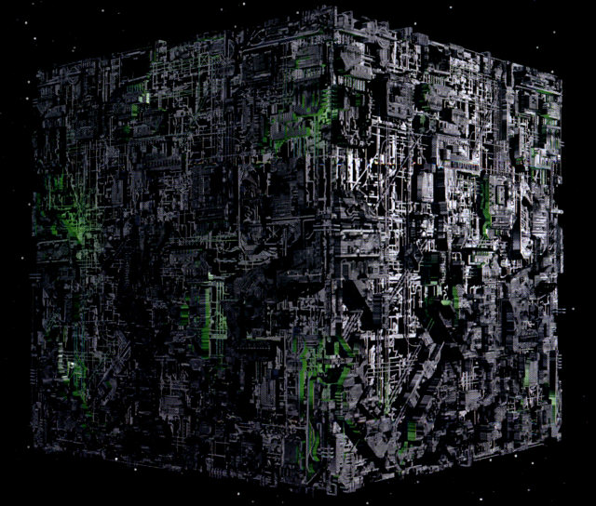
Notes:
Google borg

Slide 4
What is DC/OS?
Operating system for your datacenter
Unified API for distributed & cloud computing

Slide 5
Key features
Installer
All-in-one GUI and CLI
Package manager
Service discovery
Self-healing
Resource management
Job scheduling
Monitoring
Networking
Programmable interfaces

Slide 6
Why DC/OS?
Distributed computing is hard and error-prone
Impossible to maintain by humans
Custom solutions are expensive
Cloud agnosticity is very hard

Slide 7
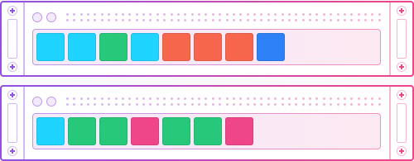
Why DC/OS?

Slide 8
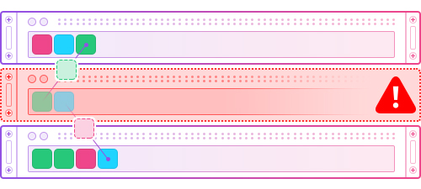
Why DC/OS?

Slide 9
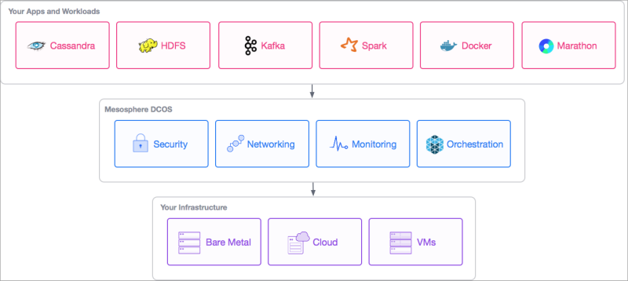
10,000 foot view

Slide 10
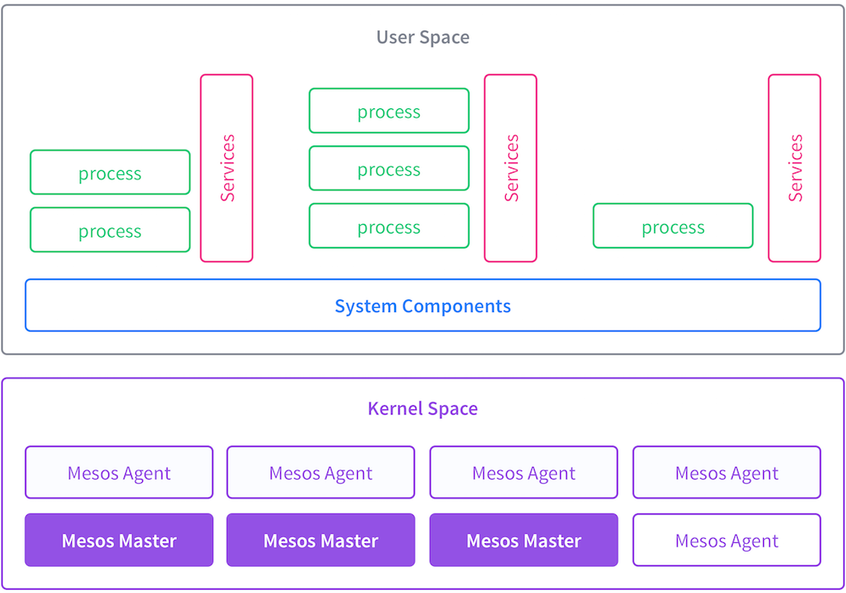
10,000 foot view

Slide 11

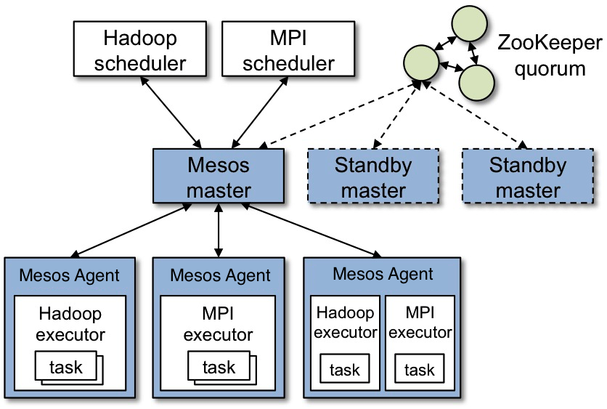

Slide 12
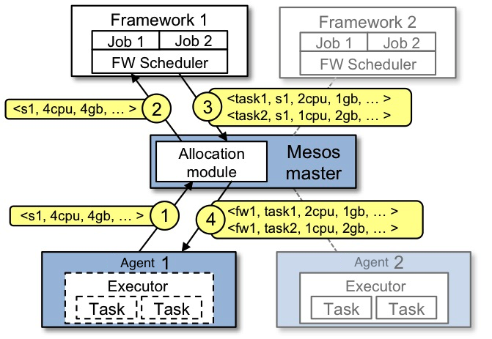

Slide 13

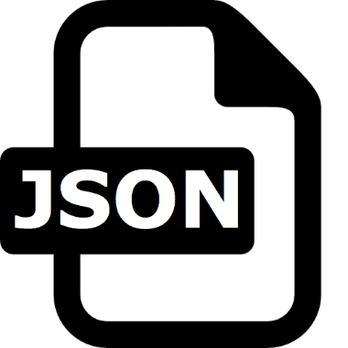

Slide 14
Healthchecks
Contraints
Application groupings
Dependent deployments
Autoscale
Volume management
Labeling

Slide 15
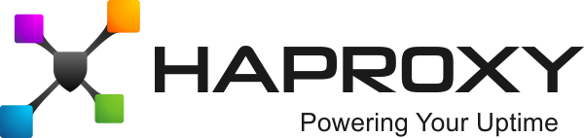
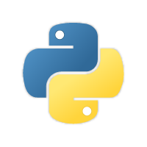
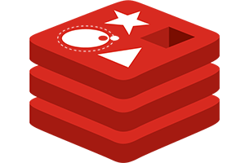
Demo

Slide 16


Slide 17


