Slide 1

“DevOps is development and operations collaboration”
“DevOps is treating your infrastructure as code”
It’s DevOps!
It’s DevOps!
“DevOps is using automation”
It’s DevOps!
“DevOps is feature switches”
It’s DevOps!
“DevOps is small deployments”
“Kanban for Ops?”

Slide 2
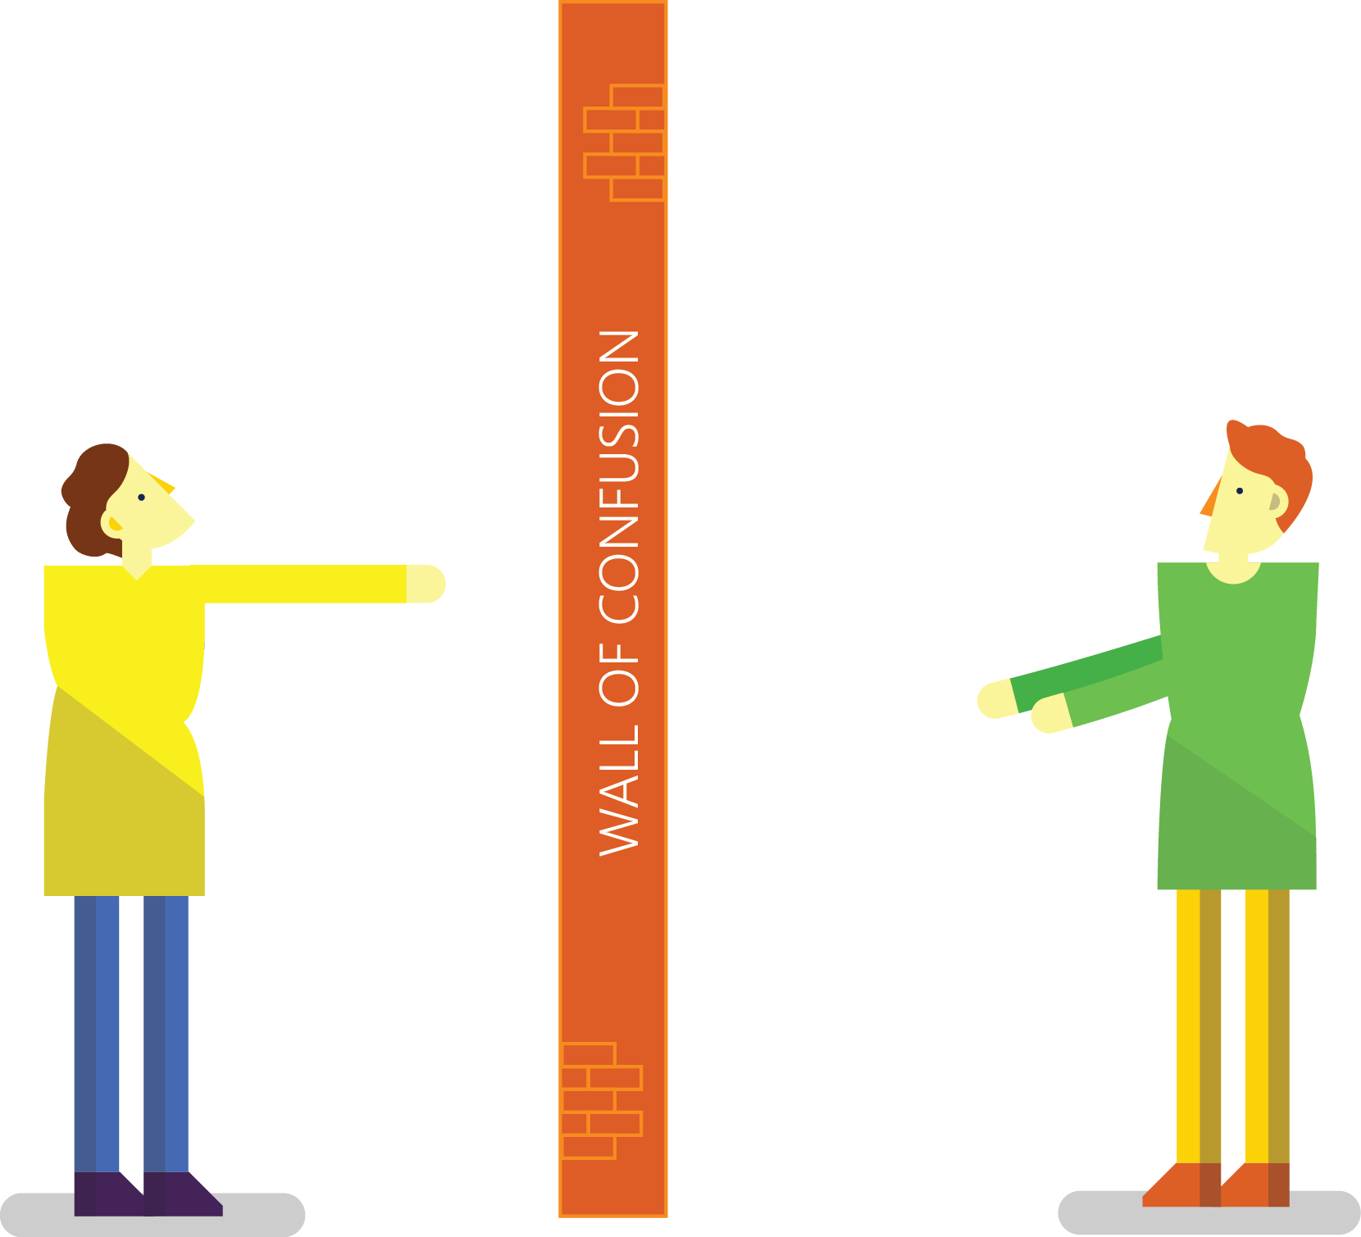

Traditional Development and Operations
DEV
OPS
Notes:
Taken from: http://dev2ops.org/2010/02/what-is-devops/
Development kicks things off by “tossing” a software release “over the wall” to Operations. Operations picks up the release artifacts and begins preparing for their deployment. Operations manually hacks the deployment scripts provided by the developers or creates their own scripts. They also hand edit configuration files to reflect the production environment, which is significantly different than the Development or QA environments. At best they are duplicating work that was already done in previous environments, at worst they are about to introduce or uncover new bugs.
Operations then embarks on what they understand to be the currently correct deployment process, which at this point is essentially being performed for the first time due to the script, configuration, process, and environment differences between Development and Operations. Of course, somewhere along the way a problem occurs and the developers are called in to help troubleshoot. Operations claims that Development gave them faulty artifacts. Developers respond by pointing out that it worked just fine in their environments, so it must be the case that Operations did something wrong. Developers are having a difficult time even diagnosing the problem because the configuration, file locations, and procedure used to get into this state is different then what they expect (if security policies even allow them to access the production servers!).
Time is running out on the change window and, of course, there isn’t a reliable way to roll the environment back to a previously known good state. So what should have been an eventless deployment ended up being an all-hands-on-deck fire drill where a lot of trial and error finally hacked the production environment into a usable state.

Slide 3


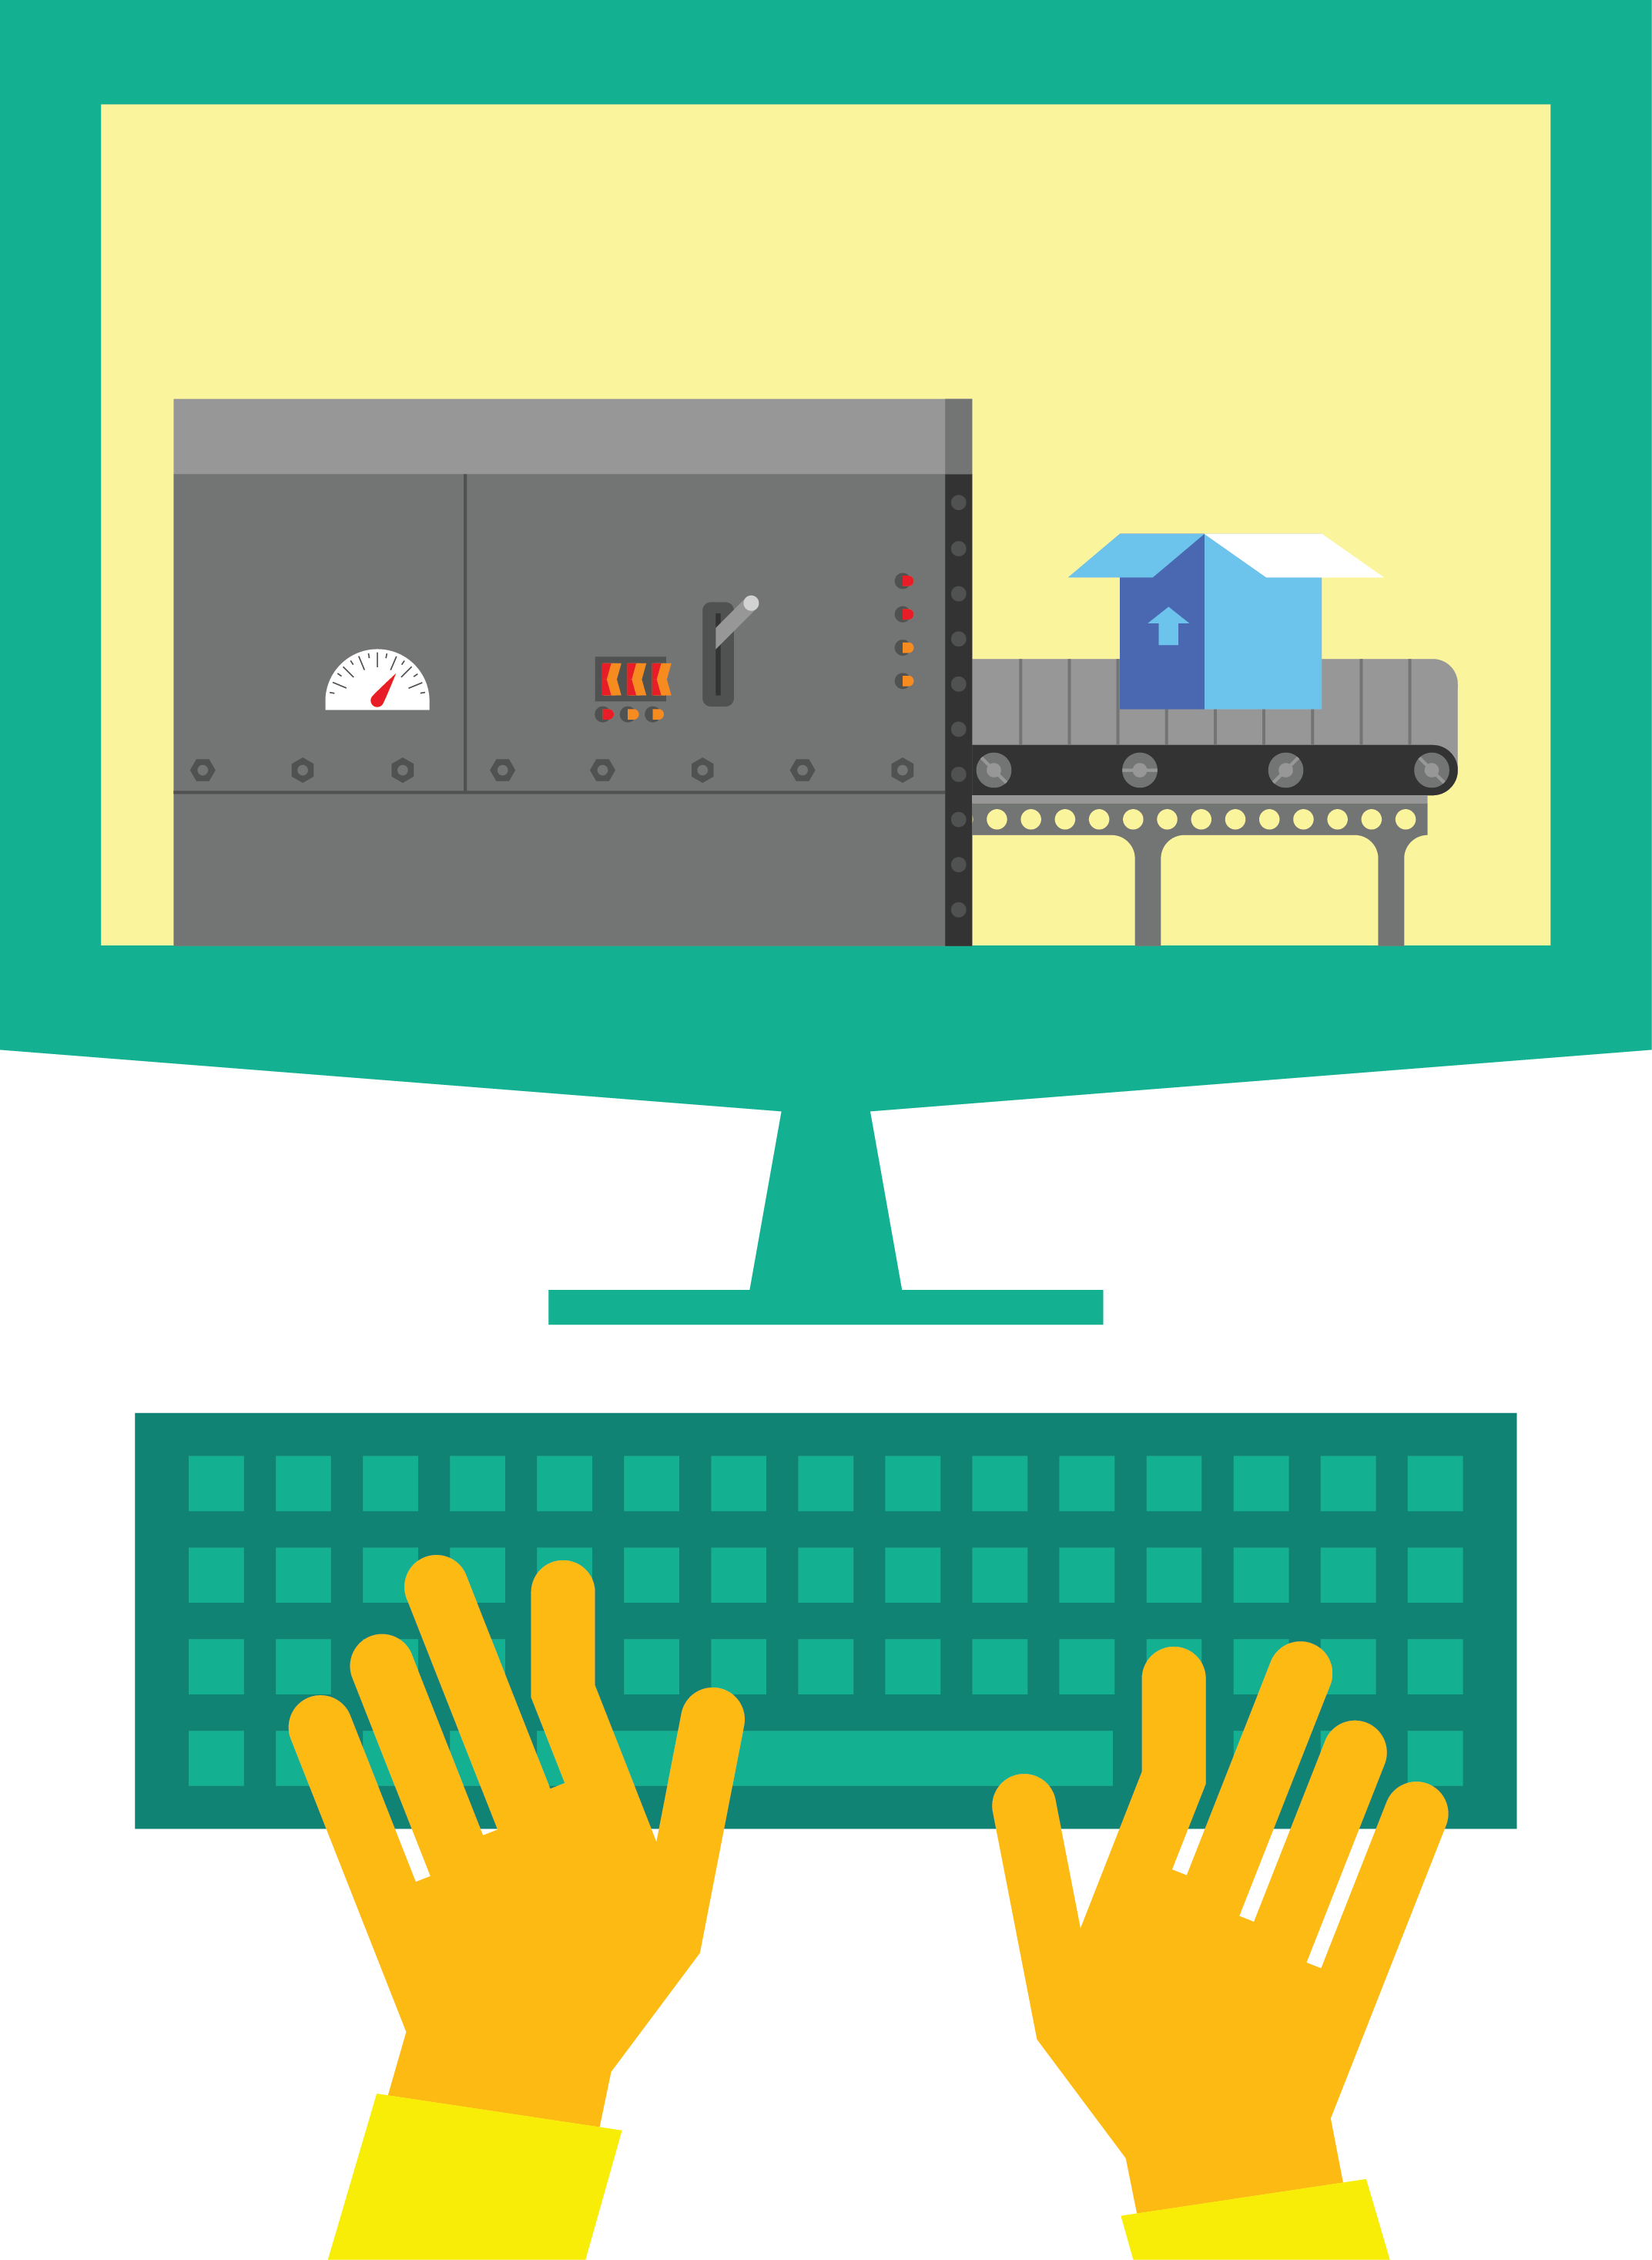

DevOps: the three stage conversation
1
People
2
Process
3
Products
Notes:
People = Culture
Fundamental attributes of successful cultures:
Shared mission and incentives: infrastructure as code, apps as services, DevOps/all as teams
You need to consider your hardware as a commodity, (don't give your servers names) , servers are like farm animals, it is just harder if you let theids name them
Build deep instrumentation into services, push complexity up the stack
Rally around agile, shared metrics, CI, service owners on call, etc.
Changing the culture: any change takes time, changing culture is no exception and you can't do it alone, exploit compelling events to change culture: downtimes, cloud adoption, devops buzz
PROCESS Definition and design, compliance, and continuous improvement
PEOPLE Responsibilities, management, skills development, and discipline
Products Tools and infrastructure

Slide 4
DevOps
Módszerek
Megvalósítás
Azure Deployment Template
Miről szól?
Infrastructure as Code
Chef / CloudInit
People, Process, Business Value, etc.
Visual Studio Team Services / Jenkins / AppVeyor / Travis CI
Continuous Integration
Docker Hub

Slide 5


Infrastruktúra mint kód
Habits
Production first mindset
Infrastructure as flexible resource
DEV
CODE
STAGE
Value
Optimized Resources
Accelerate Delivery
OPS
PRODUCTION
Measure
Deployment Rate
MTTR
DEV
OPS

Slide 6
Azure Resource Manager áttekintés
Alkalmazás életciklus konténer
Deklaratív megoldás kihelyezéshez (Deployment) és konfigurációhoz (Configuration)
Egységes menedzsment réteg
Az erőforrások közvetlenül erőforráscsoportban vannak létrehozva
ARM Template (JSON)
PowerShell
Azure CLI
Portál élmény
Microsoft Azure

Slide 7
Azure Resource Manager Templates
Azure Templates képességek:
Garantálják az idempotenciát
Egyszerűsítik a kompozíciót
Erőforrás csoportok konfigurációjának és frissítésének támogatása
Azure Templates jellemzők:
Forráskód alapúak, verziózottak
Erőforrások és függőségeik deklarálását támogatja
Parametrizáltak
Microsoft Azure

Slide 8
imperatív vagy deklaratív
New-AzureVM –VM $myVM
New-AzureStorageAccount –StorageAccountName $acct
Set-AzureVNetConfig –ConfigurationPath -Path
{
"$schema": "https://../deploymentTemplate.json#",
"contentVersion": "1.0.0.0",
"parameters": {},
"variables": {},
"resources": [],
"outputs": {}
}

