Slide 1
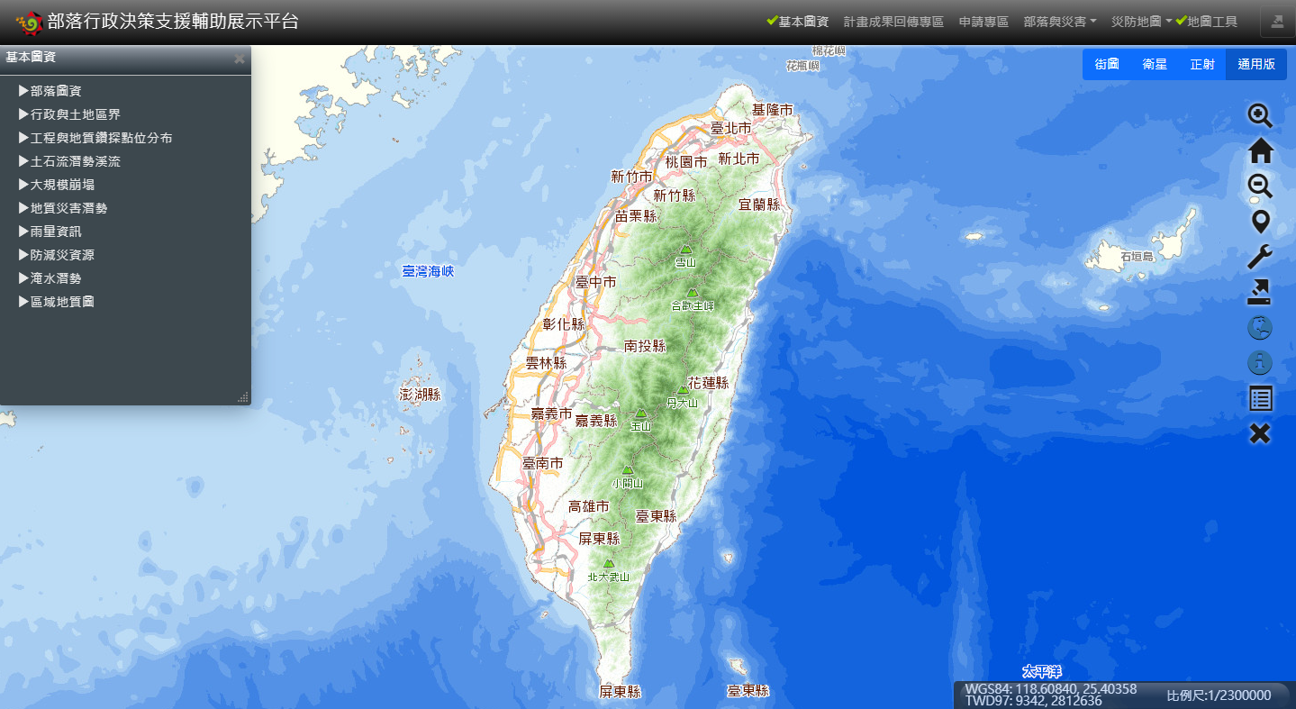
新增介接8個圖資
1.坡向圖
https://wmts.nlsc.gov.tw/wmts/MOI_ASPECT/default/GoogleMapsCompatible/15/14127/27366
2.等高線圖(2003-2005)
https://wmts.nlsc.gov.tw/wmts/MOI_CONTOUR/default/GoogleMapsCompatible/15/14127/27366
3.陰影圖
https://wmts.nlsc.gov.tw/wmts/MOI_HILLSHADE/default/GoogleMapsCompatible/15/14127/27366
4.渲染圖
https://wmts.nlsc.gov.tw/wmts/MOI_SHADERMAP/default/GoogleMapsCompatible/15/14127/27366
5.坡度圖-30%坡(2003-2005)
https://wmts.nlsc.gov.tw/wmts/MOI_SLOPEP_GT30/default/GoogleMapsCompatible/15/14127/27366
6.坡度圖-30%坡(2010-2015)
https://wmts.nlsc.gov.tw/wmts/MOI_SLOPEP_GT30_2/default/GoogleMapsCompatible/15/14127/27366
7.坡度圖-7級(2003-2005)
https://wmts.nlsc.gov.tw/wmts/MOI_SLOPEP_LV7/default/GoogleMapsCompatible/15/14127/27366
8.坡度圖-7級(2010-2015)
https://wmts.nlsc.gov.tw/wmts/MOI_SLOPEP_LV7_2/default/GoogleMapsCompatible/15/14127/27366
有說明文字與圖例
1.增加” 20公尺DTM加值成果”的分類

Slide 2
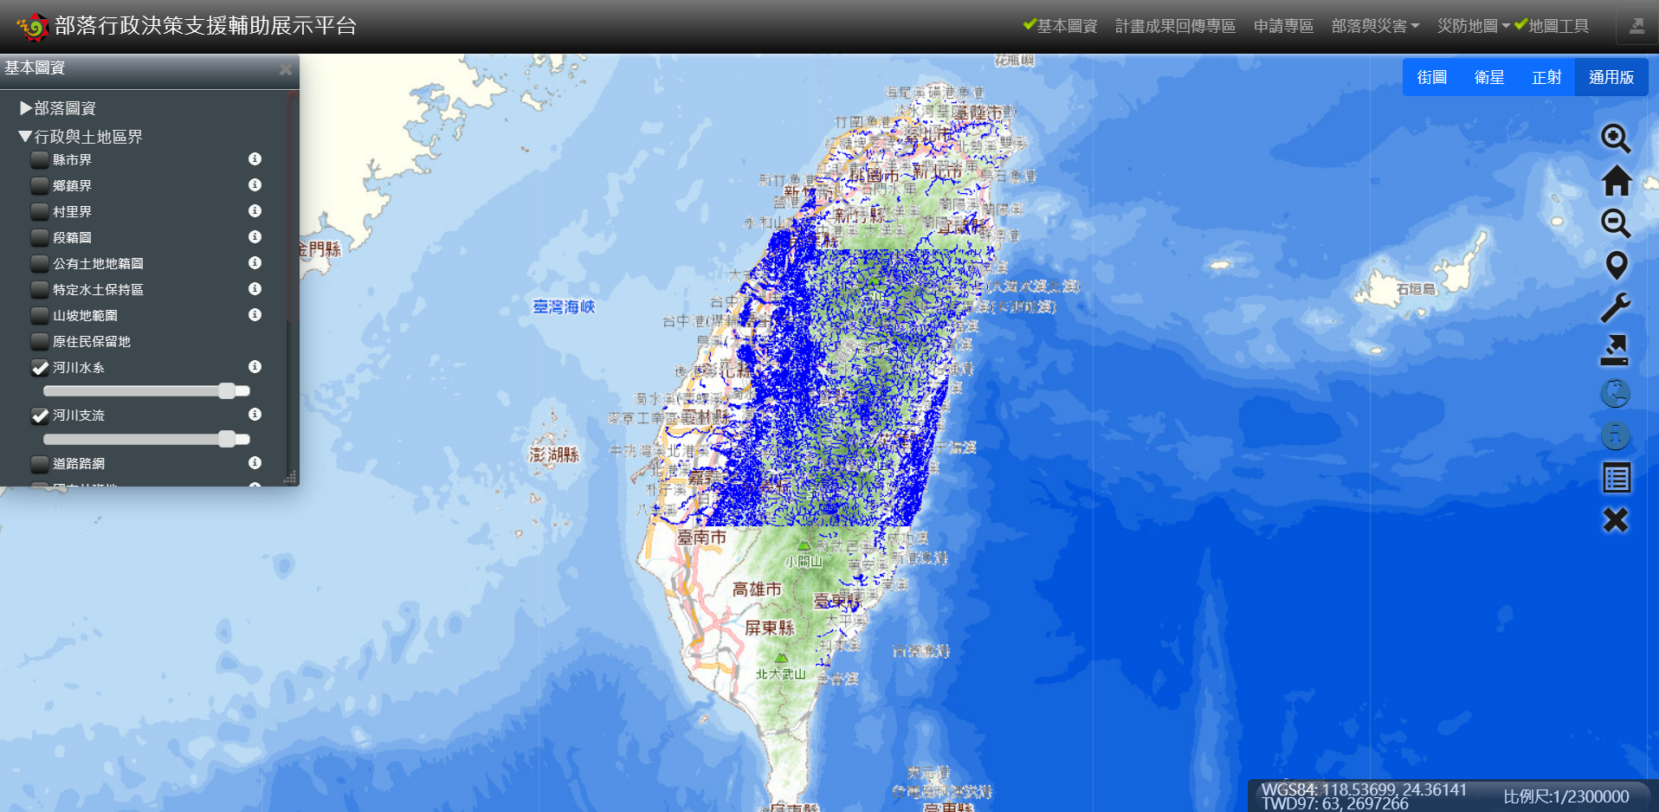
置換服務－改界接ARCGIS圖資
河川水系
http://210.59.253.2:6080/arcgis/rest/services/TaiChung/riverpoly/MapServer
河川支流
http://210.59.253.2:6080/arcgis/rest/services/TaiChung/riverline/MapServer
界接方式可參考先前土地開發補償的水道人孔的程式碼
https://sewer.water.tainan.gov.tw/RSMap/#

