Slide 1





AZURE DevOPS
- Tamil

Slide 2
What is DevOps and different DevOps Platform
What is AZURE DevOps
Azure DevOps Components
Azure Board
Azure Repo
Azure Pipelines
Azure Test Plans
Azure Artifacts

Slide 3
What is DevOps
DevOps is a platform which used to manage Project development life cycle. It is a combination of various Tools, Concepts and Practices
Different DevOps Platform
Azure DevOps
Aws
Google Cloud
GitLab
JIRA , Jenkins

Slide 4
What is Azure DevOps
Azure DevOps is Microsoft provided DevOps platform, Which is used to manage entire project cycle like Requirement, Version control, Automated build and deployment, Testing and release management.
Types of Azure DevOps
Azure DevOps Services (Cloud)
Azure DevOps Server (On-Prem)
Plan → Code → Build → Package →Test → Release → Configuration → Monitor

Slide 5
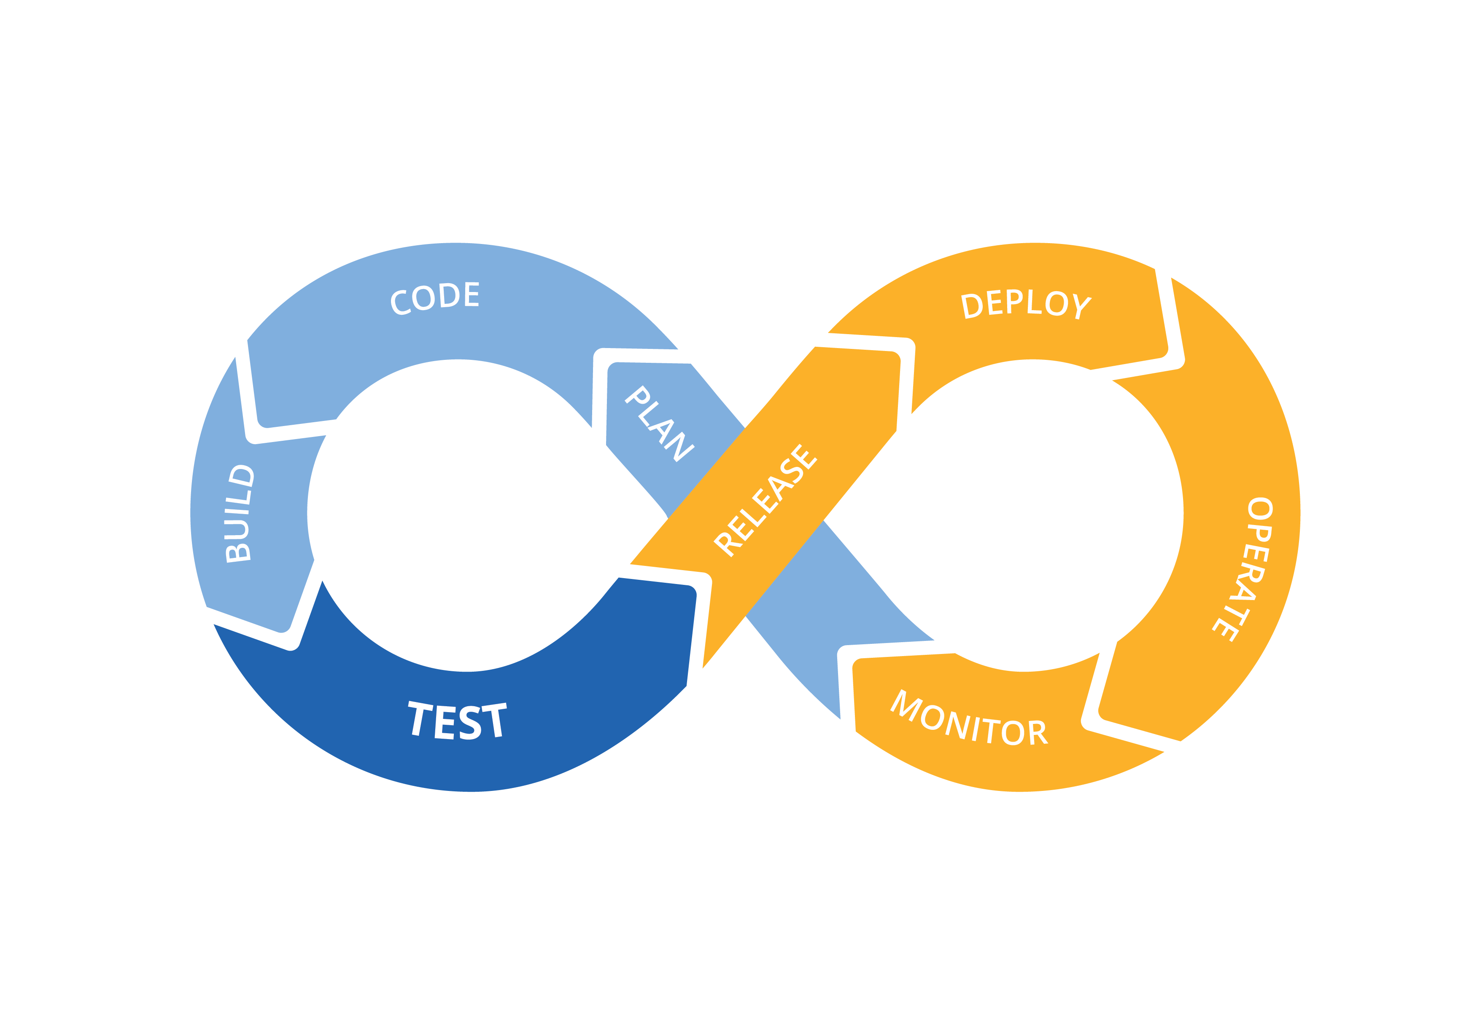
What is Azure DevOps
Azure DevOps is Microsoft provided DevOps platform, Which is used to manage entire project cycle like Requirement, Version control, Automated build and deployment, Testing and release management.
DEV
OPS

Slide 6
Azure DevOps Components
Azure Board
Azure Repo
Azure Pipelines
Azure Test Plans
Azure Artifacts

Slide 7

DevOps Flow
BA, PM & Developer
AZURE Board

Slide 8

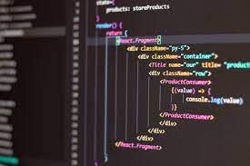
DevOps Flow
BA, PM & Developer
Developer
AZURE Board
Coding
AZURE Repo
Git, TFS

Slide 9

DevOps Flow
Azure Build Pipeline
Get Source
Build
Run Test
Artifacts
BA, PM & Developer
Developer
Agent (YAML Script)
AZURE Board
Coding
AZURE Repo
AZURE Build Pipeline (CI)
Artifacts

Slide 10
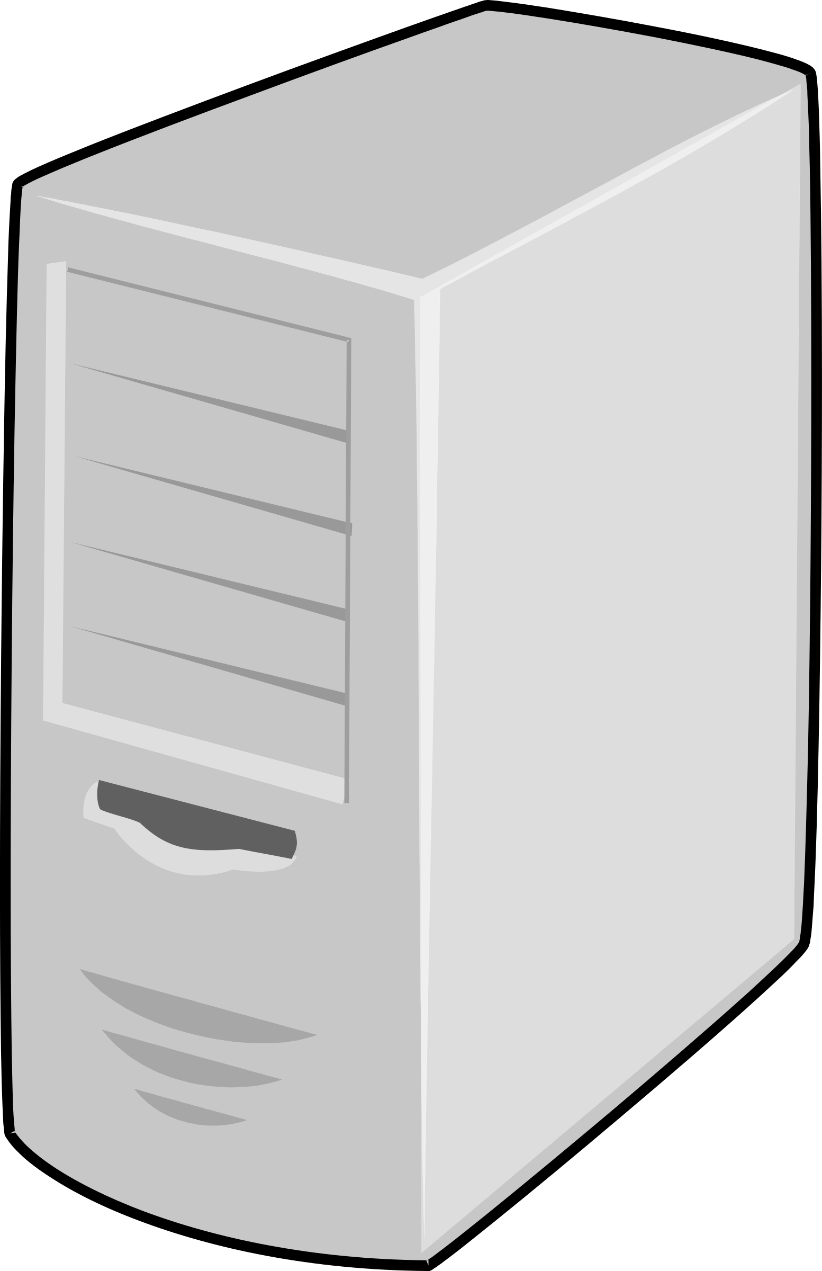
DevOps Flow
Azure Build Pipeline
Get Source
Build
Run Test
Artifacts
BA, PM & Developer
Developer
Agent (YAML Script)
AZURE Board
Coding
AZURE Repo
AZURE Build Pipeline (CI)
Artifacts
Azure Release Pipeline
Approval
Production
UAT
AZURE Release Pipeline (CD)

Slide 11
DevOps Pipe Line
Azure Build Pipeline (YAML Script)
Get Source
Build
Run Test
Artifacts
BA, PM & Developer
Developer
Agent
AZURE Board
Coding
AZURE Repo
AZURE Build Pipeline (CI)
Azure Release Pipeline
Artifacts
Approval
Agent (Deployment Group)
Production
UAT
AZURE Release Pipeline (CD)

Slide 12
Azure DevOps Pipelines
What is Pipeline
Manual Build Process
Auto-matted Build Process (CI /CD)
Agent
Task
YAML
Artifacts

Slide 13
What is Pipeline
Pipeline is used to automate the build and delivery process. This process is called CI/CD
CI (Continuous Integration)
Read the code changes from repository (GIT , TFS .. Etc)
Build the code
Store the build output (deliverables) into Artifacts
CD (Continuous Deployment)
Move the deliverables into different environment

Slide 14

Manual Build Process
Without clear understanding of manual build process don’t automate the build process.
CI (Continuous Integration)
Read the code changes from repository (TF.Exe)
Build the code (MsBuild.exe , Dotnet.Exe )
CD (Continuous Deployment)
Move the deliverables into different environment

Slide 15
Auto-matted Build Process (CI /CD)
YAML (Yet another markup language)
Readable configuration file used to crate tasks in Azure devops.
Task Templates
Restore
Build
Publish … etc
Agent & Agent Pool
Agent is a Software/Machine, which will run the configured task. Agent will execute each task separately and pick the next task once the previous task is completed.
Artifacts
Deliverables is called Artifacts. It may be .dll, .zip, .xml, .txt or any type

Slide 16
Azure Pipeline Configuration

Slide 17
Azure CI Pipeline Configuration
CI Pipeline Automation (Triggers)
Check-in
Gated Check-in **
Schedule
Parameters

Slide 18
CI Pipeline Automation (Triggers)
Triggers are used to run pipeline’s automatically.
Check-in
Whenever new code changes are added in repository then automatically CI pipeline will be started
Gated Check-in **
This option used to avoid a broken code check-in into the source control. Our code changes must be built by Azure Pipelines before they checked in.
Schedule
This option used to start pipeline in scheduled interval (like Hourly, daily … etc)

Slide 19
Parameters

Slide 20
Integrating Unit Test

Slide 21
Demo

Slide 22
Azure Repo

Slide 23
Azure Boards

Slide 24
Azure Test Plans

Slide 25
Azure Artifacts

Slide 26
THANK YOU

