Slide 1


The labbuildr toolkit – unleash the Potential of VMware Workstation
Join Mspecialist, HyperV Guy and Powershell Guru Karsten Bott who will demonstrate the power and simplicity of managing Vmware Workstation withMicrosoft Powershell. This session will provide an overview of Powershell, as well as an in depth training on labbuildr
Notes:
Welcome. We’ll be discussing a solution that empowers your business to use technology strategically.

Slide 2
Important Rules
Important: always use Tab-Completion !
Important: always use Tab-Completion !
Important: always use Tab-Completion !
When i say [TAB] : use Tab-Completion !
Listen, then Type
When i say Close VMware, then Close Vmware
When i say exit VPN .... Exit VPN
Also consider stop-service nam ( as admin )
Connect to Guest - WLAN

Slide 3
How to get started
https://github.com/bottkars/labbuildr/wiki
STOP ! We will do this together !

Slide 4
Check for Powershell Version
Code: $PSVersionTable
PS C:\Users\Karsten> $PSVersionTable
Name Value
---- -----
PSVersion 5.0.10240.16384
WSManStackVersion 3.0
SerializationVersion 1.1.0.1
CLRVersion 4.0.30319.42000
BuildVersion 10.0.10240.16384
PSCompatibleVersions {1.0, 2.0, 3.0, 4.0...}
PSRemotingProtocolVersion 2.3

Slide 5
Check for .Net Version and Vmware Version
https://support.microsoft.com/en-us/kb/318785
Vmware must be at least 10 or 11 ( n-1)

Slide 6
Download labbuildr and vmxtoolkit
Google [labbuildr]beta
Browse to the end
Download both attachements

Slide 7
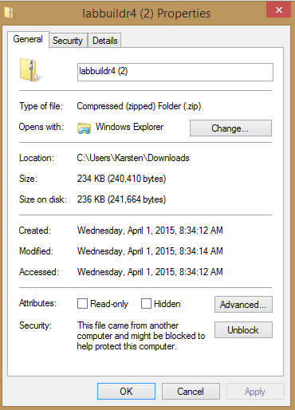
Unblock Files

Slide 8
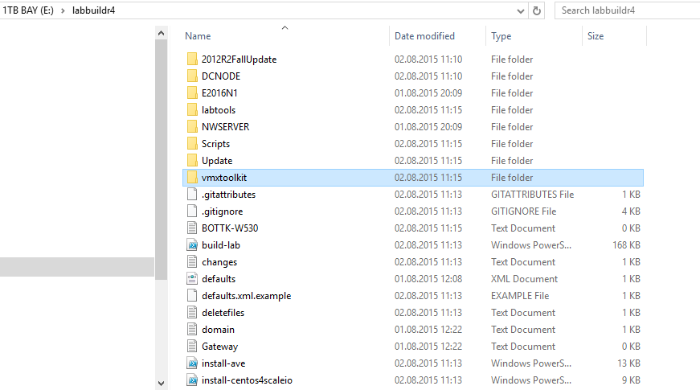
Xtract Files

Slide 9
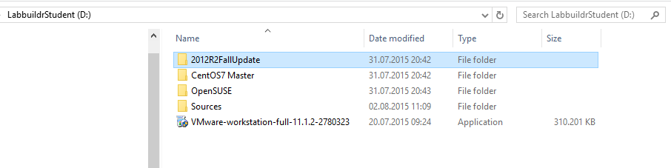
Copy 2012R2Master from labbuildrstudent Stick

Slide 10
What is a Powershell command ?
Get
-Help
-parameter
-commonParameter
Verb
„What to do“
(see get-verb )
Get
New
Add
Invoke
Noun
„Who“
(see get-noun)
Disk
Lun
xxxLUN
EMCLun
Use –[tab]
Use get-Help
Use get-help –parameter Types: Optional/Mandatory
Switch, int, String, int64 ...
Array, List, hashtable...
Get-help About_CommonParameter
-debug
-Verbose
-Force

Slide 11
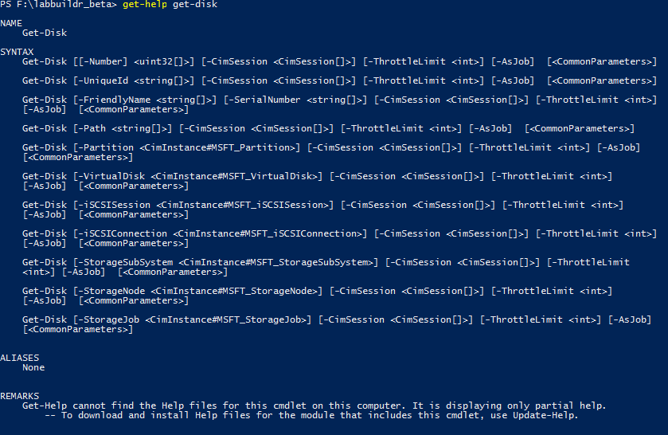
Specials : Parameter Sets

Slide 12
Special: ConfirmationPreference
$ConfirmPreference
Determines whether Windows PowerShell automatically prompts you for confirmation before running a cmdlet or function. When the value of the $ConfirmPreference variable (High, Medium, Low) is less than or equal to the risk assigned to the cmdlet or function (High, Medium, Low), Windows PowerShell automatically prompts you for confirmation before running the cmdlet or function. If the value of the $ConfirmPreference variable is None, Windows PowerShell never automatically prompts you before running a cmdlet or function. To change the confirming behavior for all cmdlets and functions in the session, change the value of the $ConfirmPreference variable. To override the $ConfirmPreference for a single command, use the Confirm parameter of the cmdlet or function. To request confirmation, use -Confirm. To suppress confirmation, use -Confirm:$false

Slide 13
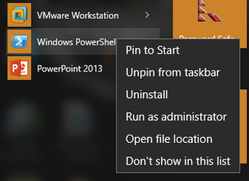
Open Powershell ( as admin )
Set-ExecutionPolicy -ExecutionPolicy Unrestricted

Slide 14
Open Powershell as user
Set-location ( your labbuildr dir ) Set-Location -Path D:\labbuildr4\
CD works also ☺
Hint: get-alias

Slide 15

Run Each Step: [hint: Tab-Completion]
.\profile.ps1
.\build-lab.ps1 –update
.\build-lab.ps1 –createshortcut
Exit
Now click on

Slide 16
Ready to Build you First Lab ?

Slide 17
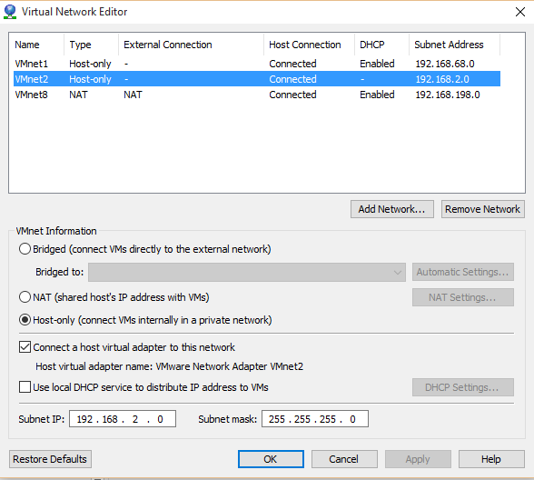
No. Lets Unterstand some Basics
What is Part of a „LAB“
vmnet ( default: vmnet2 )
BuildDomain ( default: labbuildr
Mysubnet (default: 192.168.2.0 )
Master ( default: 2012R2FallUpdate )
$Vmwarepath\*net*.exe

Slide 18
Let us buil the First LAB, our DC
We do a dry run using the –verbose option !
.\build-lab.ps1 –dconly –verbose –savedefaults –sourcedir [usbstick]

