Slide 1


CodeCraft

Slide 2
TABLE OF CONTENTS
01
02
03
04
Team Members
Idea of the app
Stages of Working
Used Technologies

Slide 3
01
TEAM MEMBERS

Slide 4
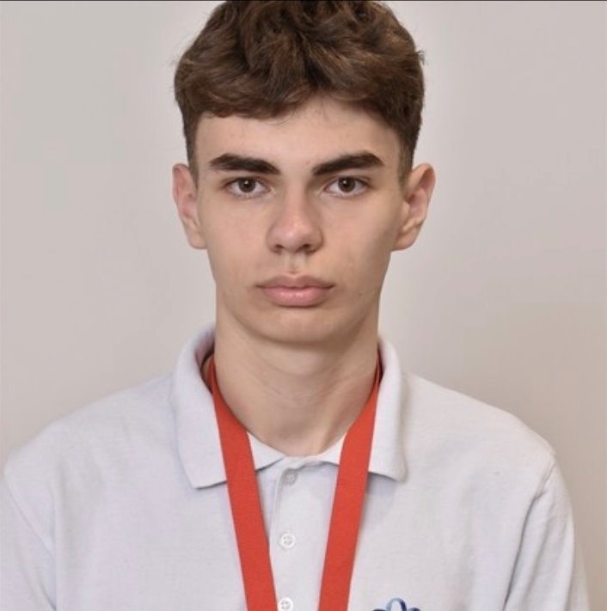
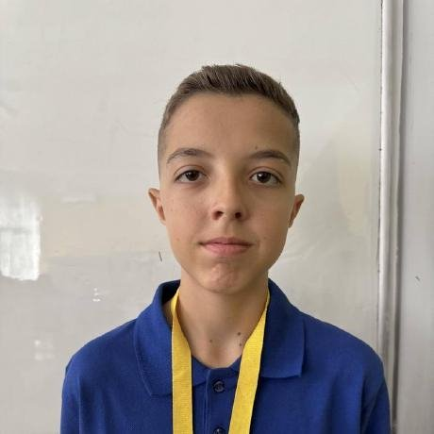


Team Members
Ivaylo Georgiev
Toma Ivanov
Scrum Trainer
CSS Developer
Dimitur Bornusuzov
Ioan-Aleksandur Georgiev
JavaScript Developer
HTML Developer

Slide 5
02
IDEA OF THE APP

Slide 6
Idea of the app
QuizMaster is a browser-based quiz platform where users can test their
knowledge across categories like Science, Geography, History, and
more. Players earn XP and level up from Rookie to Grandmaster by
answering questions correctly, with a full leaderboard to compete
against others. The app includes a quiz generator, achievements,
personal stats, and detailed history so you can track your progress over
time. An admin panel lets moderators manage users, custom quizzes,
and platform content.

Slide 7
03
STAGES OF WORKING

Slide 8
Stages of Working
First Week
Creating the Working Environment.
Second Week
Creating the rest of the pages
The main idea
Creating the presentation and the documentation
Creating the layout of the website
Creating the quizzes, leaderboard and dashboard pages
Making final changes to the website and fixing bugs

Slide 9
04
USED TECHNOLOGIES

Slide 10








Used Technologies

Slide 11

Let’s get to the app!

