Slide 1
Testing

Slide 2
History

Slide 3
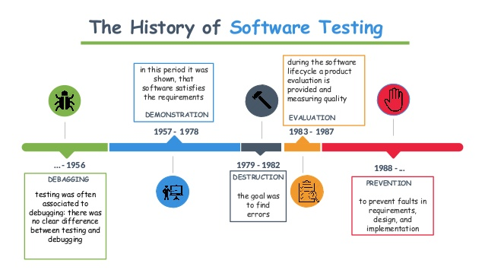

Slide 4
What is Software Testing

Slide 5
Software Testing
Is the process to help identify the correctness, completeness and quality of the developed software.
Is the process of executing program or application with the intent of finding errors.
Is criticism or comparison.
Cost of software testing is 40:50 percentage of software development but it depends on the organization to organization and project to project.
Can be viewed as destructive rather than constructive.
To be most effective, it should be conducted by independent third party.

Slide 6
Testing Stages

Slide 7
Testing Stages
Development testing
where the system is tested during development to discover bugs and defects. System designers and programmers are likely to be involved in the testing process.
2. Release testing
where a separate testing team tests a complete version of the system before it is released to users. The aim of release testing is to check that the system meets the requirements of system stakeholders.

Slide 8
3. User testing
where users or potential users of a system test the system in their own environment. For software products, the ‘user’ may be an internal marketing group who decide if the software can be marketed, released, and sold.

Slide 9
Testing Methodologies

Slide 10
Black Box Testing | White Box Testing (glass box testing)
This is a higher level testing such as functional testing. | This type of testing is performed at a lower level of testing such as Unit Testing, Integration Testing.
It concentrates on the functionality of the system under test. | It concentrates on the actual code program and its syntax.
Black box testing requires Requirement specification to test. | White Box testing requires Design documents with data flow diagrams, flowcharts etc.
Black box testing is done by the testers. | White box testing is done by Developers or testers with programming knowledge.

Slide 11
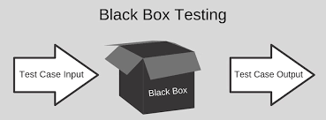
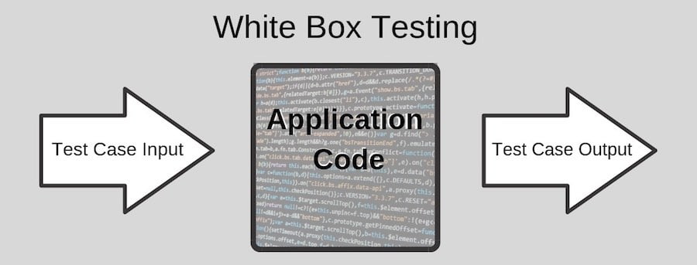

Slide 12
Types of Testing

Slide 13
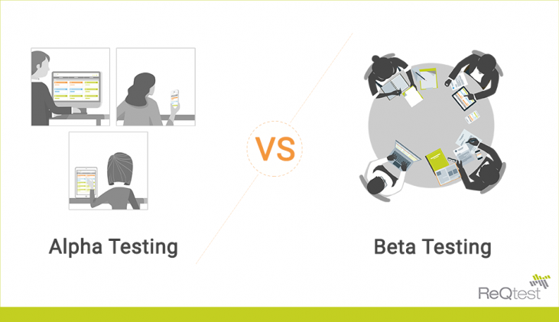

Slide 14
Alpha Testing | Beta testing
Performed by developers | Performed by customers
It’s conducted for software application | It’s conducted for product
Performed in virtual environment | Performed in real environment
Involve both white and black box testing | Involve black box testing only
It takes typically, months but teams can use intelligent automation to speed this up | It takes generally, a few weeks

Slide 15
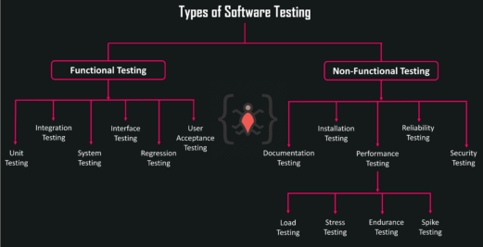

Slide 16
Functional Testing
Functional testing is checking the functionalities of the software system.
The purpose of Functional tests is to test each function of the software application, by providing appropriate input, verifying the output against the Functional requirements.

Slide 17
Functional Testing Cont:
It mainly concentrates on :
Mainline functions: Testing the main functions of an application.
Basic Usability: It checks whether a user can freely navigate through the screens without any difficulties.
Accessibility: Checks the accessibility of the system for the user.
Error Conditions: It checks whether suitable error messages are displayed.

Slide 18
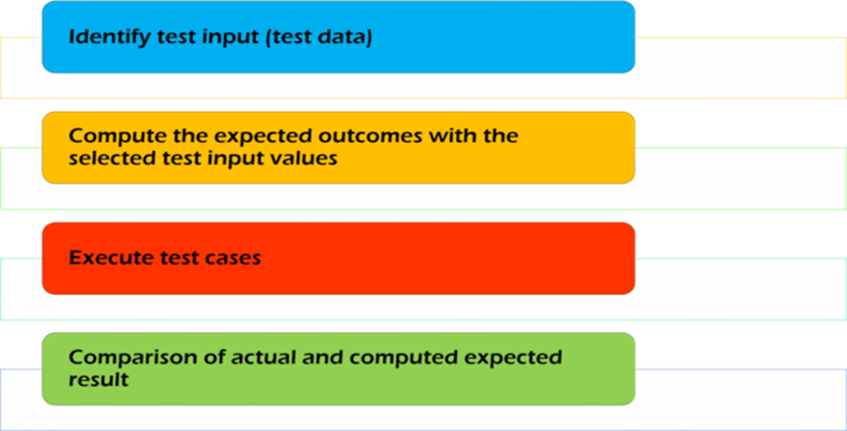
How to do Functional Testing:

Slide 19
Unit Testing
the smallest piece of code that can be logically isolated in a system.
A unit test targets a small unit of code.
In most programming languages, that is a function, a method or property.
e.g., a method or a class.
is usually performed by the developer or QA engineers.

Slide 20
2. Integration Testing
When two or more modules are combined and tested, it is called integration testing.
Responsibility for integration testing depends on the project and the company.
Java Integration Testing Tools: DBUnit, Greenmail.

Slide 21
3. System Testing
After all the modules are combined and the complete system is made, testing of the whole system is known as System Testing.
4. System Acceptance Testing
is the testing done on a particular application in different environments such as different OS, Browsers, browser versions etc. It is usually done in developer location only.

Slide 22
5. User Acceptance Testing
is a type of testing done by users, customers, or other authorised entities to determine application/software needs and business processes.
It is the most important phase of testing as this decides whether the client approves the application/software or not.
It will take place in client place.

Slide 23
6. Regression Testing
is performed when there is a code change in a software application.
verifies that recent code changes haven't altered or destroyed the already existing functionality of a system.

Slide 24
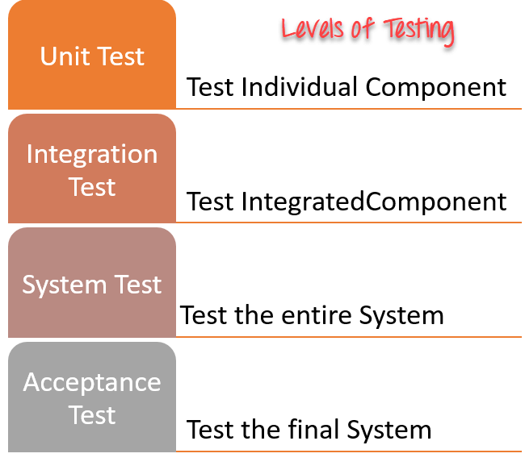

Slide 25
Non Functional Testing
is the testing of a software application or system for its non-functional requirements: the way a system operates, rather than specific behaviours of that system.
For example, software performance that includes many specific requirements like reliability and scalability.

Slide 26
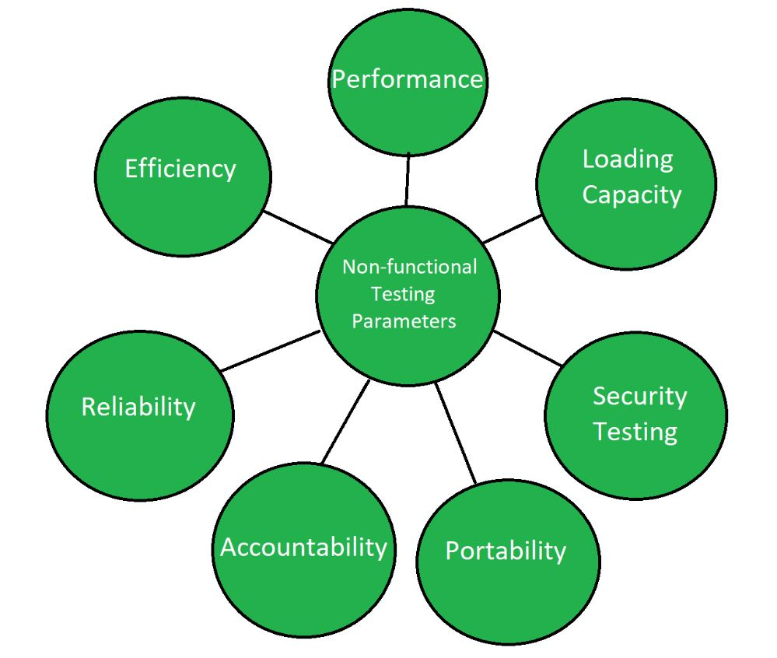

Slide 27
Non Functional Testing Cont.
Documentation Testing
ensures that documentation about how to use the system matches with what the system does, providing proof that system changes and improvement have been documented.
2. Reliability Testing
is performed to ensure that the software is performing consistently in each environmental condition as well as in a specified period. It ensures that product is fault free.
For example, a medical thermometer is a reliable tool that would measure the correct temperature.

Slide 28
3. Security Testing
It ensures that the software system and application are free from any threats or risks that can cause a loss.
determines that the data and resources of the system are protected from possible threats.
4. Load Testing:
is type of software testing which is conducted to understand the behavior of the application under a specific expected load.
is performed to determine a system's behavior under both normal and at peak conditions

Slide 29
5. Volume Testing
is to check system performance with increased volume of data in the database.

Slide 30
TDD

Slide 31
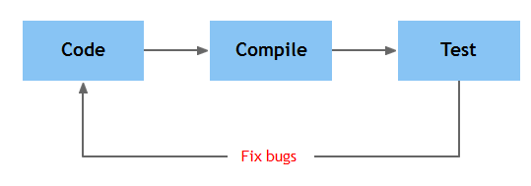
Traditionally
● How much do you code before your test?
● How do you test?

Slide 32
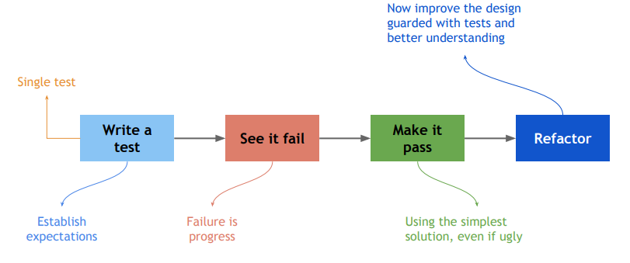
TDD…

Slide 33
Advantages Of TDD
Allows the developer to create for higher quality code from the start of the project.
Allows the developer to code and test their application at the same time.
No untested code.
Save project costs in the long run.
With TDD you will get a reliable solution.

Slide 34
Disadvantages Of TDD
Takes time to make these test.
Developers can focus on the test more than the actual code itself.
Increases the complexity of development since the developer is forced to create the unit testing upfront.

Slide 35
Software Testing Tools

Slide 36
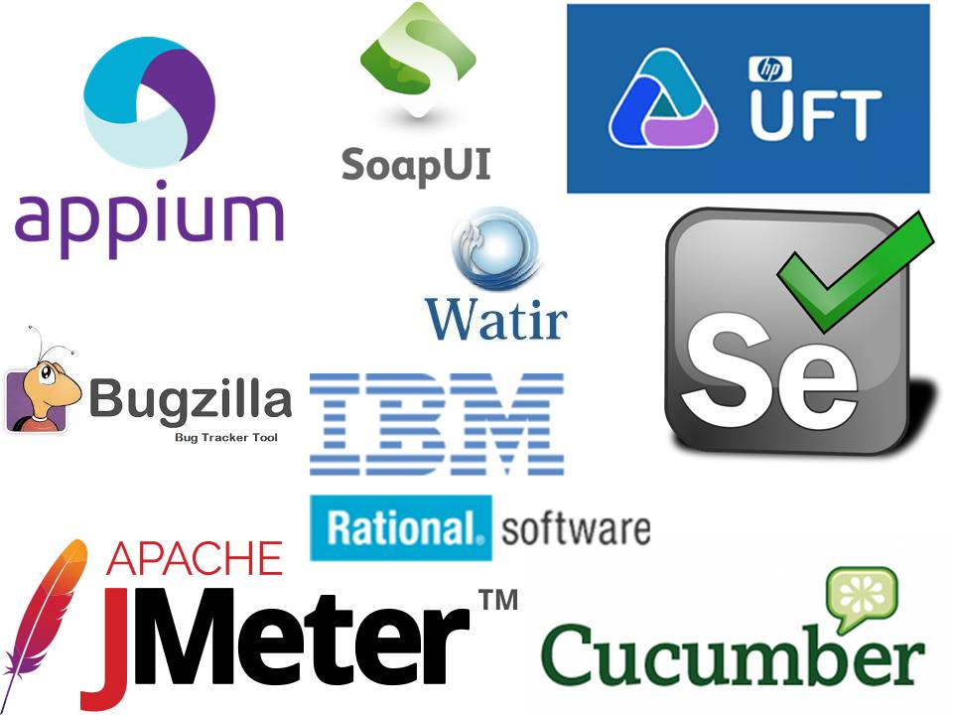
What Is?
Testing Tools
in software testing can be defined as products that support various test activities starting from planning, requirement gathering, build creation, test execution, defect logging and test analysis. These testing tools are mainly used for testing software firmness, thoroughness, and other performance parameters.

Slide 37
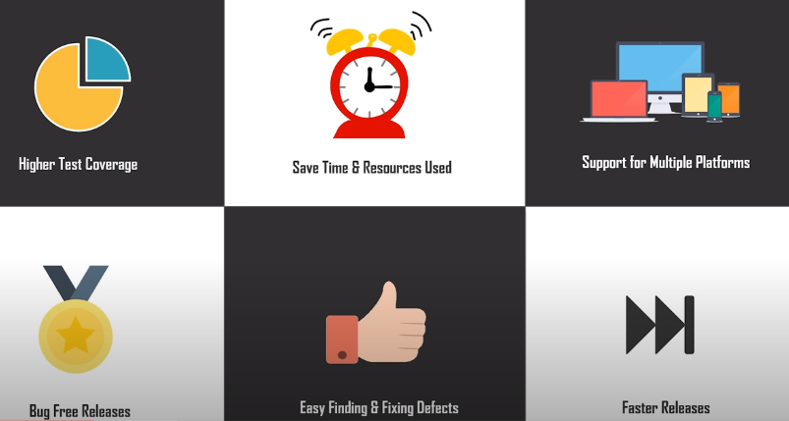
Benefits of Testing Tools

Slide 38
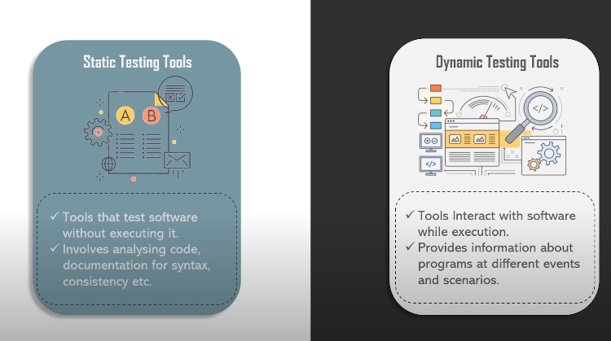
Types of Testing Tools

Slide 39
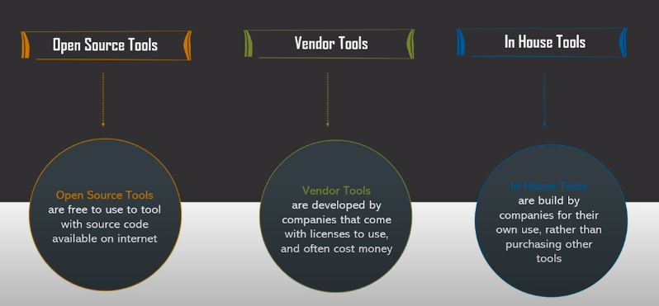
Types of Testing Tools Cont.

Slide 40
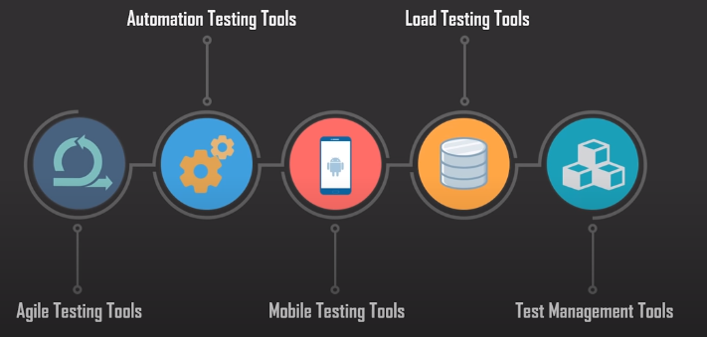
Types of Testing Tools Cont.

Slide 41
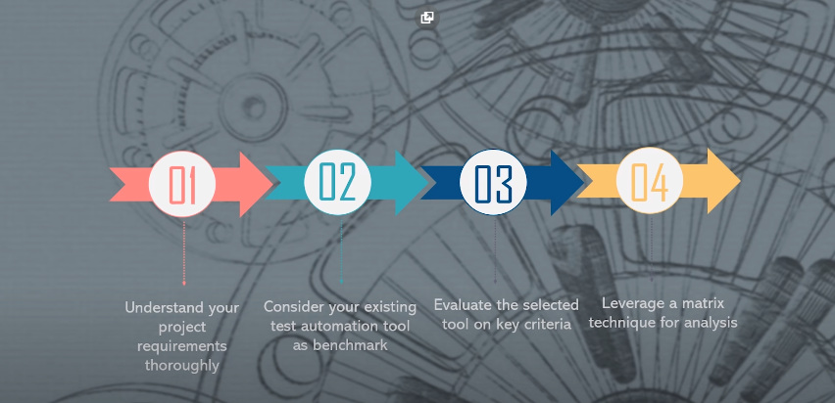
GuideLines For Choosing Testing Tool

Slide 42
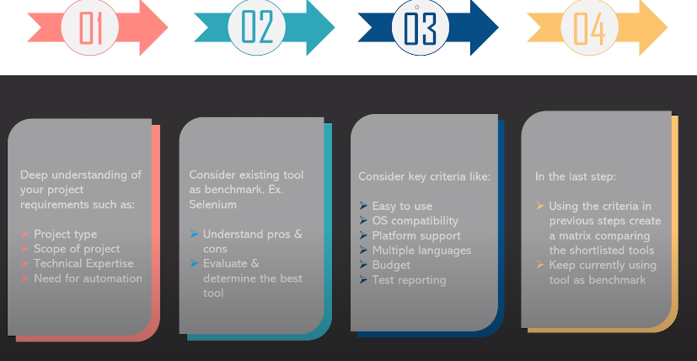
GuideLines For Choosing Testing Tool Cont.

Slide 43
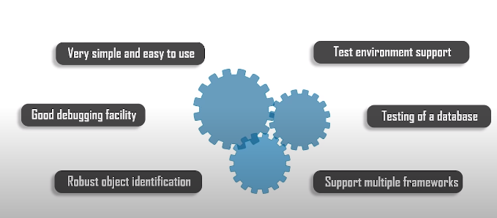
Characteristic of Good Tool

Slide 44
Selenium

Slide 45
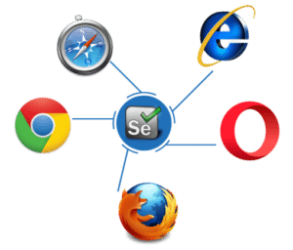
What Is ?
Selenium is an open-source tool that is used for automating the tests carried out on web browsers.
Web applications are tested using any web browser

Slide 46
Advantages
Test scripts can be written in any of these programming languages: Java, Python, C#, PHP, Ruby, Perl & .Net
Tests can be carried out in any of these OS: Windows, Mac or Linux and using any browser: Mozilla Firefox, Internet Explorer, Google Chrome, Safari or Opera
It can be integrated with tools such as TestNG & JUnit for managing test cases and generating reports
It can be integrated with Maven, Jenkins & Docker to achieve Continuous Testing

Slide 47
Disadvantages
We can use Selenium only to test web applications.
It is not possible to perform testing on images.
There is no native reporting facility.

Slide 48
Selenium Suite of Tools
Selenium RC (Now depreciated)
Selenium IDE
Selenium Grid
Selenium WebDriver

Slide 49

DEMO

