Slide 1
DHIS 2 FHIR Adapter:
An Overview
Volker Schmidt
2 March 2019

Slide 2
Why HL7® FHIR® standard? (Fast Healthcare Interoperability Resources)

Slide 3
HL7® FHIR® - Interoperability out of the Box
Defined RESTful API over HTTP/HTTPS (same Transport)
Defined JSON/XML based RESTful Resources (same Structures)
Defined Coding System like LOINC® (same Semantics)

Slide 4
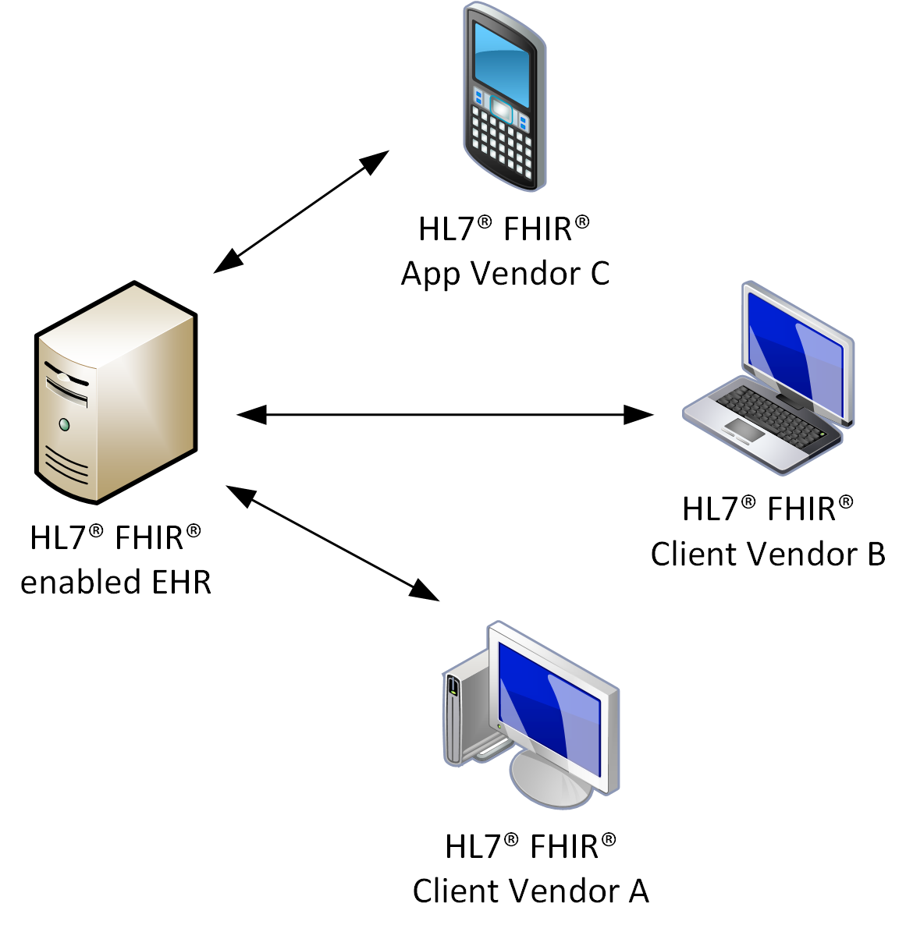
Tomorrow (with HL7® FHIR® standard)

Slide 5
Mapping obsolete?
As long as HL7® FHIR® standard is not adapted, mapping may be completely obsolete between HL7® FHIR® connected systems. Adaptations may exist often:
Custom Profiles (may include following items)
Custom Coding Systems (like national or EMR based coding systems)
Different non-standard use of HL7® FHIR® Resources (e.g. Observation or Medication Request instead of Immunization)
Custom HL7® FHIR® Resources (not defined by HL7® FHIR® standard)
Additionally, authentication and authorization are not part of the HL7® FHIR® standard. These topics need to be addressed by vendors of HL7® FHIR® enabled systems.

Slide 6
What does DHIS 2 FHIR Adapter?

Slide 7
Applying Business Rules
The adapter imports patient related clinical data to questionnaire-like structures (DHIS2 Tracker Programs and their Program Stages) on basis of a domain specific business rule engine (part of the adapter). It also can be used to export that data and to handle other type of data.
Simple example: The body weight of a child can be used on day 0 and 1 as birth weight of a child for the first stage of a Tracker Program. Otherwise it can be used as infant weight on day 6 and 7 for the second stage of a Tracker Program. Since the weight of a new born child changes rapidly it can only be used for a specific data element for a limited amount of time.

Slide 8
How does DHIS 2 FHIR Adapter work?

Slide 9
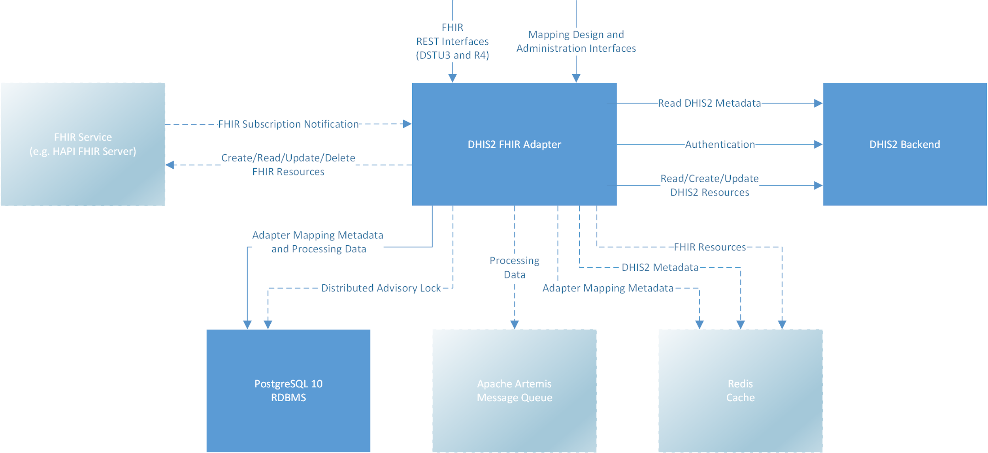
DHIS 2 FHIR Adapter Diagram

Slide 10
DHIS 2 FHIR Adapter Components
Receives HL7® FHIR® Resource by subscription notification payloads or by polling them based on subscription notifications.
Accesses mapping and processing data from a PostgreSQL database.
Uses PostgreSQL advisory locks for distributed pessimistic locking (optimistic locking not appropriate for this use case).
Uses an embedded or external Apache Artemis Message Queue for handling big amount of received data that cannot be processed immediately by DHIS 2 and to retry failed processings.
Caches frequently accessed data in-memory or in Redis for three different cache use cases.

Slide 11
Persisted Data
The database contains different types of persisted data:
Administration data (e.g. connected HL7® FHIR® systems).
Coding data (e.g. system dependent codes for body weight)
Mapping data (e.g. rules and transformations).
Processing data (short term, e.g. already processed resources).
Assignment data (permanent, e.g. rule based assignments of HL7® FHIR® Resources to DHIS 2 Resouces).

Slide 12
Interoperability between HL7® FHIR® and DHIS 2
HL7® FHIR® contain well defined extensible definitions of healthcare related resources (like a patient or an immunization). E.g. the blood pressure of a Patient can be collected an unrestricted amount of times per day.
DHIS 2 Tracker is a highly flexible system that may not be used for healthcare related resources only. Resources are defined as needed (e.g. Tracked Entity Types that may be a Patient or even a Borehole). Data of a Tracked Entity Instance is collected in a structured way that is defined on a specific system installation by DHIS 2 Tracker Programs and their Stages. E.g. the blood pressure of a Patient can only be collected when a DHIS 2 Tracker Program includes it and only as many times as a DHIS 2 Tracker Program allows it.

Slide 13
Mapping between HL7® FHIR® and DHIS 2
Static mapping only for static DHIS 2 resources (e.g. DHIS 2 Organisation Units).
Highly dynamic mapping for highly dynamic DHIS 2 resources (DHIS 2 Tracked Entity Types and DHIS 2 Tracker Programs).
Dynamic mappings are triggered by rules that define when the rule can be used and how to perform the mapping.
Dynamic mappings are performed by reusable domain specific JavaScripts snippets that can be parameterized for different use cases.
Separate FHIR resource related mappings of DHIS 2 Tracked Entity Instance, Organisation Unit, GEO Location and various dates (e.g. enrollment date or effective date).

Slide 14
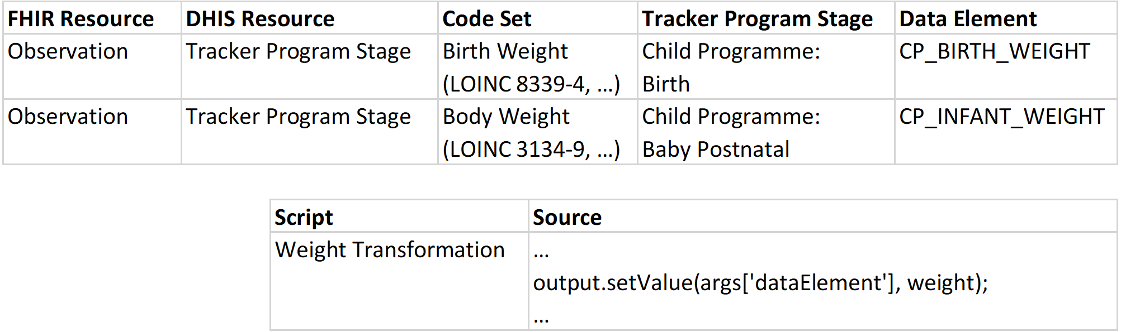
Mapping Rule Example
Simplified rough example of a mapping that uses the same reusable JavaScript snippet.

Slide 15
Why dynamic Mappings?
The adaptor should be able to participate in interoperability use cases of tomorrow’s healthcare infrastructure and should support common adaptations of the HL7® FHIR® standard without the need of additional mediator services.
Unlike an EMR implementation that has most likely a patient and observation resource that can be mapped one to one statically to the corresponding HL7® FHIR® Resource, DHIS 2 does not define such specific resources. All structures are defined for a specific system installation and need therefore be mapped for that specific system installation.

Slide 16
Main Mapping Services of DHIS 2 FHIR Adapter
HL7® FHIR® system dependent enrichment of incoming HL7® FHIR® Resource (e.g. enriching with managing organization).
Accessing a basic Terminology Service that provides mapping of system independent codes and code sets (e.g. set of codes that define vaccines that cause an immunization for measles).
Various domain specific utilities (e.g. handling vital signs).
Accessing further single or hierarchical HL7® FHIR® Resources from a HL7® FHIR® system.
Creation of missing resources based on existing rules while mapping other resources (e.g. creation of missing DHIS 2 Tracked Entity Instance).

Slide 17
Supported Use Cases
Import of HL7® FHIR® Resources (export of DHIS 2 Resources to HL7® FHIR® experimental currently).
HL7® FHIR® REST Interfaces that create, update and read data based on rules that are defined in the Adapter (current features similar to import and export).
Support for DHIS 2 Tracked Entity Instances and DHIS 2 Tracker Programs.
Automatic enrollment of DHIS 2 Tracked Entity Instances into DHIS 2 Tracker Programs based on rules.
Automatic creation of DHIS 2 Tracker Program Stage Instances based on rules. Supports also repeated Program Stages.
Automatic change of DHIS 2 Tracker Program Instance or DHIS 2 Tracker Program Stage Instance status based on rules.

Slide 18
Supported HL7® FHIR® Resources STU3 and R4
Location
Organization
Patient
Related Person
Encounter
Diagnostic Report
Immunization
Medication Request
Observation
Practitioner
Condition
The table above lists all FHIR Resources that can be configured in rules. Base configuration may not exist after the installation of the Adapter, but can be added as required by the needs of the specific DHIS 2 installation.

Slide 19
Difference Import/Export and FHIR REST Interfaces
Import/Export:
Resolving references to other FHIR Resources on the connected FHIR system (referenced technical IDs are not technical IDs on DHIS 2).
Handling technical IDs in FHIR Resources of connected FHIR systems, not of DHIS 2.
For a lot of use cases no mediators should be required since this can be handled by the Adapter.
FHIR REST Interfaces:
Resolving references to other FHIR Resources on DHIS 2 (referenced technical IDs contain technical IDs of DHIS 2).
All technical IDs that are handled and returned by the Adapter are related to technical IDs on DHIS 2.
If the connected system or client is not able to handle the references to DHIS 2, additional mediators may be required.

Slide 20
References
Supported HL7® FHIR® standard: https://hl7.org/fhir/STU3/ https://hl7.org/fhir/R4/
DHIS 2 FHIR Adapter: https://github.com/dhis2/dhis2-fhir-adapter

