Slide 1


Zombies on Campus
a fun choice based game

Slide 2
Zombies on Campus
A story-based choice driven game.
Different and fun choices with different endings.
Re-playable.
Nodes: story parts
Leaves: story endings
Notes:
A user starts playing from root.
The nodes are the “story parts”, the leaves are the “story endings”
Each different choice he takes leads him into moving to a different node.
When a user reaches a “story ending” the game ends and he sees an ending and the user has an option to share it on facebook/twitter.

Slide 3
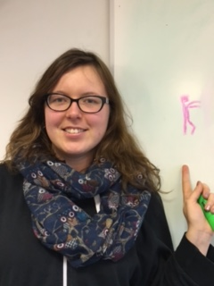

User Personas
Laura, a Creative Director
Kostis, an Internet Enthusiast
A person who has linguistic interests.
Likes to read books.
Plays board games.
Has vivid imagination.
Has a good sense of humor.
A person who wants to have fun on the internet.
Plays short games and views fun posts during ITech lectures.
Procrastinates on social networks.
Wants to experience new adventures.
Doesn’t want time consuming activities.
Notes:
Creative type: meaningful choices, creative stories,
Internet Enthusiast: quick results, short choices

Slide 4
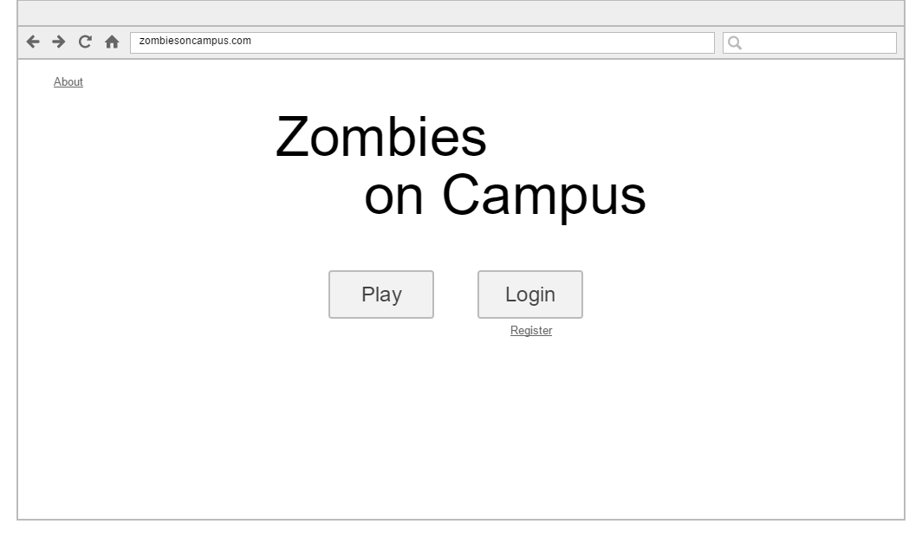
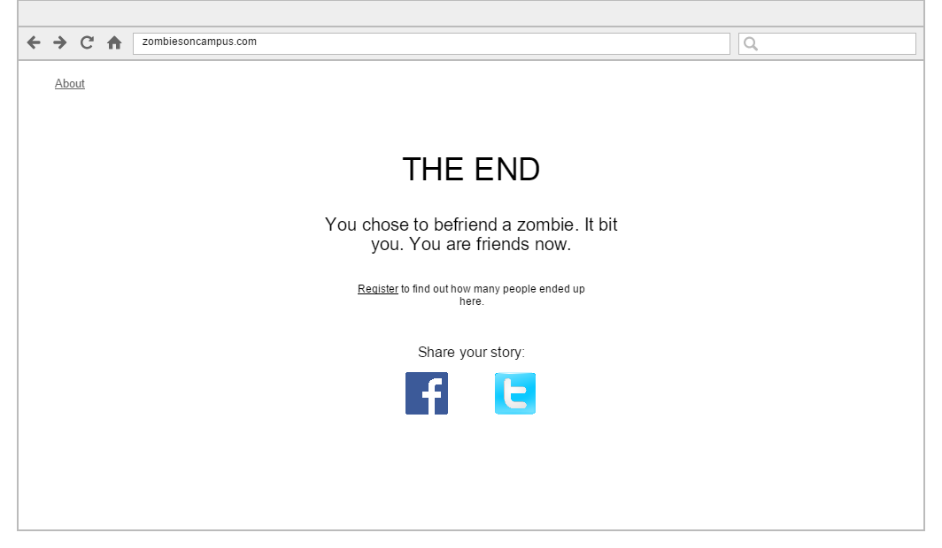
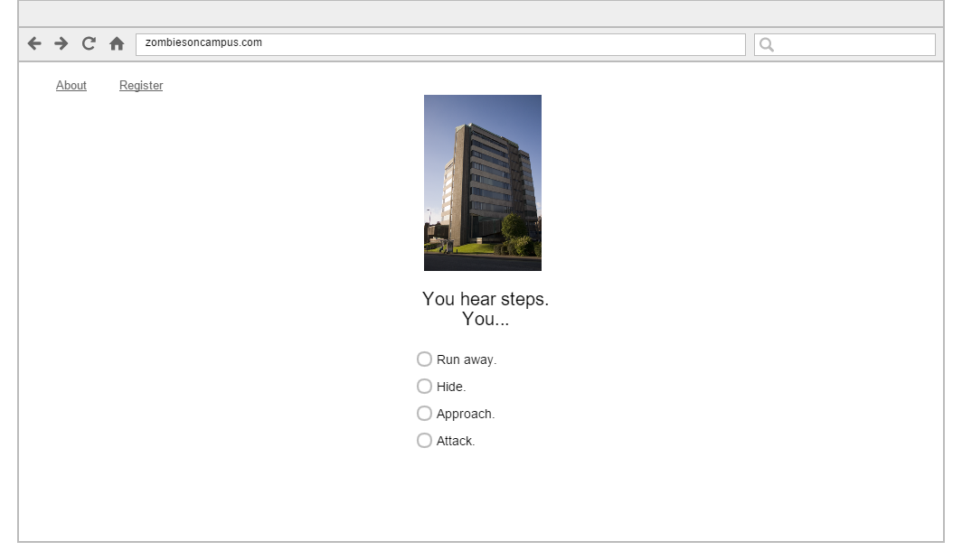
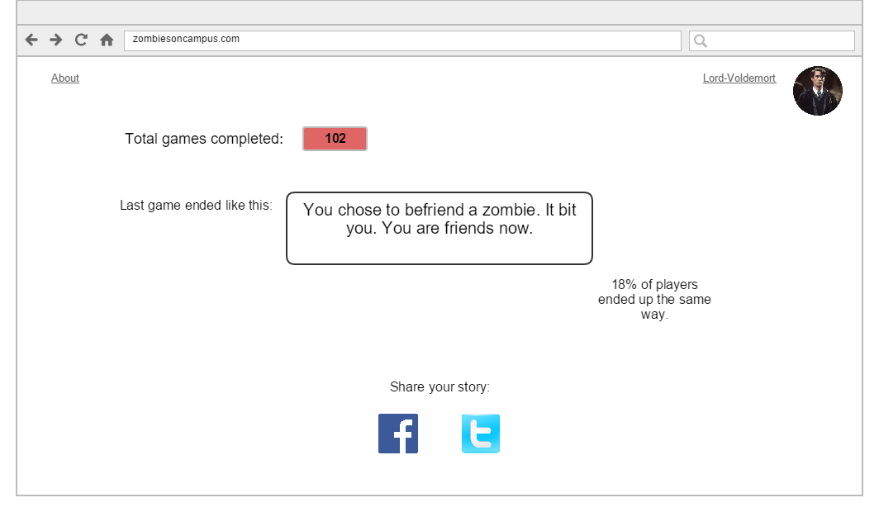
Wireframes

Slide 5


System Architecture
A 3 tier Architecture
SQLite DB
Browser
Django
User
Client
Middleware
Database

Slide 6
ER diagram
Reads
Player
1
Ending
1
1…0
M
1
Has
Storypart
Picks
1
Decides
next
1
M
1
Contains
Choice
N

Slide 7
Zombies on Campus
Any questions?
a fun choice based game

