Slide 1
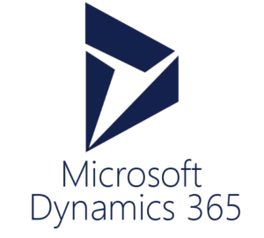
ITLec
Information technology
lectures
http://www.MSDynamicsArab.com
By ITLec.com

Slide 2

About Me
Rasheed Gomaa
Tech. Lead/ Techno-Functional Consultant
Multi-Culture experience (Australia ,USA, Dubai, Saudi, ..).
+35 Successful Project
Nuget (+370K) https://www.nuget.org/profiles/ITLec
Github (+15 Repositories) https://github.com/ITLec
https://twitter.com/Rasheed_ITLec
Rasheed@ITLec.com

Slide 3

Dynamics 365 – Riyadh User Group
Power App Component Framework
Author : Rasheed@ITLec.com

Slide 4
Agenda
What is powerApp?
PowerApp Conponent Framework Overview
PCF vs Web resource
Multiple form factor
How to install
Demo
Samples
Join US

Slide 5
What is PowerApp?
a suite of apps, services, connectors and data platform that provides a rapid application development environment to build custom apps for your business needs.
Canvas & Data Model
Dynamics 365 = PowerApp & Common Data Service
Reference: https://docs.microsoft.com/en-us/powerapps/powerapps-overview

Slide 6
PCF Overview
create custom components in model-driven apps to provide an enhanced user experience for the users to view and work with data in forms, views and dashboards.
a preview feature
Custom components are supported only on Unified Interface for model-driven appsversion 9.1.0.3842 or later.
Reference: https://docs.microsoft.com/en-us/powerapps/developer/component-framework/overview

Slide 7


PCF VS Web Resource
Runng / Execution
Running/ Execution
Same form context
asynchronous
Package
Package
Different web resources
One Package
Performance
Performance
Better thank WR
Reusability
Reusability
Better than WR
Reference:
https://medium.com/capgemini-dynamics-365-team/what-is-the-custom-control-framework-and-why-should-dynamics-365-developers-be-excited-about-it-a3f0e3f8be4
Notes:
© Copyright PresentationGO.com – The free PowerPoint template library

Slide 8
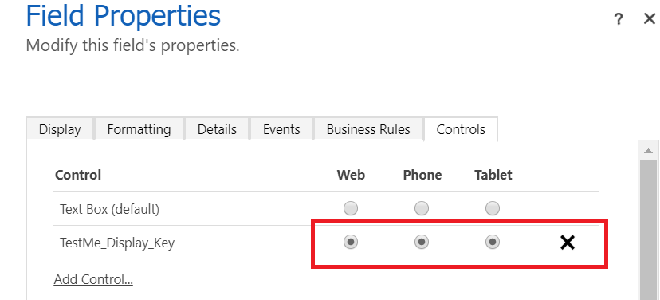
Multiple form factor support

Slide 9
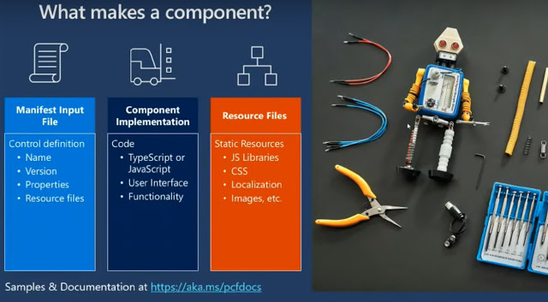
Copy write: public internet video

Slide 10
How To Install
Install NPM https://nodejs.org/en/
Install .NET Framework 4.6.2 Developer Pack.
If you don’t already have Visual Studio 2017 or later, follow one of the options below:
Option 1: Install Visual Studio 2017 or later.
Option 2: Install .NET Core 2.2 SDK and then install Visual Studio Code.
Install Power Apps CLI https://aka.ms/PowerAppsCLI
Reference: https://docs.microsoft.com/en-us/powerapps/developer/component-framework/get-powerapps-cli

Slide 11
Steps
Open Developer Command Prompt for VS 2017, as administrator
Create folder C:\DeleteME\CF
from vs cmd navigate to ur folder cd C:\DeleteME\CF
pac pcf init --namespace ITLecControls --name TestMe --template field
npm install
npm run build
npm start
create "deplpoyment" folder inside your folder
cd C:\DeleteME\CF\deployment
pac solution init --publisherName ITLec --customizationPrefix itlec
pac solution add-reference --path C:\DeleteME\CF
MSBUILD /t:restore
MSBUILD
C:\DeleteME\CF\deployment\bin\Debug\deployment.zip

Slide 12
Samples
Editable Grid
Auto Complete
https://pcf.gallery
https://aka.ms/pcfdemos
Github
….

Slide 13
https://www.facebook.com/RasheedITLec/
https://twitter.com/Rasheed_ITLec
https://www.youtube.com/channel/UCI_UMrnQMXbE216WrsmqGpw
Thanks …

