Slide 1

ITLec
Information technology
lectures (Arabic)
http://www.MSDynamicsArab.com
By ITLec.com

Slide 2

About Me
Rasheed Gomaa
MCT/ Sr. Techno-Functional Consultant
Multi-Culture experience (Australia ,USA, Dubai, Saudi, ..).
+35 Successful Project
Nuget (+270K) https://www.nuget.org/profiles/ITLec
Github (+15 Repositories) https://github.com/ITLec
https://twitter.com/Rasheed_ITLec
Rasheed@ITLec.com

Slide 3

Power BI & Dynamics 365
Power Query Builder
XrmToolBox Plugin
Author : Rasheed@ITLec.com & CRM Chart Guy

Slide 4
Agenda
Dynamics 365 & Power BI
XrmToolBox & Power Query Builder
Odata Query
FetchXml Query
Odata vs. FetchXml
Coming features
Join US

Slide 5
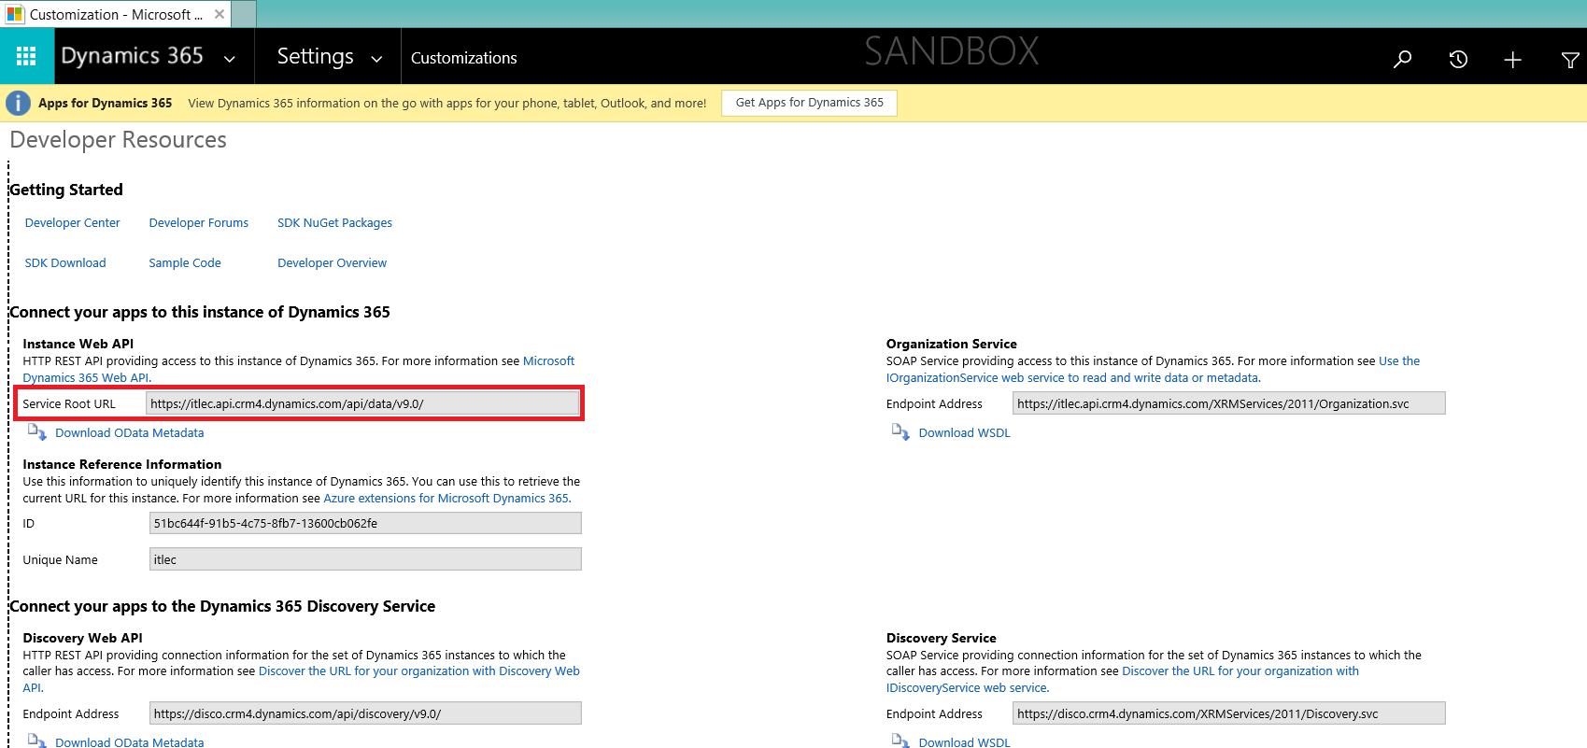
Dynamics 365 & Power BI

Slide 6
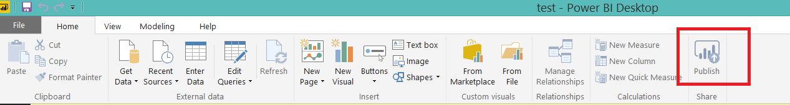
Dynamics 365 & Power BI
Power BI Desktop https://powerbi.microsoft.com/en-us/desktop/
Power BI Online

Slide 7
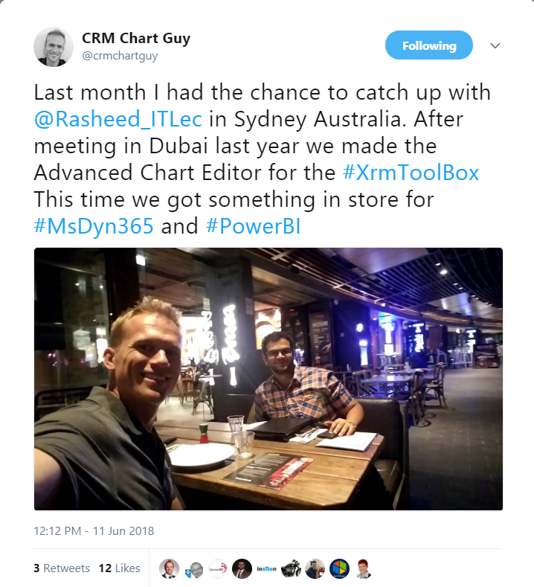
Power Query Builder XrmToolBox Plugin
Ulrik (CRM Chart Guy) https://crmchartguy.com/
Mohamed Raseed Gomaa http://www.itlec.com/

Slide 8
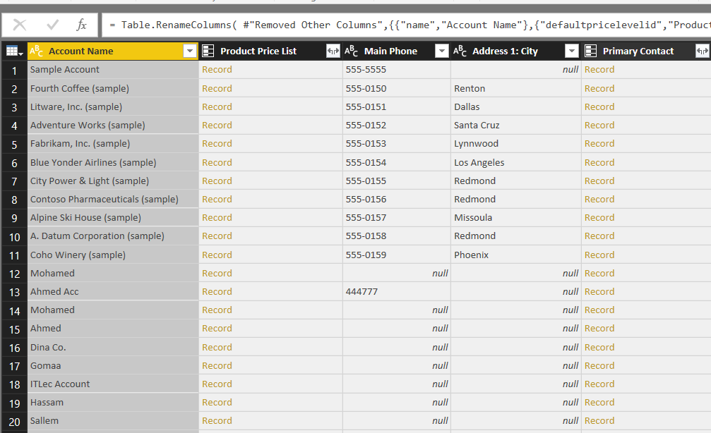
Odata Query
let
Source = OData.Feed(ServiceRootURL, null, [Implementation="2.0"]),
entity_table = Source{[Name = "accounts", Signature = "table"]}[Data],
#"Removed Other Columns" = Table.SelectColumns(entity_table,{"name","defaultpricelevelid","telephone1","address1_city","primarycontactid"}),
#"Renamed Columns" = Table.RenameColumns( #"Removed Other Columns",{{"name","Account Name"},{"defaultpricelevelid","Product Price List"},{"telephone1","Main Phone"},{"address1_city","Address 1: City"},{"primarycontactid","Primary Contact"}})
in #"Renamed Columns"

Slide 9
FetchXml Query
let
GetResults = (z as text, x as number) =>
let
S = Json.Document(Web.Contents(ServiceRootURL & "/accounts", [Headers=[Prefer="odata.include-annotations=*"],Query=[fetchXml="
<fetch page=""" & Text.From(x) & """ paging-cookie=""" & z & """>
<entity name=""account"">
<attribute name=""name""/>
<attribute name=""defaultpricelevelid""/>
<attribute name=""telephone1""/>
<attribute name=""address1_city""/>
<attribute name=""primarycontactid""/>
<attribute name=""accountid""/>
<filter type=""and""><condition attribute=""statecode"" operator=""eq"" value=""0"" /><condition attribute=""customertypecode"" operator=""eq"" value=""11"" /></filter>
</entity>
</fetch>"]])),
P = try Xml.Document(S[#"@Microsoft.Dynamics.CRM.fetchxmlpagingcookie"]) otherwise null,
R = if P <> null
then List.Combine({S[value],@GetResults(Text.Replace(Text.Replace(Text.Replace(Uri.Parts("http://a.b?d=" & Uri.Parts("http://a.b?d=" & P{0}[Attributes]{1}[Value])[Query][d])[Query][d], ">", "&gt;"), "<", "&lt;"), """", "&quot;"), x + 1)})
else S[value]
in
R,
ResultsList = GetResults("", 1),
#"Converted to Table" = Table.FromList(ResultsList, Splitter.SplitByNothing(), null, null, ExtraValues.Error),
#"Expanded Column1" = Table.ExpandRecordColumn(#"Converted to Table", "Column1",
{
"name",
"_defaultpricelevelid_value",
"_defaultpricelevelid_value@OData.Community.Display.V1.FormattedValue",
"telephone1",
"address1_city",
"_primarycontactid_value",
"_primarycontactid_value@OData.Community.Display.V1.FormattedValue",
"accountid"
},
{
"name",
"_defaultpricelevelid_value",
"_defaultpricelevelid_value@OData.Community.Display.V1.FormattedValue",
"telephone1",
"address1_city",
"_primarycontactid_value",
"_primarycontactid_value@OData.Community.Display.V1.FormattedValue",
"accountid"
}),
#"Renamed Columns" = Table.RenameColumns(#"Expanded Column1",
{
{"name", "Account Name"},
{"_defaultpricelevelid_value", "Product Price List (defaultpricelevelid)"},
{"_defaultpricelevelid_value@OData.Community.Display.V1.FormattedValue", "Product Price List"},
{"telephone1", "Main Phone"},
{"address1_city", "Address 1: City"},
{"_primarycontactid_value", "Primary Contact (primarycontactid)"},
{"_primarycontactid_value@OData.Community.Display.V1.FormattedValue", "Primary Contact"},
{"accountid", "Account"}
}),
#"Changed Type" = Table.TransformColumnTypes(#"Renamed Columns",
{
{"Account Name", type text},
{"Product Price List (defaultpricelevelid)", type text},
{"Product Price List", type text},
{"Main Phone", type text},
{"Address 1: City", type text},
{"Primary Contact (primarycontactid)", type text},
{"Primary Contact", type text},
{"Account", type text}
})
in
#"Changed Type"

Slide 10
Odata vs. FetchXml
Only use FetchXml for (Presales, small data size).

Slide 11
Coming Features

Slide 12
https://www.facebook.com/RasheedITLec/
https://twitter.com/Rasheed_ITLec
https://www.youtube.com/channel/UCI_UMrnQMXbE216WrsmqGpw
See you late

