Slide 1

ITLec
Information technology
lectures (Arabic)
http://www.MSDynamicsArab.com
By ITLec.com

Slide 2
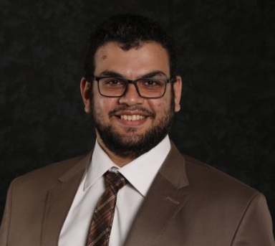
About Me
Rasheed Gomaa
MCT/ Sr. Techno-Functional Consultant
Multi-Culture experience (Australia ,USA, Dubai, Saudi, ..).
+35 Successful Project
Nuget (+280K) https://www.nuget.org/profiles/ITLec
Github (+15 Repositories) https://github.com/ITLec
https://twitter.com/Rasheed_ITLec
Rasheed@ITLec.com

Slide 3
Dynamics 365
Most important Dynamics 365 Advices - Part 2 - Arabic
Author : Rasheed@ITLec.com

Slide 4
Agenda
Do not use hard coded lookup.
Use Tools
Administration form
Don't use default system configuration
In workflow add true conditions as much as you can.
Make it generic
War room.
Avoid await condition.
Join US

Slide 5
1- Do not use hard coded lookup.
Create configuration entity
Create Global Action to retrieve configuration values

Slide 6
2- Use Tools
Paid tools
Free tools(XrmToolBox, …)

Slide 7
3- Administration form
For each entity create an administration for contains:-
No JavaScript/ Business
No Plugins
All Fields (No Hidden Fields).
Useful for:-
Creating/Update Workflows
Quick way to edit forms, regardless business logic.

Slide 8
4- Don't use default system configuration
Make sure you choice/set your default values.
No default business unit.
No deault Team.
No default currency.
……

Slide 9
5- In workflow add true conditions as much as you can.
You cannot add condition filter for set of already existed steps.

Slide 10
6- Make it generic
Do your work one time, and use it 1 million times!!!

Slide 11
7- War room.
When you have an issue which is re-opened multiple times:
Do not play Bing Bong Testing:-
You close the issue
Client open it again.
War Room means:-
You, client, project manager and all the team in one room till you close the issue.

Slide 12
8- Avoid await condition.
Wait conditions hurt the performance of your environment.

Slide 13
Looking for more Advices
Wait my next Video !!!!
ITLec.com
http://www.msdynamicsarab.com
OOP principles
Top 10 Rules for Microsoft Dynamics 365/CRM Administrators By Gus Gonzalez
https://crm.audio/implement-this-25-things-the-second-time-around-in-dynamics-365/

Slide 14
https://www.facebook.com/RasheedITLec/
https://twitter.com/Rasheed_ITLec
https://www.youtube.com/channel/UCI_UMrnQMXbE216WrsmqGpw
See you late

