Slide 1
Hashing Algorithms and Their Use in Digital Forensics Investigation HI-TEC 2015 PORTLAND, OR
Nick Novotny
Notes:
Connie and I introduce ourselves

Slide 3



Slide 4
Masters Project
Open Source Research
Hash Function
Lab Activity for Digital Forensics Students
Notes:
Forenzix Development
Hashing difficult to understand the concepts
Lab Activity developed initially for the IT Academy so that I could earn my CTT+

Slide 5
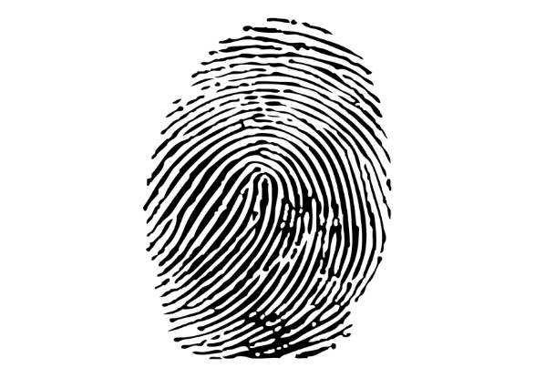
What is Digital Forensics
(superawesomevectors.com)

Slide 6
Cryptography/Hashes in Brief
Hashing algorithm
Plain text
Hash Value
Notes:
-Describe cryptographic algorithms
- plaintext
- algorithm
-ciphertext
Hashes have no key and are not decryptable (Because they have no key)

Slide 7
Cryptography in General
Plaintext
Algorithm
Key
Ciphertext

Slide 8
Hashes
Hash Differences
Hashing Uses
Authenticate Passwords
Verify Identity or Integrity
Notes:
Since Hashes are one-way, they are used for these purposes, rather than message transmission (message transmission requires the ability to decrypt the message).

Slide 9
Authenticate Passwords
Unencrypted Database leak
Username | Password
nnovotny | MySi$terRulz
cjustice | I<3my$tudents

Slide 10
Authenticate Passwords
Encrypted Database leak
Username | Password
nnovotny | feadfced32df76f8758942f508768d78
cjustice | 1d2389af9dfb53d9c87ee5a916eb583a

Slide 11

Verify Identity or Integrity

Slide 12
MD5 Hash Examples
MD5
quickhash.com
Dac175ed4db3c7c5b34f936e8a5c6daf
Password

Slide 13
MD5 Hash Examples
MD5
quickhash.com
Cc3a0280e4fc1415930899896574e118
password

Slide 14
MD5 Hash Examples
MD5
quickhash.com
Cfcd208495d565ef66e7dff9f98764dam
0

Slide 15
MD5 Hash Examples
MD5
quickhash.com
c4ca4238a0b923820dcc509a6f75849b
1

Slide 16
MD5 Hash Examples
Plain text | Hash value
Password | Dac175ed4db3c7c5b34f936e8a5c6daf
password | Cc3a0280e4fc1415930899896574e118
0 | Cfcd208495d565ef66e7dff9f98764dam
1 | c4ca4238a0b923820dcc509a6f75849b

Slide 17
Forensics Investigation
1. Search and Seizure
2. Evidential Integrity
3. Verification
Notes:
I changed the order to seizure and search to emphasize the need for a warrant, and before obtaining the warrant, the existent probable cause. Need to hash to take “state” of data
-previous slide to verify integrity.
- Always verify evidence is unchanged
- if it is changed, we need the documented process (and an unchanged copy of the evidence to verify that the change is repeatable)
- Forenzix details
- Forenzix lead to development of this lab exercise to show how hashes can change and their importance in an investigation

Slide 18
The right of the people to be secure in their persons, houses, papers, and effects, against unreasonable searches and seizures, shall not be violated, and no Warrants shall issue, but upon probable cause, supported by Oath or affirmation, and particularly describing the place to be searched, and the persons or things to be seized.
– Fourth Amendment of the US Constitution

Slide 19
Boot Process
Interrupt 13

Slide 20
Boot Process
Interrupt 13

Slide 21
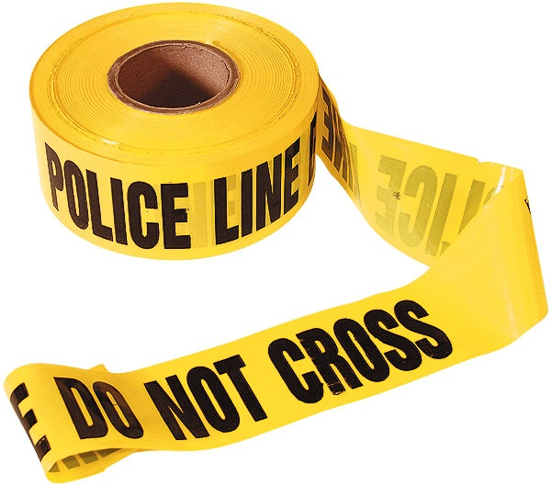
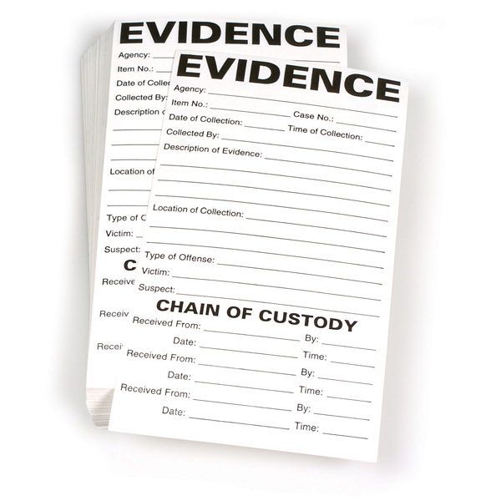

Evidential Integrity

Slide 22
Forenzix
Linux Distro in Development Process
Virtualbox added to a bootable Operating System

Slide 23
Lab Creation
Bypass writing to HDD Evidence
Take “State” of Evidence
Small Change, Hash, Small Change,…
Notes:
Go through the lab step by step, describing how booting pre-empts interrupt 13 where HDD writes begin after loading the MBR of the boot volume (by default the HDD – which is evidence)
Boot into non-evidence drive
Hash before dumping to verify evidence and to have a comparison
Change the evidence slightly, hash, change slightly, hash – observe and explain the changes and the significance of the changes in terms of a forensics investigation

Slide 24
Your Turn!
Lab (20 minutes)
Cheatsheet
Chain of Custody
Investigation Documentation
2 GB USB - Evidence

Slide 25
Lab Concept Review
Boot Process
Hash Changes (cause and how different)
Notes – documentation of all steps
Who had the evidence
Notes:
Review questions from the lab in discussion

Slide 26
Extra Credit
Windows Disk Detection
Notes:
Review questions from the lab in discussion

Slide 27
Thank You!
@novotny_nick
@ITAcademyIUPUI
Notes:
Review questions from the lab in discussion

