Slide 1
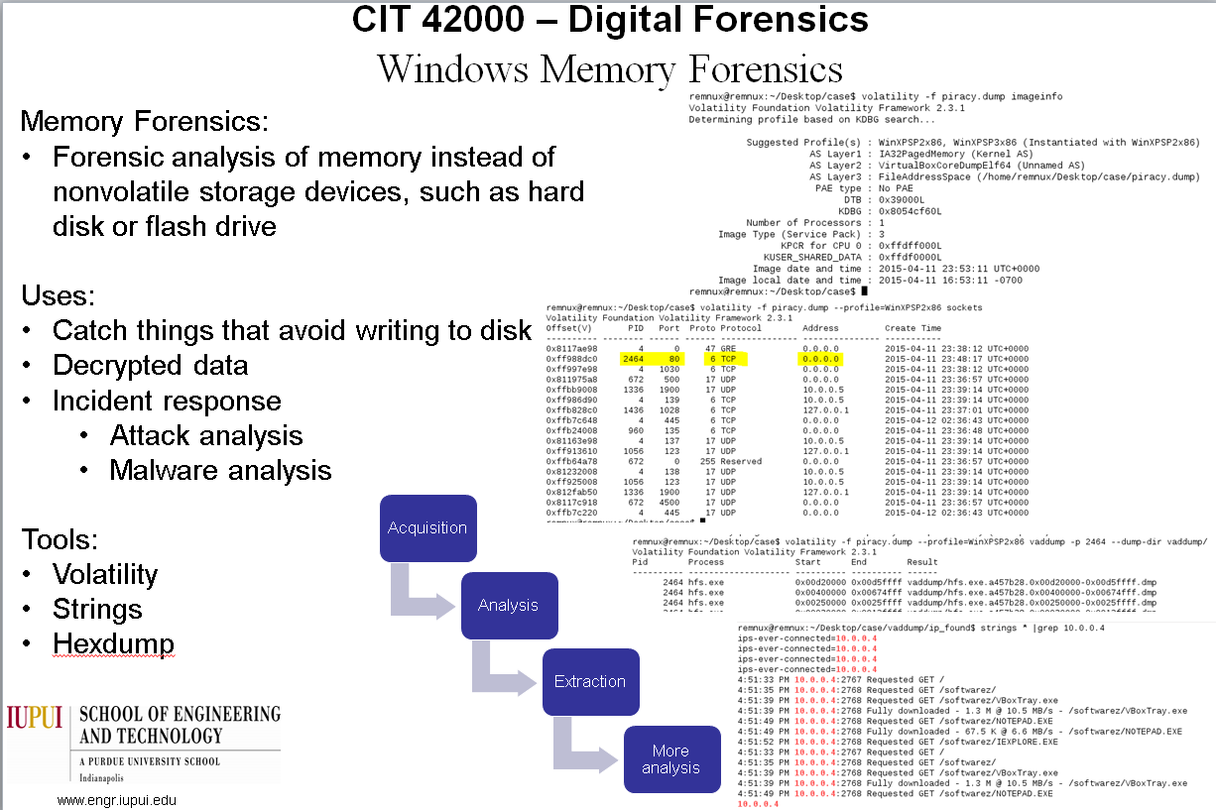
This poster sucks.

Slide 2
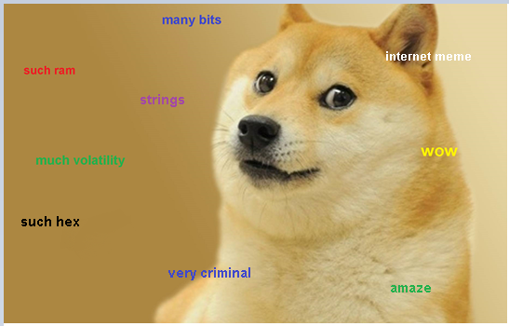
Memory Forensics
Such RAM
Much volatility
http://fanaru.com/doge/image/18360-doge-doge-simple.jpg

Slide 3
TOPICS
What is memory forensics?
Why memory forensics?
Acquisition
Forensic Tools
Scenario
Examination
We’re focusing Windows

Slide 4
What is memory forensics?
Forensic analysis of memory instead of nonvolatile storage devices, such as hard disk or flash drive

Slide 5
Why memory forensics?
Catch things that avoid writing to disk
Decrypted data
Incident response
Attack analysis
Malware analysis
Not always useful or possible to do during criminal cases

Slide 6
Acquisition
Virtual Machines
Physical Machines
Software Solutions
Hardware Solutions

Slide 7
Virtual Machines
Focus
VMWare
VirtualBox

Slide 8
Virtualbox
Format:
Vboxmanage debugvm VM_NAME dumpguestcore --filename filename.dmp
Example:
VBoxManage.exe debugvm XPVM dumpguestcore --filename memdump.dmp

Slide 9
VMWare
Vmware stores .vmem file in the virtual machine’s folder

Slide 10
Physical Machines
Live
Cold Boot

Slide 11
Live
Requires admin privileges
You plug in a USB drive with your application
Run the application
Dump the memory to a file

Slide 12
Cold boot
Does not require admin privileges
Requires access to the RAM sticks
Process
Freeze the RAM sticks
Turn off the computer
Boot from USB drive
Run an application to dump the memory to a file

Slide 13
Software Solutions
Mdd
Memoryze
Kntdd
Moonsols DumpIt
HBGary Fastdump

Slide 14
Hardware Solutions
Aka “I don’t have that kinda money” solutions
WindowSCOPE devices
>$4000
Other devices are either not public or were just research projects

Slide 15
Forensics
Basic
Hex/String analysis
Extraction/Carving
Advanced
Volatility

Slide 16
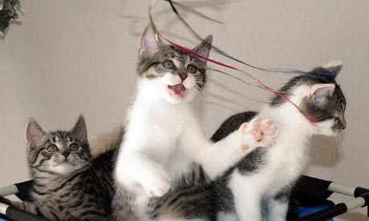
Hex/Strings
Strings
Extracts ASCII or Unicode chars from the memory
Hexdump
Good for looking at the whole structure after you find an interesting address
Good way to look for keywords
http://static.guim.co.uk/sys-images/Guardian/About/General/2009/12/29/1262101542012/cat-plays-with-string-001.jpg

Slide 17
Extraction/Carving
bulk_extractor
Foremost
Useful for extracting files and properties

Slide 18
Volatility
Memory forensics framework
Supports analysis of
Various memory dump formats
Linux, Mac, and Windows
Mostly used in malware analysis

Slide 19
Scenario
Web server hosting pirated material
Analysts were able to get access to virtual machine host and dump the memory

Slide 20
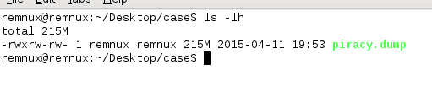
Examination
Used REMnux
Kali Linux would work too

Slide 21
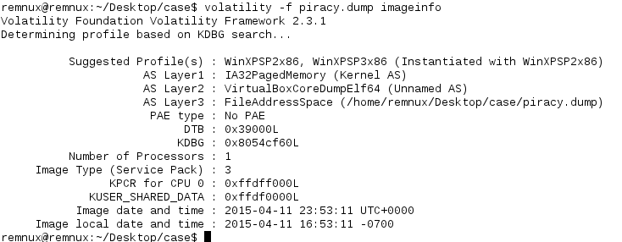
Getting more information the image (Profiles are important)

Slide 22
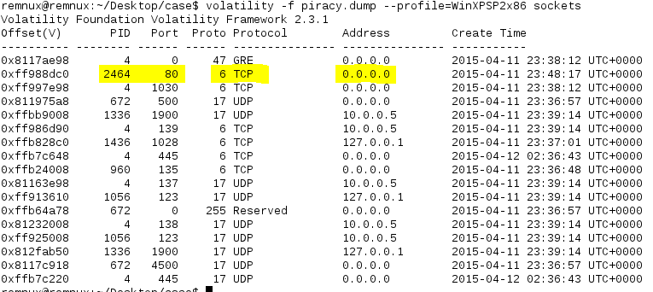
What ports are opened and by which process?

Slide 23
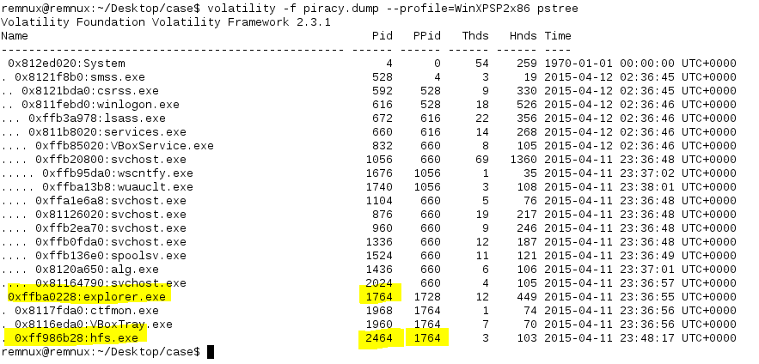
The process (could be executed by the user)

Slide 24
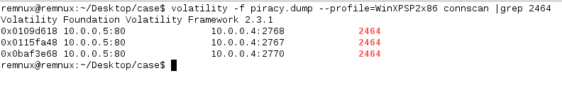
Connections that were happening
Person at 10.0.0.4 is downloading the pirated software

Slide 25
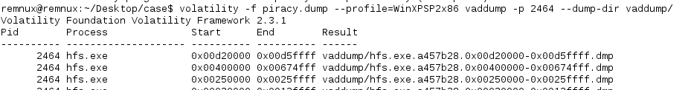
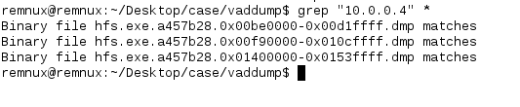
Dumping the process memory and looking for 10.0.0.4

Slide 26
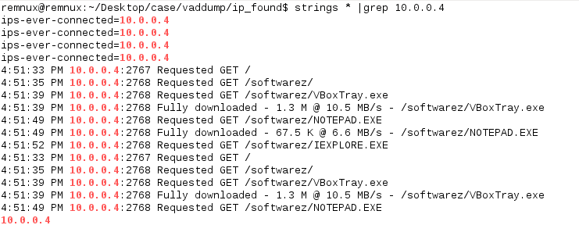
Looking for 10.0.0.4 again with strings

Slide 27
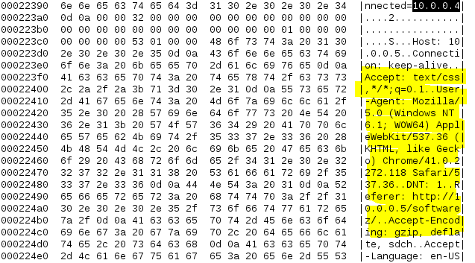
Let’s get more info on the pirate

Slide 28
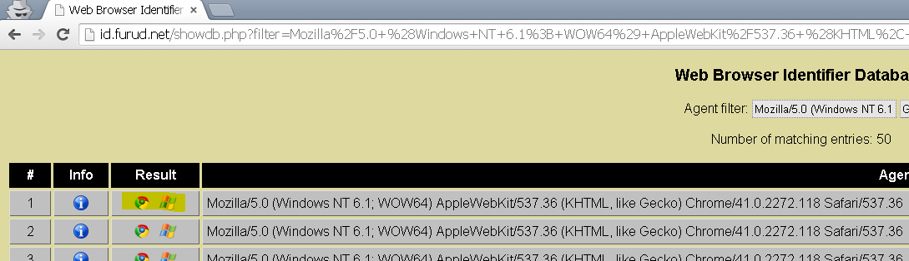
More info
They are using Windows 7 (64bit) with Chrome

Slide 29
END
Memory analysis can be useful (sometimes)
All the tools are included in Kali Linux

