Slide 1
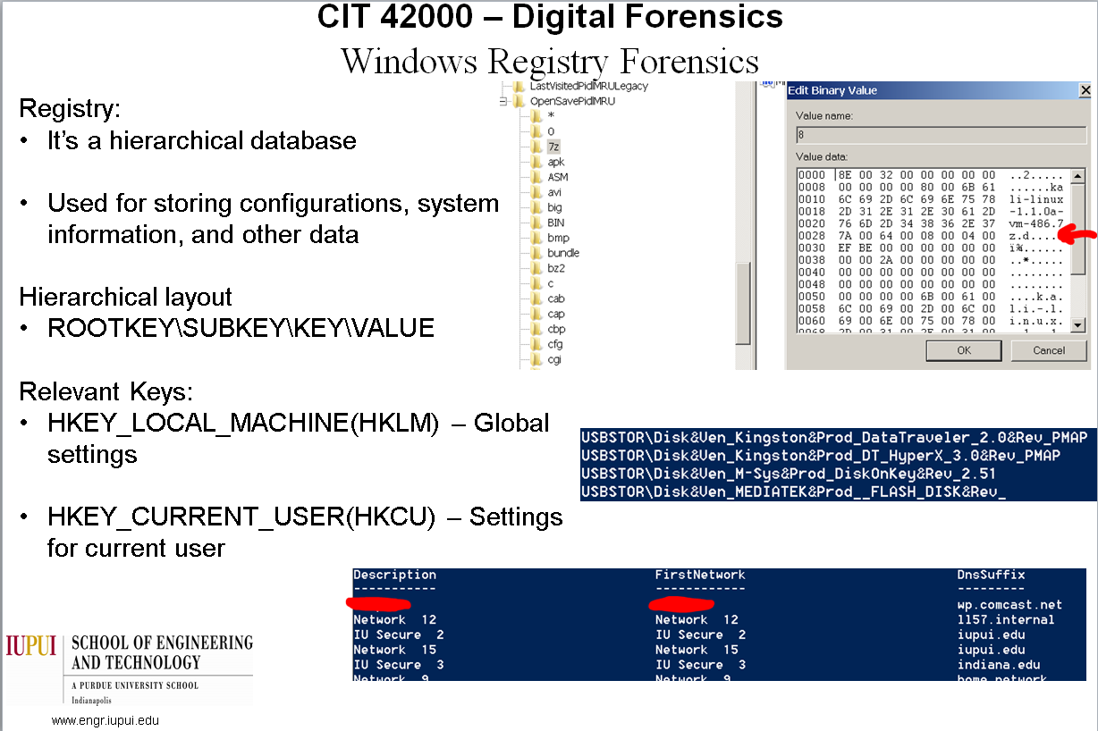
This poster just sucks. It’s okay because I’m not being graded.

Slide 2
Windows Registry Forensics
ALL ABOUT THAT [DATA]BASE

Slide 3
Our goal
None of the things we’re showing are new
We’re just exposing you to registry forensics

Slide 4
Windows Registry
It’s a hierarchical database
Used for storing configurations, system information, and other data
Hierarchical layout
ROOTKEY\SUBKEY\KEY\VALUE
Run regedit.exe for more information

Slide 5
Relevant Root keys
HKEY_LOCAL_MACHINE(HKLM) – Global settings
HKEY_CURRENT_USER(HKCU) – settings for current user
Source: Practical Malware Analysis

Slide 6
MRU (Most Recently Used)
Applications/OS typically stores information about the files, folders, or applications you recently accessed
When looking for this MRU, look for keys with MRU in the name

Slide 7
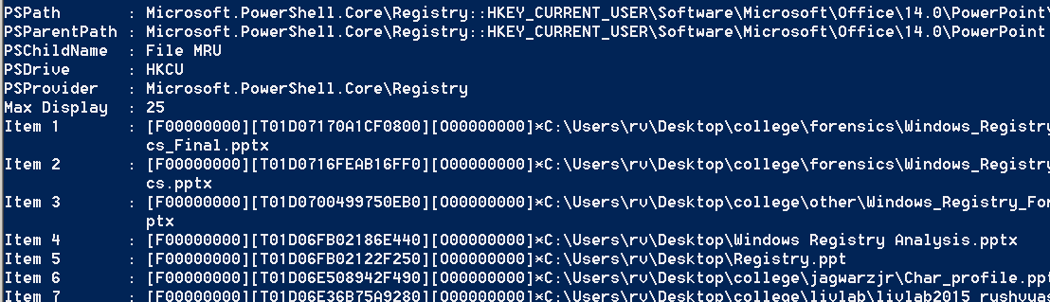
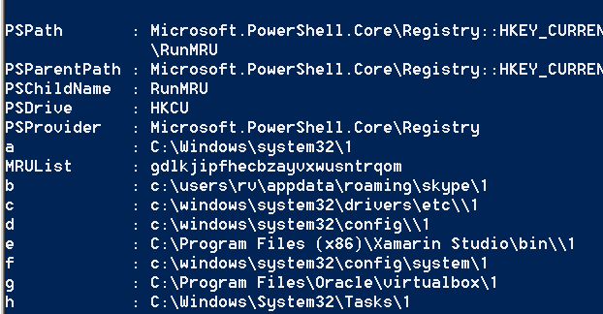
Examples
Office
Most recently ran

Slide 8
ComDlg32 (MRU)
HKCU\Software\Microsoft\Windows\CurrentVersion\Explorer\ComDlg32
Keeps track of anything that was accessed using Common Dialog
Files can be securely wiped, but registry knows if they were opened
Really Useful

Slide 9
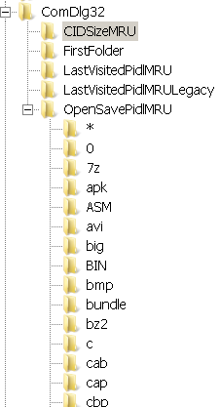
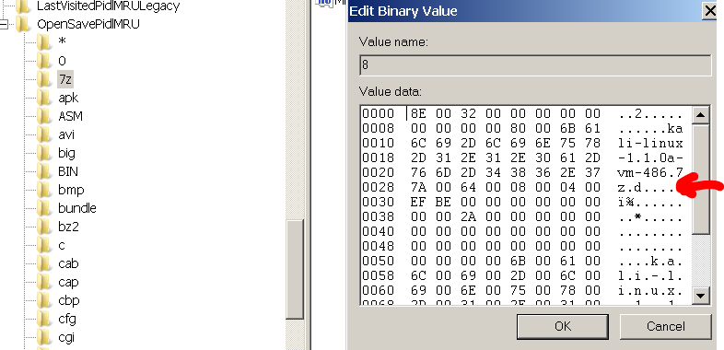
Examples

Slide 10
Use cases
To know what files were on the machine before they were erased
Use your imagination

Slide 11
Networks
Windows stores wired, wireless, and VPN connections in the registry (with domain information)
Connection logs stay in the registry even if the Wireless or VPN profiles are deleted
Information is stored under
HKLM:\SOFTWARE\Microsoft\Windows NT\CurrentVersion\NetworkList

Slide 12
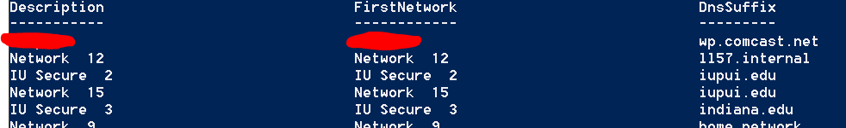
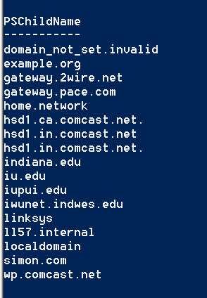
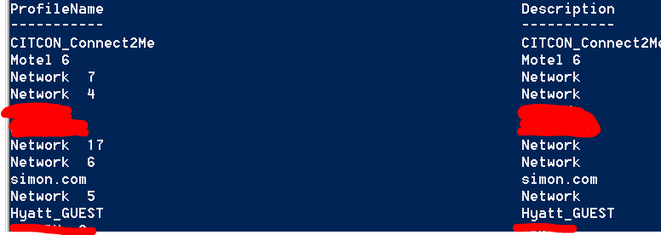
Examples

Slide 13
Use cases
If the case involved a suspect connecting to unauthorized networks
Or to see if they accessed a network or not
Use your imagination

Slide 14
USB / Storage Devices
HKLM:\SYSTEM\CurrentControlSet\
Enum\USBSTOR
Control\usbflags
USBSTOR keeps track of storage devices
Usbflags keep track of any USB device
Key format: VVVVPPPPRRRR
V = Vendor ID
P = Product ID
R = Revision ID

Slide 15


Examples

Slide 16
Use cases
If the case involved a user sharing or stealing files
USB based compromises or infections
Use your imagination

