Slide 1
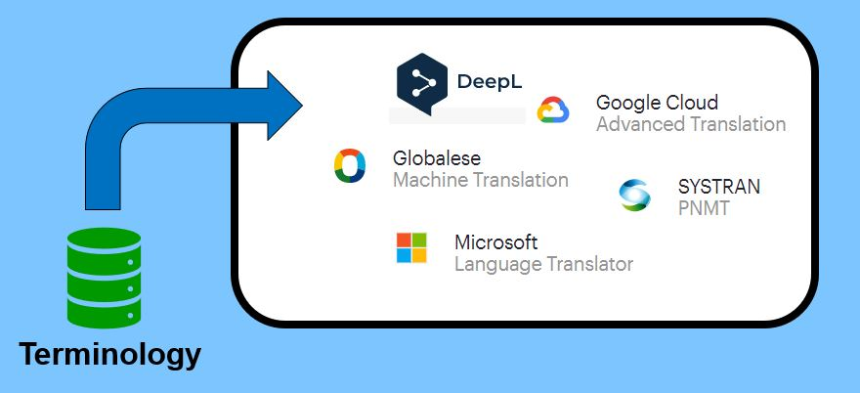
Integrating Terminology into NMT – Glossaries
Notes:
Hello & Welcome everyone to yet another learning nugget on terminology integration into neural machine translation (NMT)
We would like to pay a little more attention to this topic, because it is a very dynamic one at m.
In fact, the various MT providers are currently outbidding each other with new ideas and solutions.
And today, we want to shed light on so-called glossaries, which is a method of enforcing desired target terms in machine translation output

Slide 2
Agenda
Quick paper recap
Terminology check during post-editing
Why Glossaries?
Reducing post-editing effort
Issue 1: Concept vs. term orientation
Issue 2: How does the actual term integration work?
Demonstration
From termbase to glossary
DeepL and its glossary feature
Conclusion and outlook
References
Notes:
To this end,
Let's do a quick recap of the paper first.
Then, we have a look at checking terminology during post-editing.
And building on that we look at how glossaries can help with that and discuss potential pitfalls.
Putting theory into practice, I will show you a) how to convert a termbase into a glossary usable for NMT and b) how you can use glossaries in DeepL.
Last but not least, we’ll summarize what we’ve learned and discuss some future possibilities.

Slide 3
1) Quick paper recap…
Terminology integration can be part of
customising or domain-adapting a generic NMT engine
by re-training it with translation data from a specific domain
e.g. client or project TMs with consistent terminology
Different approaches:
architecture-centric
data-centric
at decoding
at training (masking, data augmentation)
Notes:
Masking → replace source terms with placeholders, translate, replace placeholders with target terms; however this method struggels with necessary morphosyntactic modifications when integrating the target terms. This means that it struggels with adapting the target sentence according to the grammatical gender of the desired target term.
Data augmentation, also known as inline term annotation → target language lemmas (the basic form of a word, for example the singular form of a noun or the infinitive form of a verb) are appended to the source terms in the training data, forcing the egine to copy and inflect the target term in the NMT output
But after hearing this or reading the paper, you might think…

Slide 4

2) Terminology check during post-editing
Can‘t we just post-edit the MT output?
We can always use a termbase to check the use of terminology...
Notes:
And of course your not wrong!

Slide 5
2) Terminology check during post-editing
Ensuring consistent terminology in the target text forms part of full post-editing (ISO 18587:2017)
Generic MT engines often struggle to produce output with consistent terminology due to:
synonyms/variants in the training data → translation unit vs. source/target pair
highly specific terms missing from the training data
complex term structure (e.g., compounds and multi-word terms) → high-efficiency particulate air filter
Such an MT output may include:
mistranslations of homographs and acronyms (depending on the amount of context!) → mole = Muttermal (birthmark) vs. Maulwurf (animal) → NMT = NMT vs. NMÜ (often copied from the source text)
omissions of whole terms or word parts
inconsistent terminology (e.g., Winter/Zielinski 2020:216–221)
Notes:
In fact, ensuring consistent terminology… However;
2.1: Many synonyms /variants for the same concept (e.g. words with varying hyphenation) makes the training data inconsistent → varying translations
2.3: Logical: With more word parts, the room more varying translations increases!

Slide 6





2) Terminology check during post-editing
Source text
generic NMT engine
MT output
detecting missing or forbidden target terms in the MT output
Source terms
Post-editing
Terminology check
Terminology check with QA component in a CAT tool or with a stand-alone QA tool such as QA Distiller (if you want to learn more, see our advanced learning nugget on that topic)
Termbase
Target text with desired target terms
Notes:
high-quality terminology check: import incorrect terms from MT ouput in TB

Slide 7
2) Terminology check during post-editing
Efficient (full) post-editing of NMT output requires:
a well-maintained termbase
if possible, avoid amitted synonyms and variants and (Seidel/Grützmacher 2020:188f.)
include forbidden terms (both from text producers and the MT engine)
if you use homographs and acronyms, manage them with clear data categories or cross-references
Competent post-editors (Nitzke et al. 2019)
bilingual competency
AND extralinguistic competency (domain knowledge), among others
Notes:
a post-editor has to have proficient knowledge of the source and target language, as monolingual PE always bears the risk that content mistakes are not recognised
a post-editor also needs to have […] relevant domain knowledge in order to properly understand the subject and terminology of the source text.
There are of course other competency dimension to consider, and you can learn more about them in this journal article from 2019

Slide 8
2) Terminology check during post-editing
Well, post-editing all terminology mistakes does sound like a lot of work!
Any way to reduce this effort?
Notes:
Well, since you‘re asking, there is!

Slide 9
3a) Why Glossaries? Reducing post-editing effort
Besides customising or domain-adapting a generic NMT engine, you can use glossaries.
What is a glossary?
“terminological dictionary
that contains designations [terms]
from one or more domains or subjects
together with equivalents in one or more natural languages” (ISO 1087 2019:16)
Several NMT providers/systems offer custom terminology support via glossaries
e.g., DeepL, IBM Watson, SYSTRAN, Globalese, Google Cloud, among others
numbers rising → seven in 2021, nine in 2022 (Intento 2021, 2022)
English | German
ant | Ameise
butterfly | Schmetterling
mole | Maulwurf
Notes:
E.g. glossary about the animals that live in my backyard + german equivalents
In fact, at time of recording, there are several NMT providers…
But how does that help with integrating terminology data in NMT?

Slide 10



3a) Why Glossaries? Reducing post-editing effort
Source text
generic NMT engine
MT output
MT output with desired target terms
Source terms
Desired target terms
Post-editing
Glossary
with one-to-one correspondence of source & target terms
→ term orientation
Termbase
with concept-oriented entries
Target text
Notes:
Let’s have a look at our workflow again because up to the point where the engine produces a flawed MT output, the workflow is the same.
Glossaries (click) can created from scratch or exported from a termbase (more on that later)
They are then used to automatically check the terminology in the MT output
So that you as post-editor (click) are presented with an MT output that already contains the desired target terms, which can save time and effort!
You can then focus on other aspects of post-editing
Sounds easy enough, but there’s a catch (click), which brings us to glossary issue no. 1)

Slide 11
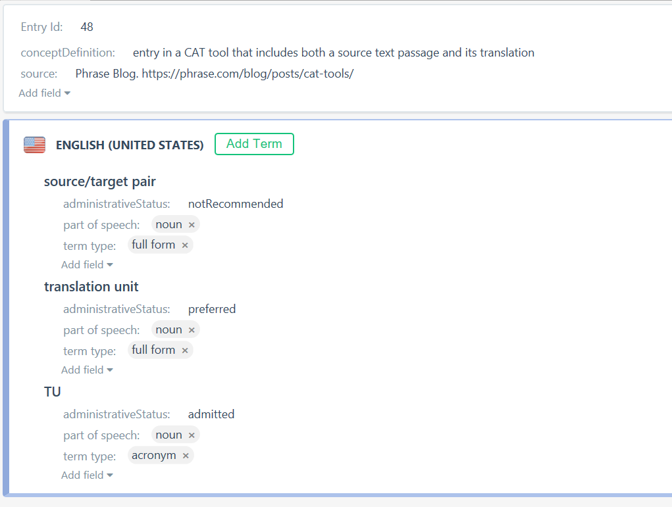
3b) Issue 1: Concept vs. term orientation
Termbases are concept-oriented: (e.g., ISO 12616-1:2021)
1 concept = 1 entry
All terms (incl. synonyms, abbreviations, variants) and all relevant metadata
e.g. administrative status to perform terminology checks in writing and translation
preferred, admitted, notRecommended, obsolete (DataCatInfo: ‘administrative status’ in TermWeb)

Slide 12

3b) Issue 1: Concept vs. term orientation
In many cases, NMT engines can’t yet use concept-oriented terminology data
need for glossaries (term lists) → e.g., in XLSX, CSV, TSV
one-to-one term correspondence (Winter 2021:6–8)
all source language terms (even forbidden ones) → complete check
ONE preferred target language equivalent (respectively)
no ambiguous source language terms to avoid substitutions with incorrect target language terms*
This could possibly exclude relevant terms from being integrated in the MT output!
consideration: Does the alternative meaning of the term occur in the source texts?
English | German
mole | Maulwurf (animal)
mole | Muttermal (birthmark)
mole | …
Notes:
Glossary formats: Excel files or as comma or tap seperated values
Glossaries need to follow specific criteria → keyword: 1-to-1
No ambiguous terms? In many cases, it does make sense!
Example:
Imagine a text about moles (picture!), how they live, what they eat etc.
In other contexts, the term mole can also refer to a birthmark, but would this meaning occur in our source text about the animal? Probably not.
If the alternative meaning doesn’t occur in the STs, you can consider including your original entry in the glossary (green mark!)
So, now that we’ve covered the issue of concept vs. term integration, we’re now moving on to the second glossary issue…

Slide 13
3c) Issue 2: How does the actual term integration work?
Term substitution is often only based on string matching, i.e. Find & Replace
If your glossary doesn’t contain inflected forms (e.g., conjugated verbs, declined nouns),
Only lemmas are found and replaced → limited use (proper names, slogans, etc.)
Data augmentation at least manages inflected forms more or less reliably (but only when the source term is detected) (Winter 2021:6–8)
Solution: (Winter 2021:6–8)
Include inflected forms in your glossary to improve term detection (overkill?)
Morphosyntactic terminology integration (as provided by e.g. DeepL)
adapts integrated terms and their context (articles, adjectives etc.) to the grammar of the target language (e.g. grammatical gender/number)

Slide 14
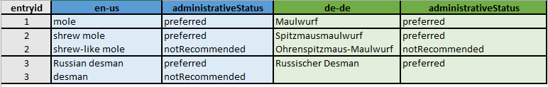
4a) Demonstration: from termbase to glossary
Concept-oriented terminology entries
But how do we get a glossary now?
Notes:
Respective Entrid indicates the 3 concepts
the animal mole (picture!) and 2 genera: The shrew mole and The Russian desman
Preferred and forbidden (or notRecommended) terms in both English and German

Slide 15
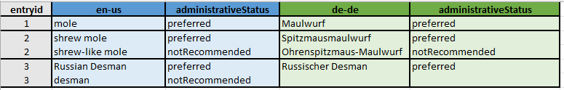
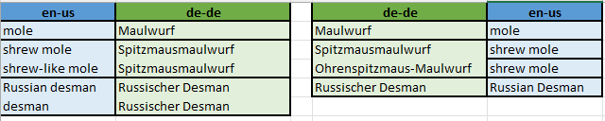
4a) Demonstration: from termbase to glossary
Concept-oriented terminology entries
Term-oriented glossary entries → two lists, depending on the language pair
Notes:
First of all, 2 lists, because term orientation makes glossaries language dependent!
For example, English into German:
all source terms (both preferred and forbidden)
ONE AND THE SAME preferred target equivalent for each source term
Shrew mole example

Slide 16
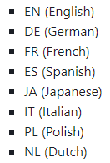
4b) Demonstration: DeepL and its glossary feature
MT output produced by DeepL (i.e., by a generic NMT engine)
any of the terminology mistakes discussed earlier?
How does the glossary feature work?
today → free desktop version: 1 glossary, up to 10 entries
glossary support
for web and desktop (since May 2020) (DeepL 2020)
for the API (since August 2021) (DeepL 2021)
in the formats CSV/TSV and for 28 language pairs (DeepL n. d.)

Slide 17
4b) Demonstration: DeepL and its glossary feature
Source text sample:
Original MT output:
“[Moles] are small, dark-furred animals with cylindrical bodies and hairless, tubular snouts.
They range in size from the tiny shrew moles of North America, as small as 10 cm in length and weighing under 12 grams, to the Russian desman, with a body length of 18–22 cm, and a weight of about 550 grams.
The fur varies between species, but is always dense and short; desmans have waterproof undercoats and oily guard hairs, while the subterranean moles have short, velvety fur lacking any guard hairs.” (Wikipedia 2023, ‘Talpidae’)
„Maulwürfe sind kleine, dunkelhäutige Tiere mit zylindrischen Körpern und unbehaarten, röhrenförmigen Schnauzen.
Ihre Größe reicht von den winzigen nordamerikanischen Spitzmäusen, die nur 10 cm lang sind und weniger als 12 Gramm wiegen, bis zum russischen Desman mit einer Körperlänge von 18-22 cm und einem Gewicht von etwa 550 Gramm.
Das Fell variiert von Art zu Art, ist aber immer dicht und kurz; Desmans haben ein wasserdichtes Unterfell und ölige Deckhaare, während die unterirdischen Maulwürfe ein kurzes, samtiges Fell ohne Deckhaare haben.“
(DeepL, 20 February 2023)
Notes:
Small text sample, from Wikipedia, link in the references
Moles → Maulwürfe (ok)
Shrew moles → Spitzmäuse (shrews) (different animal!)
Russian Desman → russischer Desman (ok, but we‘d like russisch to be capitalised!)
Desmans → Desmans (Russian is missing, since it was not given in the source, but incorrect plural form!)
Next, we‘ll switch to DeepL to see how the glossary feature works!

Slide 18
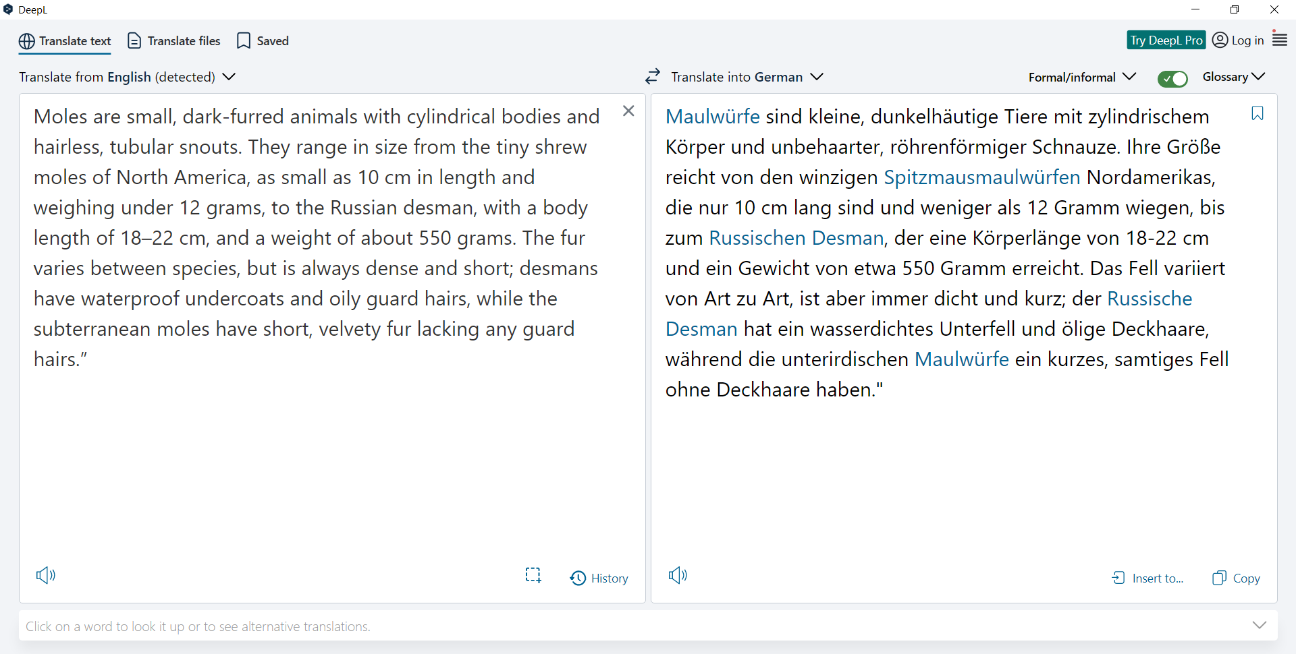
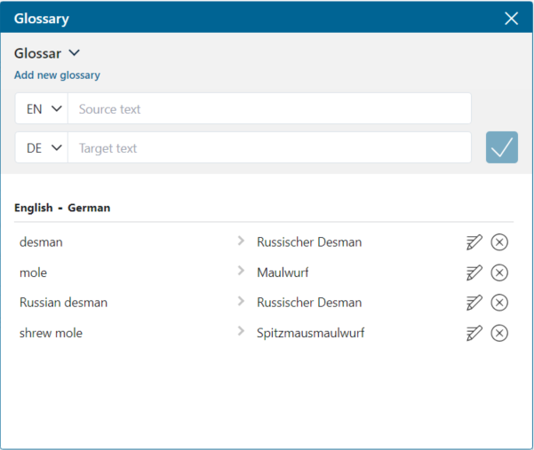
4b) Demonstration: DeepL and its glossary feature (see video)

Slide 19
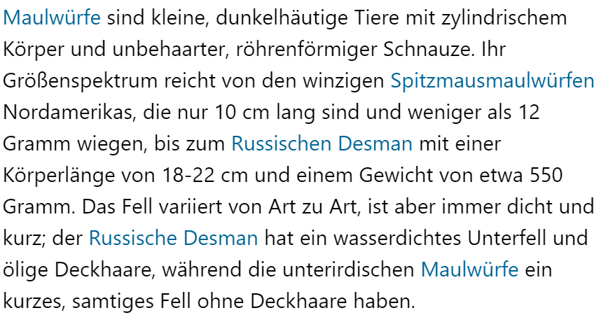
5) Conclusion and outlook
The glossary feature seems to reduce post-editing effort
if the integrated target terms are correctly inflected
DeepL seems to be pretty reliable when integrating and inflecting nouns and adjectives
less reliable with verbs (Keller 2021:35)
Integration of the glossary feature in CAT tools
DeepL API supports the feature (e.g. see memoqdocs)
e.g., DeepL plug-in for Trados Studio not (yet)
Phrase Translate supports a glossary feature directly in the CAT tool, but the terms are not correctly inflected yet (Keller 2022:35)
depends on the engine/provider (e.g. DeepL and Phrase NextMT now often inflect terms correctly (April 2023))
Notes:
We used the desktop version!
Howerver, most professionals work in CAT tools these days
In memoq, you can import glossaries for DeepL
Unfortunately, memoq doesn‘t specifiy whether the integrated target terms are correctly inflected
The CAT tool Trados Studio doesn‘t support the glossary feature in its DeepL plug-in yet
Another interesting case is the CAT tool Phrase, formerly known as Memsource. Its component Phrase Translate enables you to use various MT systems via plug-ins. The component is not only supposed to select the best MT system for a specific translation job, but it also supports a glossary feature directly in the CAT tool. Unfortunately, however, the terms are not correctly inflected yet as Keller (2022) points out in an article about Phrase Translate.
To sum it up, I hope it has become clear that terminology integration into NMT output currently is a very dynamic topic and that the glossary feature can reduce post-editing effort if properly implemented.

Slide 20
Thanks for watching!
(references in the companion PDF)
Notes:
That‘s it, we‘ve reached the end of this learning nugget. If you‘re interested in the references, you can find them in the companion PDF. Goodbye!

Slide 21
References
DatCatInfo (n. d.): Welcome to DatCatInfo. DatCatInfo. https://datcatinfo.net/ (20 February 2023).
DeepL (2020): Customize DeepL Translator with the glossary feature. DeepL blog. https://www.deepl.com/en/blog/20200506 (20 February 2023).
DeepL (2021): Announcing glossary support for the DeepL API. DeepL blog. https://www.deepl.com/en/blog/announcing-glossary-support-for-deepl-api (20 February 2023).
DeepL (n. d.): Manage glossaries. DeepL. https://www.deepl.com/docs-api/glossaries/ (20 February 2023).
Intento (2021): The state of machine translation 2021. intento. https://try.inten.to/machine-translation-report-2021/ (20 February 2023).
Intento (2022): The state of machine translation 2022. intento. https://inten.to/machine-translation-report-2022/ (20 February 2023).
ISO 10897 (2019): Terminology work and terminology science — Vocabulary: Geneva: ISO Copyright Office.

Slide 22
References
ISO 12616-1 (2021): Terminology work in support of multilingual communication — Part 1: Fundamentals of translation-oriented terminography: Geneva: ISO Copyright Office.
Keller, Nicole (2021): DeepL integriert Glossarfunktion. In: edition 17(1), 34f.
Keller, Nicole (2022: Glossarfunktion in Phrase Translate. In: edition 18(2), 33–35.
Seidel, Jenny/Grützmacher, Ulrike (2020): Without terminology, translation is nothing. In: Dalla-Zuanna, Jean-Marc/Kurz, Christopher (Eds.): Translation quality in the age of digital transformation. Berlin: BDÜ Fachverlag, 184–199.
Wikipedia (31 January 2023): Talpidae. Wikipedia. https://en.wikipedia.org/wiki/Talpidae (20 February 2023).
Winter, Tom (2021): Terminologische Beeinflussung der Neuronalen Maschinellen Übersetzung: Ein Praxisbericht. In: edition 17(2), 5–10.
Winter, Tom/Zielinski, Daniel (2020): Terminologie in der neuronalen maschinellen Übersetzung. In: Porsiel, Jörg (Ed.): Maschinelle Übersetzung für Übersetzungsprofis. Berlin: BDÜ Fachverlag, 210–233.

