Slide 1
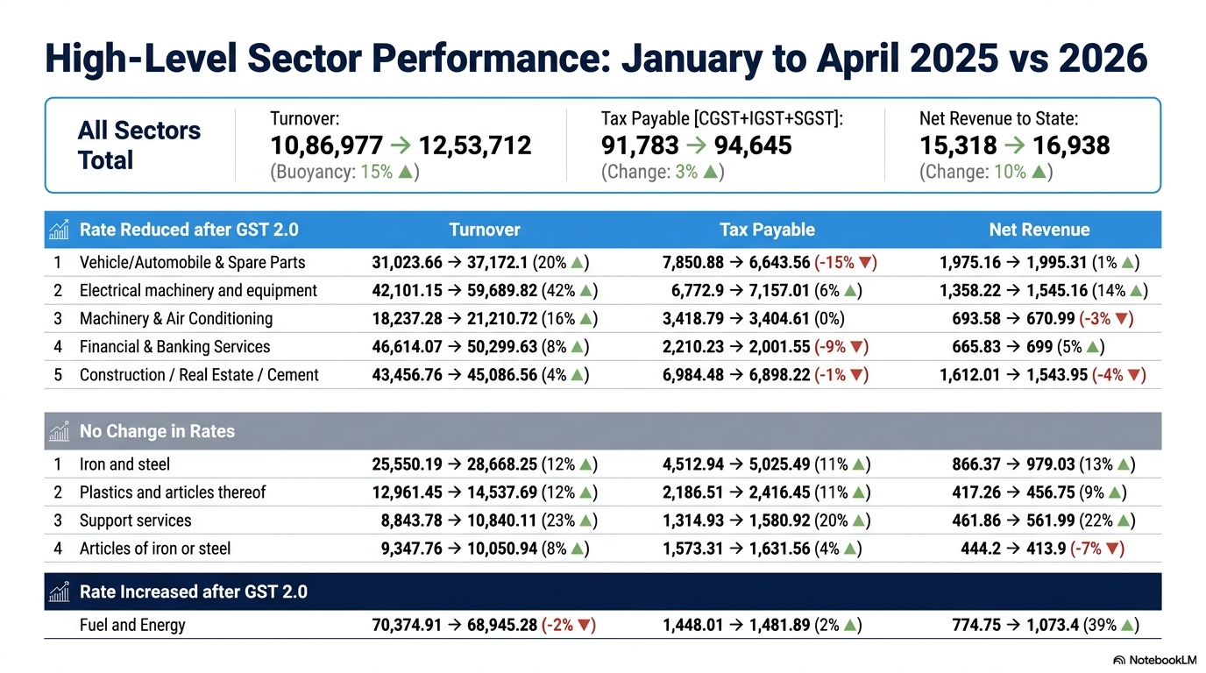


Slide 2
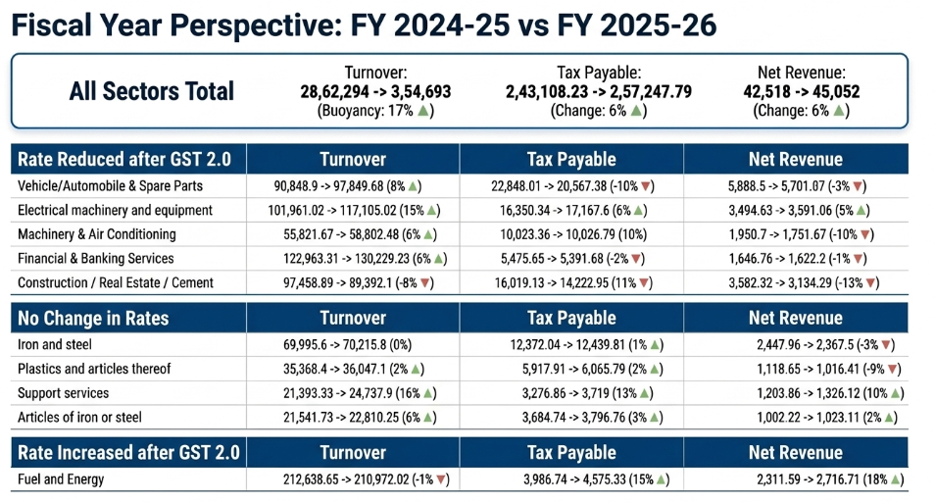

Slide 3
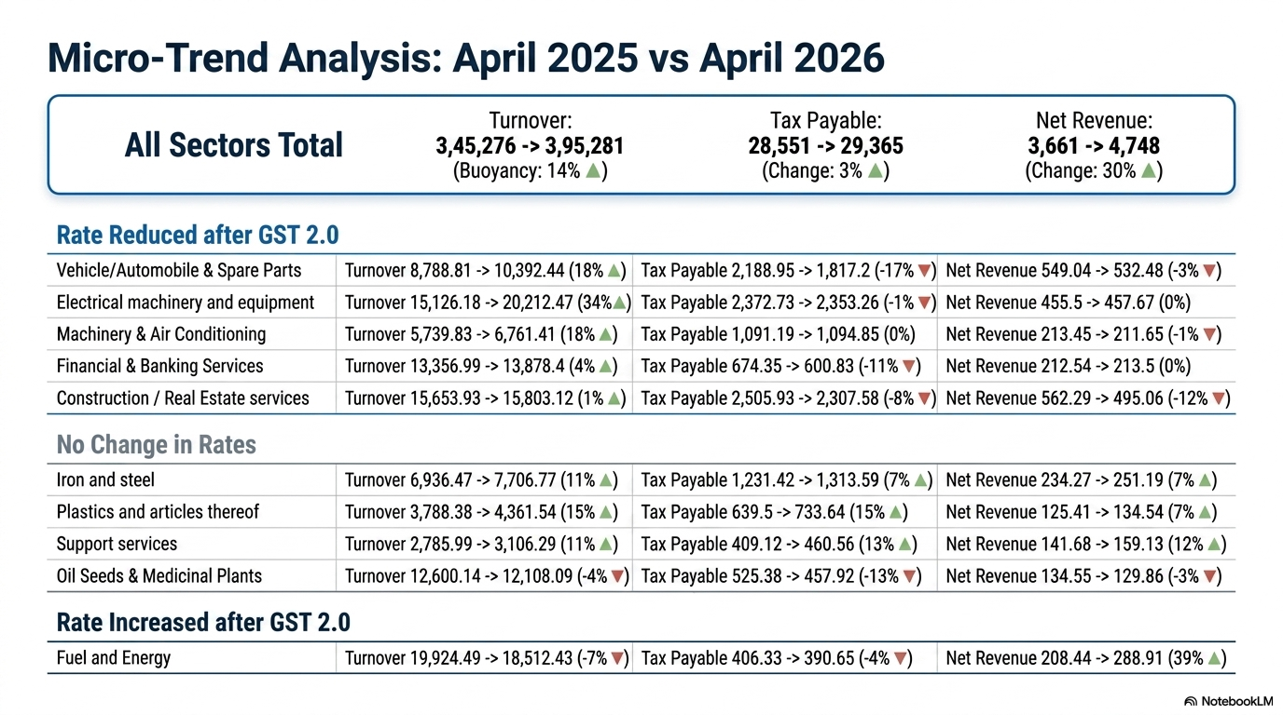
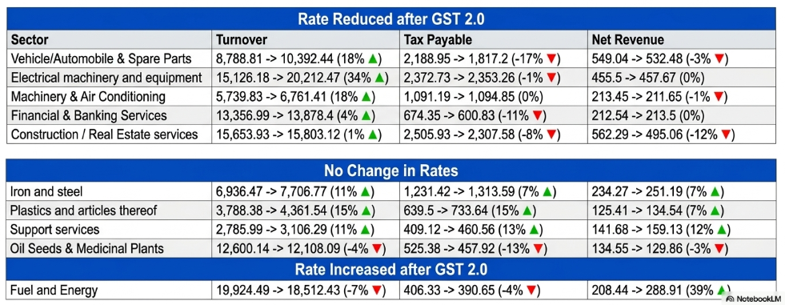

Slide 4



Slide 5
Audit – Data driven selection and Risk Score
Audit Completed (Jan’26 – till date) | Plan for next 6 months
1610 | No of Cases | Revenue Potential (in Cr.)
 | 2235 | 87.80
Initiative | Status | Deadline | Comments
Data driven selection of audit cases along with Risk Rating | In-progress | 15-06-2026 | ITMS Team
Priority Audits for Large taxpayers with High Risk Score | In-progress | 15-06-2026 | ITMS Team
Sector wise and Region wise selection Targeting | In-progress | 15-06-2026 | ITMS Team
Focus on revenue-sensitive and Evasion prone sectors | In-progress | 15-06-2026 | ITMS Team

Slide 6
Scrutiny of Returns: Enhancing Recovery Rates
Aim: Increase Recovery rate from 11.48% to 20%.
Cases under Scrutiny | Potential (in Cr.)
40970 | 425.96
Initiative | Status | Deadline | Comments
Initiate high inter-state sales scrutiny based on new selection parameters. | In-progress | 15-06-2026 | ITMS Team
Investigate Reversal in Exempted Turnover cases. | In-progress | 15-06-2026 | ITMS Team
E-way Bill to Toll Plaza data analysis integration. | In-progress | 15-06-2026 | ITMS Team
Complete ongoing SCN pendency for all existing scrutiny cases. | In-progress | 15-06-2026 | ITMS Team

Slide 7
Enforcement : Operations & Targets
Particulars | Completed in 2025-26 | Plan for 2026-27
No. of Cases | 638 | 1000
No. of Arrests | 6
No. of Vehicle Inspection | 267
Revenue Realized | 459 Cr.
Initiative | Status | Deadline | Comments
Focus on Fake Firms | In-progress | 15-06-2026 | ITMS Team
Red Alert from central Authorities | In-progress | 15-06-2026 | ITMS Team
High Evasion prone Sectors (Tabacco, sanitary items, Pan Masala, Electrical Goods, Iron & Stell, Dry Fruits, Timber , Edible Oil) | In-progress | 15-06-2026 | ITMS Team

Slide 8
Fraud Detection : Intelligence & Analytics
Fake Firms Detected since Sep 2024 | ITC involved (in Cr.)
300+ | 668.41
Initiative | Status | Deadline | Comments
New Report: New Registrations with abnormal Turnover spike | In-progress | 15-06-2026 | ITMS Team
New Report: New Registrations with high inter-state Sales | In-progress | 15-06-2026 | ITMS Team
New Report: Image Analytics – Detecting fake registrations using images of past fake Taxpayers | In-progress | 15-06-2026 | ITMS Team
New Report: Detect evasions using Electricity, Transport, Mining, Registration and Stamps Departmental data. | In-progress | 15-06-2026 | ITMS Team
Increase Pre-GST field visits of suspicious taxpayers – Increase monthly average of 350 to 500. | In-progress | 15-06-2026 | ITMS Team

Slide 9
Taxpayer Base Enhancement
The GST Taxpayer base of Rajasthan has grown by 126% in last 8 years of GST implementation. Current Userbase 9.81 Lakh
Initiative | Status | Deadline | Comments
Use of inter-departmental data analytics (like TDS, Electricity, Mining etc.) to identify businesses with high Turnover but no GST Registrations. | In-progress | 15-06-2026 | ITMS Team
Identifying new sectors for Registrations: Special Drive for Villas, Hostels, Sports Academies in next 6 months. | In-progress | 15-06-2026 | ITMS Team

Slide 10
Recovery : Top Case Optimization
Top 100 Cases of all Zones | Amount involved (in Cr.) | Target for next 6 months (in Cr.)
1600 | 394.01 | 118.20
Initiative | Status | Deadline | Comments
Focus on Top Recovery Cases of all zones | In-progress | 15-06-2026 | ITMS Team
Development of new dashboard for Recovery Monitoring to evaluate jurisdictional performance. | In-progress | 15-06-2026 | ITMS Team
Coordination with Central agencies and other State Departments. | In-progress | 15-06-2026 | ITMS Team
Focus on Bank Accounts attachment and Third-party creditors. | In-progress | 15-06-2026 | ITMS Team

Slide 11
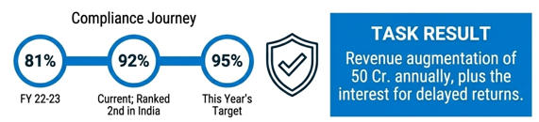
Compliance-Led Revenue Augmentation
Initiative | Status | Deadline | Comments
To develop automated analytics-based compliance tracking with message and whatsapp trigger. | In-progress | 15-06-2026 | ITMS Team
Focus on concurrent Scrutiny of Non-Filers & Mismatch Filers | In-progress | 15-06-2026 | ITMS Team

