Slide 1


CMD Darslari
9-dars. For operatori bilan ishlash

Slide 2
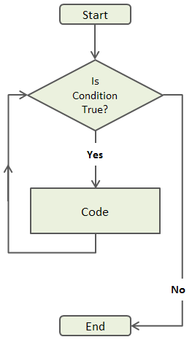
for bilan ishlash

