Slide 1


Informatika 8-sinf | Excel | ITOne Uz
1-dars. Mantiqiy amallar

Slide 2
Rost Yolg'on tushunchasi
1 - Rost = true
0 - Yolg'on = false

Slide 3
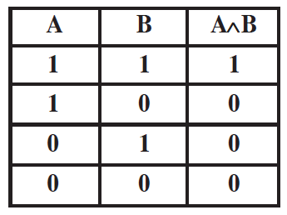
A * B = ? ( and) ∩
1 * 1 = 1
1 * 0 = 0
0 * 1 = 0
0 * 0 = 0

Slide 4
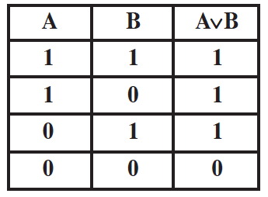
A + B = ? ( or)
1 + 1 = 1
1 + 0 = 1
0 + 1 = 1
0 + 0 = 0

Slide 5
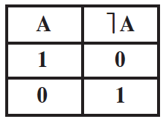
EMAS ( not )
1 = Ꞁ 0
0 = Ꞁ 1

Slide 6
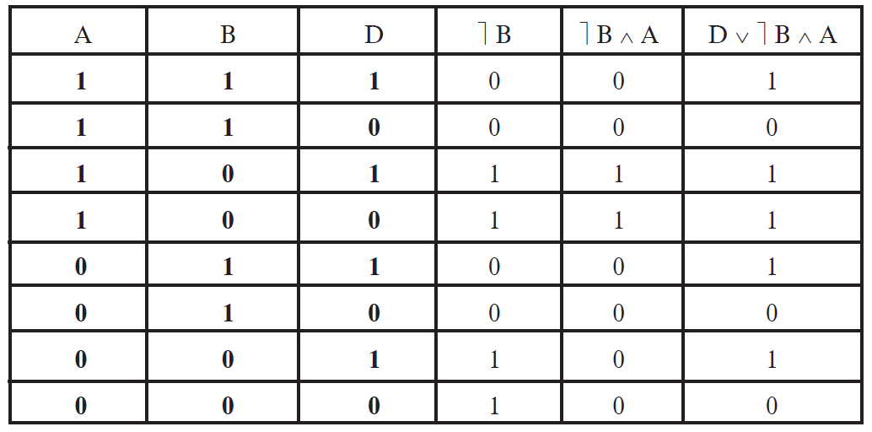
Misollar

