Slide 1

Informatika 9-sinf | ITOne Uz
10-dars. Pythonda listlar va input funksiyasi

Slide 2
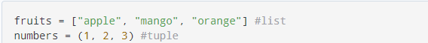
O’zgaruvchilarni e’lon qilish
guruhlar = [“126-guruh”, “127-guruh”, “128-guruh”]
print(guruhlar)
print(guruhlar[0])

Slide 3
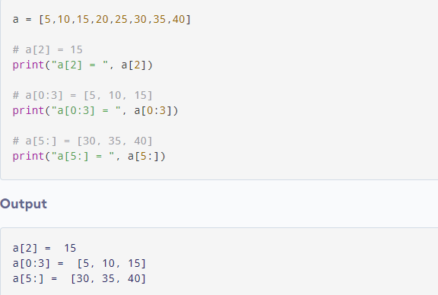
Natijani chiqarish usullari

Slide 4
Sep funksiyasi
>>> print('07', '09', '2021', sep='-‘, end=‘.’)
07-09-2021

Slide 5
Split funksiyasi
txt = "welcome,to,the,jungle"
x = txt.split(",")
print(x)

Slide 6
Kiritish amali
son = input("sonni kiriting:")
print("siz kiritgan son ", son)

