Slide 1

Informatika 9-sinf | ITOne Uz
8-dars. Boshlang'ich amallar, Pythonda amallar bajarish

Slide 2
print() – chiqarish amali
a = 5
print(‘kiritilgan son ', a)
b=“itone”
c=“andijon”
print(“bizning sayt {}, manzil {}”.format(b,c))
a=12.12321232
format(a,'.2f')
'12.12' // natija

Slide 3
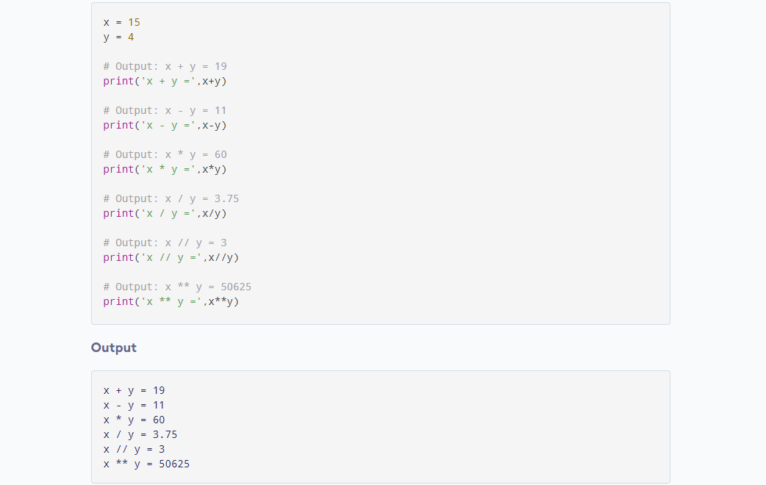
Pythonda amallar

Slide 4
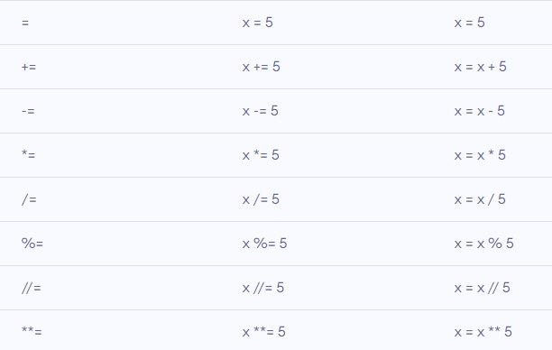
Topshiriq operatorlari

