Slide 1

Informatika 9-sinf | ITOne Uz
7-dars. O'zgaruvchilar bilan ishlash, Pythonda o'zgaruvchilar

Slide 2
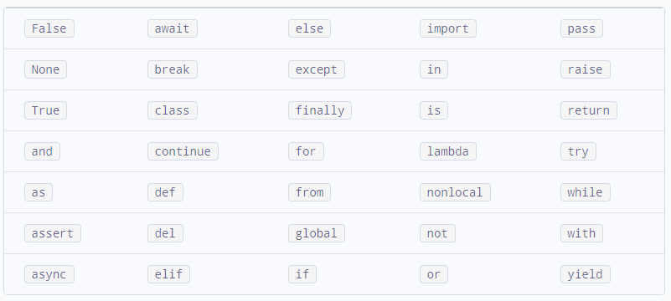
Kalit so’zlar

Slide 3

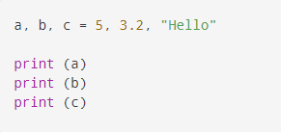
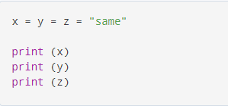
O’zgaruvchilarni e’lon qilish
A = 12
B = ‘c’
C = “itone.uz”
D = True
Print(A)
Print(A, B)
Print(A,B,C,D)

Slide 4

O’zgaruvchi turini o’zgartirish
float(12)
int(12,85)
son = “123”
print(type(son))

