Slide 1



Data Collection System For Census
Members:
Rhea Mae Cambarijan
Rodulfo Daniel Lopez
Michelle Paylangco
Rex Dominic Sihay
Princess Grace Marie Sitoy

Slide 2

INTRODUCTION
This presentation aims to provide a comprehensive overview of our data collection system for the Census. We will explore the systematic study undertaken to develop to innovative system, highlighting the progress made throughout the development process. Our objectives will be clearly outlined, along with a detailed examination of the workflow within the system. Additionally, we will discuss the design elements that contribute to the overall functionality and efficiency of our data collection approach.

Slide 3
Objectives
To establish a comprehensive and efficient data collection system for census activities, the system will have:
Function entirely offline for data entry, ensuring usability in regions without internet access.
Offer online capabilities for administrators, including account creation, user management, data aggregation and analysis.

Slide 4
Objectives
Enhanced data gathering, accuracy and analysis.
User friendly interface to ensure optional performance and user experience.
Thorough testing to validate performance, reliability, and usability.
Strong security measures for sensitive census data.

Slide 5
Scope and Delimitation
Scope:
Delimitation:
Target Users
Offline Data collection
Data Validation
Secure Data Storage
User-friendly
Enable Remote Administration
Data Limitations
System Complexity
Time Constraints
Team Capacity
Resource Constraints

Slide 6
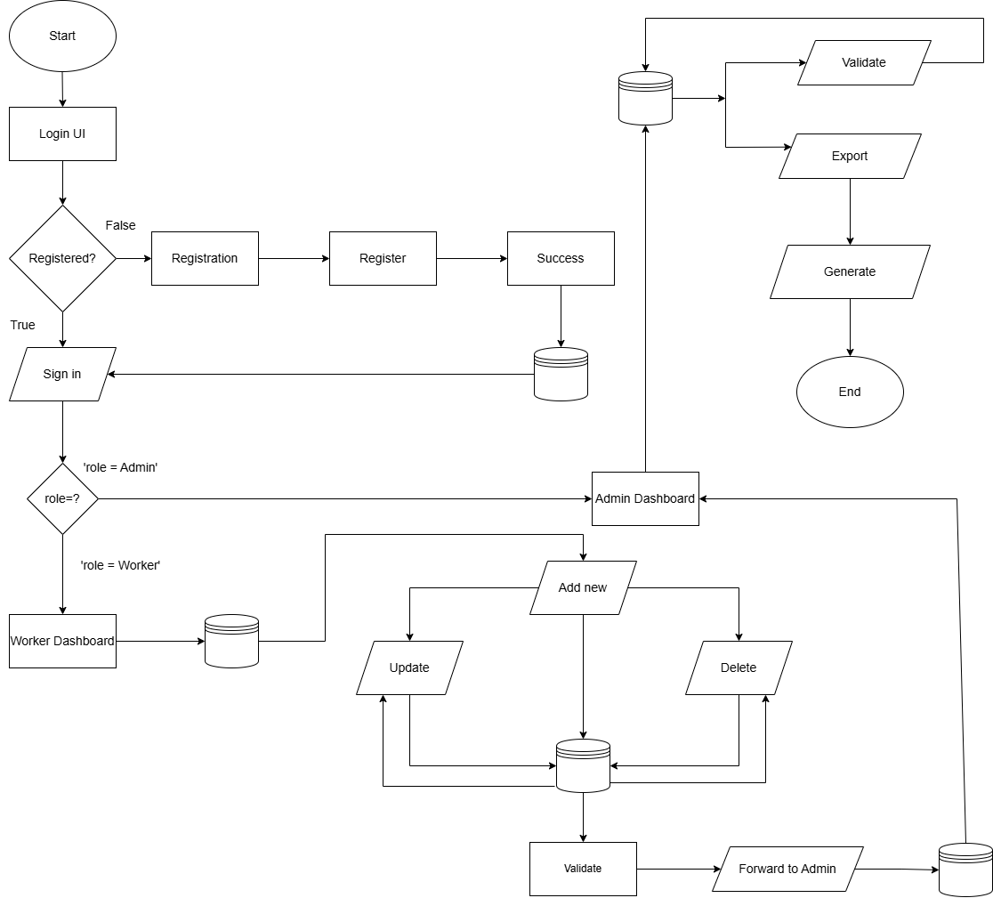
FLOWCHART

Slide 7
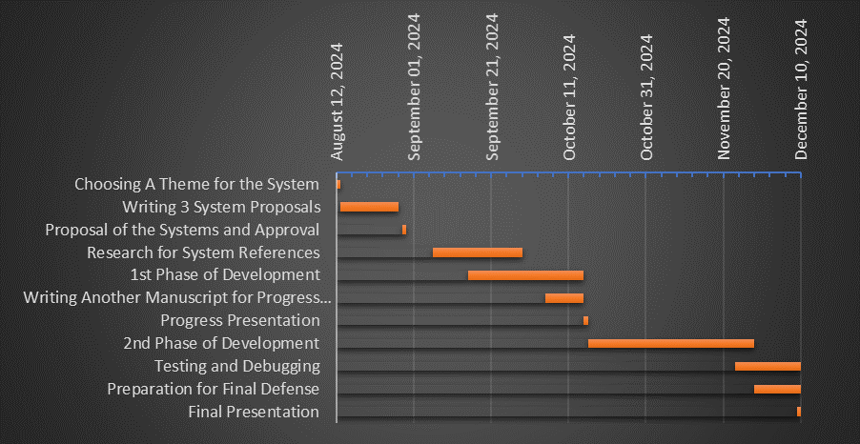
GANTT CHART

Slide 8
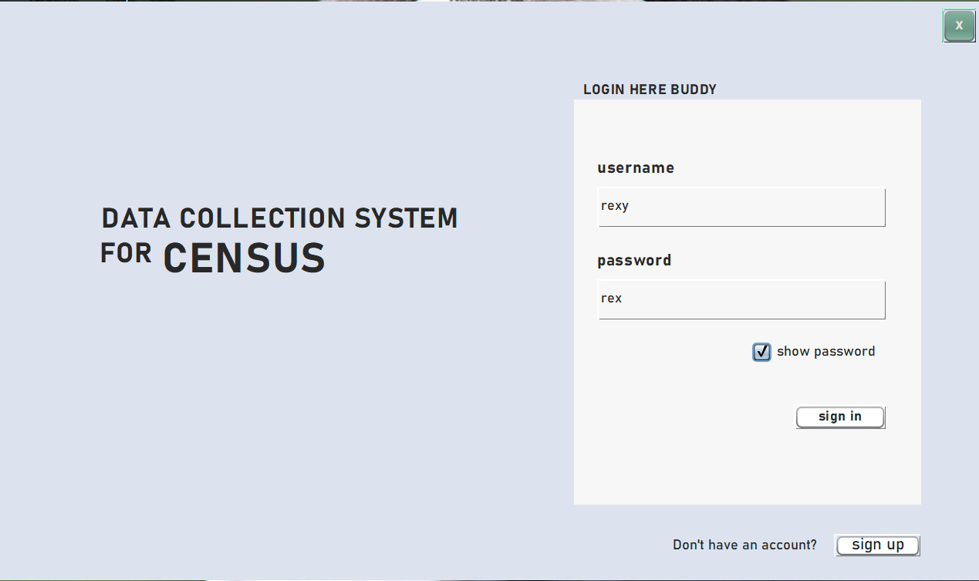
SYSTEM DESIGN
Main Login and Title of the System
Title: “Data Collection System for Census”.
Main Login Panel:
Located on the right side of the window.
Fields:
Username: Enter user credentials.
Password: Input with "show password" option.
Buttons:
Sign In: Authenticate admin.
Sign Up: Redirect to registration.
Green Back Button: Present on all windows to return to the previous screen.

Slide 9
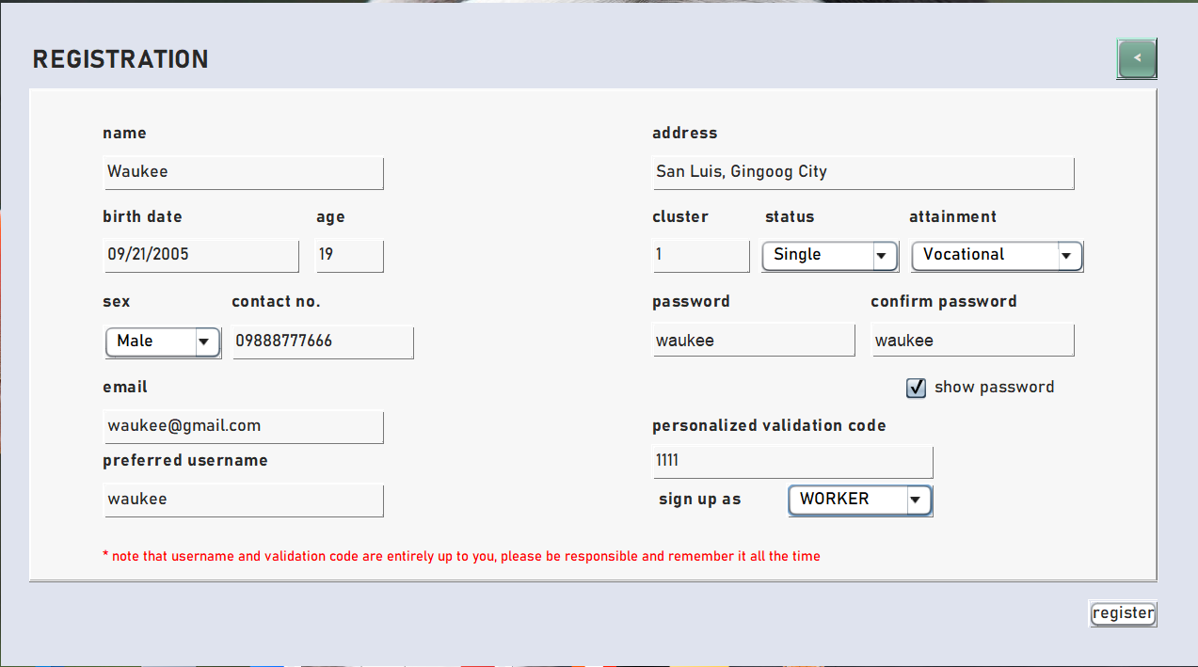
SYSTEM DESIGN
Registration Window
Fields to input essential registration information.
Register Button: Located at the lower right to complete the registration process.

Slide 10
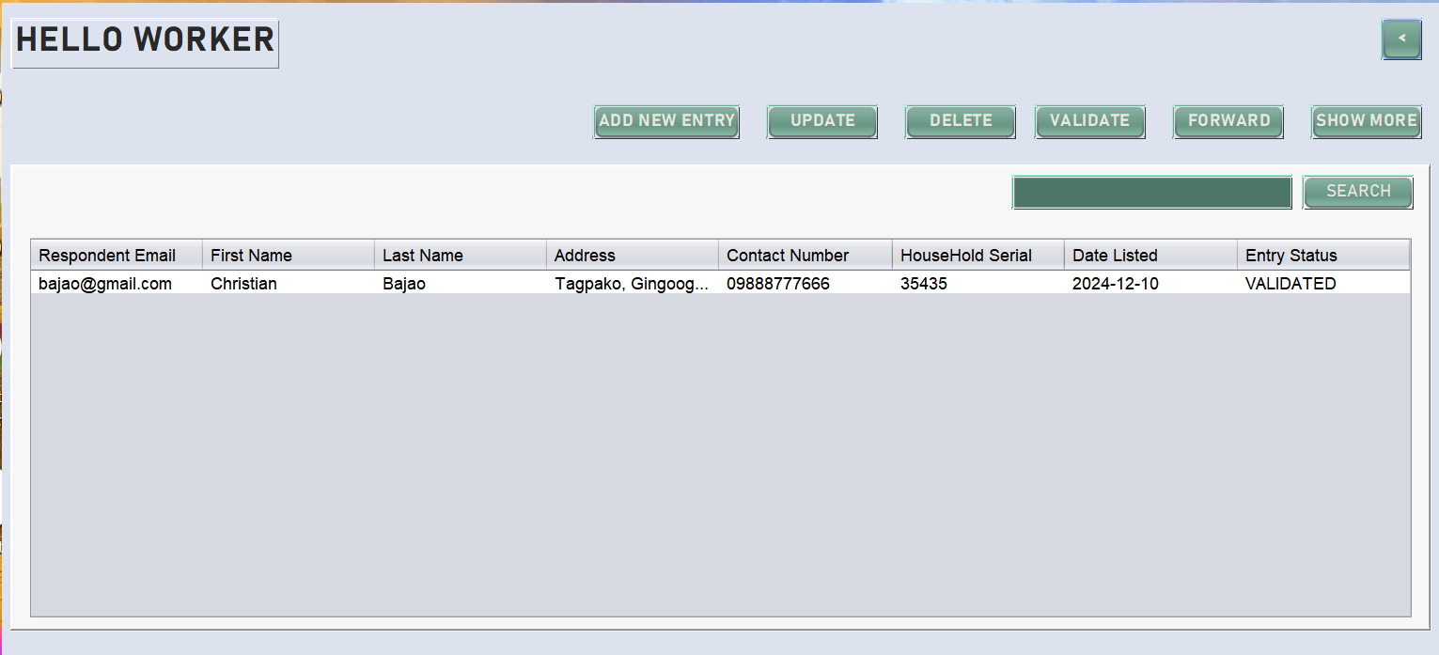
SYSTEM DESIGN
Worker Dashboard
"HELLO WORKER" label: Displays worker details when clicked.
Data Table: Shows all collected data.
Buttons:
ADD NEW ENTRY: Opens window to add data.
UPDATE: Edit selected data entry.
DELETE: Remove selected data entries.
VALIDATE: Enter validation code to validate all data.
FORWARD: Sends validated data to admin, excludes already forwarded.
SHOW DATA: View additional details of selected data.
SEARCH: Search for specific data in the table.

Slide 11
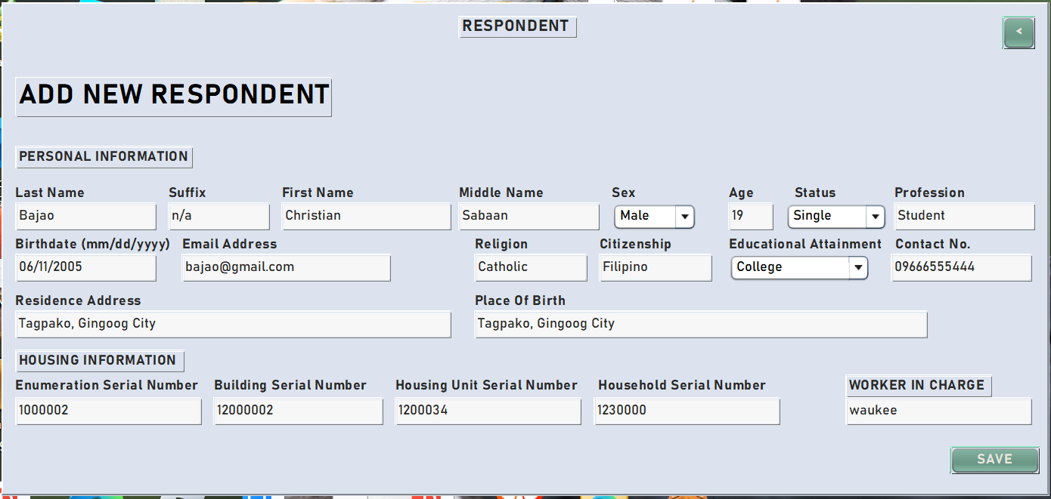
SYSTEM DESIGN
Window for Adding a New Respondent
Accessed by clicking "ADD NEW ENTRY" in the Worker Dashboard.
Text fields to input respondent data.
SAVE Button: Saves the data to the database and displays it in the Worker Dashboard table.

Slide 12
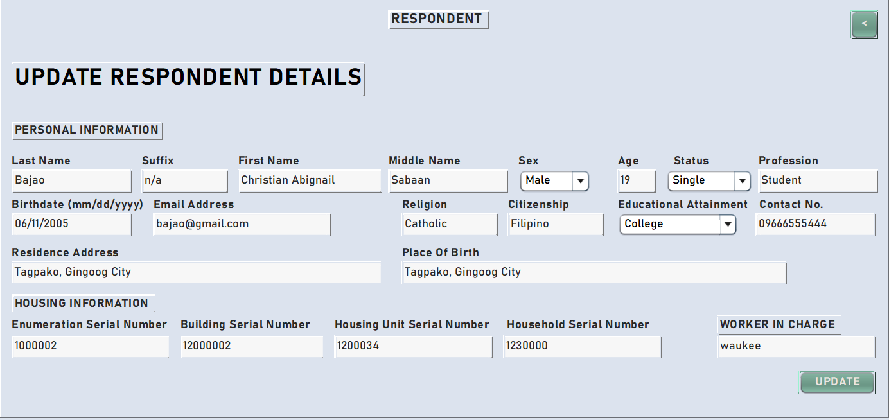
SYSTEM DESIGN
Window For Updating Existing Records About the Respondent
Accessed by selecting a row and clicking "UPDATE" in the Worker Dashboard.
Allows the worker to edit respondent data.
Dynamic text fields to modify the information.
UPDATE Button: Saves changes to the database and updates the table in the Worker Dashboard.

Slide 13
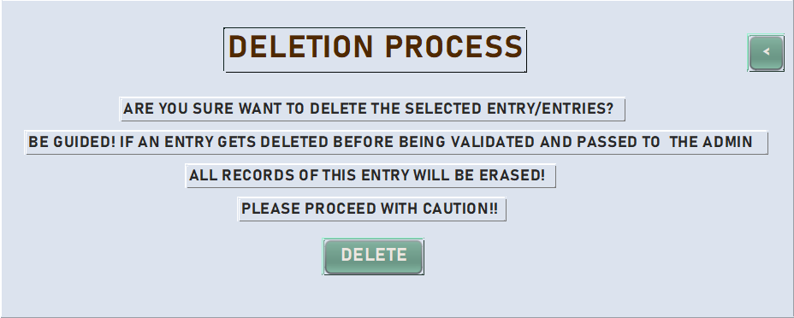
SYSTEM DESIGN
Window for the Delete Process
Accessed by selecting rows and clicking "DELETE" in the Worker Dashboard.
Prompts confirmation to delete selected data.
DELETE Button: Confirms and deletes the selected data.

Slide 14
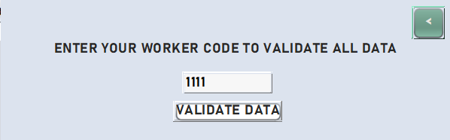
SYSTEM DESIGN
Window for the Validation Process
Accessed by clicking "VALIDATE" in the Worker Dashboard.
Prompts the worker to enter a validation code.
VALIDATE DATA Button: Checks the code and validates all unvalidated entries if the code matches.

Slide 15
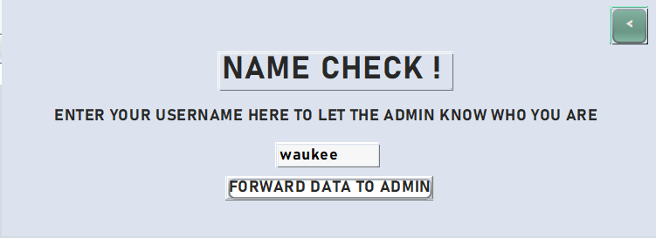
SYSTEM DESIGN
Window for the Forward Process
Accessed by clicking "FORWARD" in the Worker Dashboard.
Prompts the worker to enter their username.
FORWARD DATA TO ADMIN Button: Verifies the username, checks for validated entries, and forwards them to the admin, excluding already forwarded data.

Slide 16
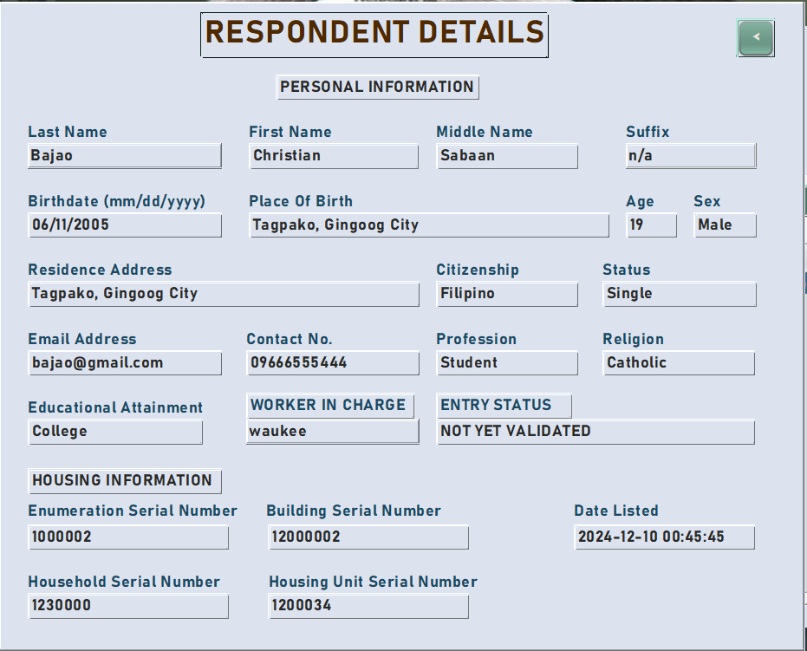
SYSTEM DESIGN
Window for Showing More Info About the Respondent
Accessed by selecting a row and clicking "SHOW DATA" in the Worker Dashboard.
Displays detailed data from the database for the selected entry.

Slide 17
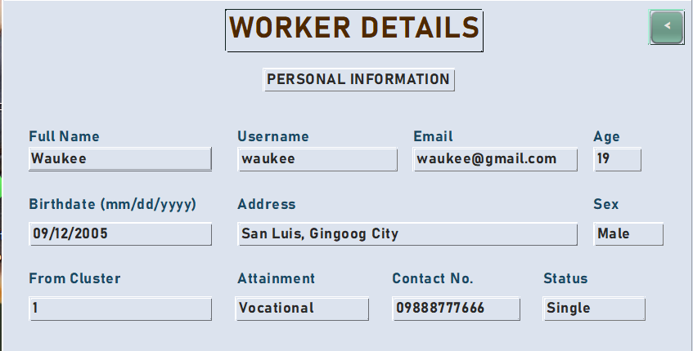
SYSTEM DESIGN
Window for Showing the Information About the Worker
Accessed by clicking the "HELLO WORKER" label in the Worker Dashboard.
Displays all data related to the worker.

Slide 18
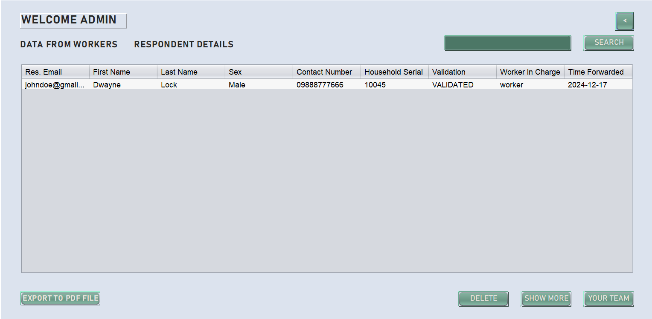
SYSTEM DESIGN
Admin Dashboard
“WELCOME ADMIN" label: Displays admin details when clicked.
Data Table: Shows data transferred by the worker.
Buttons:
EXPORT TO TXT FILE: Export selected rows to a file after choosing the directory.
YOUR TEAM: Opens window showing all workers handled by the admin.
DELETE: Delete selected data entries.
SHOW MORE: View additional details of selected data.
SEARCH: Search for specific data in the table.

Slide 19
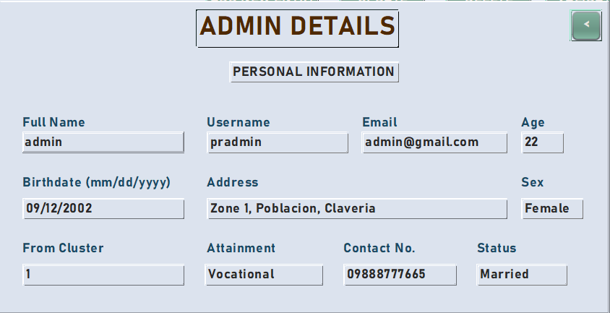
SYSTEM DESIGN
Window for Showing Information About the Admin
Accessed by clicking the "WELCOME ADMIN" label in the Admin Dashboard.
Displays all data related to the admin.

Slide 20
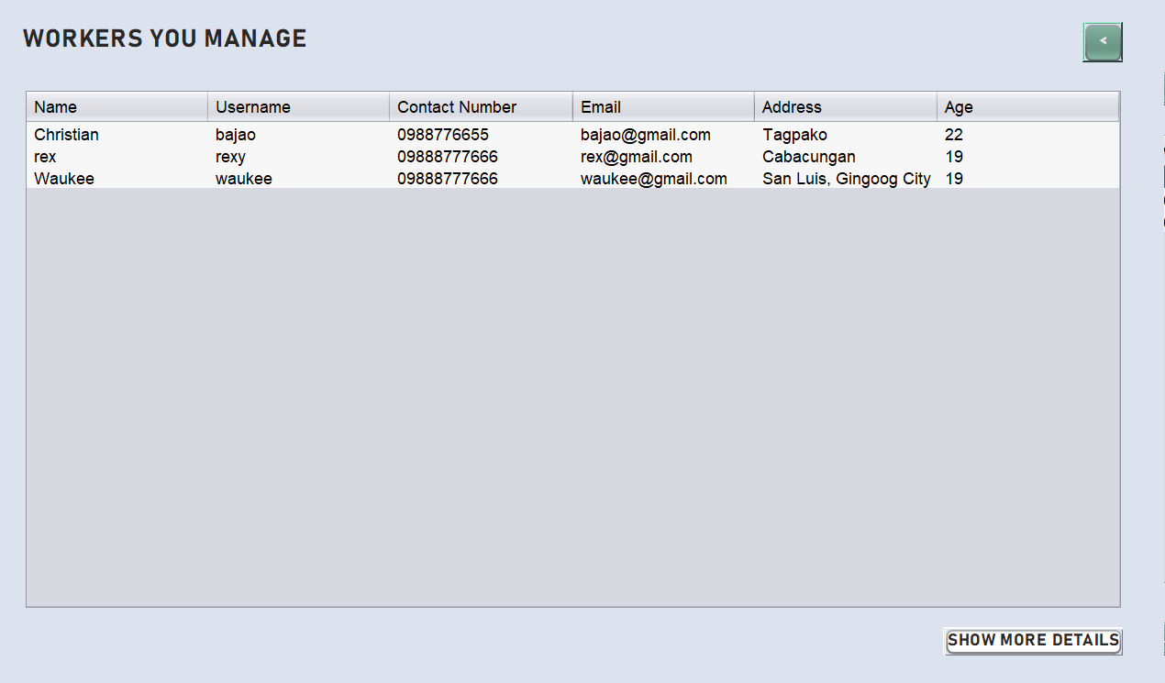
SYSTEM DESIGN
Window For Showing the List of Workers that the Admin Handles
Accessed by clicking the "YOUR TEAM" button in the Admin Dashboard.
Contains:
Table: Displays the list of workers managed by the admin.
SHOW MORE DETAILS Button: View additional information about a selected worker.

Slide 21
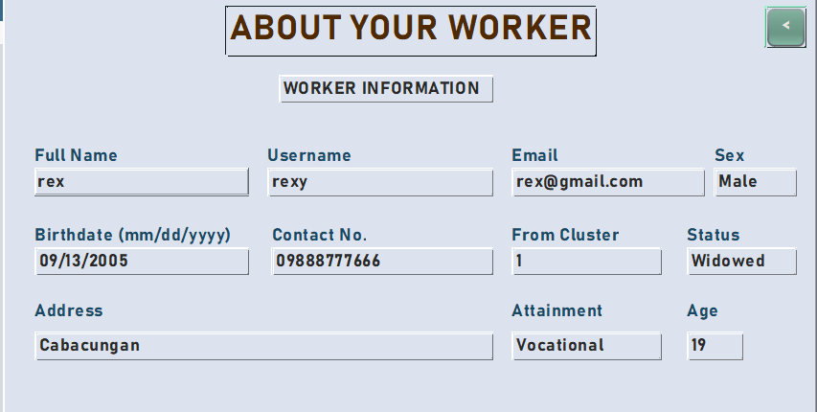
SYSTEM DESIGN
Window for Showing the Information about the Worker that the Admin handles
Accessed by clicking "SHOW MORE DETAILS" in the worker list table.
Displays detailed information about the selected worker.

Slide 22
SYSTEM DESIGN
Window For Showing More Info About the Respondent
Accessed by selecting a row and clicking "SHOW MORE" in the Admin Dashboard.
Displays detailed data from the database for the selected respondent.

Slide 23
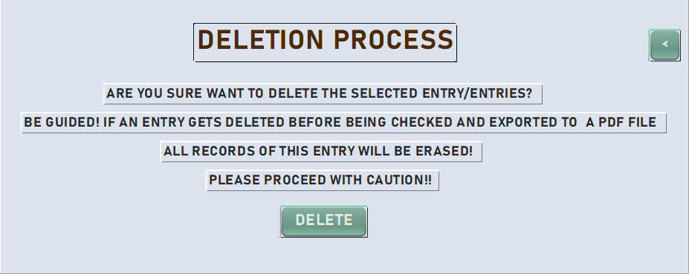
SYSTEM DESIGN
Window for the Delete Process
Accessed by selecting rows and clicking "DELETE" in the Admin Dashboard.
Prompts the admin for confirmation.
DELETE Button: Confirms and removes the selected data.

Slide 24
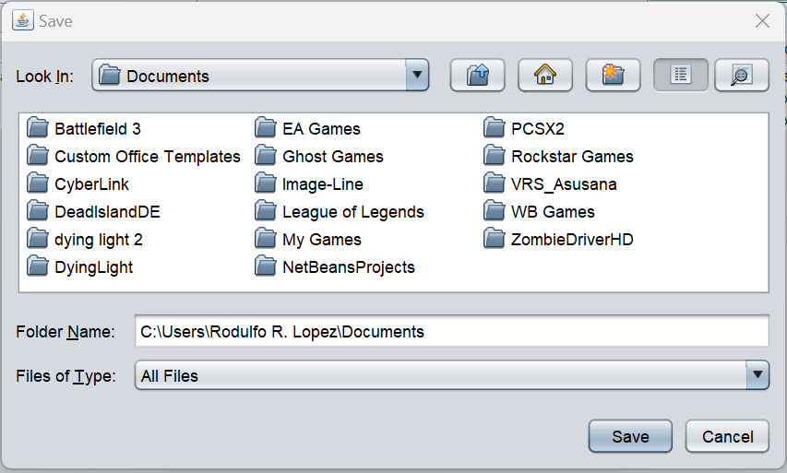
SYSTEM DESIGN
Window for the Export Process
Accessed by selecting rows and clicking "EXPORT TO TXT FILE" in the Admin Dashboard.
Allows the admin to choose a directory on the desktop to export the selected data as a file.

Slide 25
CONCLUSION
The Data Collection System for Census was developed using a structured, research-driven approach, adhering to established guidelines and best practices. Designed to address the needs of census operations in areas with limited or no internet, it combines robust offline data entry with comprehensive online administrative functionalities, such as account creation, user management, and data analysis.
Rigorous testing validated the system's performance, usability, and reliability. By ensuring accuracy, security, and compliance with technical and ethical standards, the system simplifies census processes and demonstrates the effectiveness of systematic development methodologies.

Slide 26
RECOMMENDATION
Feedback From the user

