Slide 1
Ayurveda Chatbot
Developed by
Aman Sahu
Pawan Srivastava
Sahil Tiwari
Aniket Vishwakarma

Slide 2
Table of contents
01
Introduction
04
Framework
02
Utility
03
Hardware & Software Requirements
05
Limitation
06
Demo

Slide 3
Introduction
Imagine a guide through the world of Ayurvedic medicine that's not just smart but cutting-edge. That's Ayurveda Chatbot for you! This state-of-the-art software blends ancient wisdom with the latest technology.

Slide 4
Scope
1.1
The proposed software aims to address the challenges faced by Ayurvedic students and practitioners in navigating a vast repository of classical texts. It will leverage AI technologies, particularly Dialogflow, to streamline the process of identifying appropriate drugs and formulations based on specific disease symptoms and pharmacological properties.

Slide 5
Objectives
1.2
i) Develop a Custom Software Solution:
Design an intuitive and user-friendly software capable of extracting information from over 150 Ayurvedic classical texts.
Implement a chatbot using Dialogflow for intelligent interactions and recommendations.
ii) Personalized Formulation Identification:
Enable the software to tailor suggestions based on an individual's clinical condition, age, and other relevant factors.
Incorporate multiple names and synonyms of diseases to enhance the accuracy of formulation suggestions.

Slide 6
Utility
2
The software will serve the following purposes:
1) Formulation Recommendations:
Suggest Ayurvedic drugs and formulations designed for specific diseases and pharmacological properties.
Provide detailed information, including references, properties, and suitability based on the patient's condition.
2) User-Friendly Interface:
Create an interface accessible to both students and practitioners, facilitating easy navigation and understanding.

Slide 7
Hardware & Software Requirements
3
Hardware
Requirements
Standard computer system with a reliable internet connection. Mobile devices for accessibility.
Software
Requirements
Operating System: Compatible with Windows, macOS, and Linux. Development Framework: Utilized Dart and Flutter for mobile app development. AI Integration: Dialogflow for NLP-powered chatbot functionality.

Slide 8
Framework
4
The software is developed using Dart for Programming and Flutter framework for UI/UX Design for the mobile app, ensuring cross-platform compatibility. Dialogflow will be incorporated for NLP capabilities, providing an intelligent and interactive chatbot experience.

Slide 9
Limitations
5
1) Dependency on Digital Texts:
The software's effectiveness relies on the availability and accuracy of digitized Ayurvedic texts.
2) Language and Script Challenges:
Handling multiple languages and scripts within the classical texts may pose translation and interpretation challenges.
3) Continuous Update Requirement:
Regular updates are necessary to incorporate new texts, synonyms, and emerging Ayurvedic knowledge.

Slide 10
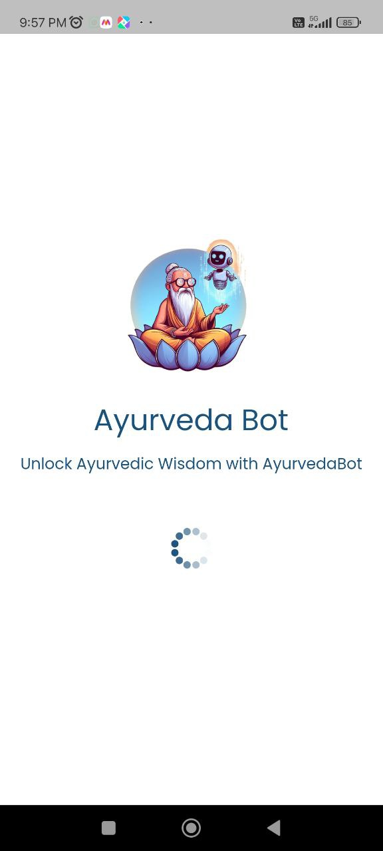
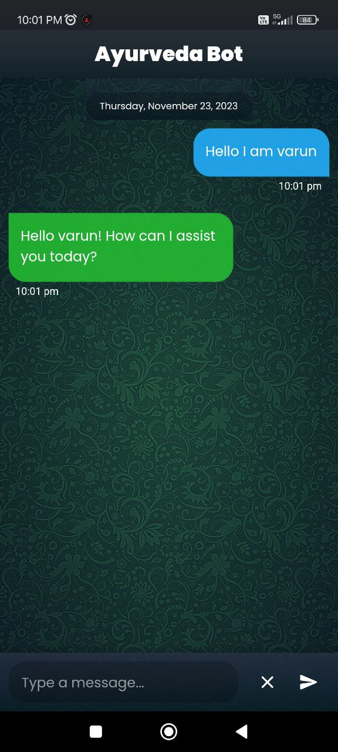
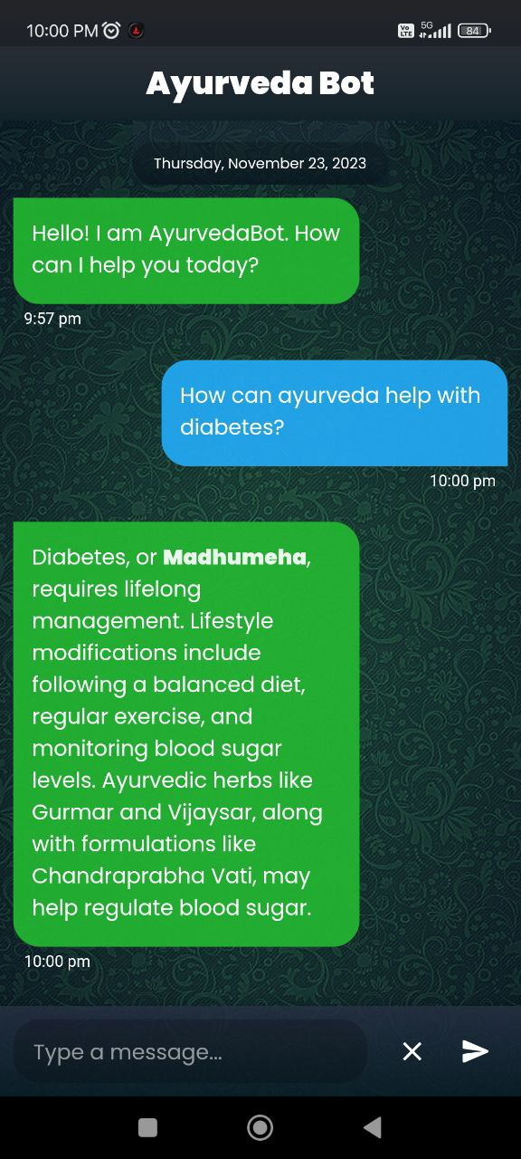
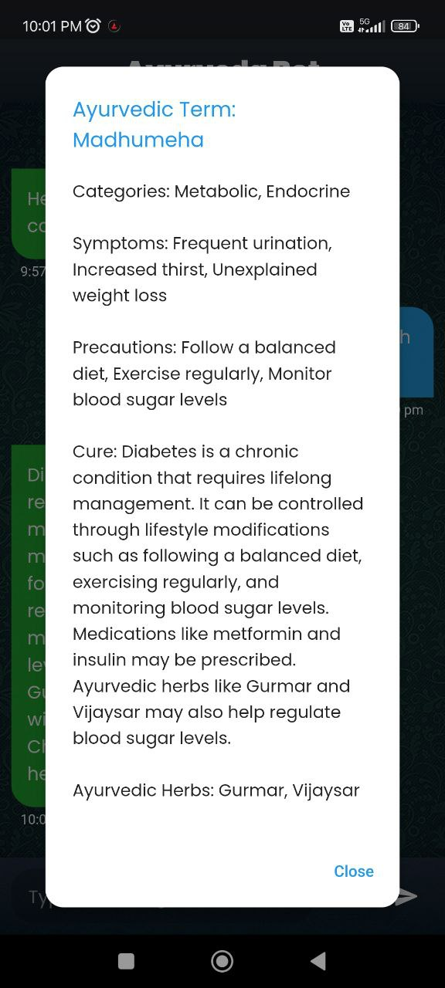
Demo
6

Slide 11
Conclusion
This software aims to significantly ease the process of formulating Ayurvedic prescriptions by leveraging cutting-edge AI technologies. Despite potential limitations, the utility and benefits of such a system are substantial in the context of Ayurvedic medicine.

Slide 12
Thank you!

