Slide 1
BLUESTOCK FINTECH
Mutual Fund Analytics Capstone
An end-to-end data pipeline, risk analytics, and Power BI dashboard
for 40 mutual fund schemes and ~33,000 investor transactions
Tejas Bhole | August 2026

Slide 2
The Problem & Objective
The Problem
The Objective
Bluestock Fintech's mutual fund data — transactions, NAV history, fund performance, and portfolio holdings — lives in disconnected raw sources. There is no unified view of fund risk, investor behavior, or portfolio concentration to support product and advisory decisions.
1
Ingest & consolidate fund, NAV, transaction, and portfolio data
2
Clean and validate for accuracy and completeness
3
Analyze fund performance and quantify risk (VaR, Sharpe, HHI)
4
Understand investor behavior — cohorts, SIP continuity
5
Deliver an interactive dashboard and fund recommender
2

Slide 3
Data Sources
A star-schema data model built from five raw sources into one SQLite database
Table | Type | Rows | Purpose
dim_date | Dimension | 1,608 | Calendar attributes
dim_fund | Dimension | 40 | Fund master & risk category
fact_nav | Fact | 64,320 | Daily NAV per fund
fact_transactions | Fact | 32,778 | Investor SIP/Lumpsum/Redemption
fact_performance | Fact | 40 | Returns, Sharpe, Sortino, Alpha, Beta
fact_portfolio | Fact | 322 | Stock holdings & sector weights
fact_aum | Fact | 90 | Fund-house AUM over time
fact_sip_industry | Fact | 48 | Industry-wide SIP inflow stats
3

Slide 4
Pipeline Architecture
A reproducible ETL + analytics flow orchestrated end-to-end by run_pipeline.py
Ingest
Clean
Load
Analyze
Deliver
Raw fund, NAV,
transaction & portfolio data
→
Validate amounts, KYC,
dates; drop duplicates
→
Star-schema SQLite
database (bluestock_mf.db)
→
EDA + risk metrics
(VaR, Sharpe, HHI)
→
Power BI dashboard +
fund recommender
Each stage is an independent, single-responsibility script — data ingestion, per-domain cleaning, database load, and metrics computation — reproducible with one command.
4

Slide 5
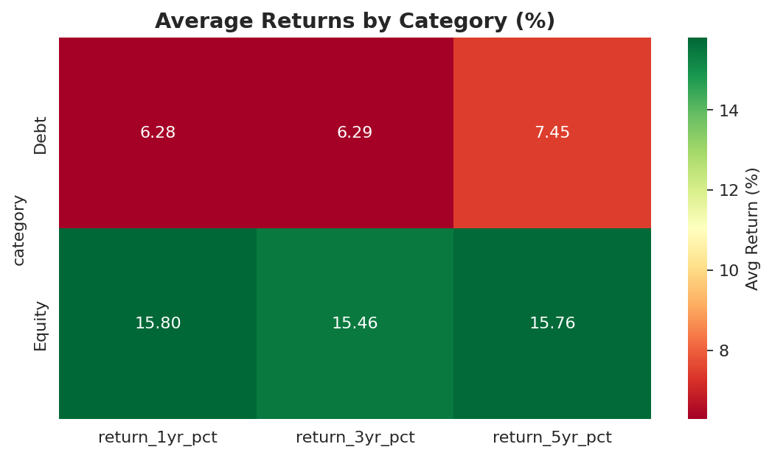
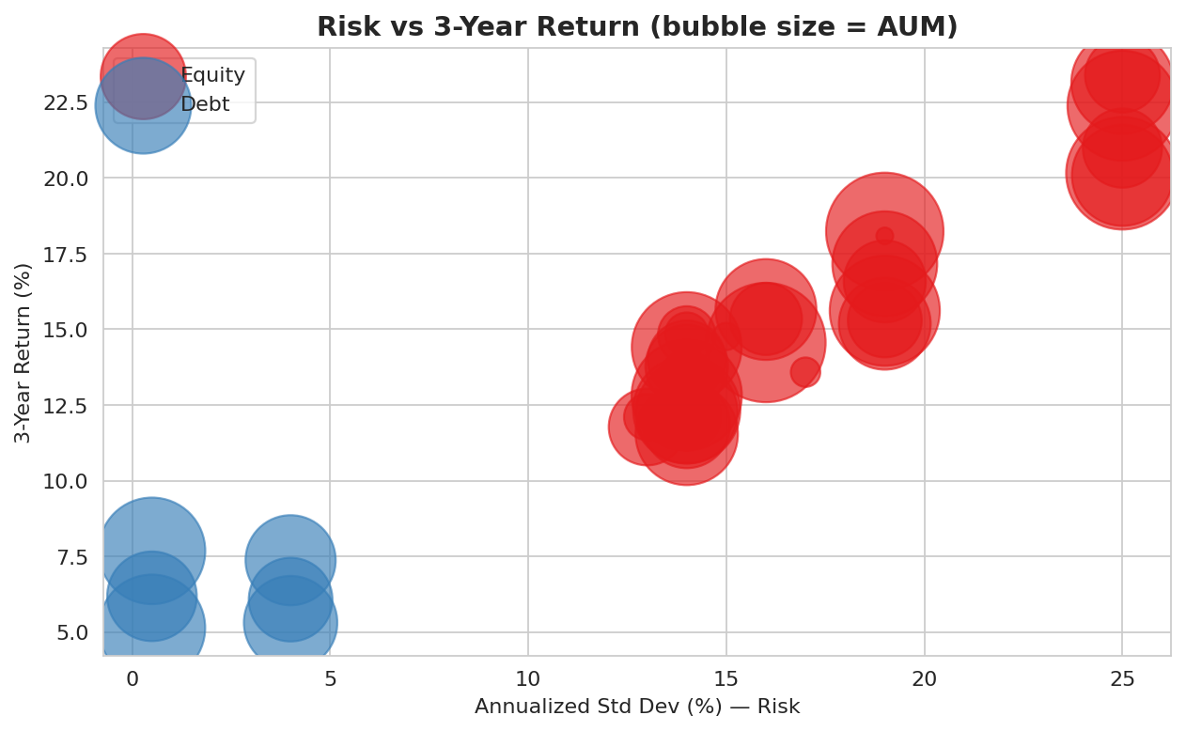
EDA Highlights — Risk & Return
Equity funds average ~15.5% returns across 1/3/5-year horizons — more than double Debt funds (~6-7%). Risk and return are clearly positively correlated: higher-volatility funds deliver higher 3-year returns, especially within Equity.
5

Slide 6
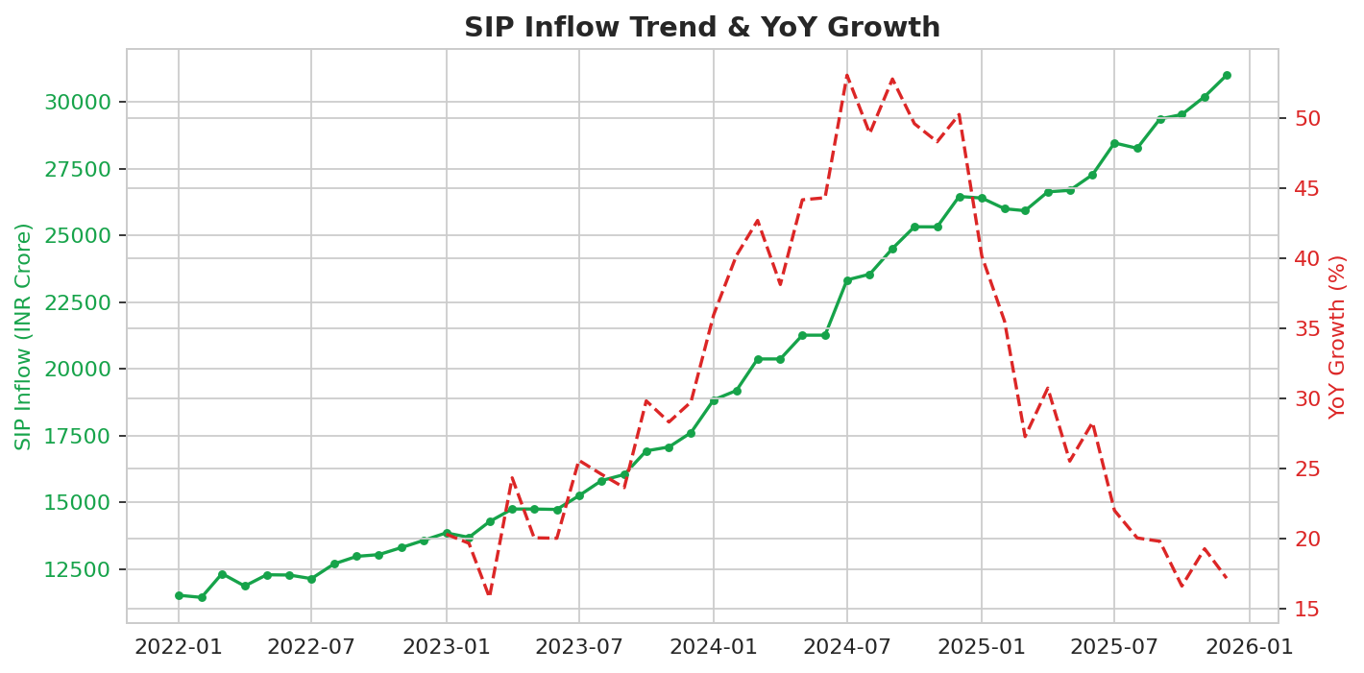
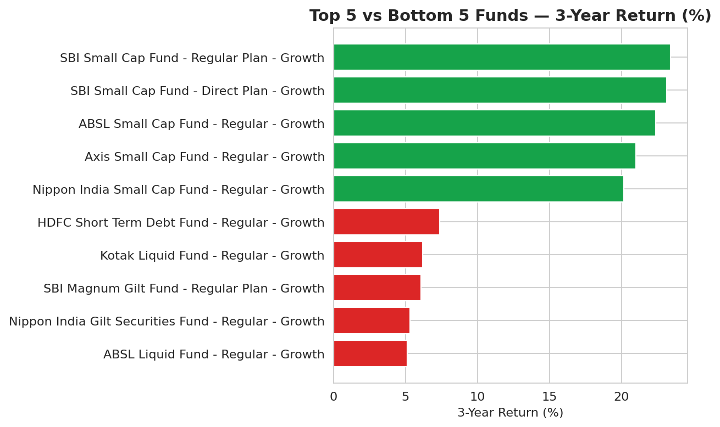
EDA Highlights — Flows & Performance
Industry SIP inflow grew from ~₹11,500 Cr to ~₹31,000 Cr. All 5 top-performing funds by 3-year return are Small Cap equity funds; the bottom 5 are Debt, Gilt & Liquid — a clean illustration of the risk-return tradeoff at the fund level.
6

Slide 7
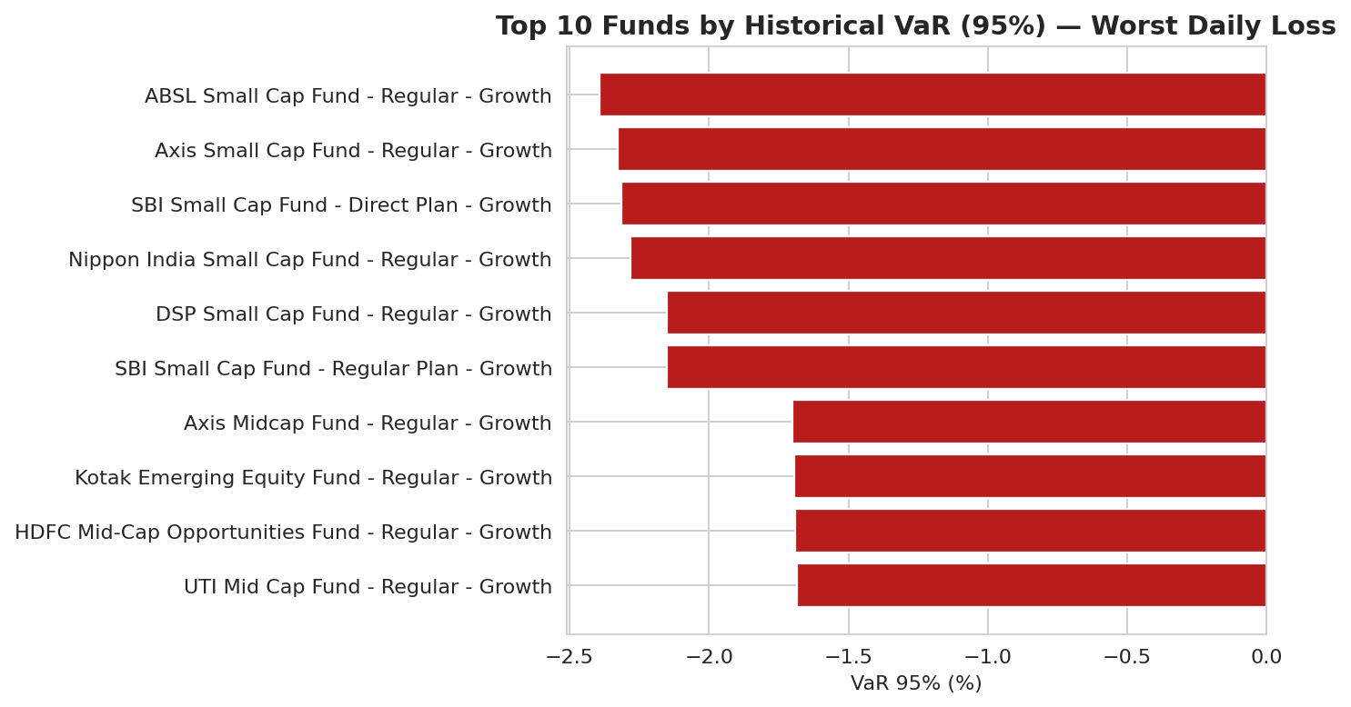
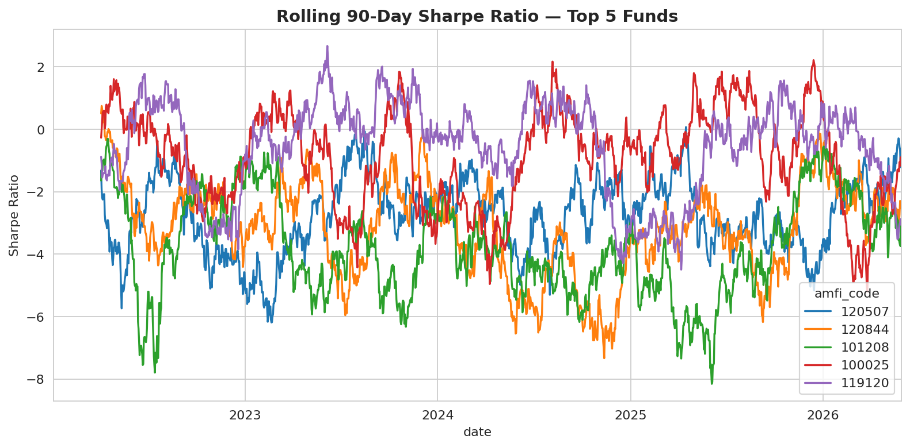
Risk Metrics — VaR & Rolling Sharpe
Small-cap funds dominate the highest-VaR list (~-2.3% daily downside). Rolling 90-day Sharpe swings from -6 to +3 for top funds — no fund sustains strong risk-adjusted performance consistently, cautioning against trailing-Sharpe-only selection.
7

Slide 8
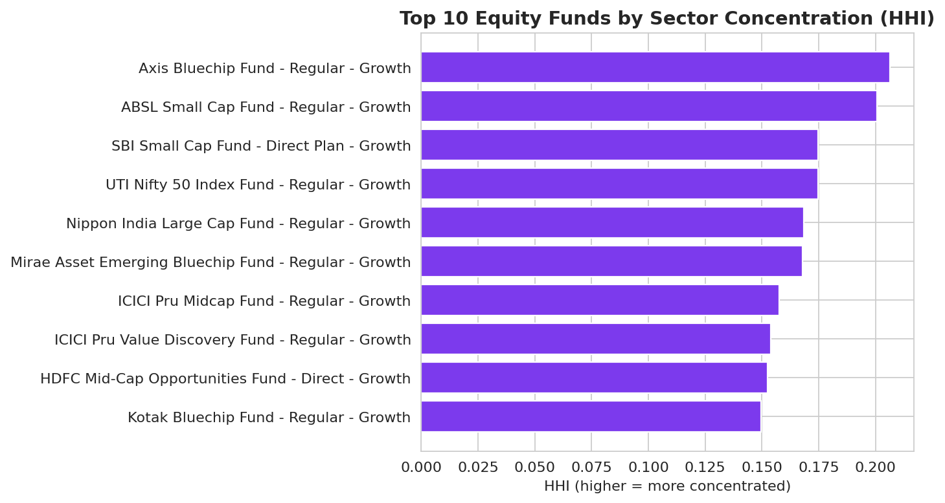
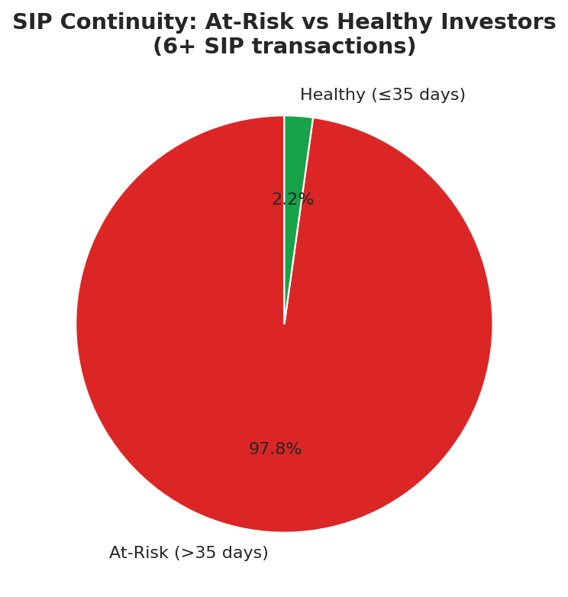
Concentration Risk & SIP Continuity
Axis Bluechip Fund shows the highest sector concentration (HHI ≈ 0.206) — higher single-sector exposure than its 'diversified large-cap' label suggests. Among 6+ SIP investors, 97.8% show gaps exceeding 35 days between contributions — a systemic retention signal worth investigating.
8

Slide 9
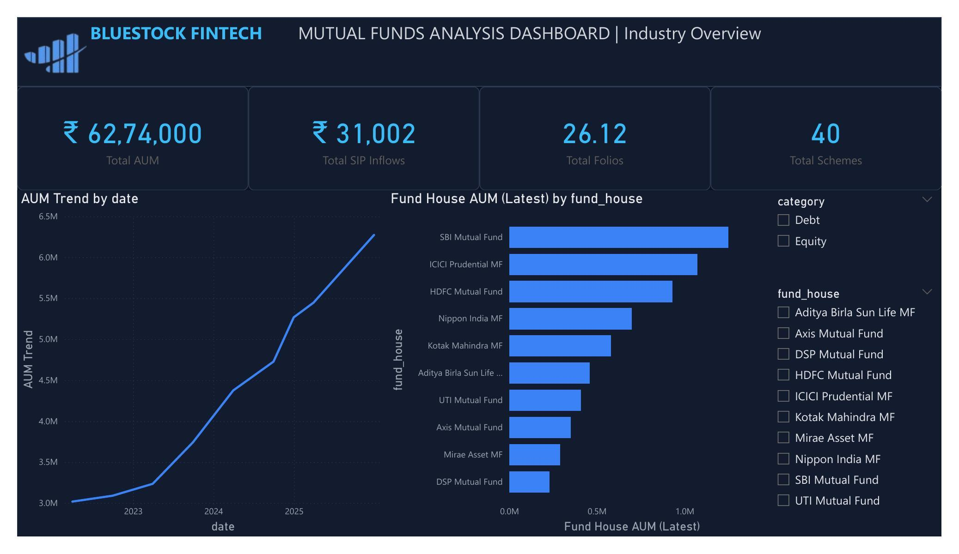
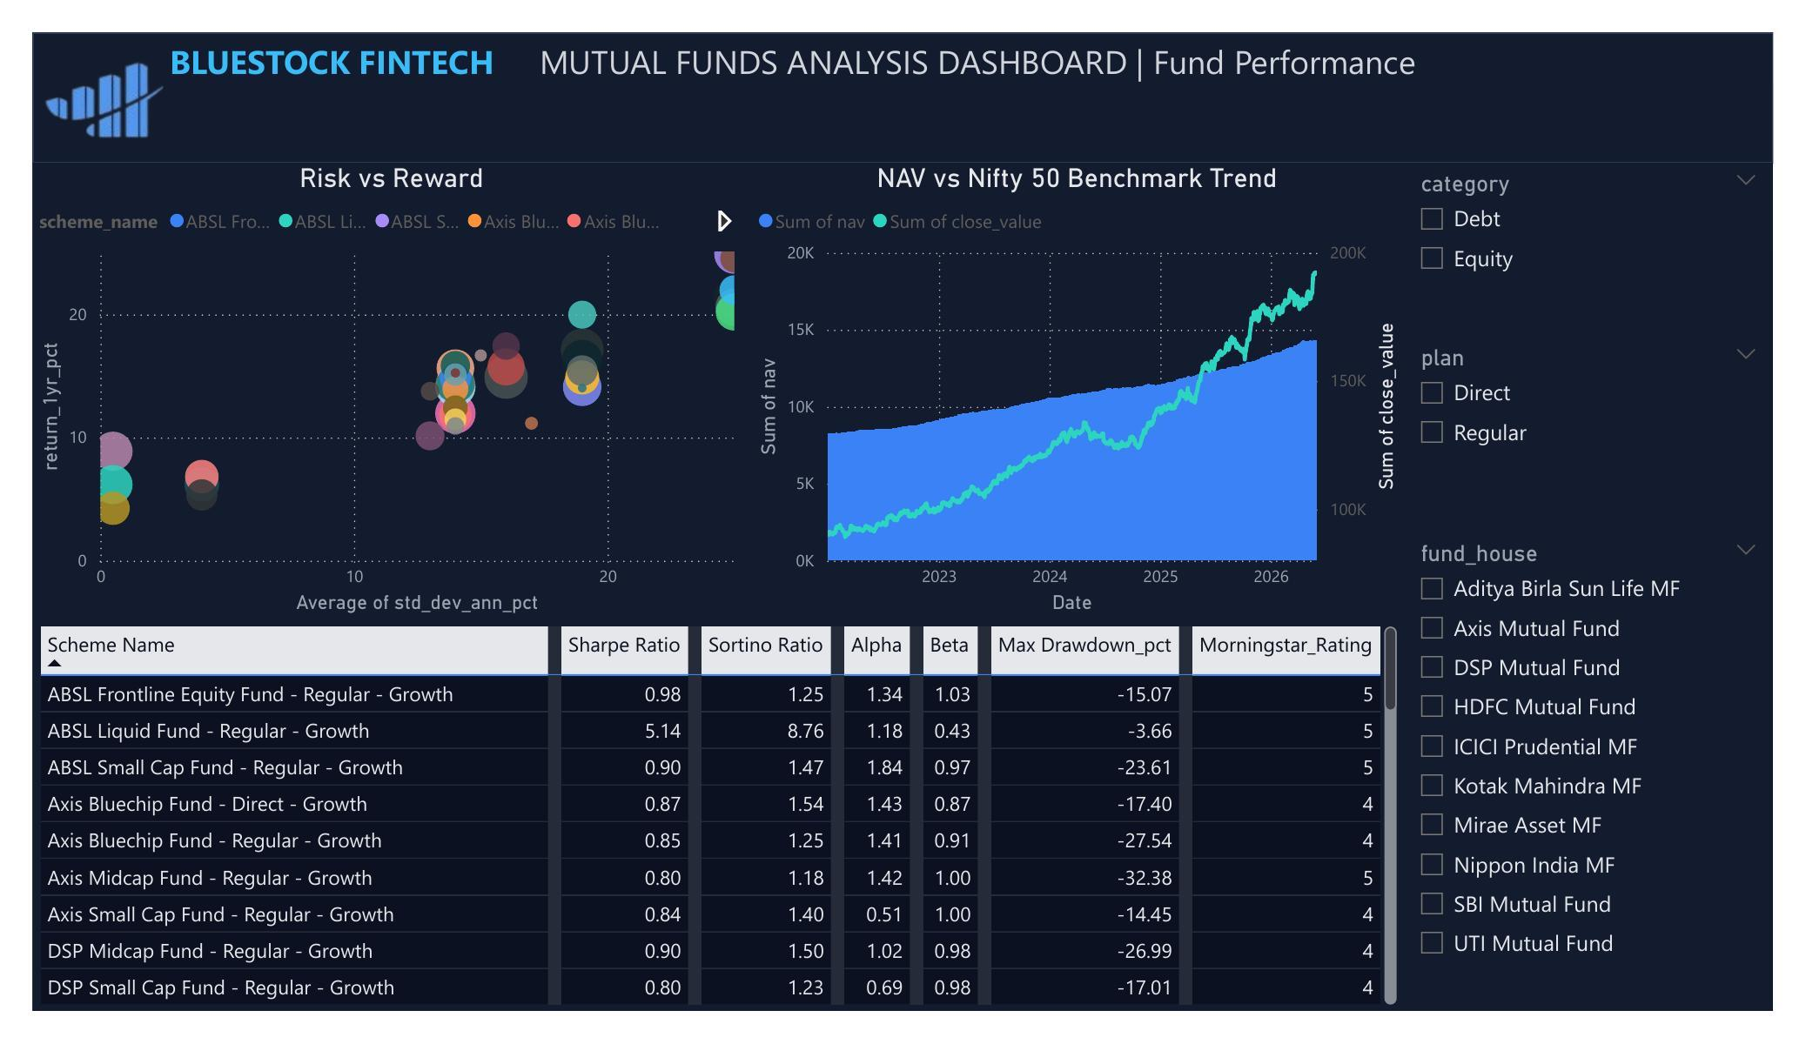
Dashboard — Industry & Fund Performance
₹62.74 lakh Cr Total AUM • 40 schemes • Sharpe/Sortino/Alpha/Beta tracked per scheme
9

Slide 10
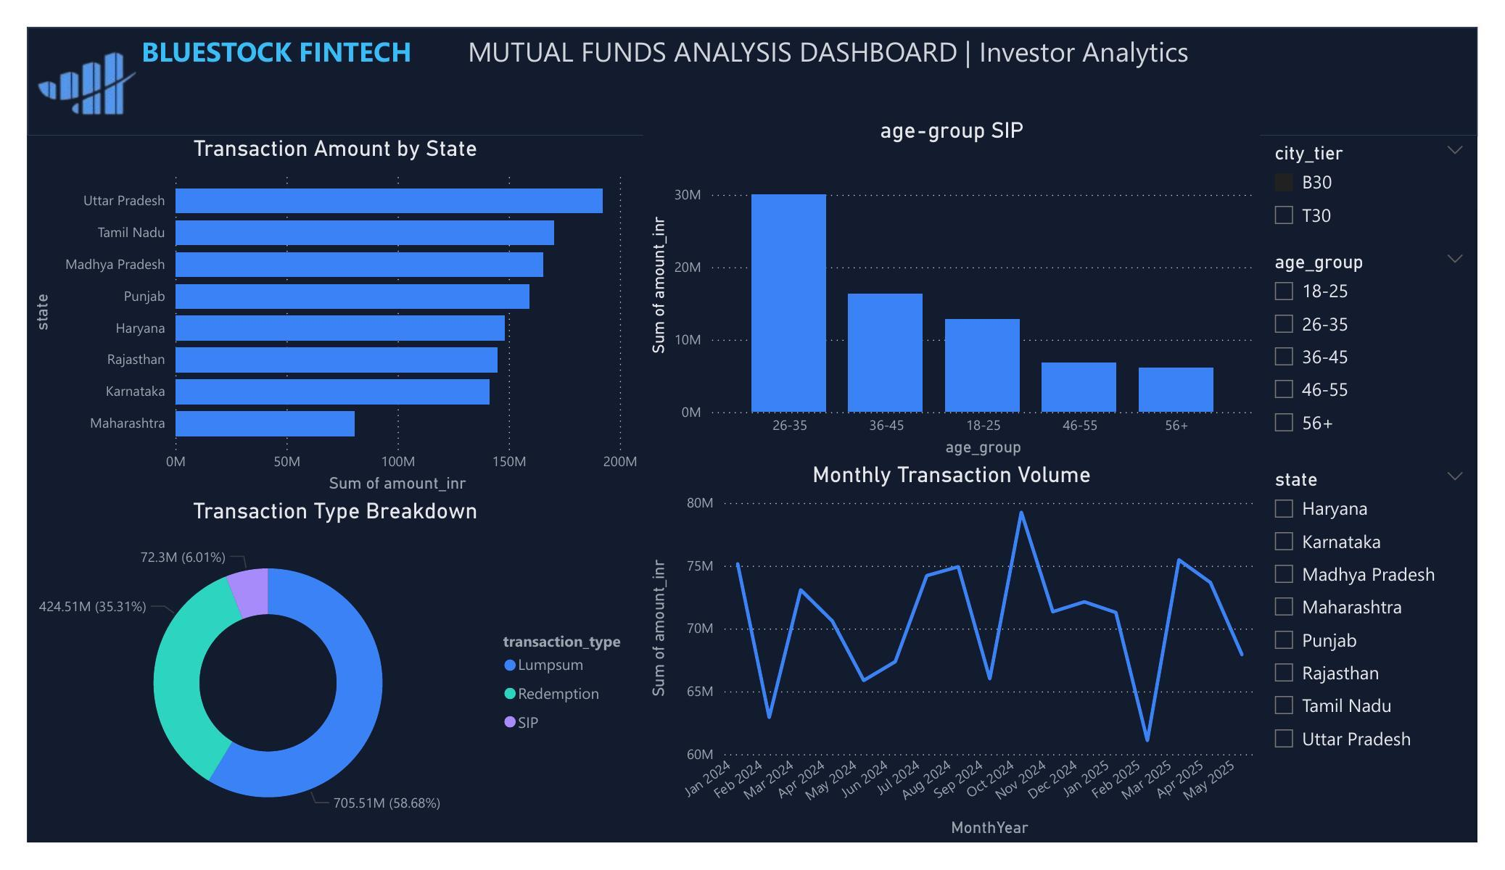
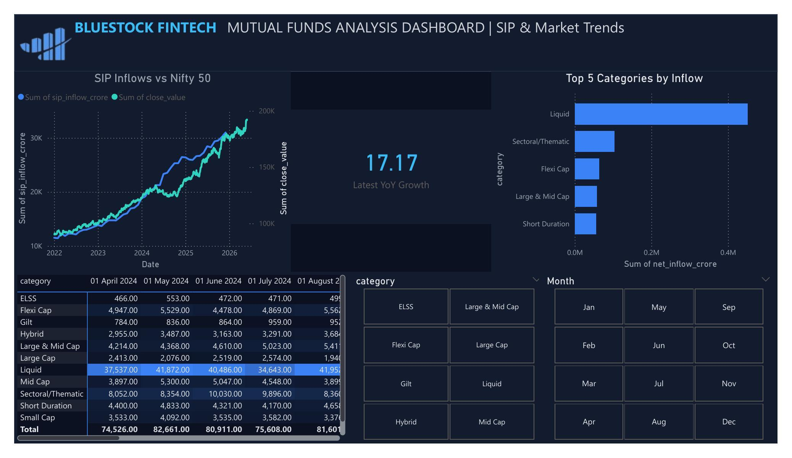
Dashboard — Investor & SIP Trends
Uttar Pradesh leads by transaction value • Lumpsum = 58.7% of value • Liquid category leads SIP inflows
10

Slide 11
Key Findings
Equity vs Debt
SBI leads AUM
Equity funds return ~15.5% vs ~6-7% for Debt — with proportionally higher risk.
SBI Mutual Fund tops industry AUM, followed by ICICI Prudential and HDFC.
Small Cap dominates
SIP continuity risk
All top-5 funds by 3-yr return are Small Cap; bottom-5 are Debt/Gilt/Liquid.
97.8% of regular SIP investors show gaps exceeding 35 days — a retention signal.
Concentration risk
Demographic skew
Axis Bluechip Fund shows the highest sector HHI among large-cap peers.
26-35 age group & male investors (66.5%) dominate transaction volume.
11

Slide 12
Thank You
Questions & discussion welcome
Bluestock Fintech | Mutual Fund Analytics Capstone | Tejas Bhole

