Slide 1
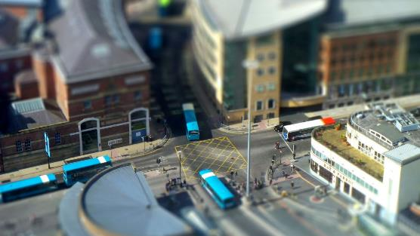
Institute for Transport Studies
FACULTY OF ENVIRONMENT
Routing
Getting from A to B the thoughtful way
Dr Malcolm Morgan
Research Fellow in Transport and Spatial Analysis
Transport Data Science
15th February 2021

Slide 2
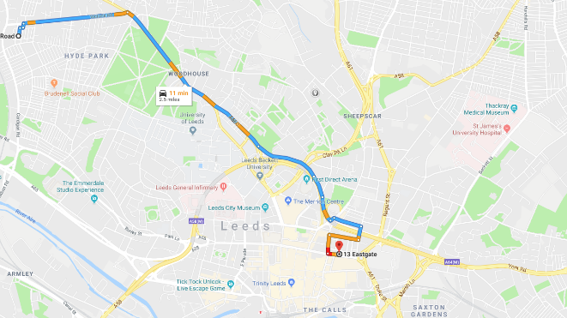
What is routing
Finding the “shortest” path between two locations
Distance
Time
Other factor
Routing allows understanding of:
People’s experience of the transport network
Traffic / Capacity
Infrastructure
Mode Choice
Severance

Slide 3
Content
Graph Theory
Shortest Path Routing
Going beyond A to B routing
Practical Routing in R

Slide 4
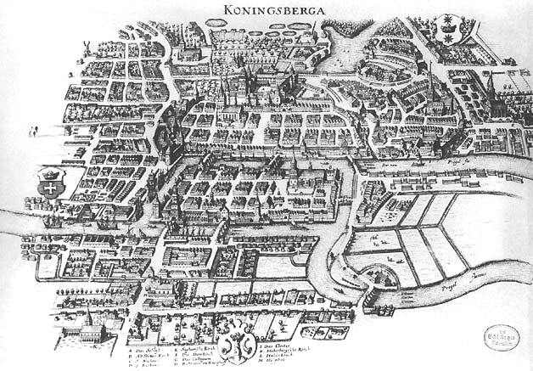
The Königsberg Bridge problem
Path though the city crossing each bridge only once
Solved by Euler in 1736
Foundation of graph theory
City now called Kaliningrad

Slide 5
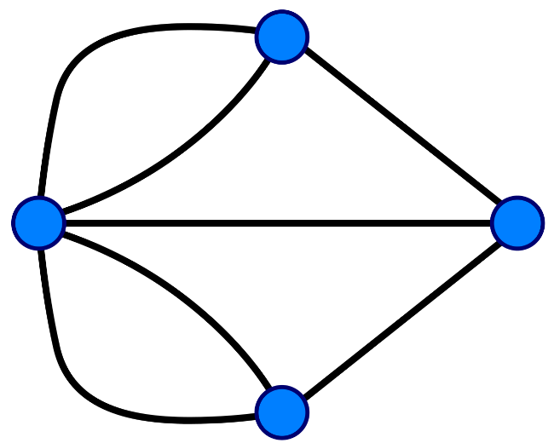
Graph Theory
Branch of mathematics about graphs (networks)
Vertex (Node)
Edge (Link)

Slide 6
Basic Properties of a Graph
Undirected Directed
Do edges have a direction
C
C
F
F
D
D
E
E
C
C
A
B
A
B
D
D

Slide 7
Basic Properties of a Graph
Weighted Unweighted
Are all edges equal or do they have a value
C
9
F
C
1
F
D
6
1
D
2
1
7
E
E
1
A
14
C
A
1
C
10
1
4
1
10
1
A
B
A
B
5
D
1
D

Slide 8
Basic Properties of a Graph
Simple Complex
Are loops and multiple edges allowed?
C
C
F
F
D
D
Loop
E
E
Multiple Edges
C
C
A
B
A
B
D
D

Slide 9
Basic Properties of a Graph
Contracted Uncontracted
Are there straight lines (vertices with 2 edges)
C
C
F
F
D
D
E
E
C
C
H
G
A
B
A
B
D
D

Slide 10
Basic Properties of a Graph
Connected Unconnected
All parts of the graph connected
C
C
F
F
D
D
E
E
C
C
A
B
A
B
D
D

Slide 11
The Königsberg Bridge problem
3
Degree: Number of edges connected to a vertex
Strength: Weighted number of edges
Euler Observed:
Vertices must have even degree except the start and end
So there is no solution
5
3
3

Slide 12
The Königsberg Bridge problem
Bonus Problem
Where would you add a bridge such that you could start at the Red vertex and finish at the Yellow vertex
What would the path be?

Slide 13
Shortest Path
C
Dijkstra Algorithm
Visits each unvisited vertex counting cumulative distance
Prioritised by distance, thus excludes options longer than current shortest route
O(|V|²) unprioritized
O(|E| + |V|log|V|) when using a priority heap
9
F
D
6
2
7
E
A
14
C
10
Veil of Ignorance
4
10
A
B
5
D
What is the shortest path from A to F?
How many paths do we need to check?

Slide 14
Dijkstra Algorithm
Measure from A
Rank < <
Measure from B
Rank c < d < e
Measure from E
Reached F in 15
→ B → E →
A
9
F
15
D
6
B
C
D
14
2
B
7
E
16
9
C
D
E
14
10
C
15
E
10
4
10
F
A
A
B
E
F
B
5
5
Note: In reality we need to check C and D to be sure, as we must do a full round of measurements before halting.
The value in Dijkstra is once you have found a path you know it is the shortest, so you can stop searching.

Slide 15
Dijkstra’s nightmare
10
A
B

Slide 16
A* Search Algorithm
Widley used and faster than Dijkstra Algorithm
Prioritises the next path by both:
The total distance so far (just like Dijkstra)
A heuristic to estimate the remaining distance (e.g. straight line distance)
Can relax constraints to get faster sub-optimal solutions
A*
Weighted A*
Image Source: https://en.wikipedia.org/wiki/A*_search_algorithm

Slide 17
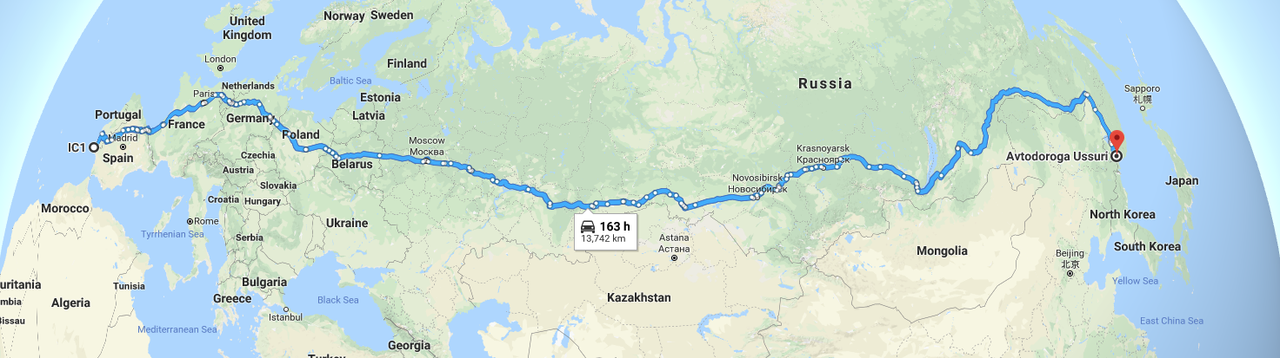
Shortest Path
There are many different variants of these algorithms
Best algorithms now precompute parts of routes
Finding useful shortcuts
E.g. using motorways for long distance travel

Slide 18
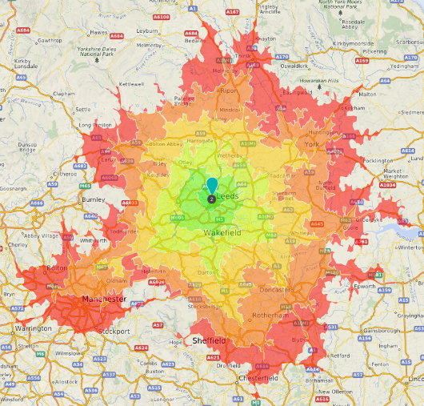
Isochrones
Lines of equal time
Efficient to do with Dijkstra
Key tool for transport planning
All places within a 1 mile walk of X
Time for ambulance to get from hospital to any location within the city
How many jobs can I access from my home?
Supported in some routing services but not all

Slide 19
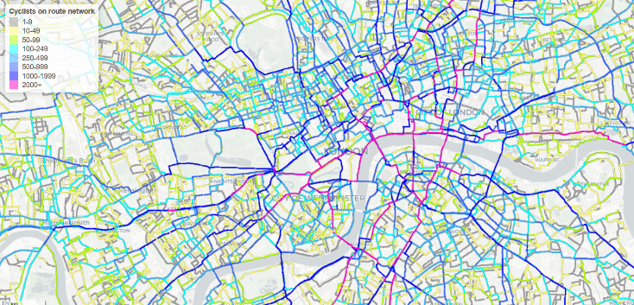
Travel Time Matrix
Routing All to All
Usually to population points
Can combine with flow data
Morgan M, Lovelace R. Travel flow aggregation: Nationally scalable methods for interactive and online visualisation of transport behaviour at the road network level. Environment and Planning B: Urban Analytics and City Science. July 2020. doi:10.1177/2399808320942779

Slide 20
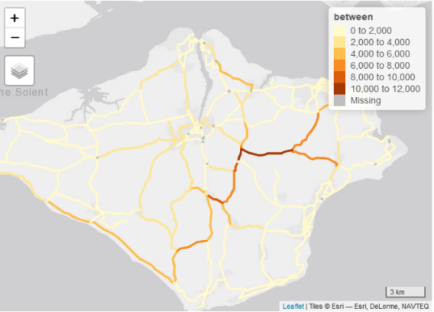
Network Analysis
E.g. Betweenness Centrality
igraph
Via dodgr
dodgr_to_igraph
Via stplanr (spatial lines network)
http://rpubs.com/edzer/6767
Or use overline + all to all routing
Slow with large networks
Consider contraction and simplifications

Slide 21
Practical routing in R
Algorithm choice determines:
selected “shortest” path
results of your analysis
Things to consider:
Weighting factors used (max speed vs average speed),
Is effect of hills considered (walk & cycle)
Do they vary for mode
Dynamic? (e.g. traffic)
Base map used
Quality / Accuracy / Suitability
Routing rules
E.g. can you cycle on major roads
Localisation – running a US algorithm on European Roads etc
Are turn weighting applied (left turn vs right turn)
Traffic light timings
Important to understand what the algorithm is trying to tell you

Slide 22
Routing Packages in R
Package | CRAN | Local | Remote | Modes | Traffic | Other Features | Comments
googleway | ü | X | Google Maps | Car, Walk, Bike, Transit | ü | Geocode, Matrix, + more | Freemium Service
mapsapi | ü | X |  | Car, Transit |  | Geocode, Matrix
ggmap | ü |  |  | Car, Walk, Bike, Transit
hereR | ü | X | Here Maps | Car, Walk, Bike, Transit, + variants | ü | Matrix, Isochrones | Freemium Service
mapboxapi | ü | X | Mapbox | Car , Walk , Bike | ü | Isochrones, Geocode, Matrix | Freemium Service
cyclestreets | ü | X | CycleStreets | Bike | X |  | Freemium Service, open to researchers
openrouteservice-r | X | X | Open Route Service | Car , Walk , Bike, + variants | X | Isochrones | Freemium Service
transportAPI | X | X | Transport API | Car, Walk, Bike, Transit | X |  | UK only, Freemium Service
osrmr | ü | ü | Open Source Routing Machine | Car, Walk, Bike | X |  | Separate setup of OSRM for Local
opentripplanner | ü | ü | OpenTripPlanner | Car, Walk, Bike, Transit, Mixed | X | Isochrones, Geocode | Local use requires Java 8
graphhopper-r | X | ü | Graphhopper | Car , Walk , Bike, + variants | X |  | Separate setup of Graphhopper for Local
r5r | ü | ü | X | Car, Walk, Bike, Transit, Mixed | X |  | Requires Java
dodgr | ü | ü | X | Car, Walk, Bike, Custom | X | Centrality
igraph | ü | ü | X | N/A | X | Network Analysis
gtfsrouter | ü | ü | X | Transit | X |  | Requires GTFS files
tidytransit | ü | ü | X | Transit | X |  | Requires GTFS files
sfnetworks | X | ü | X | Custom | X | Edge circuity
cppRouting | ü | ü | X | Custom | X | Matrix, Isochrones
stplanr | ü | ü | Multiple | Multiple | X |  | Transport analysis package

Slide 23
The Königsberg Bridge problem
3
Bonus Problem
Where would you add a bridge such that you could start at the Red vertex and finish at the Yellow vertex
What would the path be?
5
4
4

Slide 24
Homework
Complete the getting started steps for the routing practical
tinyurl.com/y465d2jj
or
https://github.com/ITSLeeds/TDS/blob/master/practicals/6-routing-homework.md

Slide 25
Thank you for listening

