Slide 1
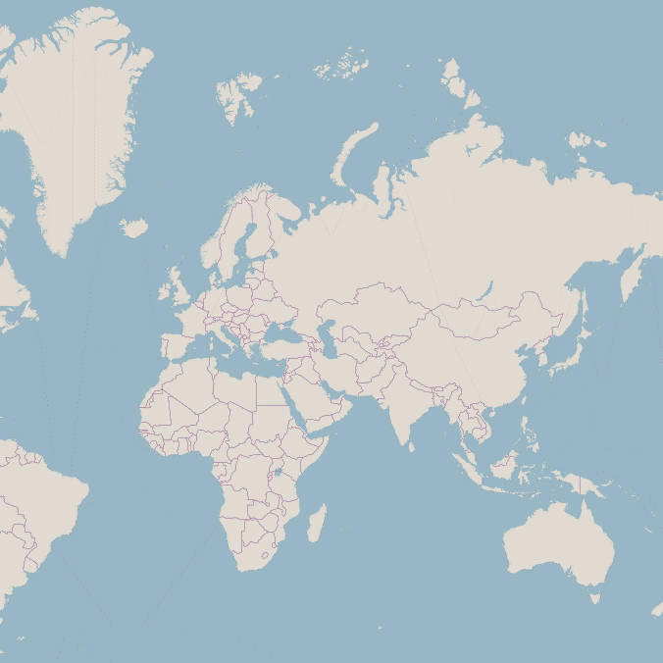
Zoom 0: One Tile
Zoom 1: Four Tiles
Zoom 2: Sixteen Tiles

Slide 2
Mapbox GL JS
Style.json
JavaScript library for creating maps
Defines where to get data from and how it should be visualised
Sources
Glyphs
Layers
Instructions on how the tiles should be visualised
Folder of Vector Tiles
basemap/{z}/{x}/{y}.pbf
Folder of Vector Tiles
HTML
JavaScript
mydata/{z}/{x}/{y}.pbf
General structure and layout of the webpage
Specific setup the your map
Folder of Fonts
fonts/{fontstack}/{range}.pbf

