Slide 1
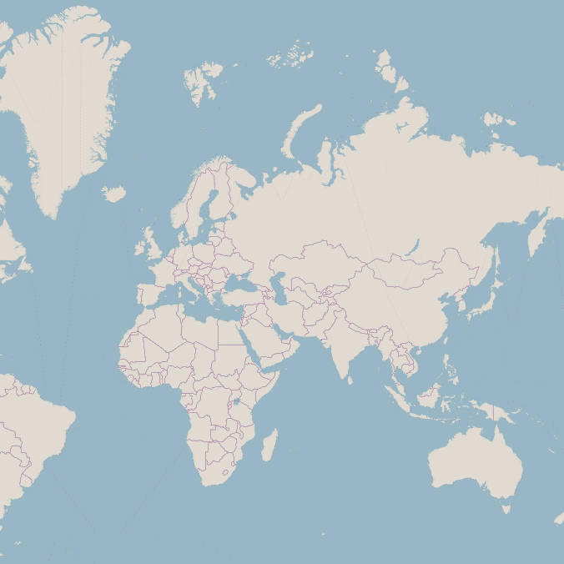
Zoom 0: One Tile
Zoom 1: Four Tiles
Zoom 2: Sixteen Tiles

Slide 2
Mapbox GL JS
Style.json
JavaScript library for creating maps
Defines where to get data from and how it should be visualised
Sources
Glyphs
Layers
Instructions on how the tiles should be visualised
Folder of Vector Tiles
basemap/{z}/{x}/{y}.pbf
Folder of Vector Tiles
HTML
JavaScript
mydata/{z}/{x}/{y}.pbf
General structure and layout of the webpage
Specific setup the your map
Folder of Fonts
fonts/{fontstack}/{range}.pbf

Slide 3
OpenMapTiles
Download tiles for your area or whole planet
Hosting with specialist tile server
.osm.pbf
.mbtiles
tilemaker
Single file vector tiles
Raw extract from the OpenStreetMap
openmaptiles
mbutil
Simple hosting on any server
.gpkg
Any GIS software
.geojson
Your spatial data in any format e.g. .shp or .gpgk
tippcanoe
Folder of .pbf files
With modification of HTTP headers to allow gzip compression
A GeoJSON file using CRS epsg:4326
With gzip compression
bash
Folder of .pbf files
Without modification of HTTP headers
Without gzip compression

