Slide 1
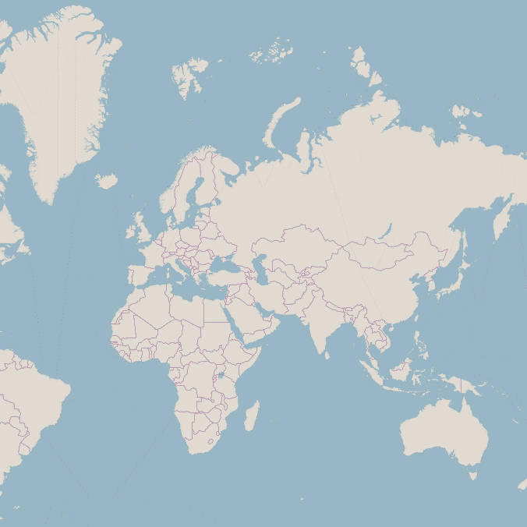
Zoom 0: One Tile
Zoom 1: Four Tiles
Zoom 2: Sixteen Tiles

