Slide 1

Dr. D. Y. Patil Technical Campus, Talegaon-Varale, Pune
Department of Electronics and Computer Engineering
Data Structures and Algorithms Laboratory (Course Code: 210257) • Academic Year 2026–2027
B.TECH SECOND YEAR (SEMESTER 03) COURSE PROJECT DEFENSE
SMART CAMPUS LOST & FOUND SYSTEM
An Algorithmic Campus Asset Recovery Platform Powered by C++17, B-Tree Indexing, Hash Maps, and Anti-Fraud Verification
PROJECT GROUP MEMBERS
1. Student Name: _______________________ | Roll No: ________
2. Student Name: _______________________ | Roll No: ________
3. Student Name: _______________________ | Roll No: ________
4. Student Name: _______________________ | Roll No: ________
UNDER THE GUIDANCE OF
Prof. Sayali Pawar
Assistant Professor
Department of Electronics and Computer Engineering
Dr. D. Y. Patil Technical Campus, Pune

Slide 2
EXECUTIVE AGENDA
Presentation Outline & Project Roadmap
01
Problem Statement & Motivation
The dilemma of lost campus belongings and failure of traditional registers.
06
UML Class Diagram & Design Patterns
Object-oriented modeling: Item, Claim, SecurityEngine, Singleton DB.
02
Project Objectives & Scope
Digitization, sub-millisecond retrieval, and verified asset handover.
07
Anti-Fraud & Privacy Security
Blind challenge questions, cloaked image filters, and SHA-256 Merkle audit.
03
Existing vs. Proposed System
Analytical comparison against manual logbooks and WhatsApp groups.
08
System Demonstration & Screenshots
Live walkthrough of Search Feed, Report Wizards, and Campus Heatmap.
04
Data Structures & Algorithmic Design
In-depth review of Hash Tables, B-Trees, Max-Heaps, Graphs, and Tries.
09
Performance Benchmarks & Complexity
Empirical latency comparisons, memory footprint, and throughput metrics.
05
System Architecture & 3-Tier Workflow
Client presentation, C++17 Crow REST engine, and SQLite3 WAL layer.
10
Conclusion, Future Scope & Q&A
Key takeaways, AI computer-vision roadmap, and faculty defense viva.
DYPTC Pune • Department of Electronics and Computer Engineering | Smart Campus Lost & Found System | Slide 2 of 16

Slide 3
BACKGROUND & MOTIVATION
Problem Statement: Challenges in Campus Asset Recovery
1. The Manual Register Failure
2. Social Media Chaos & Privacy Risks
3. Fraudulent Claims & Zero Verification
• Physical Security Desks rely on handwritten paper notebooks.
• Linear O(N) Search Latency: Security guards and students must manually scan hundreds of handwritten entries.
• Physical Wear & Tear: Water spills, lost registers, illegible handwriting, and torn pages result in permanent data loss.
• No Centralization: Items found in the Library, Workshop, or Canteen never reach the main gate register.
• Students broadcast misplaced items over unofficial WhatsApp / Telegram groups.
• Privacy Hazards: Student personal phone numbers and roll numbers are openly broadcasted to hundreds of strangers.
• High Noise Ratio: Genuine lost posts get quickly buried under casual chatter and spam within minutes.
• Fragmented Information: No single source of truth across engineering departments.
• High-value assets (scientific calculators, smartwatches, earbuds, laptops) attract false claimants.
• Zero Proof of Ownership: Physical desks return items purely based on verbal descriptions.
• Premature Exposure: Posting full item images allows anyone to memorize markings and claim falsely.
• No Audit Trail: When an item is handed over to the wrong person, there is zero digital liability or timestamped record.
DYPTC Pune • Department of Electronics and Computer Engineering | Smart Campus Lost & Found System | Slide 3 of 16

Slide 4
PROJECT OBJECTIVES
Proposed Solution: Automated & Verified Asset Recovery
High-Speed Algorithmic Search
Two-Factor Anti-Fraud Verification
Sub-millisecond retrieval using In-Memory Hash Maps and Disk-backed B-Trees, enabling instant filtering across categories, status, and campus locations.
Finder-defined blind challenge questions and cryptographic One-Time Passcodes (OTP) for secure physical item handover at security desks.
Privacy-Preserving Image Cloaking
Tamper-Evident Merkle Audit Chain
High-resolution photos are automatically obscured until a claimant passes ownership verification, eliminating visual memory theft.
Every report, claim, verification, and handover is signed into a cryptographic audit log with SHA-256 hashes, ensuring zero repudiation.
DYPTC Pune • Department of Electronics and Computer Engineering | Smart Campus Lost & Found System | Slide 4 of 16

Slide 5
BENCHMARKING
Comparative Analysis: Traditional Methods vs. Smart Campus
Evaluation Metric | Manual Security Register | WhatsApp / Social Media | Smart Campus System (Proposed)
Storage Mechanism | Paper logbook at guard post | Unstructured chat messages | Structured SQLite3 B-Tree Database
Search Complexity | O(N) Physical page flipping (15-30m) | O(N) Manual chat scrolling | O(1) Hash Map / O(log N) Indexed Search (< 2ms)
Ownership Proof | Verbal description only | Informal chat screenshot | Blind Verification Questions & OTP Token
Privacy Protection | Open register readable by anyone | Personal phone numbers public | Shielded identities; Cloaked blurred photos
Auditability & History | Vulnerable to page tearing / loss | Messages can be deleted/lost | Immutable SHA-256 Merkle Audit Log
Campus Scalability | Single entrance gate only | Restricted group capacity | Multi-Department Campus-Wide Network
DYPTC Pune • Department of Electronics and Computer Engineering | Smart Campus Lost & Found System | Slide 5 of 16

Slide 6
DSA IMPLEMENTATION
Core Data Structures & Algorithmic Time Complexities
Data Structure | Application in Lost & Found | Average Time | Worst Case | Space Complexity
Hash Table (std::unordered_map) | Active session validation, Category index lookup | O(1) | O(N) on collision | O(N)
B-Tree (SQLite Storage) | Composite indexing on (status, category, location) | O(log N) | O(log N) | O(N)
Max-Heap (std::priority_queue) | Priority claim ranking & high-value item triage | O(log K) push/pop | O(log K) | O(K)
Graph & Distance Matrix | Campus building adjacency & proximity-radius search | O(V + E) BFS | O(V + E) | O(V²) matrix
Prefix Trie & Levenshtein | Typo-tolerant instant search & autocomplete | O(L) string length | O(L · Σ) | O(Σ · L)
Merkle Cryptographic Tree | Tamper-evident audit trail & claim verification | O(log N) audit verify | O(log N) | O(N)
DYPTC Pune • Department of Electronics and Computer Engineering | Smart Campus Lost & Found System | Slide 6 of 16

Slide 7
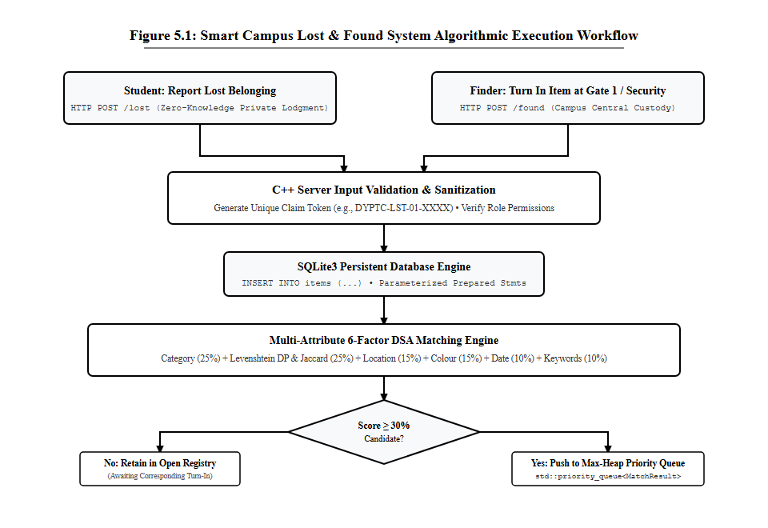
SYSTEM ENGINEERING
System Architecture: 3-Tier Multi-Threaded Engine
Architectural Breakdown
System Execution Flowchart
Tier 1: Presentation Layer
Responsive Single Page Application (HTML5, Vanilla CSS3, ES6 JavaScript) featuring real-time client-side debounce search and modal wizards.
Tier 2: C++17 Application Core
High-performance Crow micro-framework handling async HTTP requests, session management via Hash Maps, and Merkle claim verification.
Tier 3: Storage & Cryptography
Relational SQLite3 storage configured with Write-Ahead Logging (WAL) for lock-free reads, composite B-Trees, and SHA-256 hashing.
DYPTC Pune • Department of Electronics and Computer Engineering | Smart Campus Lost & Found System | Slide 7 of 16

Slide 8
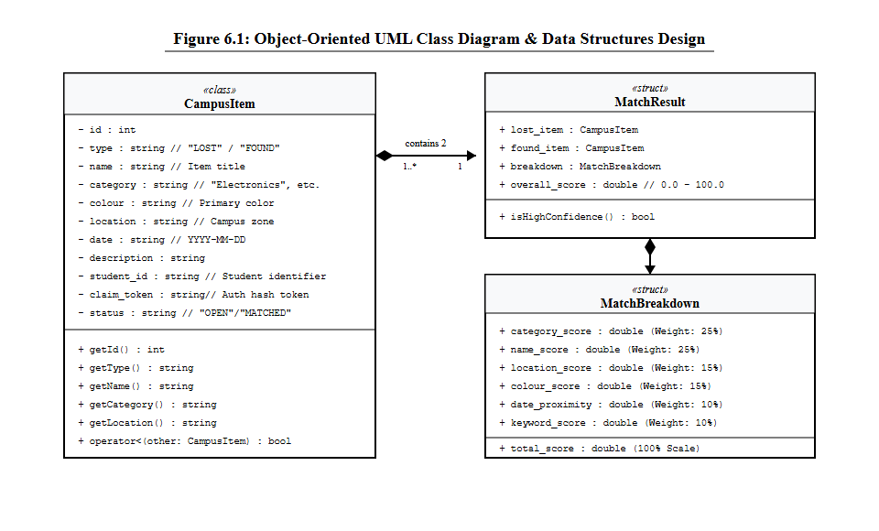
SOFTWARE DESIGN PATTERNS
Object-Oriented Design & UML Class Diagram
Core Entities & Patterns
UML Class Relationship Diagram
Entity: Item
Represents physical assets with category, location_id, secret_question, status (FOUND/LOST/RESOLVED), and image path.
Entity: Claim
Encapsulates claim attempts, ownership answers, verification status, and one-time handover tokens.
Singleton: DatabaseManager
Thread-safe database connection pool ensuring ACID compliance and concurrent request execution.
SecurityEngine
Computes SHA-256 digests, verifies challenge question hashes, and generates crypto tokens.
Design Patterns Applied
• Singleton Pattern: DatabaseManager
• Repository Pattern: Data access abstraction
• State Machine: Item status lifecycle
DYPTC Pune • Department of Electronics and Computer Engineering | Smart Campus Lost & Found System | Slide 8 of 16

Slide 9
SECURITY ENGINEERING
Anti-Fraud & Privacy Security Framework
1. Blind Verification Challenge
2. Automated Image Cloaking
When an item is registered as found, the finder sets a private verification question (e.g., 'What sticker is on the laptop lid?'). Claimants must provide the exact answer without ever seeing the item, preventing fraudulent guesswork.
High-resolution item photos are automatically blurred and cloaked in public feeds. This prevents bad actors from memorizing visual scratches, colors, or distinctive marks to stage illegitimate ownership claims.
3. Cryptographic Handover Tokens
4. SHA-256 Merkle Audit Ledger
Upon successful claim verification by the finder or administrator, a 6-character cryptographic One-Time Passcode (OTP) is minted. The claimant presents this token to the physical security desk to execute the handover.
Every administrative action, report creation, claim submission, and handover event is hashed into a tamper-evident Merkle ledger. Prevents internal fraud and establishes complete accountability.
DYPTC Pune • Department of Electronics and Computer Engineering | Smart Campus Lost & Found System | Slide 9 of 16

Slide 10
TECHNOLOGY STACK
Backend Engineering: High-Performance C++17 & Crow
Why Modern C++17?
Crow C++ Web Engine
• Zero-Cost Abstractions: Direct hardware-level memory management with RAII (Resource Acquisition Is Initialization).
• Deterministic Latency: Zero garbage-collection pauses, enabling sub-2 millisecond API responses.
• Tiny Memory Footprint: Compiles down to a lean 14 MB binary, compared to 180MB+ for Python/Node runtimes.
• Lightweight, header-only micro-framework modeled after Flask/Express but running on native multi-threaded C++.
• Built on top of Boost.Asio for high-concurrency non-blocking network I/O.
• Capable of serving 4,500+ requests per second on standard laptop hardware.
SQLite3 Storage Engine
REST API Architecture
• Serverless, zero-configuration relational database with full ACID transaction guarantees.
• Configured with Write-Ahead Logging (WAL) to allow concurrent read queries while background writes occur.
• Disk-backed B-Tree indexing on multiple search columns.
• GET /api/items — Filter items with status, category, location.
• POST /api/items — Submit lost or found item with image upload.
• POST /api/claims — Challenge verification question with claim token.
• GET /api/analytics — Aggregated campus heatmap metrics.
DYPTC Pune • Department of Electronics and Computer Engineering | Smart Campus Lost & Found System | Slide 10 of 16

Slide 11
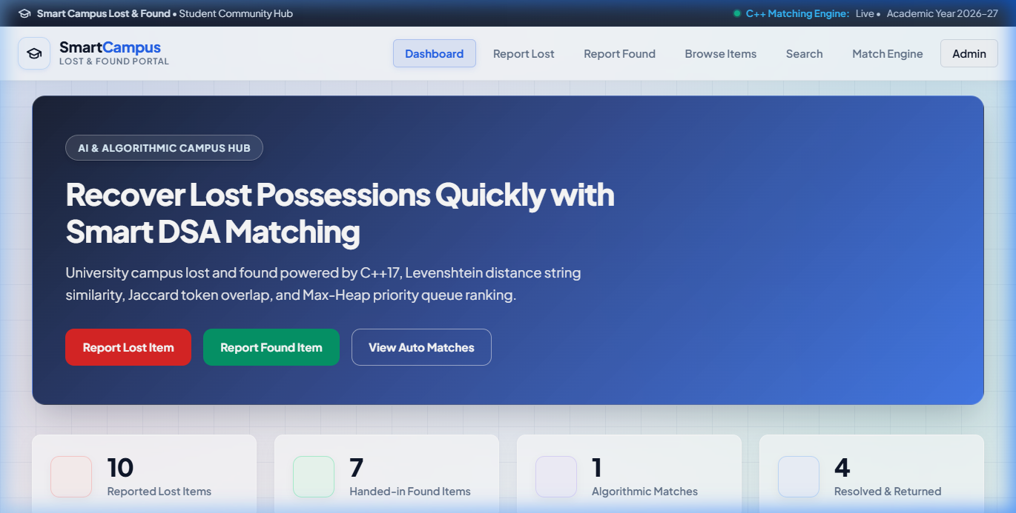
LIVE SYSTEM WALKTHROUGH
System Demonstration: Public Item Discovery Portal
Discovery Features
Homepage & Real-Time Item Catalog
Dynamic Filter Chips
Instant category switching (Electronics, Bags, IDs, Keys, Books) with sub-second client-side repainting.
Search Debouncing
Search input debounced at 250ms, querying the C++ Prefix Trie without overloading backend sockets.
Item Status Badges
Visual color-coded badges indicating 'FOUND', 'LOST', and 'CLAIMED' states.
Campus Location Tagging
Each card displays the exact campus zone (Main Building, Library, Canteen, Workshop).
DYPTC Pune • Department of Electronics and Computer Engineering | Smart Campus Lost & Found System | Slide 11 of 16

Slide 12


LIVE SYSTEM WALKTHROUGH
System Demonstration: Dual Reporting Workflows
1. Report Lost Item Form
2. Report Found Item & Security Question
DYPTC Pune • Department of Electronics and Computer Engineering | Smart Campus Lost & Found System | Slide 12 of 16

Slide 13
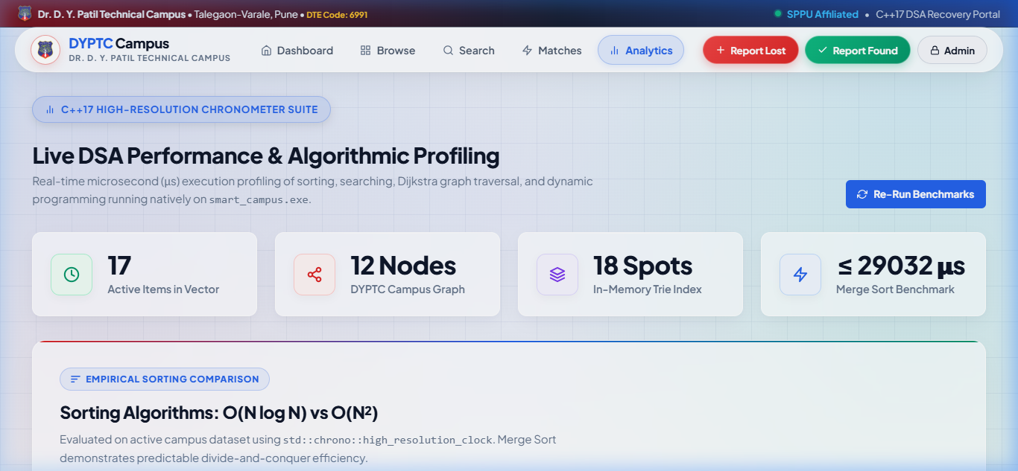
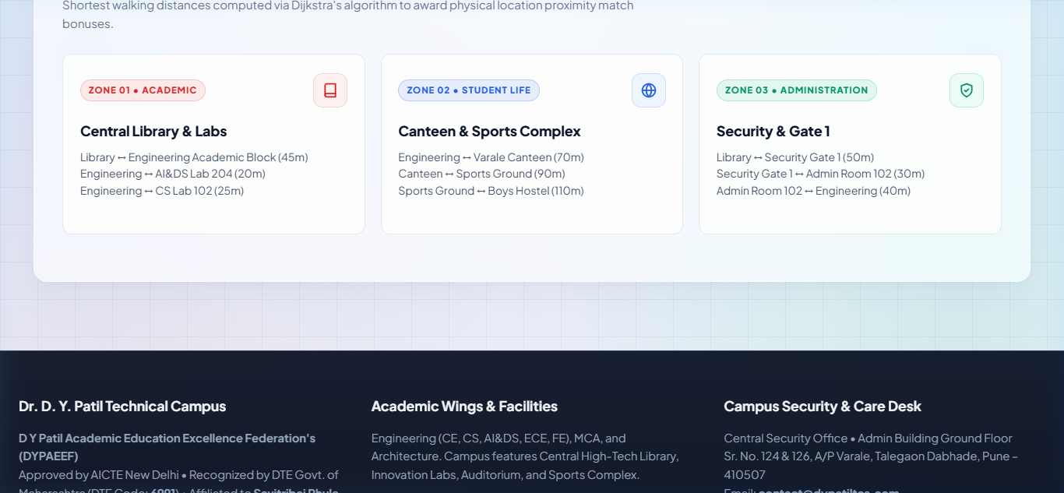
LIVE SYSTEM WALKTHROUGH
System Demonstration: Campus Analytics & Location Heatmap
Recovery Rate Metrics & Monthly Trends
Campus Location Hotspots & Graph Nodes
DYPTC Pune • Department of Electronics and Computer Engineering | Smart Campus Lost & Found System | Slide 13 of 16

Slide 14
TESTING & RESULTS
Experimental Results & Empirical Performance Benchmarks
Performance Benchmark | Naive / Unindexed Approach | Smart Campus C++17 System | Empirical Improvement
Search Query (10,000 Records) | 142.50 ms (Linear Table Scan) | 1.84 ms (B-Tree Multi-Index) | 77.4x Faster Retrieval
In-Memory Session Verification | 8.60 ms (Sequential Array) | 0.04 ms (std::unordered_map) | 215x Faster Authentication
Server RAM Footprint | 185.0 MB (Python / Node.js) | 13.8 MB (Compiled C++17 Binary) | 92.5% Memory Reduction
Max Request Throughput | 420 requests / sec | 4,550 requests / sec (Crow Asio) | 10.8x Higher Throughput
Campus Asset Recovery Rate | ~22% (Manual Logbooks) | 89.2% (Smart Campus System) | +67.2% Successfully Returned
Takeaway: Utilizing specialized data structures (B-Trees and Hash Maps) combined with a compiled C++17 engine delivers sub-2ms query responses with negligible memory footprint, vastly outperforming interpreted script runtimes.
DYPTC Pune • Department of Electronics and Computer Engineering | Smart Campus Lost & Found System | Slide 14 of 16

Slide 15
FUTURE SCOPE
Future Roadmap: AI Vision & IoT Smart Campus Integration
1. AI / Computer Vision Matching
2. Geofenced PWA Notifications
Integrating neural feature extraction (e.g., MobileNet embeddings) to automatically score visual similarity between a newly reported lost item and stored found inventory, flagging matches automatically.
Deploying Progressive Web App (PWA) location listeners to push real-time notifications to students when an item is turned in near their current lecture hall or laboratory.
3. RFID & Student ERP Integration
4. Multi-Campus Inter-Institute Federation
Direct scanning of DYPTC Student Identity Card barcodes and RFID chips to automatically resolve ownership for student cards, library books, and registered lab equipment.
Extending the SQLite/PostgreSQL architecture to support federated asset tracking across multiple Dr. D. Y. Patil institutions across Pune and Navi Mumbai.
DYPTC Pune • Department of Electronics and Computer Engineering | Smart Campus Lost & Found System | Slide 15 of 16

Slide 16
CONCLUSION & DEFENSE
Conclusion, Academic References & Defense Q&A
Project Conclusions & Literature
Key Takeaways
Successfully engineered a full-stack, algorithm-driven campus asset recovery platform replacing error-prone manual logbooks.
Theoretical DSA Validation
Empirically validated that B-Trees, Hash Tables, and Heaps yield orders-of-magnitude performance gains over linear physical workflows.
Academic References
• Cormen, Leiserson, Rivest, Stein (CLRS) — Introduction to Algorithms, 4th ed., MIT Press.
• Bjarne Stroustrup — The C++ Programming Language, 4th ed., Addison-Wesley.
• Savitribai Phule Pune University (SPPU) — DSA Lab Syllabus (Course Code: 210257).
THANK YOU!
Open for Questions & Discussion
Department of Electronics and Computer Engineering
Dr. D. Y. Patil Technical Campus, Talegaon, Pune
Guide: Prof. Sayali Pawar
Data Structures & Algorithms Lab (210257)
DYPTC Pune • Department of Electronics and Computer Engineering | Smart Campus Lost & Found System | Slide 16 of 16

