Slide 1
Intro – Way of working Git, Maven, Java

Slide 2
Git
Control System: it can be used to store content
Version Control System: Many developers can add code in parallel. Git in handling this by maintaining a history of what changes have happened
Distributed Version Control System: Git has a remote repository which is stored in a server and a local repository which is stored in the computer of each developer. Git is a Distributed Version Control System since the code is present in every developer’s computer

Slide 3
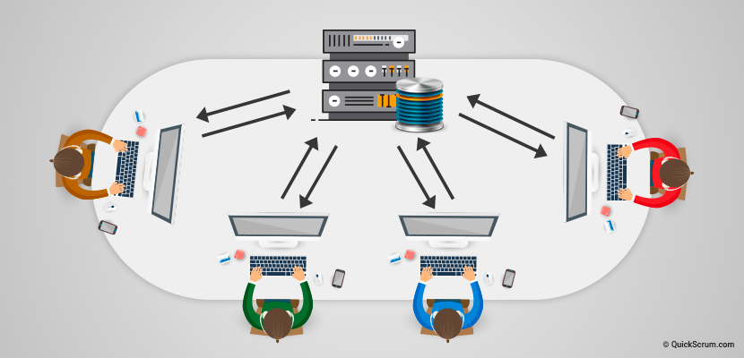
Why do we need Git?

Slide 4
Working with Git

Slide 5
What is a branch?
Git branches are effectively a pointer to a snapshot of your changes
When you want to add a new feature or fix a bug you spawn a new branch to encapsulate your changes
This makes it harder for unstable code to get merged into the main code base, and it gives you the chance to clean up your future's history before merging it into the main branch.

Slide 6
Maven
Build automation tool
Mainly used for Java projects
Uses conventions for build structure
Stores libraries and plugins in a central repository (https://search.maven.org/)
Dependency management

Slide 7
Maven – How does it work?
Build controller via pom.xml (Project Object Model)
Uses a standard build order, directories, plugins
Identifies dependencies in the pom.xml
One POM can call child POM’s

Slide 8
Let’s jump into Java
public static void main (String[] args){}
Is the most important Java method.
The Java main method is the entry point of any java program.
Java main method accepts a single argument of type String array. This is also called as java command line arguments.

Slide 9
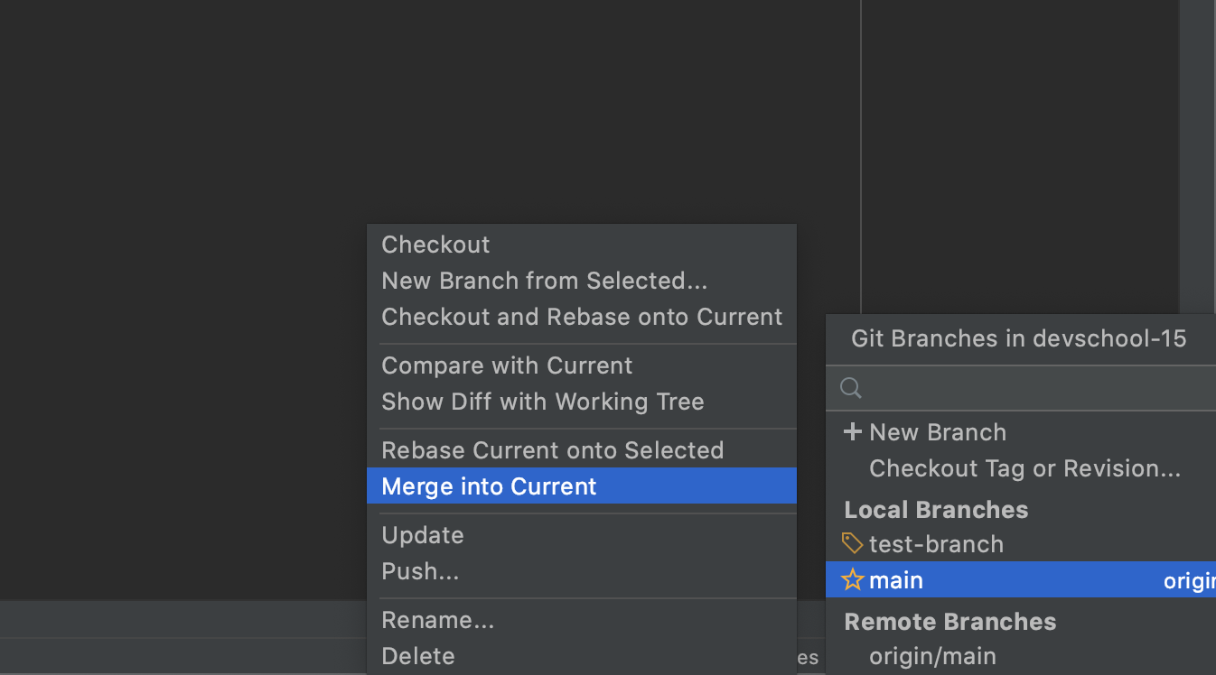
At the end of each session
Take latest changes from main
Push the local changes from your branch
git add …
git commit –m “Enter_commit_message”
git push
Check if the changes were pushed by looking in the github portal

Slide 10

Git resources
Git:
https://www.atlassian.com/git/tutorials/why-git
https://www.atlassian.com/git/tutorials/setting-up-a-repository
https://www.atlassian.com/git/tutorials/saving-changes
https://www.atlassian.com/git/tutorials/inspecting-a-repository
https://www.atlassian.com/git/tutorials/undoing-changes
https://www.atlassian.com/git/tutorials/syncing
https://www.atlassian.com/git/tutorials/using-branches

