Slide 1
Clean Code

Slide 2
What is “Clean Code”?

Slide 3
Introduction
Writing code that is understandable, clear, and maintainable not only by you, but also by others
Reduces technical debt
Maintainces becomes/remains easy
Improves code quality

Slide 4
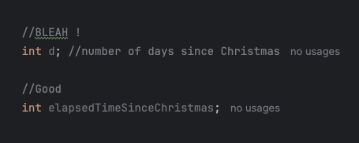
Meaningful Names
Always use relevant names for your variables
Remember you are not the only one reading your code
Even you will forget eventually what that variable was created for
More time will be lost while trying to follow the flow of the app to find out the meaning of a badly named variable

Slide 5
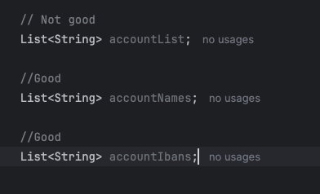
Avoid disinformation
The name of the variable should tell us as clear as possible what it holds
Avoid using names that might be misunderstood
Others might use the variable unintentionally in a bad way, and cause harm to your software because of bad naming

Slide 6
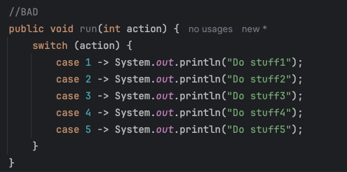
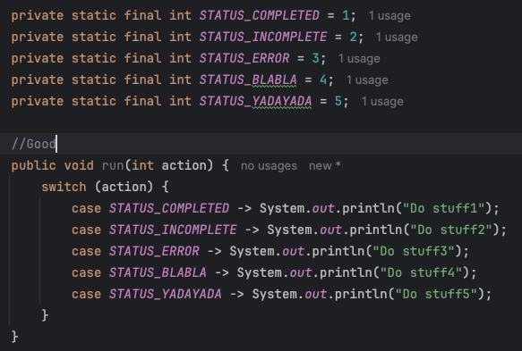
Avoid magic numbers
We must avoid using explicit and meaningless numbers in our code
They might mean something to us, but not everyone has the context of why a certain value is chosen
Somewhat disputed in industry. Some people say that if a number is used only once, adding a variable for it might actually just add complexity rather than remove it.

Slide 7
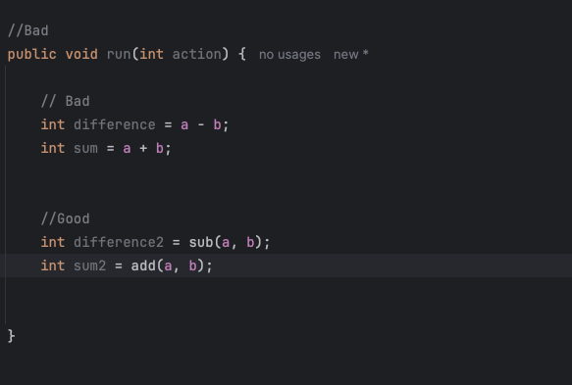
Avoid duplicate code
There are very few instances in real life where there is a good reason for duplicate code to exist
When you have duplicate code, you usually can extract a method and reuse the code
If it’s difficult to extract a method, then probably is poor written and you have to consider refactoring it

Slide 8
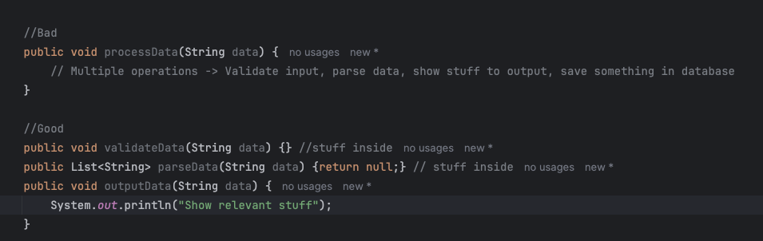
Concise and focused pieces of code
Methods and snippets of code should be created as atomic as possible
Most of the times they should be specialized in doing one thing and be good at it
There are different reference values to how many lines a code a method should have, but the main point is you shouldn’t have to scroll through it

Slide 9
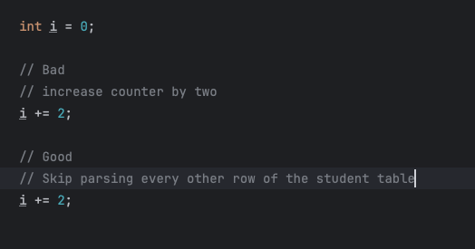
Comments – Why, not what!
Usually concise and well written code doesn’t need comments
If comments are needed, be sure to use them to explain ”Why” something is happening, not “What”/”How”.
Most engineers know i+=2 increases the counter by two

Slide 10
Formatting and styling
Formatting should be consistent across your project
Keep in mind that there are multiple “coding styles”
Most of the times, unless your colleagues are writing code without any sort of rules, you must and will adhere to a common coding style and formatting rules used withing your team/company

Slide 11
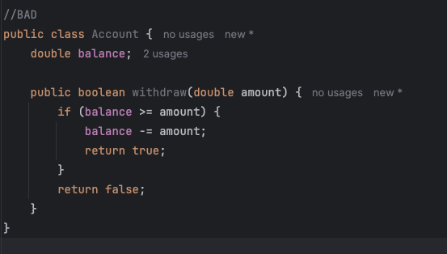
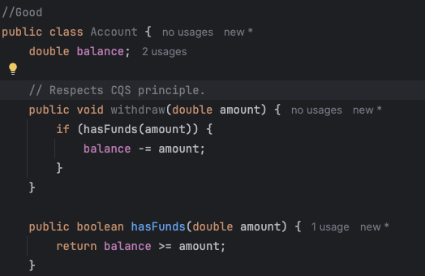
Command Query Separation
CQS is a principle which states that a method should either perform an action or a query that return data to the caller, but not both
This greatly improves readability and gives us certainty that a methods “does what it says”.
We should not expect a “withdraw” method to return anything, but just to withdraw a certain amount from an account

Slide 12
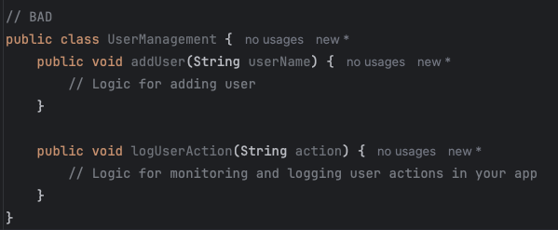
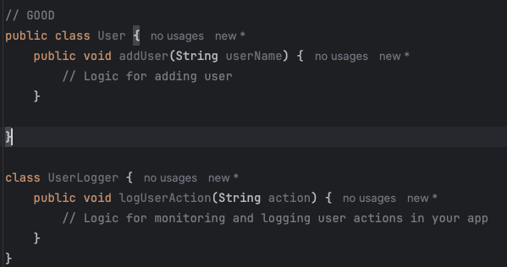
Single Responsibility Principle
SRP is a principle that states that a class should have one and only one reason to change.
This means that each class has one job, and usually it’s scope should not overextend
We should rather have specialized classes for each task we might need to complete in our app flow

Slide 13
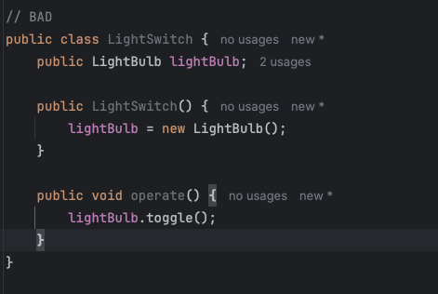
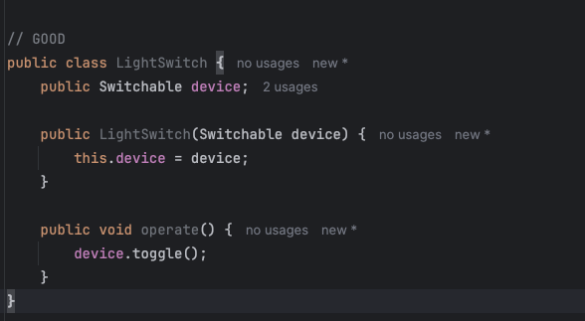
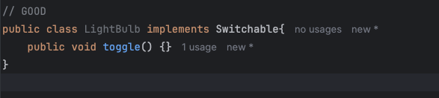
Dependency Inversion Principle
DIP is a principle that dictates that high-level modules should not depend on low-level modules
Both should depend on abstractions and the abstraction should not depend on details
We must maintain loose coupling between our classes and not create strong dependencies between each of them as we do not know how can the code from other classes change over time

